Slide 1
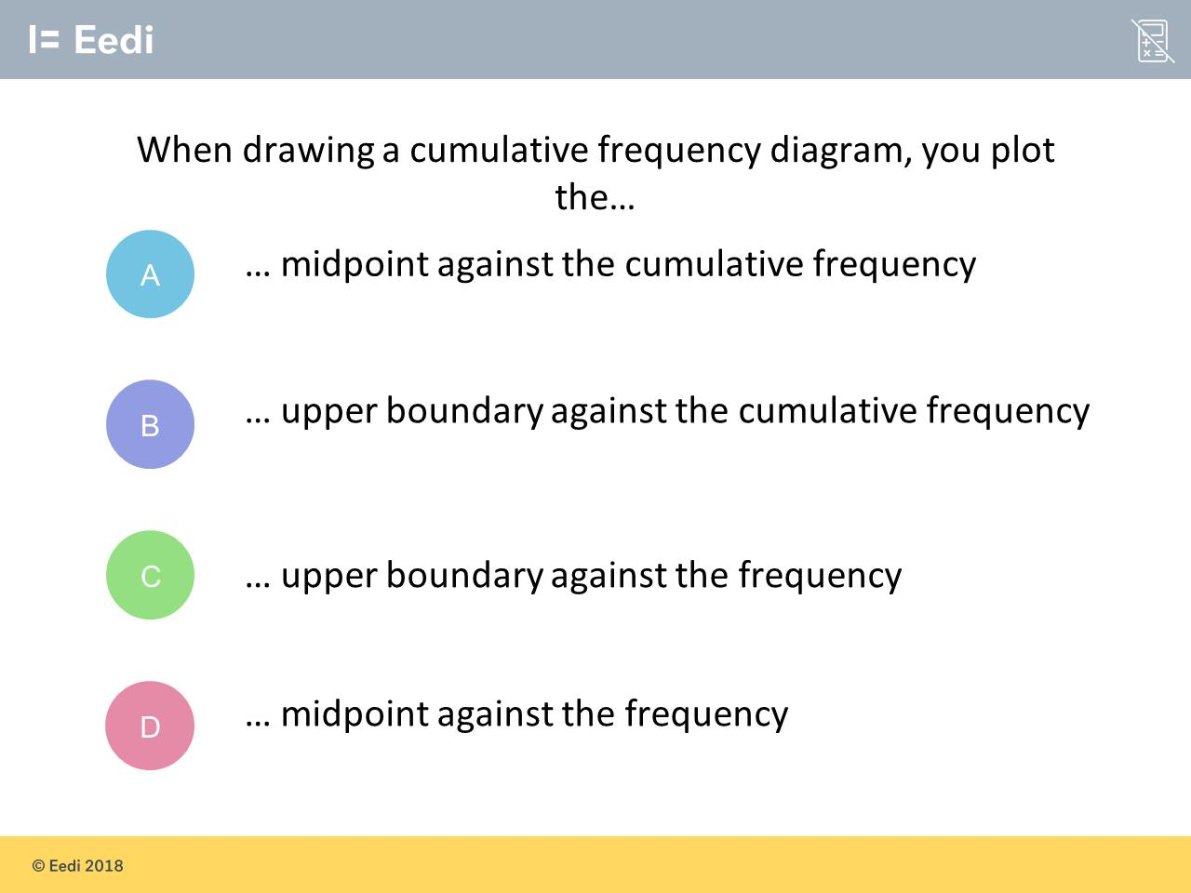
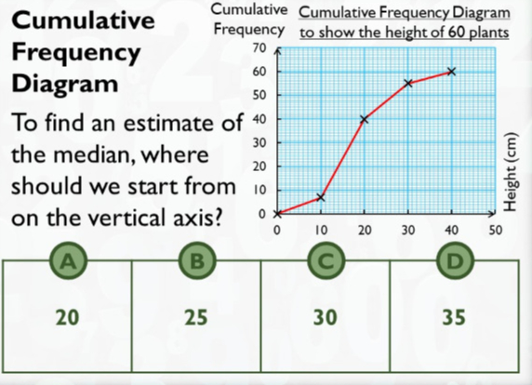
Worst answered question?
Most common wrong answer?

Slide 2
ANSWERS

Slide 3
Worst answered question?

Slide 4
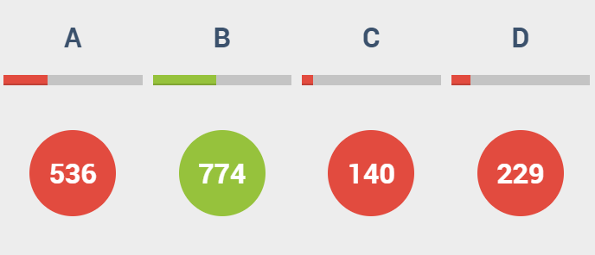
A
Mid points are used with frequency polygons not CF.

Slide 5
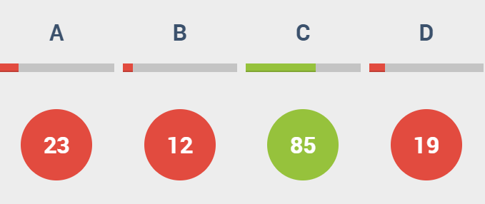
A
They did the horizontal axis instead of the vertical axis.

