Slide 1

Intermediate Challenge 4
GOLD

Slide 2
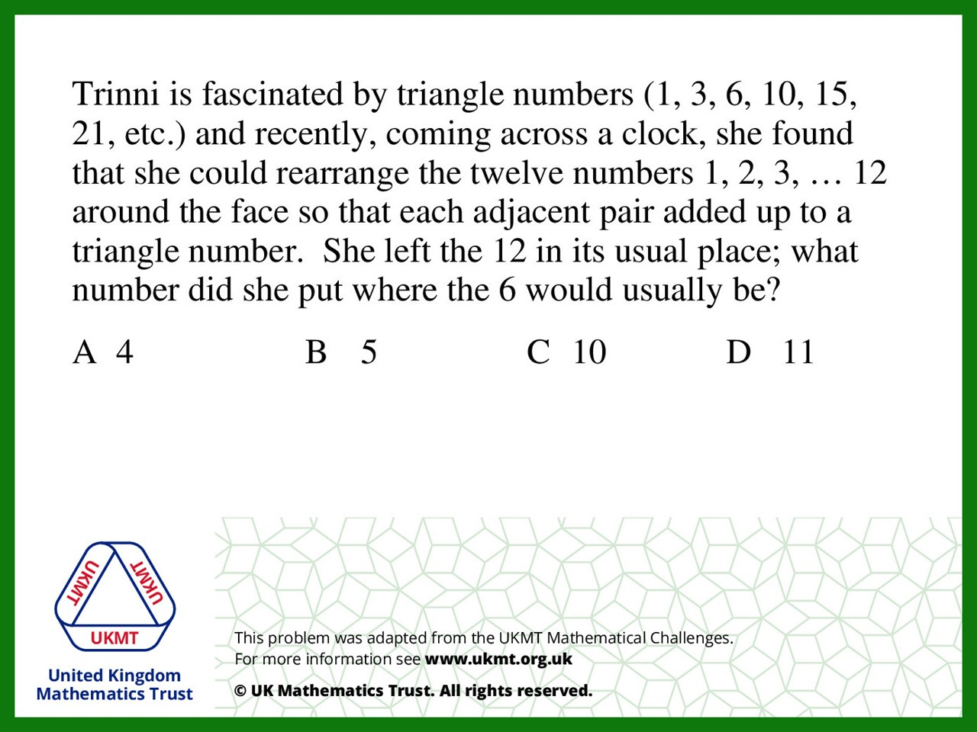
Q1.
Clockwise order the numbers are
12, 9, 6, 4, 11, 10, 5, 1, 2, 8, 7 and 3.

Slide 3
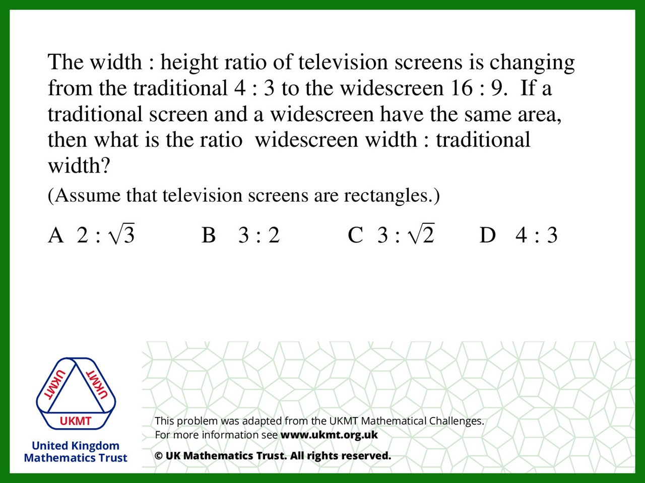
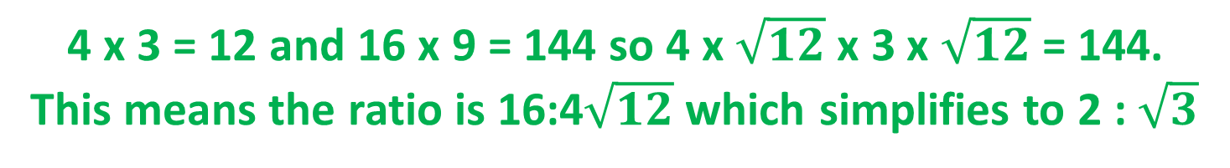
Q2.
4 x 3 = 12 and 16 x 9 = 144 so 4 x $\sqrt{12}$ x 3 x $\sqrt{12}$ = 144.
This means the ratio is 16:4$\sqrt{12}$which simplifies to 2 : $\sqrt{3}$

Slide 4
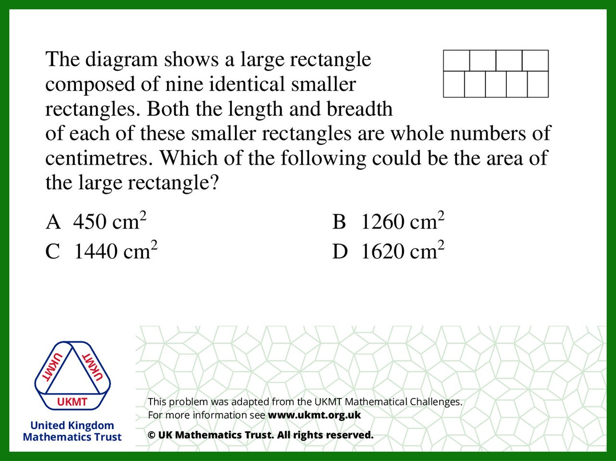
Q3.
5b(l+b) = 9(lb) therfore 5b = 4l
As b and l are integers possible pairs include: l=5 b=4, l=10 b=8, l=15 b=12 Using the formula 9(lb) to find the area, 9(15x12) = 1620

Slide 5
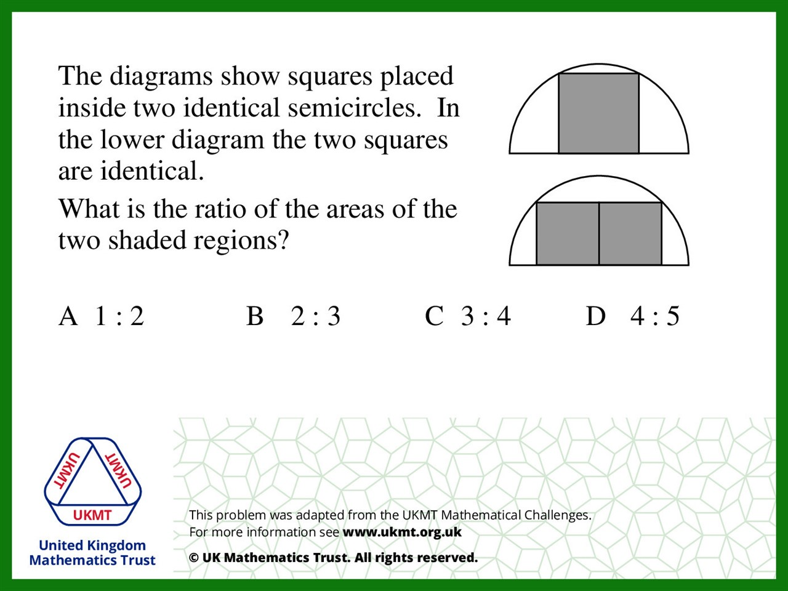
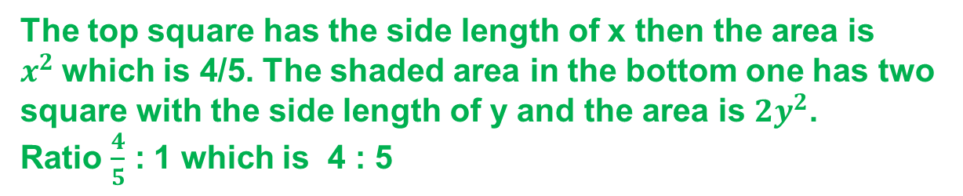
Q4.
The top square has the side length of x then the area is $x^{2}$which is 4/5. The shaded area in the bottom one has two square with the side length of y and the area is ${2y}^{2}$.
Ratio $\frac{4}{5}$ : 1 which is 4 : 5

Slide 6
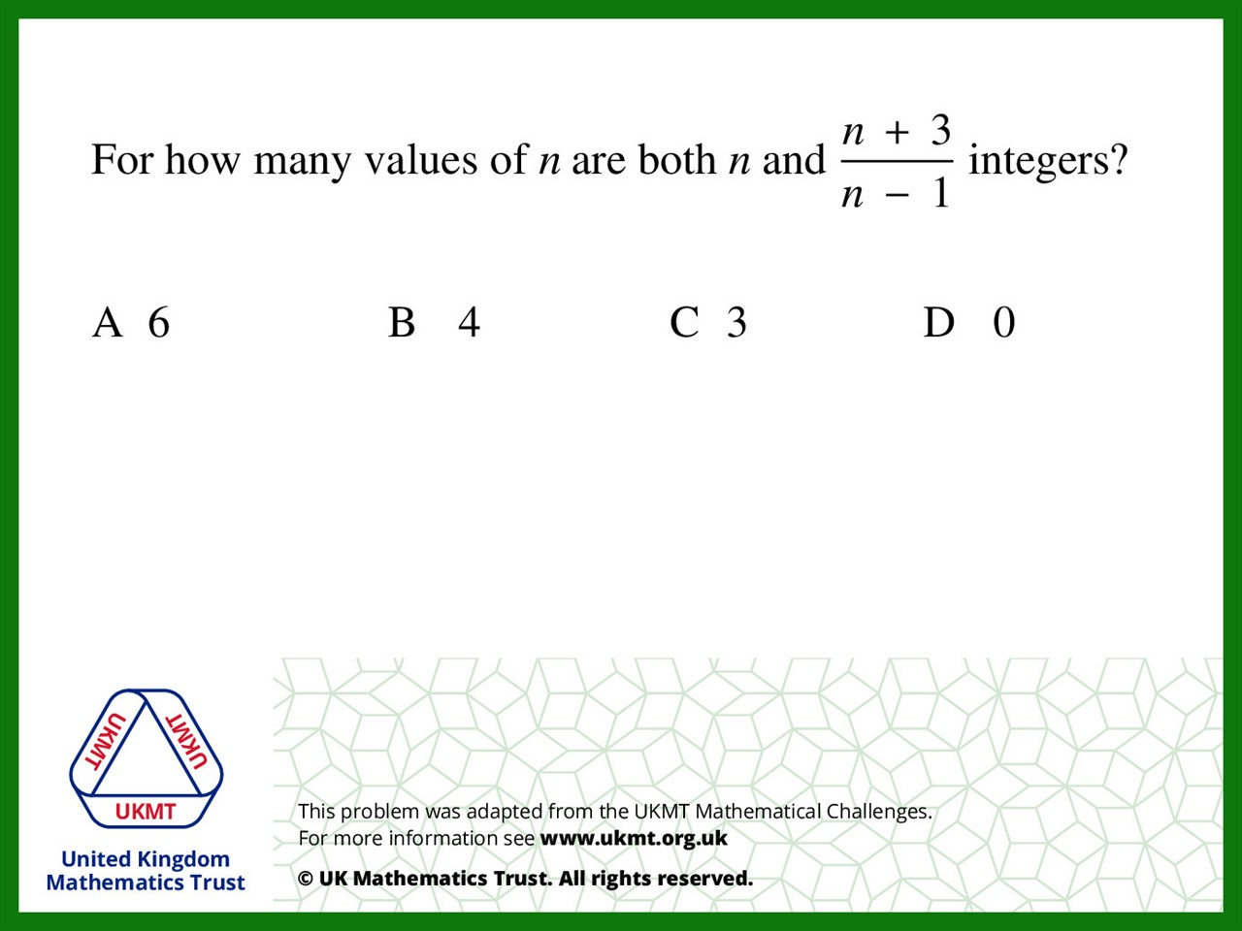
Q5.
3, -1, 0, 2, 3 and 5

