Slide 1
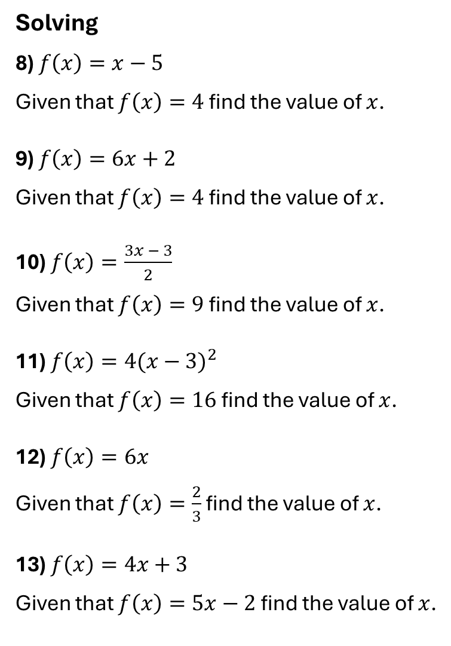
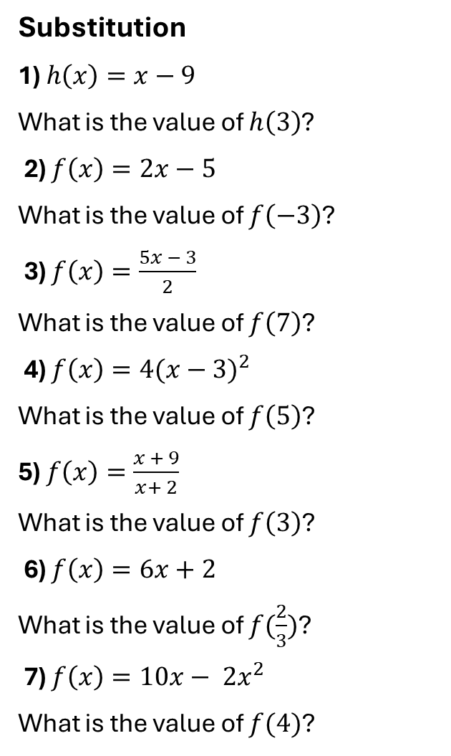
Substitution
1) $h\left(x\right)=x−9$
What is the value of $h\left(3\right)$?
2) $f\left(x\right)=2x−5$
What is the value of $f\left(−3\right)$?
3) $f\left(x\right)=\frac{5x − 3}{2}$
What is the value of $f\left(7\right)$?
4) $f\left(x\right)={4(x−3)}^{2}$
What is the value of $f\left(5\right)$?
5) $f\left(x\right)=\frac{x + 9}{x+ 2}$
What is the value of $f\left(3\right)$?
6) $f\left(x\right)=6x+2$
What is the value of $f(\frac{2}{3})$?
7) $f\left(x\right)=10x− {2x}^{2}$
What is the value of $f(4)$?
Solving
8) $f\left(x\right)=x−5$
Given that $f\left(x\right)=4$ find the value of $x$.
9) $f\left(x\right)=6x+2$
Given that $f\left(x\right)=4$ find the value of $x$.
10) $f\left(x\right)=\frac{3x − 3}{2}$
Given that $f\left(x\right)=9$ find the value of $x$.
11) $f\left(x\right)={4(x−3)}^{2}$
Given that $f\left(x\right)=16$ find the value of $x$.
12) $f\left(x\right)=6x$
Given that $f\left(x\right)=\frac{2}{3}$ find the value of $x$.
13) $f\left(x\right)=4x+3$
Given that $f\left(x\right)=5x−2$ find the value of $x$.

Slide 2
ANSWERS

Slide 3
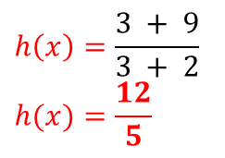
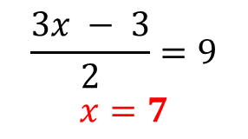
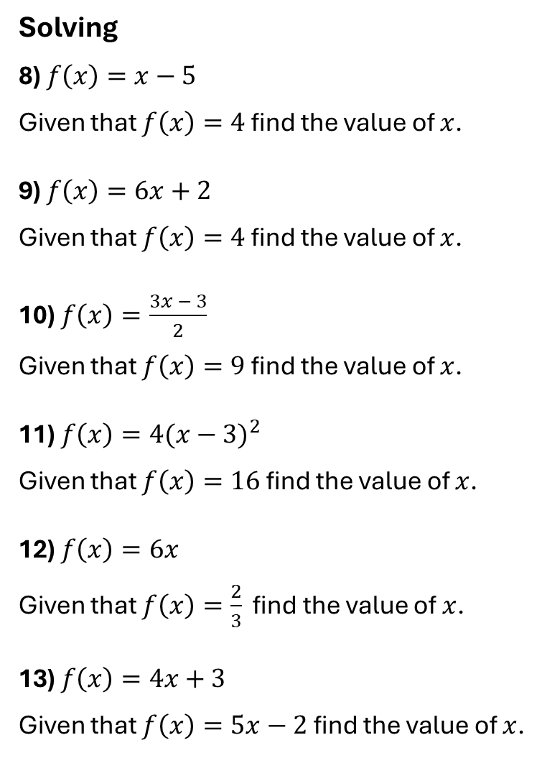
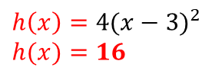
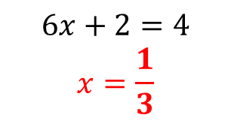
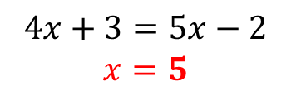
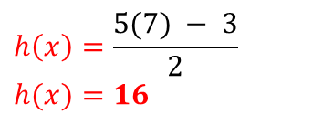
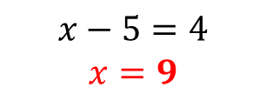
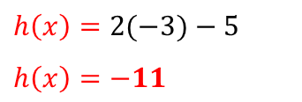
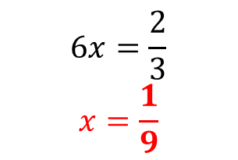
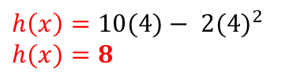

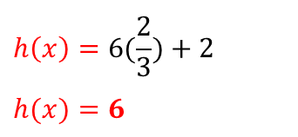
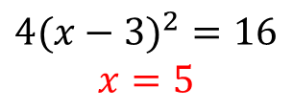
Substitution
1) $h\left(x\right)=x−9$
What is the value of $h\left(3\right)$?
2) $f\left(x\right)=2x−5$
What is the value of $f\left(−3\right)$?
3) $f\left(x\right)=\frac{5x − 3}{2}$
What is the value of $f\left(7\right)$?
4) $f\left(x\right)={4(x−3)}^{2}$
What is the value of $f\left(5\right)$?
5) $f\left(x\right)=\frac{x + 9}{x+ 2}$
What is the value of $f\left(3\right)$?
6) $f\left(x\right)=6x+2$
What is the value of $f(\frac{2}{3})$?
7) $f\left(x\right)=10x− {2x}^{2}$
What is the value of $f(4)$?
Solving
8) $f\left(x\right)=x−5$
Given that $f\left(x\right)=4$ find the value of $x$.
9) $f\left(x\right)=6x+2$
Given that $f\left(x\right)=4$ find the value of $x$.
10) $f\left(x\right)=\frac{3x − 3}{2}$
Given that $f\left(x\right)=9$ find the value of $x$.
11) $f\left(x\right)={4(x−3)}^{2}$
Given that $f\left(x\right)=16$ find the value of $x$.
12) $f\left(x\right)=6x$
Given that $f\left(x\right)=\frac{2}{3}$ find the value of $x$.
13) $f\left(x\right)=4x+3$
Given that $f\left(x\right)=5x−2$ find the value of $x$.
$$h\left(x\right)=3−9$$
$$h\left(x\right)=−6$$
$$x−5=4$$
$$x=9$$
$$h\left(x\right)=2(−3)−5$$
$$h\left(x\right)=−11$$
$$6x+2=4$$
$$x=\frac{1}{3}$$
$$h\left(x\right)=\frac{5(7) − 3}{2}$$
$$h(x)=16$$
$$\frac{3x − 3}{2}=9$$
$$x=7$$
$$h\left(x\right)={4(x−3)}^{2}$$
$$h(x)=16$$
$$h\left(x\right)=\frac{3 + 9}{3 + 2}$$
$$h(x)=\frac{12}{5}$$
$${4(x−3)}^{2}=16$$
$$x=5$$
$$6x=\frac{2}{3}$$
$$x=\frac{1}{9}$$
$$h\left(x\right)=6(\frac{2}{3})+2$$
$$h(x)=6$$
$$h\left(x\right)=10(4)− {2(4)}^{2}$$
$$h(x)=8$$
$$4x+3=5x−2$$
$$x=5$$

