Slide 1
Circles
Circumcircle
Chapter 6
(Part 4 of 4)

Slide 2
Circumcircle
A circle that touches the three points
of a triangle is know as a circumcircle.

Slide 3
The centre of a circumcircle is known
as the circumcentre.

Slide 4


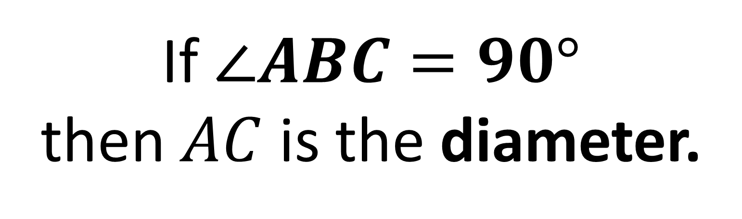

$$B$$
$$C$$
$$A$$
If $∠ABC=90°$
then $AC$ is the diameter.

Slide 5
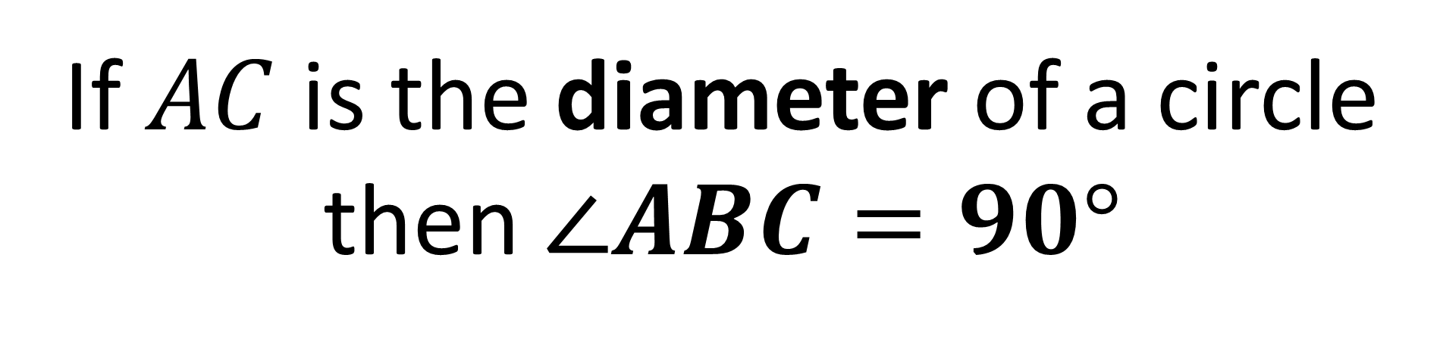
$$B$$
$$C$$
$$A$$
If $AC$ is the diameter of a circle
then $∠ABC=90°$

Slide 6
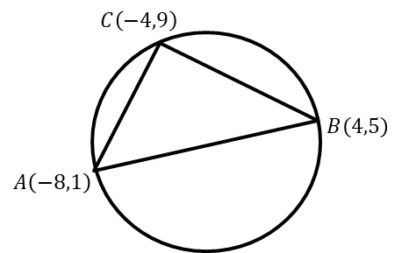
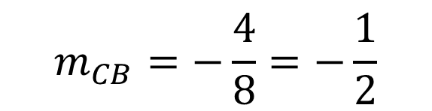
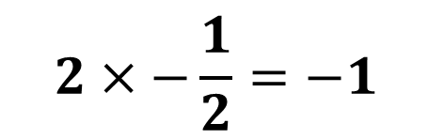
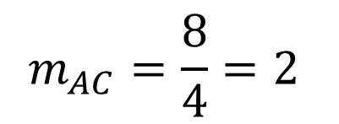
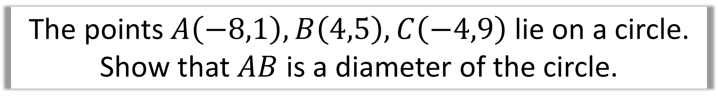
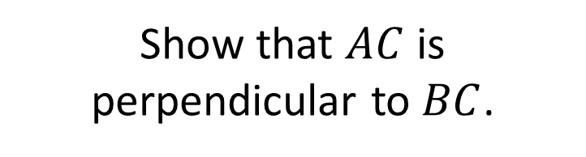
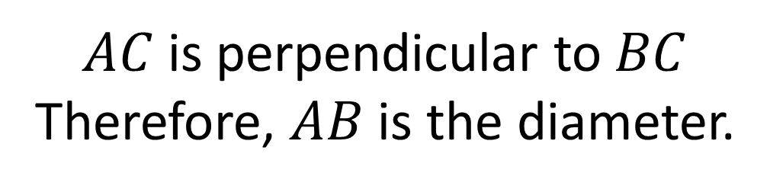
The points $A\left(−8,1\right), B\left(4,5\right),C\left(−4,9\right)$ lie on a circle.
Show that $AB$ is a diameter of the circle.
Show that $AC$ is perpendicular to $BC$.
$$m_{AC}=\frac{8}{4}=2$$
$$m_{CB}=−\frac{4}{8}=−\frac{1}{2}$$
$$2×−\frac{1}{2}=−1$$
$AC$ is perpendicular to $BC$
Therefore, $AB$ is the diameter.
Therefore, AC and CB are perpendicular
hence AB is the diameter.

Slide 7
Perpendicular Bisector
Chord
A perpendicular bisector will always
pass through the centre of the circle.

Slide 8
How can you locate the centre of the circle?
To find the co-ordinates of the point of intersection of the perpendicular bisector.

Slide 9
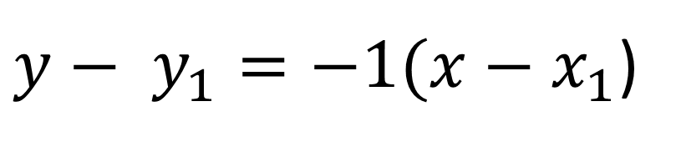


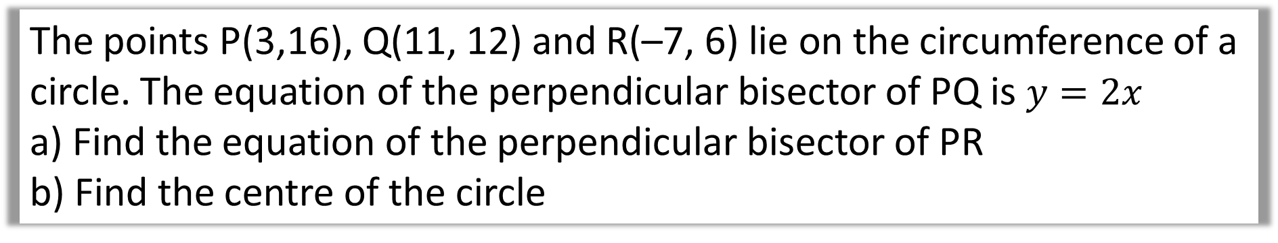
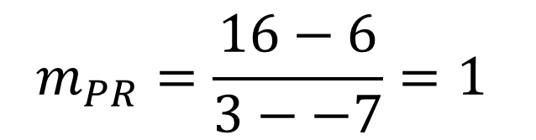
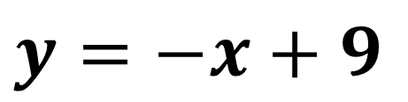


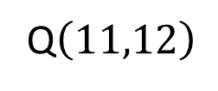
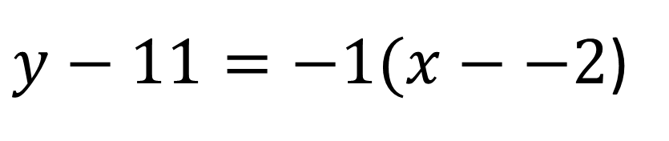
The points P(3,16), Q(11, 12) and R(–7, 6) lie on the circumference of a circle. The equation of the perpendicular bisector of PQ is $y=2x$
a) Find the equation of the perpendicular bisector of PR
b) Find the centre of the circle
$$m_{PR}=\frac{16−6}{3−−7}=1$$
a)
$$\left(3,16\right)P$$
Q$\left(11,12\right)$
$$m_{PR Bisector}=−1$$
$$\left(−7,6\right)R$$
$y− y_{1}=−1(x−x_{1}$)
$y−11=−1(x−−2$)
$$Midpoint PR=(−2,11)$$
$$y=−x+9$$

Slide 10
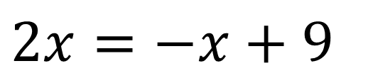
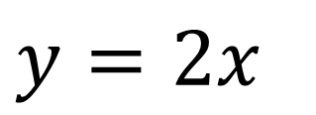

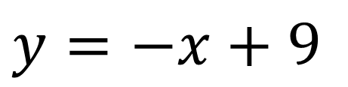

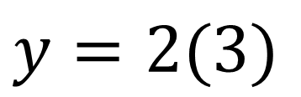
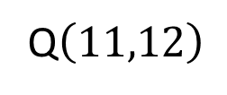
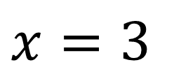

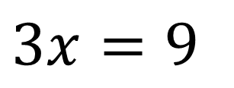
The points P(3,16), Q(11, 12) and R(–7, 6) lie on the circumference of a circle. The equation of the perpendicular bisector of PQ is $y=2x$
a) Find the equation of the perpendicular bisector of PR
b) Find the centre of the circle
$$y=2x$$
$$y=−x+9$$
b)
$$\left(3,16\right)P$$
Q$\left(11,12\right)$
$$2x=−x+9$$
$$3x=9$$
$$\left(−7,6\right)R$$
$$x=3$$
$$y=2(3)$$
(3,6)

