Slide 1
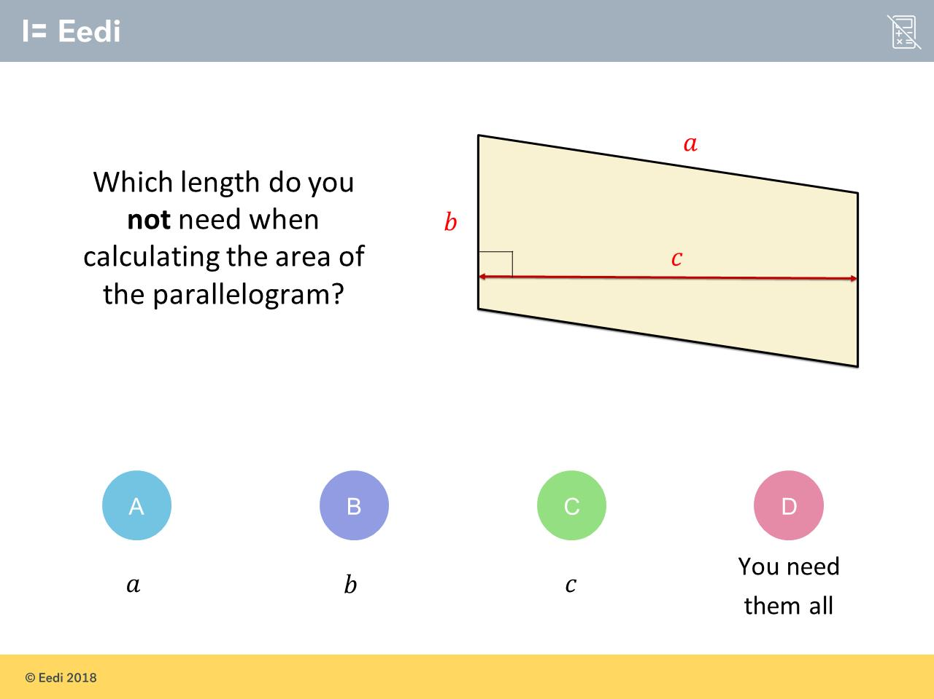
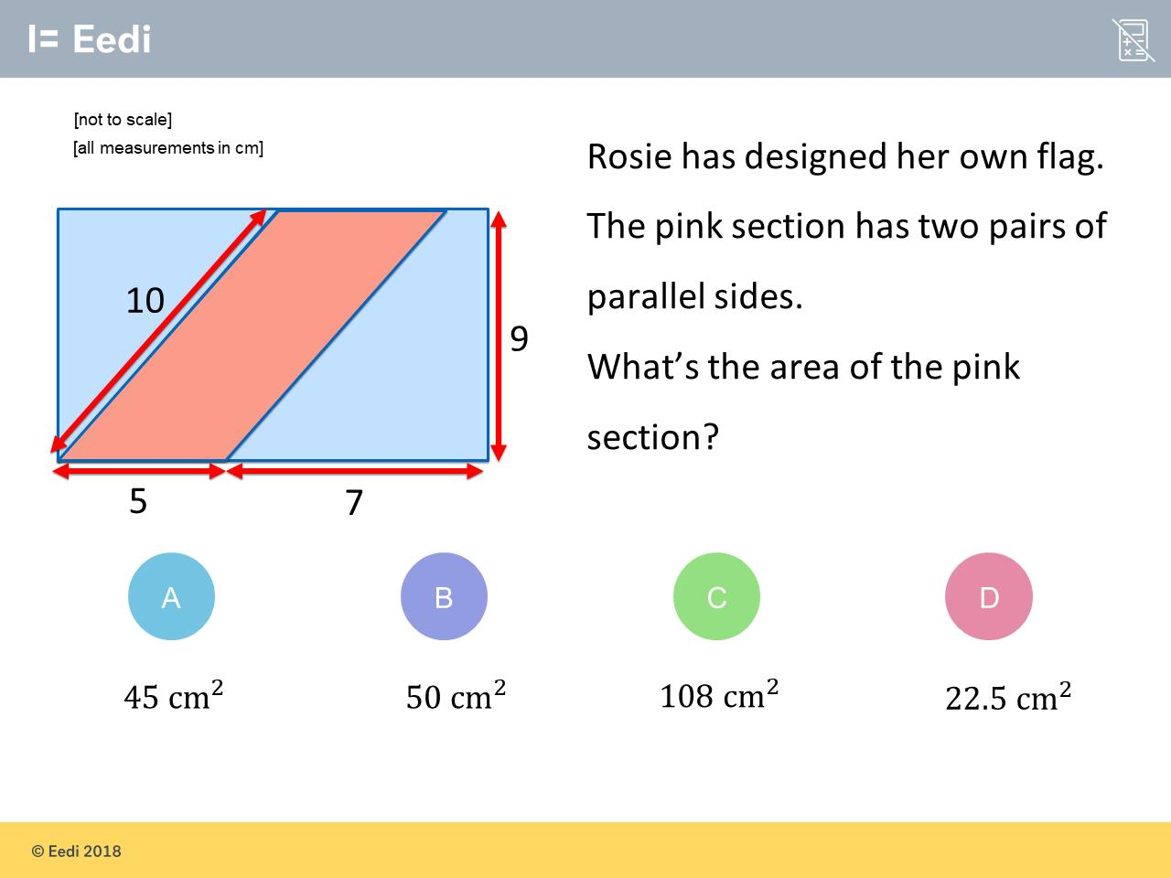
Worst answered question?
Most common wrong answer?

Slide 2
ANSWERS

Slide 3
Worst answered question?

Slide 4
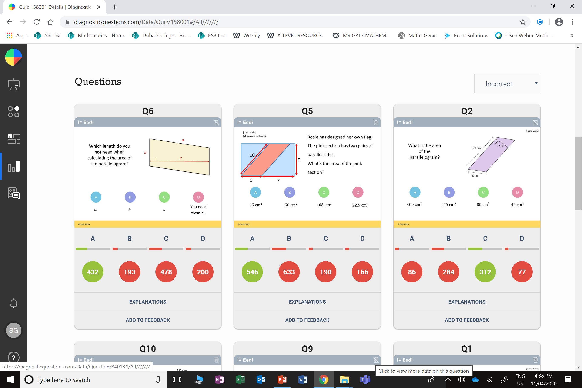
C
They think a
is the height.

Slide 5
B
They used 10
as the height instead of 9.

