Slide 1
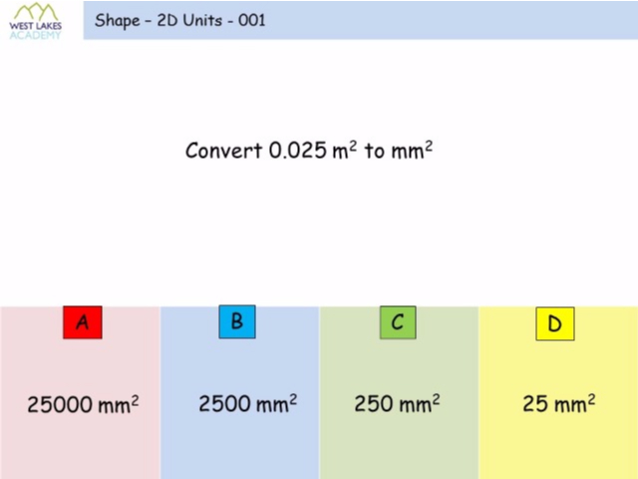
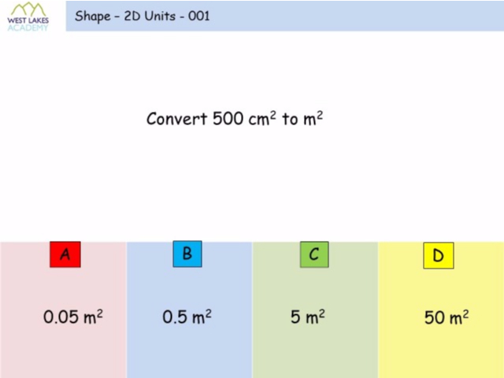
Worst answered question?
Most common wrong answer?

Slide 2
ANSWERS

Slide 3
Worst answered question?

Slide 4
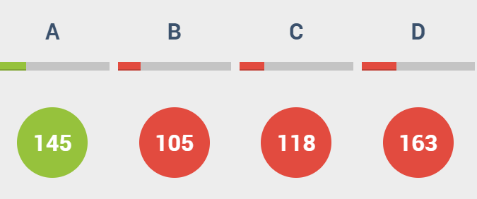
D
They divided by 1000 instead of 1000².

Slide 5
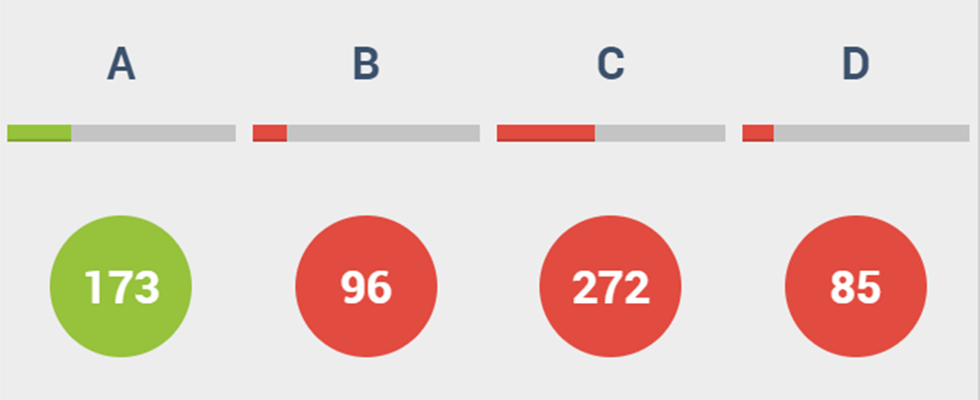
C
The student may have guessed,
or has miscalculated.

