Slide 1
Correlation and Regression
Regression
Chapter 5
(Part 2 of 2)

Slide 2
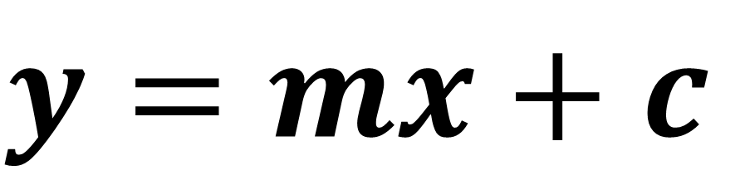
Regression Lines
You can use a regression line when the data shows
a linear correlation.
$$y=mx+c$$

Slide 3
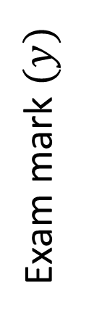
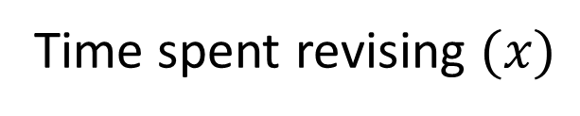
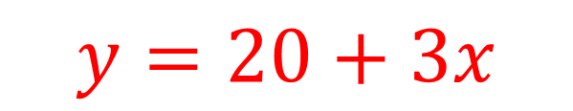
I record people’s exam marks as well as the time they spent revising.
I want to predict how well someone will do based on the time they spent revising. A regression line with help you do this.
Exam mark $(y)$
$$y=20+3x$$
Time spent revising $(x)$

Slide 4
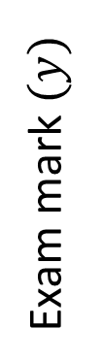
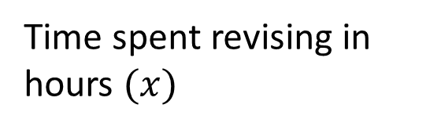

How do we interpret the gradient of 3?
$$y=20+3x$$
Exam mark $(y)$
Time spent revising in hours $(x)$
For each extra hour spent revising, 3 marks are gained.

Slide 5
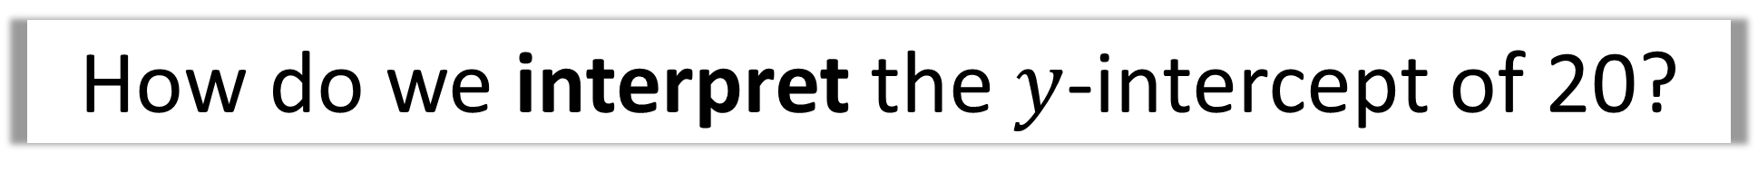
How do we interpret the $y$-intercept of 20?
$$y=20+3x$$
Exam mark $(y)$
Time spent revising in hours $(x)$
20 marks would be obtained
with no revision.

Slide 6
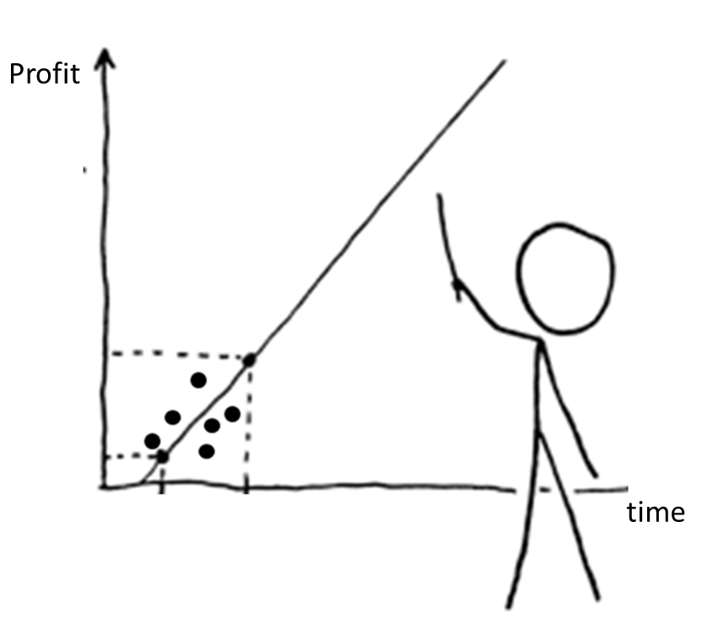
Would you trust this predictions?

Slide 7
Interpolating and Extrapolating
Estimating a value inside the data range is known as interpolating.
Estimating a value outside the data range is known as extrapolating.

Slide 8
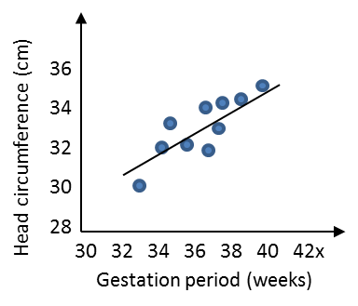
Interpolating

Slide 9
Extrapolating

Slide 10

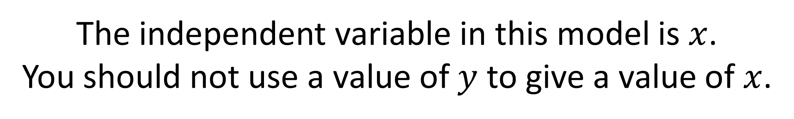
The independent variable in this model is $x$.
You should not use a value of $y$ to give a value of $x$.
Don’t predict an
x axis value from the y axis

Slide 11
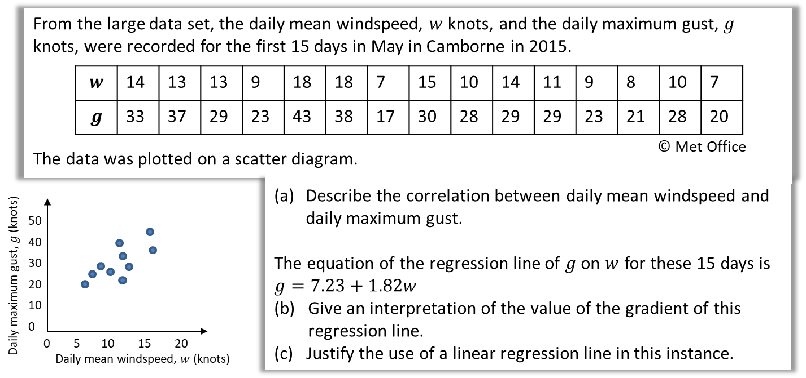

Slide 12

There is a strong positive correlation between daily mean windspeed and daily maximum gust.
a

Slide 13
b
If the daily mean windspeed increases by 10 knots the daily maximum gust increases by approximately 18 knots.

Slide 14
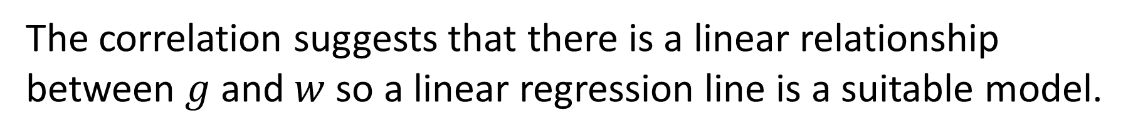
c
The correlation suggests that there is a linear relationship between $g$ and $w$ so a linear regression line is a suitable model.

Slide 15
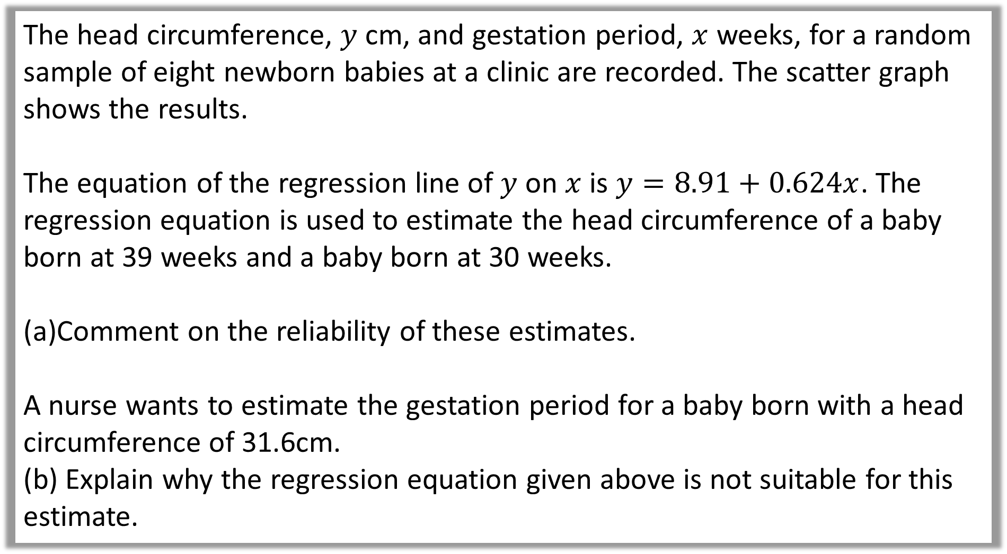
The head circumference, $y$ cm, and gestation period, $x$ weeks, for a random sample of eight newborn babies at a clinic are recorded. The scatter graph shows the results.
The equation of the regression line of $y$ on $x$ is $y=8.91+0.624x$. The regression equation is used to estimate the head circumference of a baby born at 39 weeks and a baby born at 30 weeks.
Comment on the reliability of these estimates.
A nurse wants to estimate the gestation period for a baby born with a head circumference of 31.6cm.
(b) Explain why the regression equation given above is not suitable for this estimate.

Slide 16
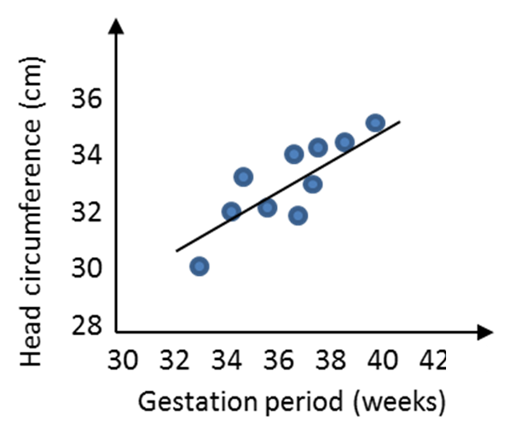
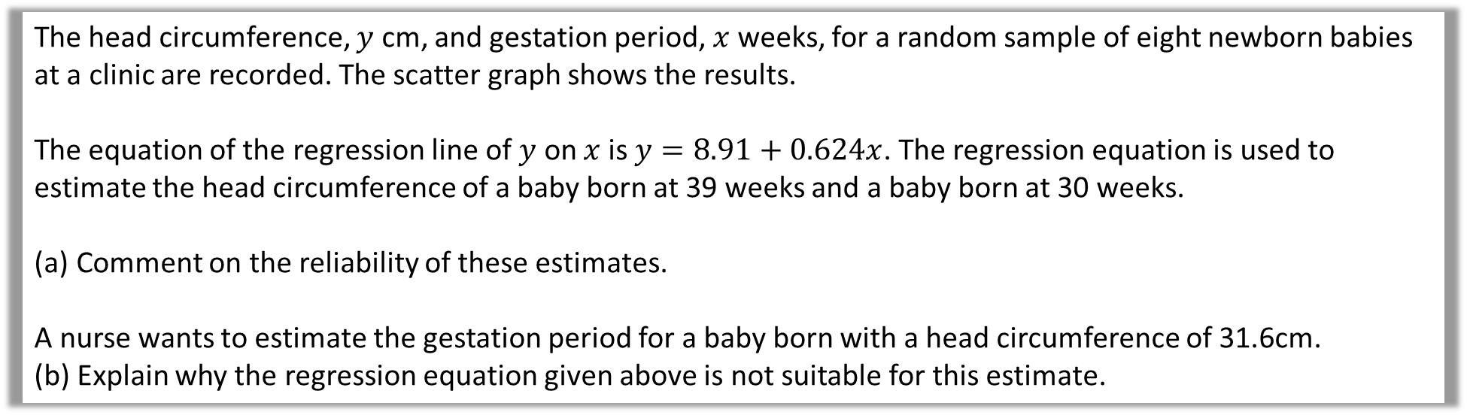
The head circumference, $y$ cm, and gestation period, $x$ weeks, for a random sample of eight newborn babies at a clinic are recorded. The scatter graph shows the results.
The equation of the regression line of $y$ on $x$ is $y=8.91+0.624x$. The regression equation is used to estimate the head circumference of a baby born at 39 weeks and a baby born at 30 weeks.
Comment on the reliability of these estimates.
A nurse wants to estimate the gestation period for a baby born with a head circumference of 31.6cm.
(b) Explain why the regression equation given above is not suitable for this estimate.
a
The prediction for 39 weeks is within the range of the data so is more likely to be correct. The prediction for 30 weeks is outside the range of the data so is less likely to be accurate.

Slide 17
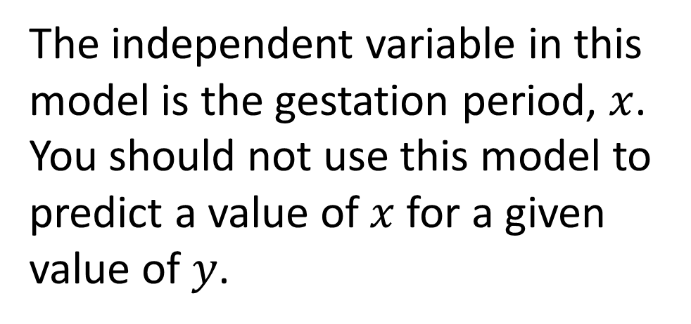
The head circumference, $y$ cm, and gestation period, $x$ weeks, for a random sample of eight newborn babies at a clinic are recorded. The scatter graph shows the results.
The equation of the regression line of $y$ on $x$ is $y=8.91+0.624x$. The regression equation is used to estimate the head circumference of a baby born at 39 weeks and a baby born at 30 weeks.
Comment on the reliability of these estimates.
A nurse wants to estimate the gestation period for a baby born with a head circumference of 31.6cm.
(b) Explain why the regression equation given above is not suitable for this estimate.
The independent variable in this model is the gestation period, $x$.
You should not use this model to predict a value of $x$ for a given value of $y$.
b

