Slide 1
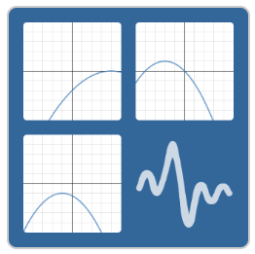
Polygraph: Parabolas 1
Activity: Click on the icon
Using only YES or NO question, get your partner to guess the correct parabolas.
Try do it in the least number of questions?

Slide 2
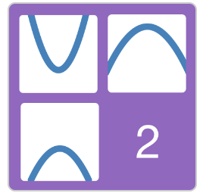
Polygraph: Parabolas 2
Activity: Click on the icon
Work thought the 10 sides answering the question as you go.

