Slide 1
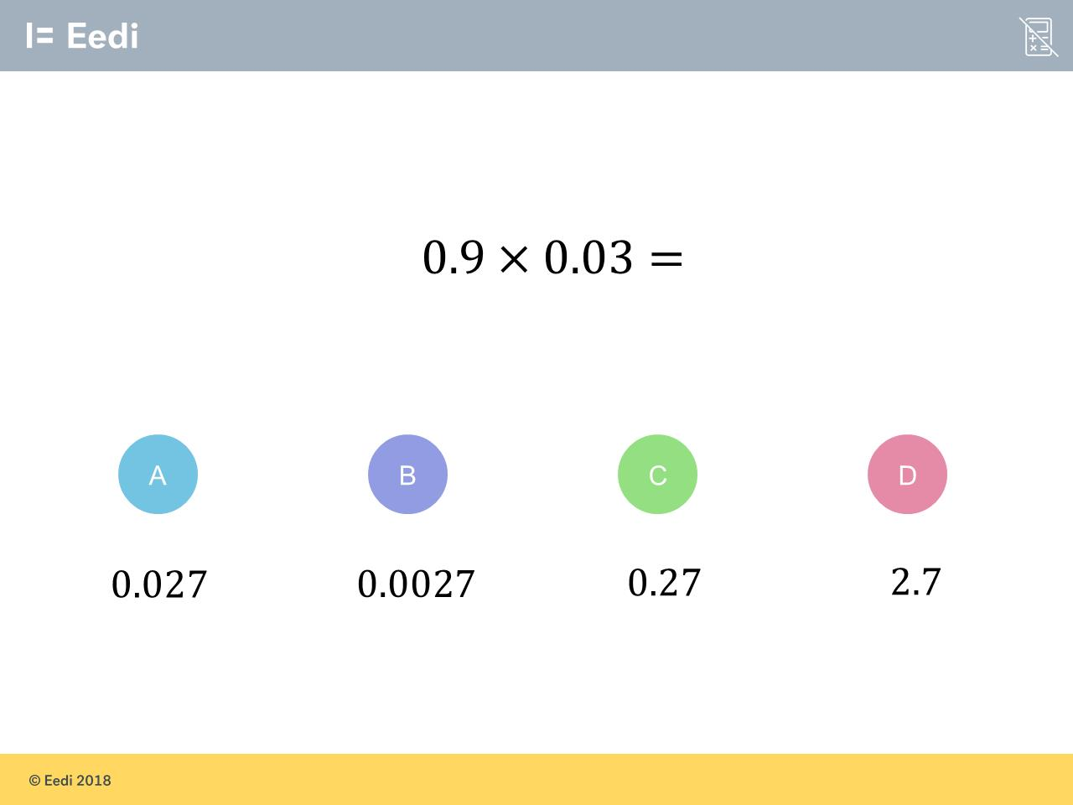
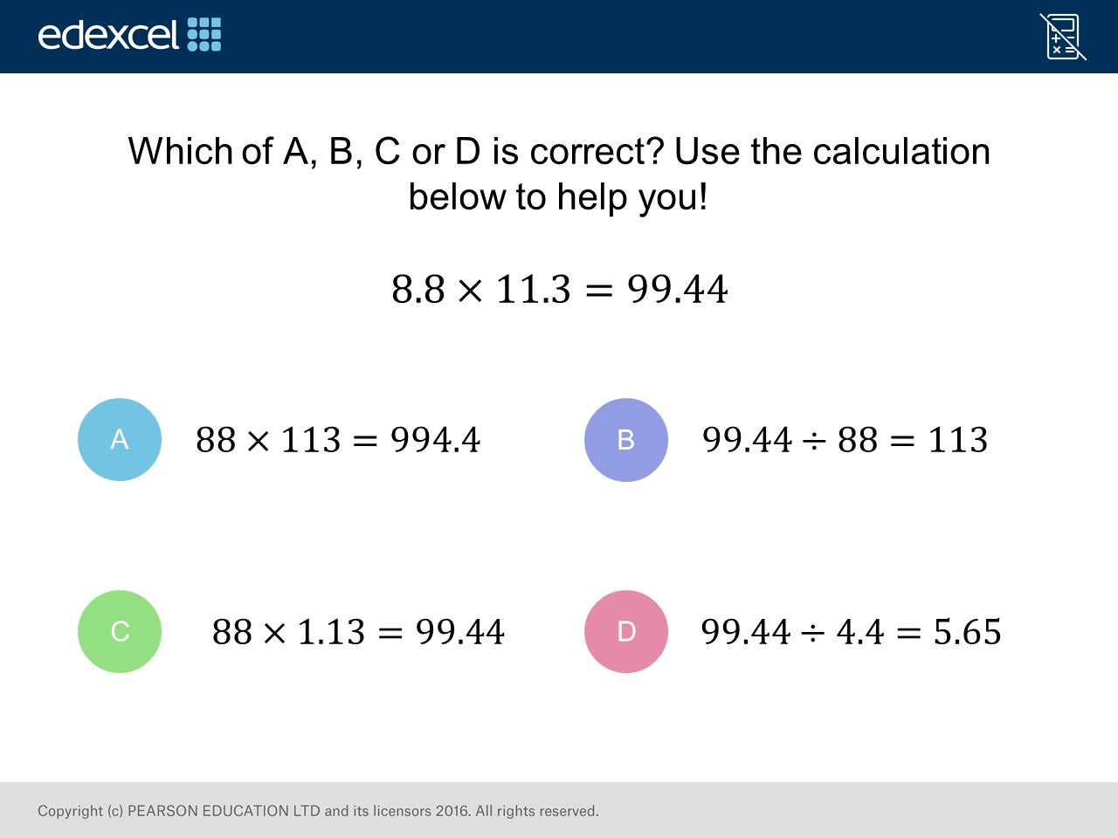
Worst answered question?
Most common wrong answer?

Slide 2
ANSWERS

Slide 3
Worst answered question?

Slide 4
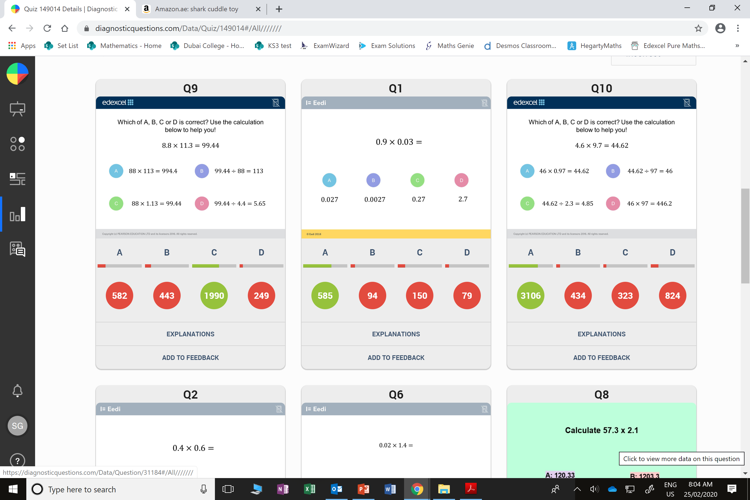
A
They only noticed that one of the numbers is multiplied by 10.

Slide 5
C
They students believed there should only be
2 decimal places
in the answer.

