Slide 1

Diagnostic Assessment .Delta 3
Unit 1
Reciprocals
Indices:
Multiplying and Dividing
Fractional and Negative
Standard Form
Surds

Slide 2
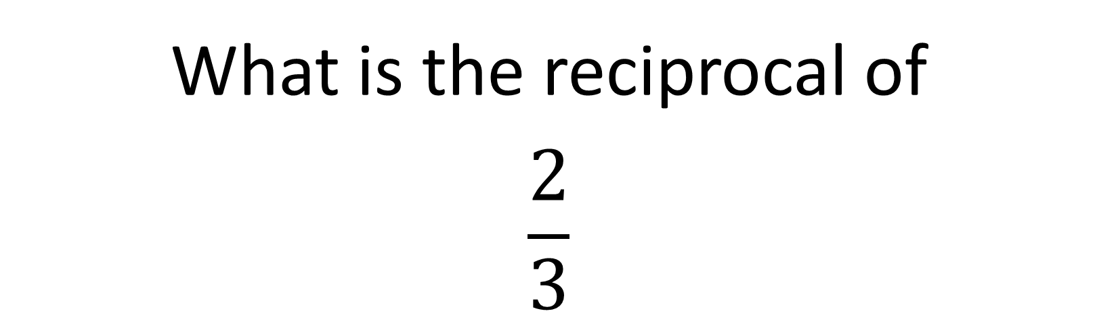
Question 1 – Reciprocals
What is the reciprocal of
$$\frac{2}{3}$$

Slide 3
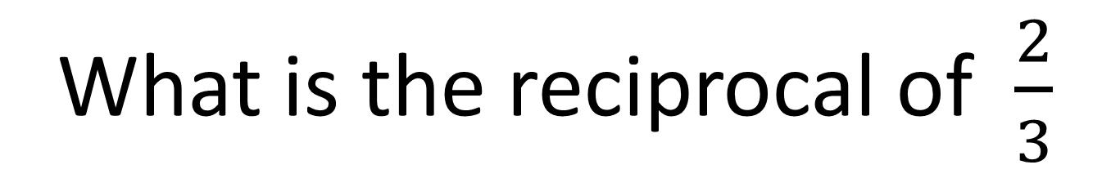
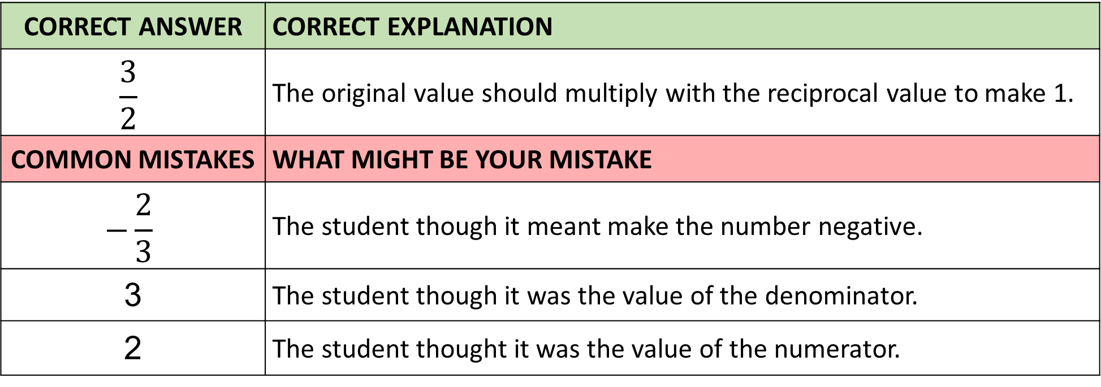
Answer 1 – Reciprocals
What is the reciprocal of $\frac{2}{3}$
CORRECT ANSWER | CORRECT EXPLANATION
$$\frac{3}{2}$$ | The original value should multiply with the reciprocal value to make 1.
COMMON MISTAKES | WHAT MIGHT BE YOUR MISTAKE
$$−\frac{2}{3}$$ | The student though it meant make the number negative.
3 | The student though it was the value of the denominator.
2 | The student thought it was the value of the numerator.

Slide 4
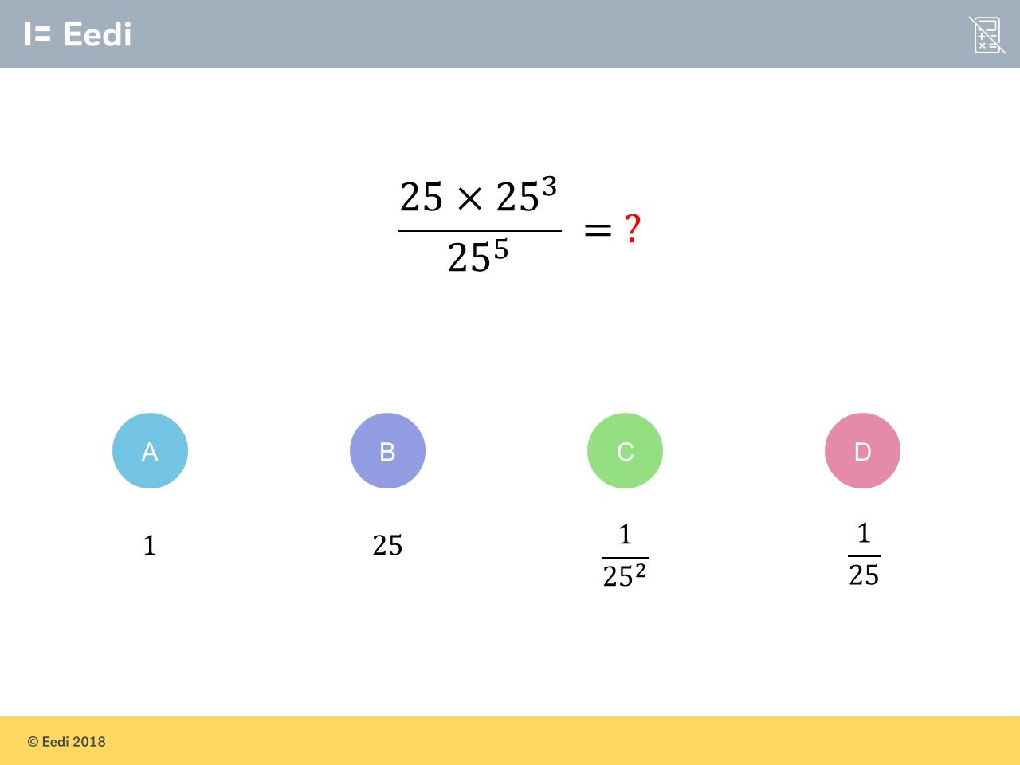
Question 2 – Indices (Multiplying and Dividing)
Evaluate

Slide 5
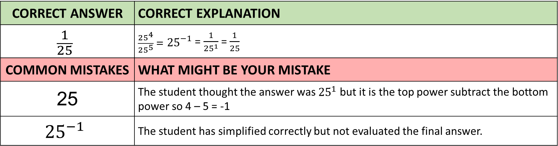
Answer 2 – Indices (Multiplying and Dividing)
Evaluate
CORRECT ANSWER | CORRECT EXPLANATION
$$\frac{1}{25}$$ | $\frac{{25}^{4}}{{25}^{5}} = {25}^{−1}$ = $\frac{1}{{25}^{1}}$ = $\frac{1}{25}$
COMMON MISTAKES | WHAT MIGHT BE YOUR MISTAKE
25 | The student thought the answer was ${25}^{1}$ but it is the top power subtract the bottom power so 4 – 5 = -1
$${25}^{−1}$$ | The student has simplified correctly but not evaluated the final answer.

Slide 6
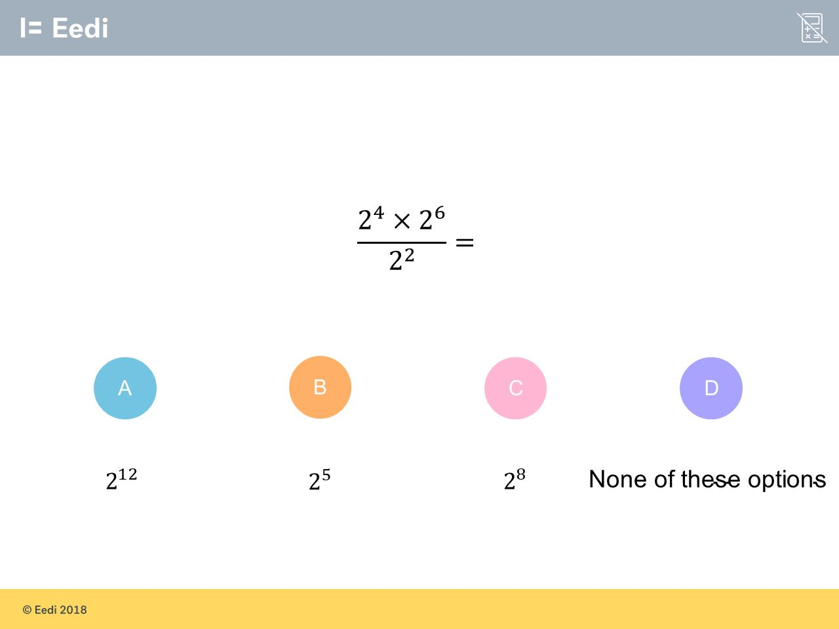
Question 3 – Indices (Multiplying and Dividing)
Simplify and write as power

Slide 7
Answer 3 – Indices (Multiplying and Dividing)
Simplify and write as power.
CORRECT ANSWER | CORRECT EXPLANATION
2⁸ | We add the powers on the numerator and subtracting the power on the denominator. This would give 4 + 6 - 2 = 8.
COMMON MISTAKES | WHAT MIGHT BE YOUR MISTAKE
2⁸ | The student has multiplied the top powers and divided the bottom powers. We need to add and subtract instead.
2⁸ | The student has added the powers on the numerator, but then divided the power on the denominator.
256 | The student has given the correct value but has not written it as a power

Slide 8
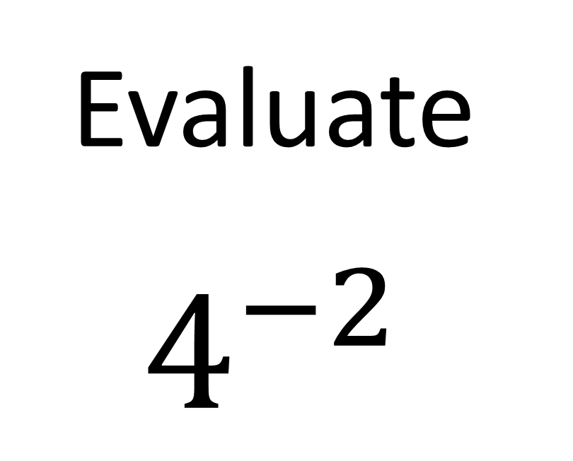
Question 4 – Indices (Fractional and Negative)
Evaluate
$$4^{−2}$$

Slide 9
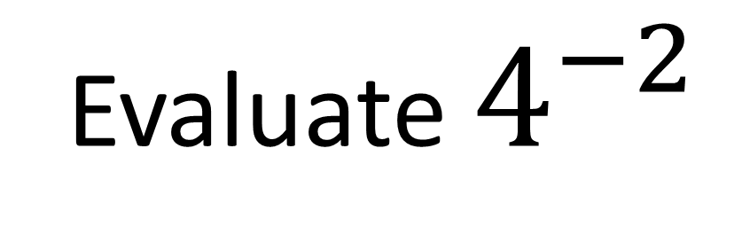
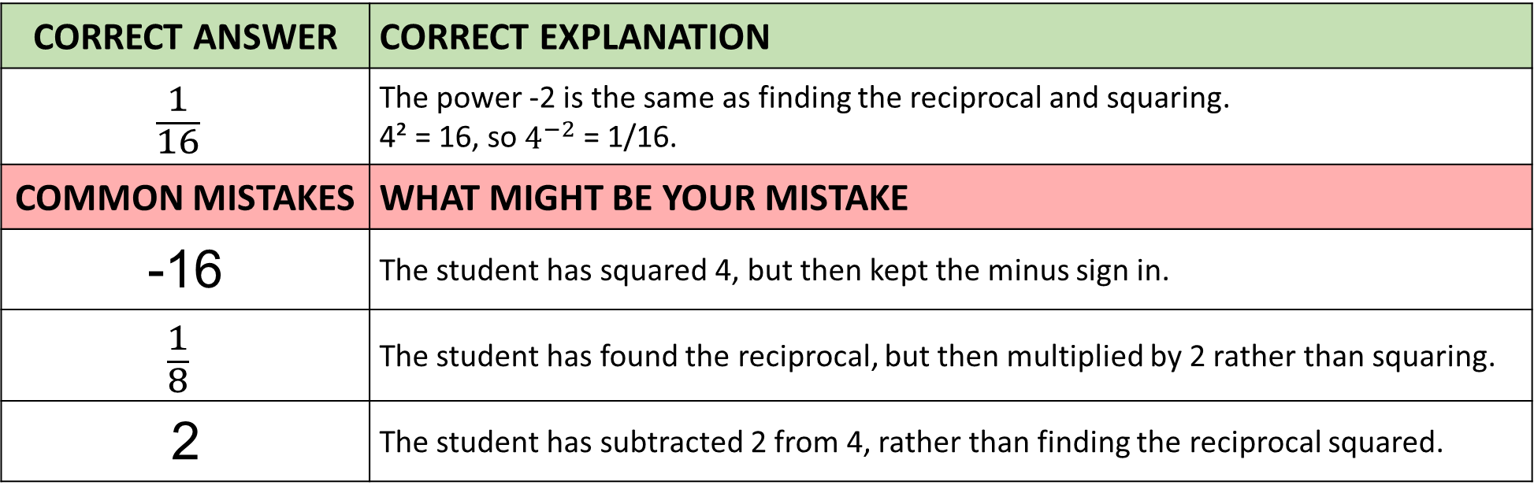
Answer 4 – Indices (Fractional and Negative)
Evaluate $4^{−2}$
CORRECT ANSWER | CORRECT EXPLANATION
$$\frac{1}{16}$$ | The power -2 is the same as finding the reciprocal and squaring. 4² = 16, so $4^{−2}$ = 1/16.
COMMON MISTAKES | WHAT MIGHT BE YOUR MISTAKE
-16 | The student has squared 4, but then kept the minus sign in.
$$\frac{1}{8}$$ | The student has found the reciprocal, but then multiplied by 2 rather than squaring.
2 | The student has subtracted 2 from 4, rather than finding the reciprocal squared.

Slide 10
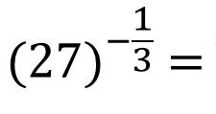
Question 5 – Indices (Fractional and Negative)
Evaluate

Slide 11
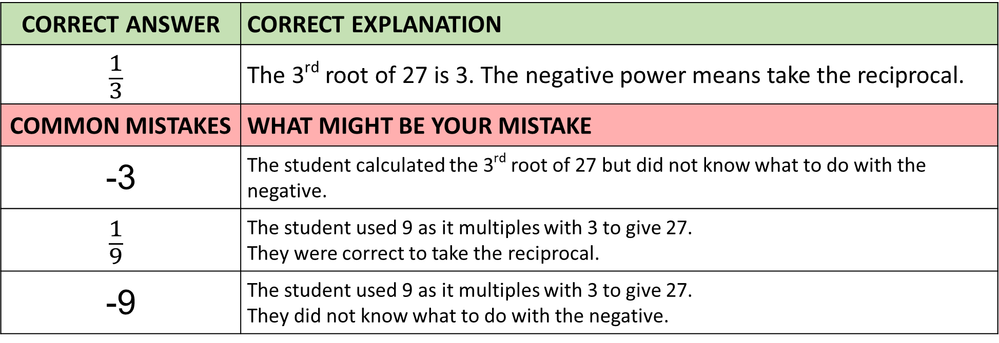
Answer 5 – Indices (Fractional and Negative)
Evaluate
CORRECT ANSWER | CORRECT EXPLANATION
$$\frac{1}{3}$$ | The 3rd root of 27 is 3. The negative power means take the reciprocal.
COMMON MISTAKES | WHAT MIGHT BE YOUR MISTAKE
-3 | The student calculated the 3rd root of 27 but did not know what to do with the negative.
$$\frac{1}{9}$$ | The student used 9 as it multiples with 3 to give 27. They were correct to take the reciprocal.
-9 | The student used 9 as it multiples with 3 to give 27. They did not know what to do with the negative.

Slide 12
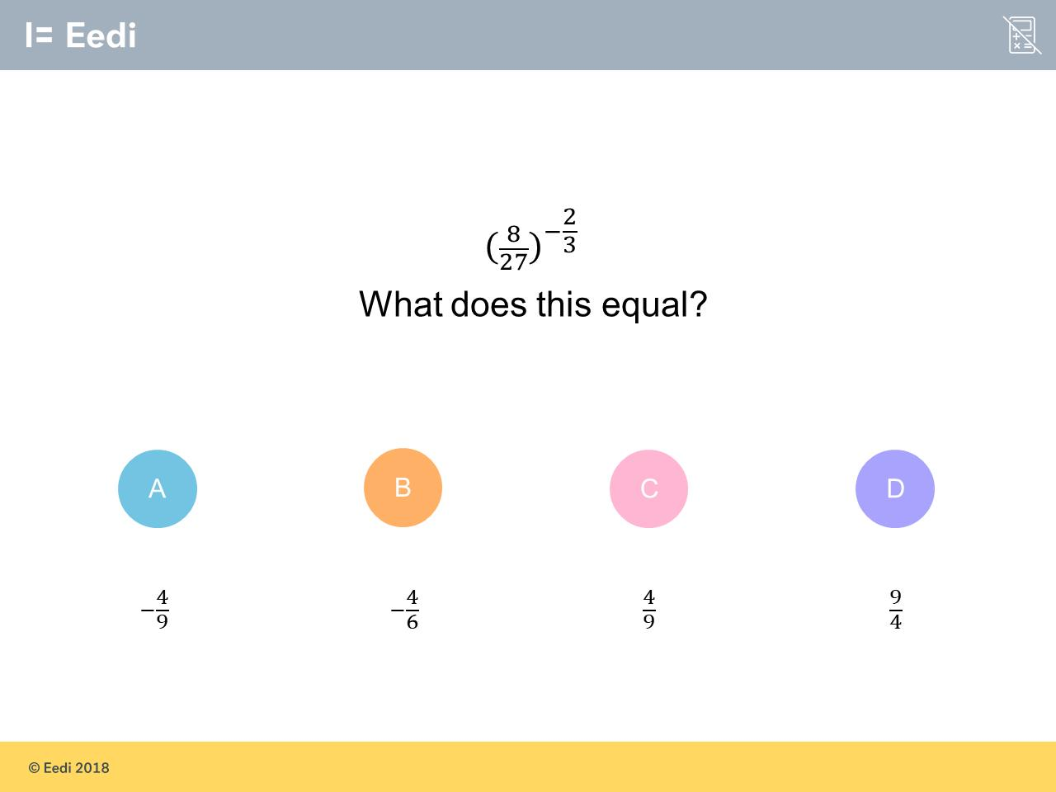
Question 6 – Indices (Fractional and Negative)

Slide 13
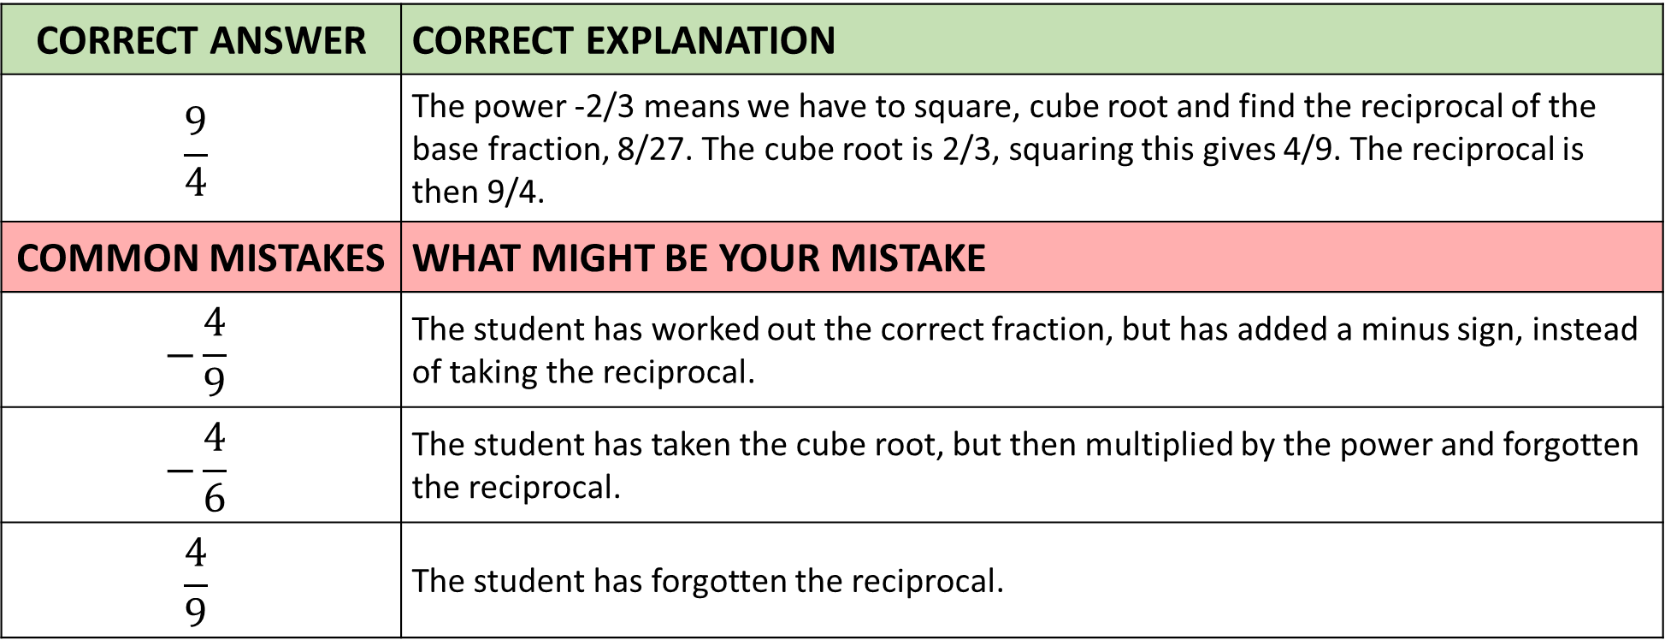
Answer 6 – Indices (Fractional and Negative)
CORRECT ANSWER | CORRECT EXPLANATION
$$\frac{9}{4}$$ | The power -2/3 means we have to square, cube root and find the reciprocal of the base fraction, 8/27. The cube root is 2/3, squaring this gives 4/9. The reciprocal is then 9/4.
COMMON MISTAKES | WHAT MIGHT BE YOUR MISTAKE
$$−\frac{4}{9}$$ | The student has worked out the correct fraction, but has added a minus sign, instead of taking the reciprocal.
$$−\frac{4}{6}$$ | The student has taken the cube root, but then multiplied by the power and forgotten the reciprocal.
$$\frac{4}{9}$$ | The student has forgotten the reciprocal.

Slide 14
Question 7 – Standard Form
Write 5672000 in correct standard form?

Slide 15
Answer 7 – Standard Form
Write 5 672 000 in correct standard form?
CORRECT ANSWER | CORRECT EXPLANATION
5.672 x 10⁶ | The student is correct. The first number must be between 1 and 9.99.... and the power of 10 means that the first number is to be multiplied by 1 million (10⁶)
COMMON MISTAKES | WHAT MIGHT BE YOUR MISTAKE
5672 x 10³ | The value is correct, but it has not been written in standard form. The first number must be between 1 and 9.99
56.72 x 10⁵ | The value is correct, but it has not been written in standard form. The first number must be between 1 and 9.99
5.672 x 10⁻⁶ | The have given a power 6 as an negative which would make the numbers very small.

Slide 16
Question 8 – Standard Form
Write 7.31 x 10⁻⁵ as an ordinary number?

Slide 17
Answer 8 – Standard Form
Write 7.31 x 10⁻⁵ as an ordinary number?
CORRECT ANSWER | CORRECT EXPLANATION
0.0000731 | The 7.31 has been divided by 10 five times (as indicated by the negative power)
COMMON MISTAKES | WHAT MIGHT BE YOUR MISTAKE
7.31 | The original number should have been divided by 10 five times as indicated by 10⁻⁵
-7.31 | The original number should have been divided by 10 five times as indicated by 10⁻⁵ . The negative power never results in a negative answer. It indicates division by 10, five times in this case.
731000 | The original number should have been divided by 10 five times as indicated by 10⁻⁵. Here it has been multiplied by 10 five times.

Slide 18
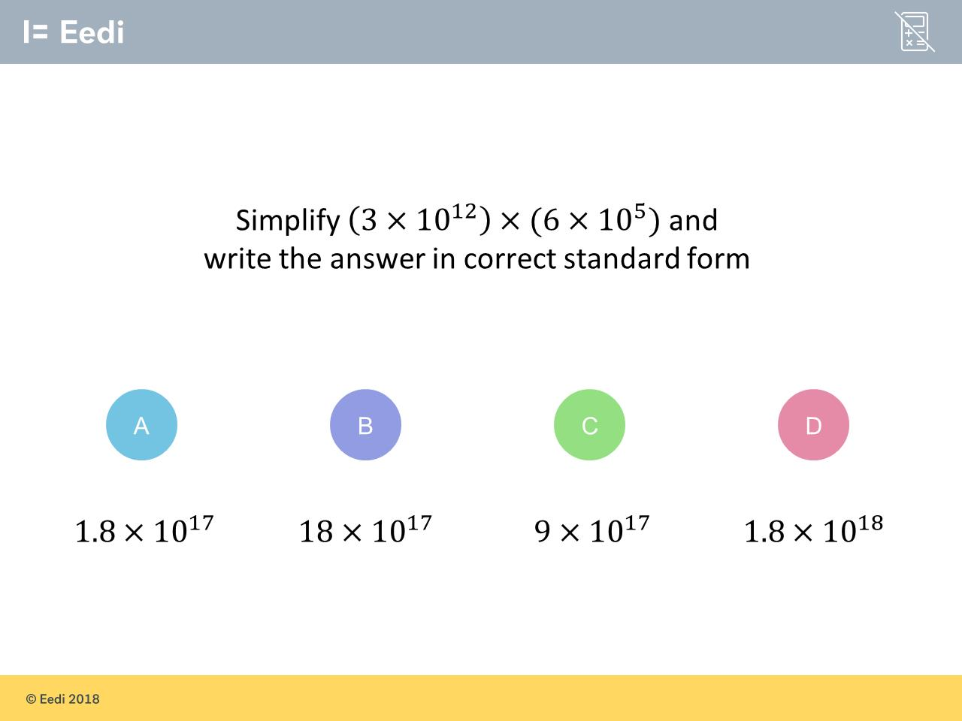
Question 9 – Standard Form

Slide 19
Answer 9 – Standard Form
CORRECT ANSWER | CORRECT EXPLANATION
1.8 x 10¹⁸ | We can multiply 3 and 6 together to get 18 and then add the powers on the 10s. This gives 18 × 10¹⁷ = 1.8 × 10¹⁸
COMMON MISTAKES | WHAT MIGHT BE YOUR MISTAKE
1.8 x 10¹⁷ | The student has worked out 1.8 correctly but has not adjusted the power correctly.
18 x 10¹⁷ | The student has not adjusted their answer so that the leading digits is the from 1 to 9.99……
9 x 10¹⁷ | The student has added the integers, rather than multiplying.

Slide 20
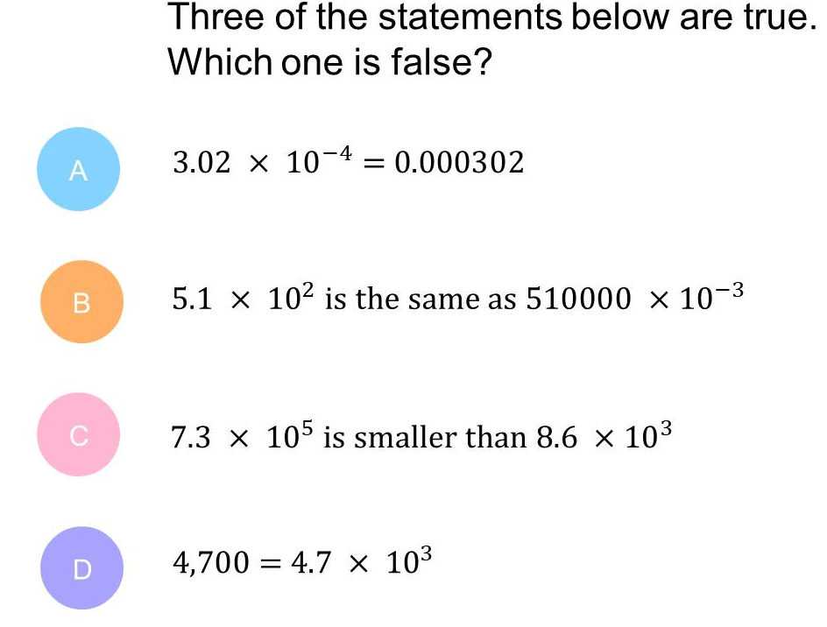
Question 10 – Standard Form

Slide 21
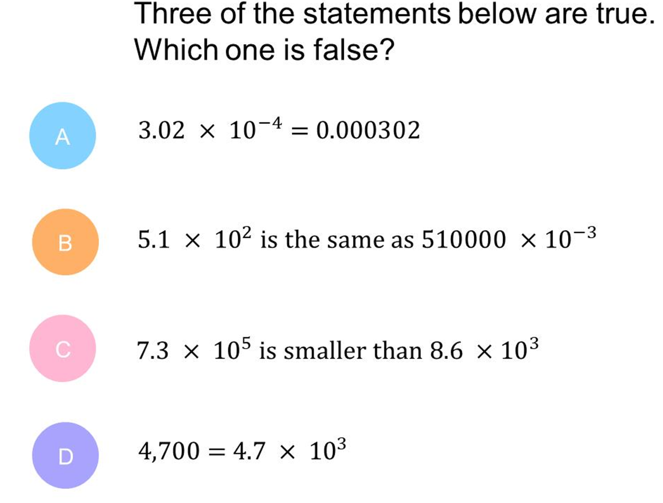
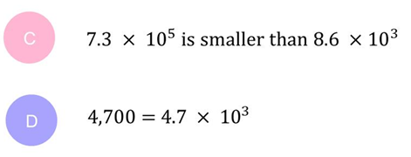
Answer 10 – Standard Form
CORRECT ANSWER | CORRECT EXPLANATION
C | 7.3 × 10⁵ is much larger than 8.6 × 10³, as the power of the 10 is greater.
COMMON MISTAKES | WHAT MIGHT BE YOUR MISTAKE
A | Correct as 3.02 is divided by 10000
B | Correct as 5.1 has been multiplied by 100000
D | Correct as 4.7 has been multiplied by 1000

Slide 22
Question 11 – Standard Form
Work out 3 x 10⁴ divided by 6 and write your answer in standard form.

Slide 23
Answer 11 – Standard Form
Work out 3 x 10⁴ divided by 6 and write your answer in standard form.
CORRECT ANSWER | CORRECT EXPLANATION
5 x 10³ | 3 ÷ 6 = 0.5 therefore the answer is 0.5 × 10⁴ then rewrite in correct standard form 5 × 10³
COMMON MISTAKES | WHAT MIGHT BE YOUR MISTAKE
0.5 x 10⁴ | The student has the correct answer, but it is not in correct standard form.
5000 | The student has the correct answers, but it is written as an ordinary number.
2 x 10⁴ | The student has done 6 ÷ 3 instead of 3 ÷ 6

Slide 24
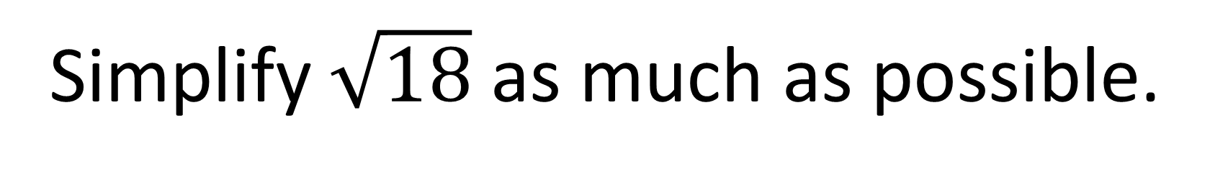
Question 12 – Surds
Simplify $\sqrt{18}$ as much as possible.

Slide 25
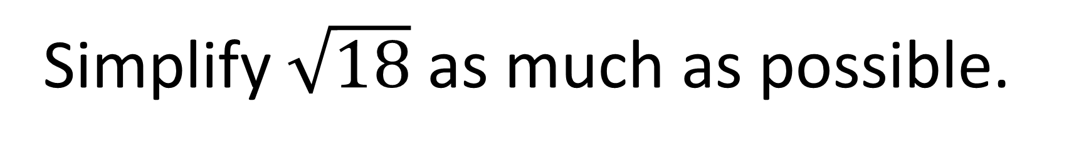
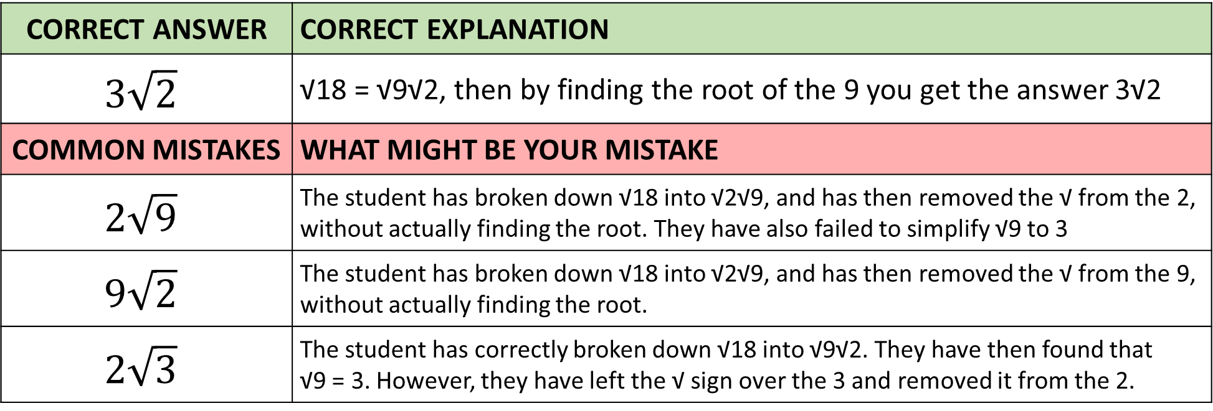
Answer 12 – Surds
Simplify $\sqrt{18}$ as much as possible.
CORRECT ANSWER | CORRECT EXPLANATION
$$3\sqrt{2}$$ | √18 = √9√2, then by finding the root of the 9 you get the answer 3√2
COMMON MISTAKES | WHAT MIGHT BE YOUR MISTAKE
$$2\sqrt{9}$$ | The student has broken down √18 into √2√9, and has then removed the √ from the 2, without actually finding the root. They have also failed to simplify √9 to 3
$$9\sqrt{2}$$ | The student has broken down √18 into √2√9, and has then removed the √ from the 9, without actually finding the root.
$$2\sqrt{3}$$ | The student has correctly broken down √18 into √9√2. They have then found that √9 = 3. However, they have left the √ sign over the 3 and removed it from the 2.

Slide 26
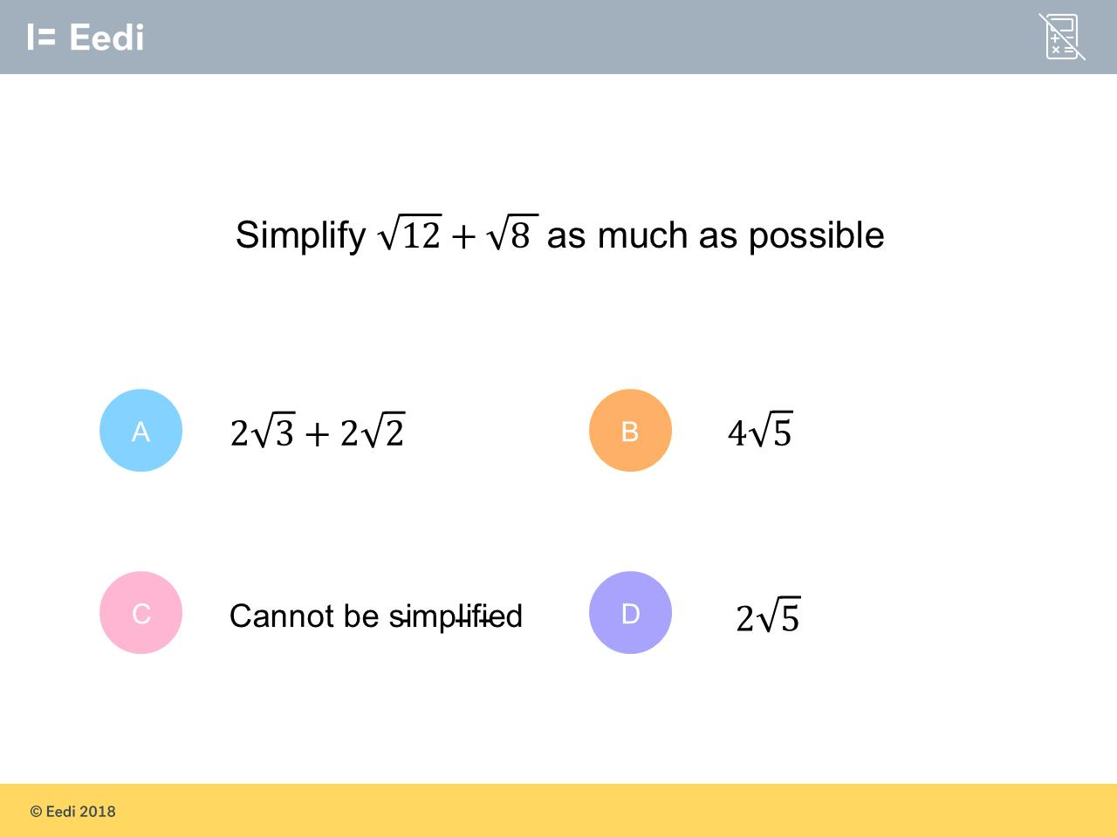
Question 13 – Surds

Slide 27
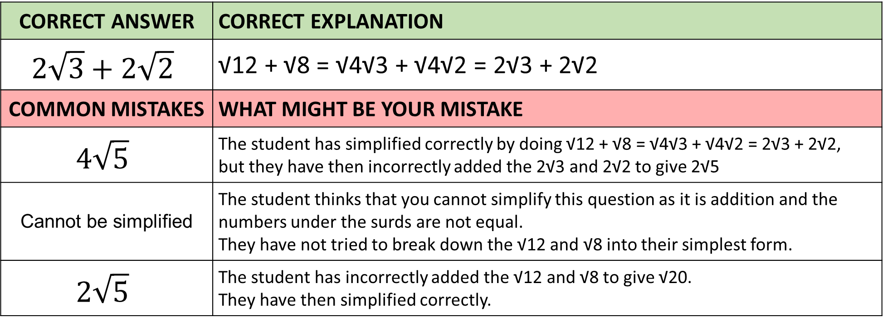
Answer 13 – Surds
CORRECT ANSWER | CORRECT EXPLANATION
$$2\sqrt{3}+2\sqrt{2}$$ | √12 + √8 = √4√3 + √4√2 = 2√3 + 2√2
COMMON MISTAKES | WHAT MIGHT BE YOUR MISTAKE
$$4\sqrt{5}$$ | The student has simplified correctly by doing √12 + √8 = √4√3 + √4√2 = 2√3 + 2√2, but they have then incorrectly added the 2√3 and 2√2 to give 2√5
Cannot be simplified | The student thinks that you cannot simplify this question as it is addition and the numbers under the surds are not equal. They have not tried to break down the √12 and √8 into their simplest form.
$$2\sqrt{5}$$ | The student has incorrectly added the √12 and √8 to give √20. They have then simplified correctly.

Slide 28
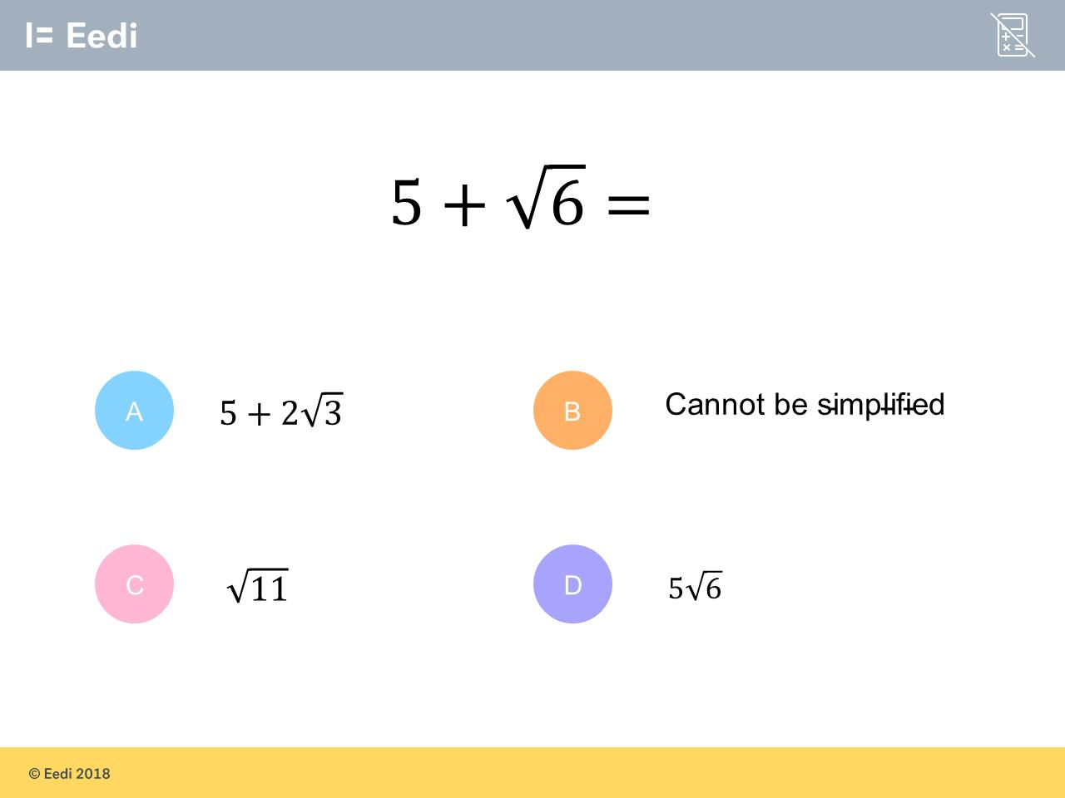
Question 14 – Surds
Simplify

Slide 29
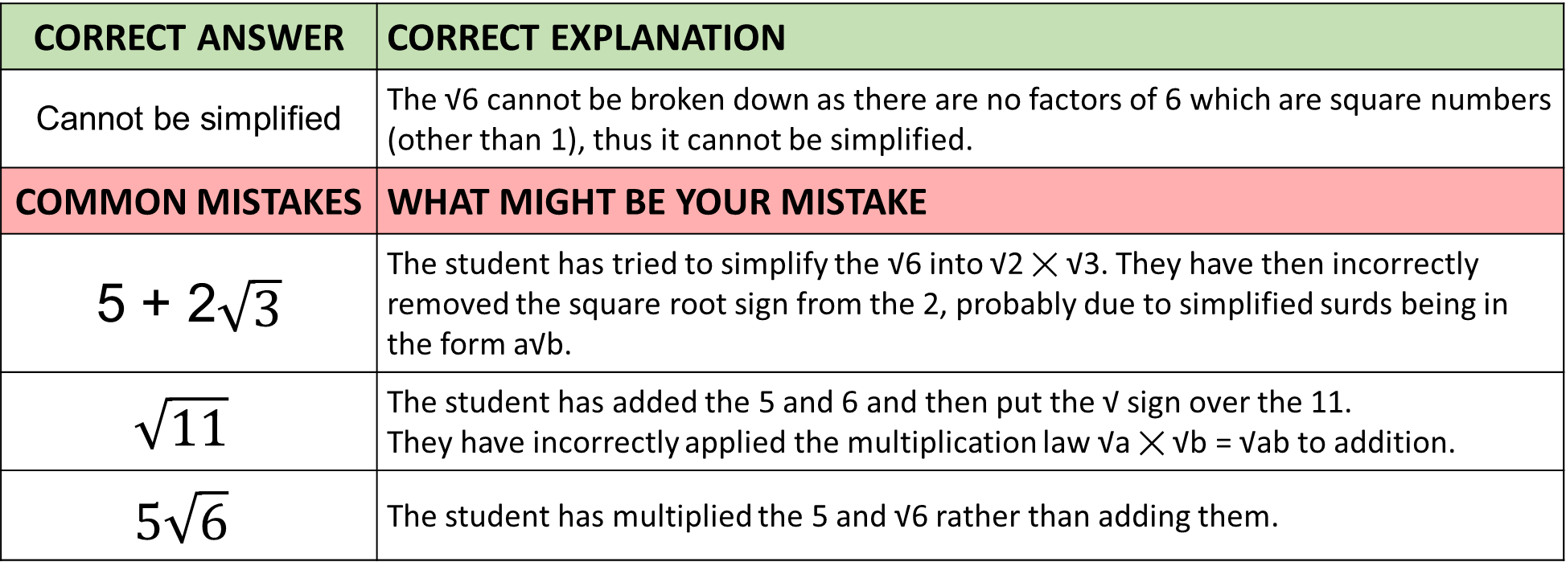
Answer 14 – Surds
Simplify
CORRECT ANSWER | CORRECT EXPLANATION
Cannot be simplified | The √6 cannot be broken down as there are no factors of 6 which are square numbers (other than 1), thus it cannot be simplified.
COMMON MISTAKES | WHAT MIGHT BE YOUR MISTAKE
5 + 2$\sqrt{3}$ | The student has tried to simplify the √6 into √2 ✕ √3. They have then incorrectly removed the square root sign from the 2, probably due to simplified surds being in the form a√b.
$$\sqrt{11}$$ | The student has added the 5 and 6 and then put the √ sign over the 11. They have incorrectly applied the multiplication law √a ✕ √b = √ab to addition.
$$5\sqrt{6}$$ | The student has multiplied the 5 and √6 rather than adding them.

Slide 30
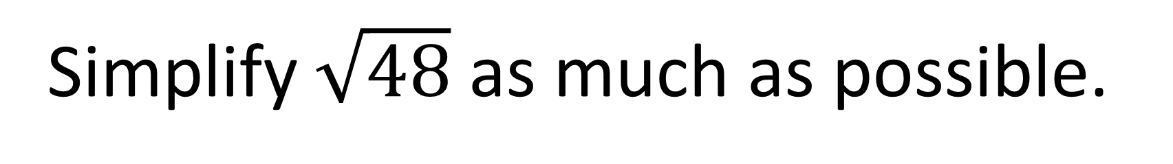
Question 15 – Surds
Simplify $\sqrt{48}$ as much as possible.

Slide 31
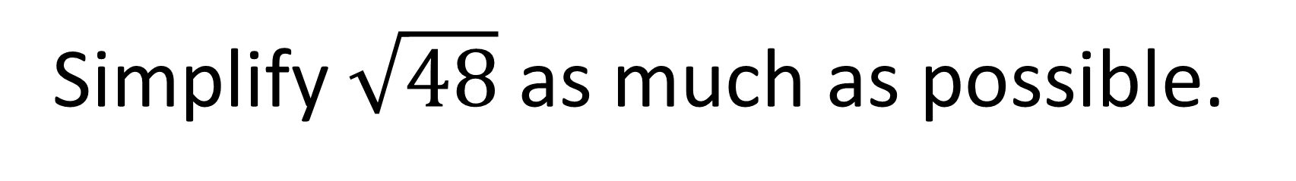
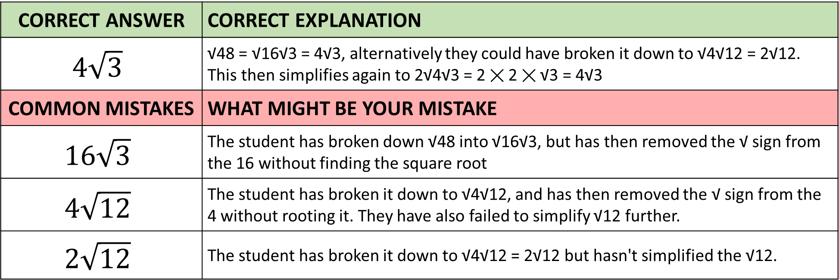
Answer 15 – Surds
Simplify $\sqrt{48}$ as much as possible.
CORRECT ANSWER | CORRECT EXPLANATION
$$4\sqrt{3}$$ | √48 = √16√3 = 4√3, alternatively they could have broken it down to √4√12 = 2√12. This then simplifies again to 2√4√3 = 2 ✕ 2 ✕ √3 = 4√3
COMMON MISTAKES | WHAT MIGHT BE YOUR MISTAKE
$$16\sqrt{3}$$ | The student has broken down √48 into √16√3, but has then removed the √ sign from the 16 without finding the square root
$$4\sqrt{12}$$ | The student has broken it down to √4√12, and has then removed the √ sign from the 4 without rooting it. They have also failed to simplify √12 further.
$$2\sqrt{12}$$ | The student has broken it down to √4√12 = 2√12 but hasn't simplified the √12.

Slide 32
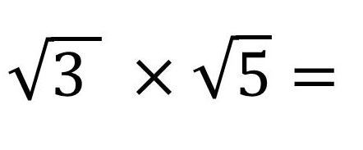
Question 16 – Surds

Slide 33
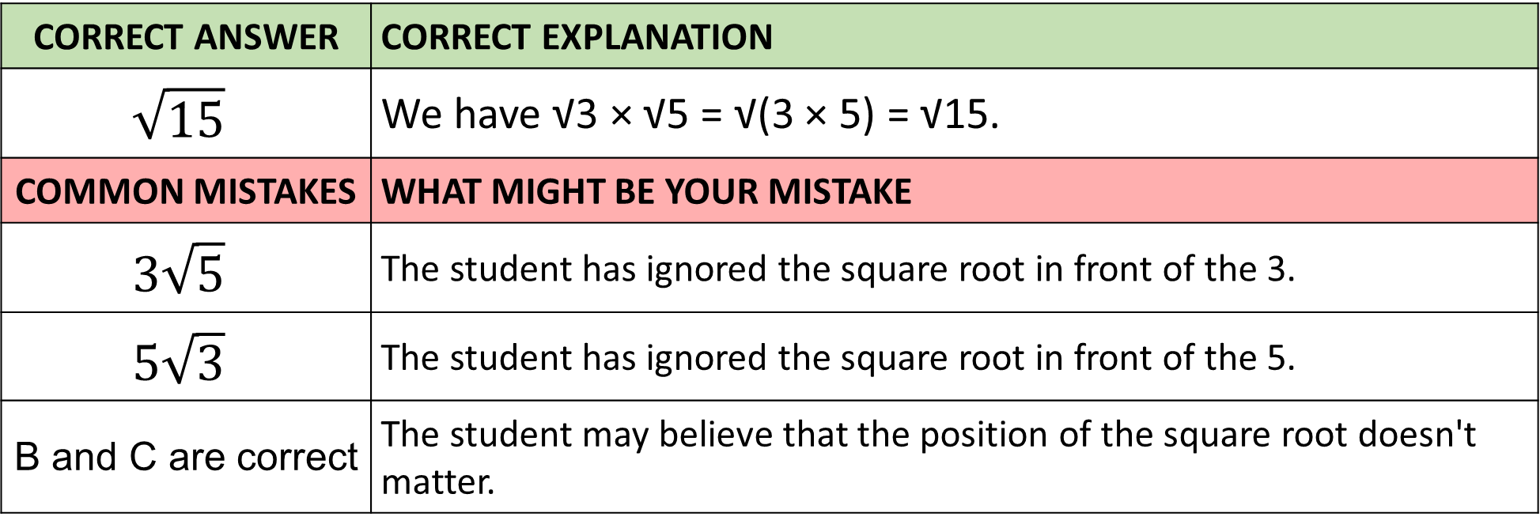
Answer 16 – Surds
CORRECT ANSWER | CORRECT EXPLANATION
$$\sqrt{15}$$ | We have √3 × √5 = √(3 × 5) = √15.
COMMON MISTAKES | WHAT MIGHT BE YOUR MISTAKE
$$3\sqrt{5}$$ | The student has ignored the square root in front of the 3.
$$5\sqrt{3}$$ | The student has ignored the square root in front of the 5.
B and C are correct | The student may believe that the position of the square root doesn't matter.

