Slide 1
LO: Solving Equations
(Algebraic Fractions)

Slide 2
When solving an equation with fractions:
Step 1: Combine fractions into single fraction
Step 2: Multiply through by denominator.

Slide 3
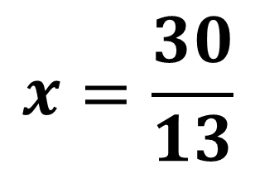

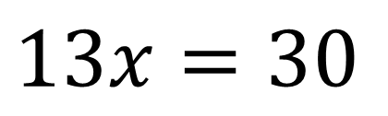
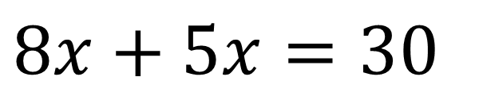
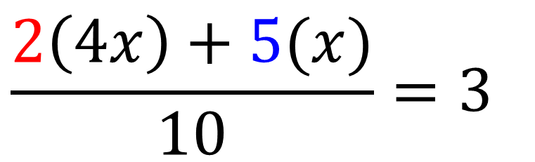
$$\frac{4x}{5} + \frac{x}{2}=3$$
$$\frac{2\left(4x\right)+5(x)}{10}=3$$
$$8x+5x=30$$
$$x=\frac{30}{13}$$
$$13x=30$$

Slide 4
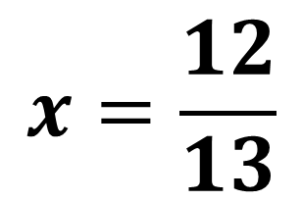
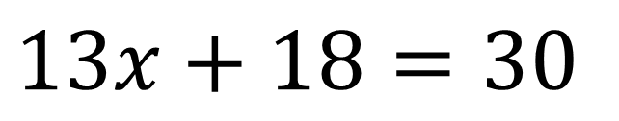
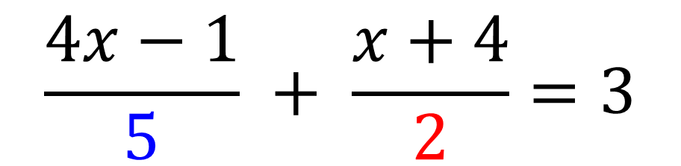
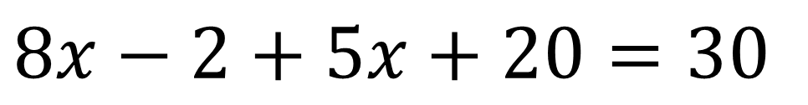
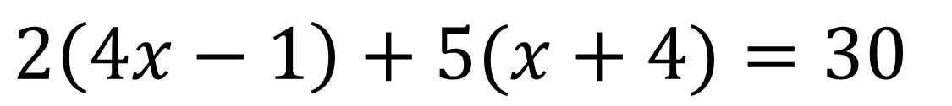
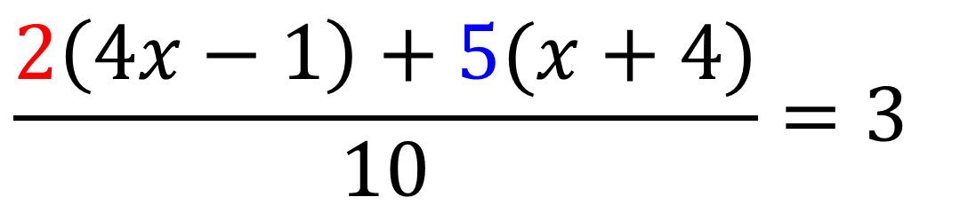
$$\frac{4x−1}{5} + \frac{x+4}{2}=3$$
$$\frac{2\left(4x−1\right)+5(x+4)}{10}=3$$
$$2\left(4x−1\right)+5(x+4)=30$$
$$8x−2+5x+20=30$$
$$x=\frac{12}{13}$$
$$13x+18=30$$

