Slide 1
Algebraic Methods
Proofs - Jottings
Chapter 7
(Part 5 of 5)

Slide 2
You must always start a proof from know facts.
Never start your proof with the statement you are trying to prove.

Slide 3
Jottings
Use jottings to get some ideas for a good starting point.
These don’t form part of your proof but can give you a clue to how to start your proof.

Slide 4
Jottings
Proof
Proof
Know Fact
Know Fact
Proof

Slide 5
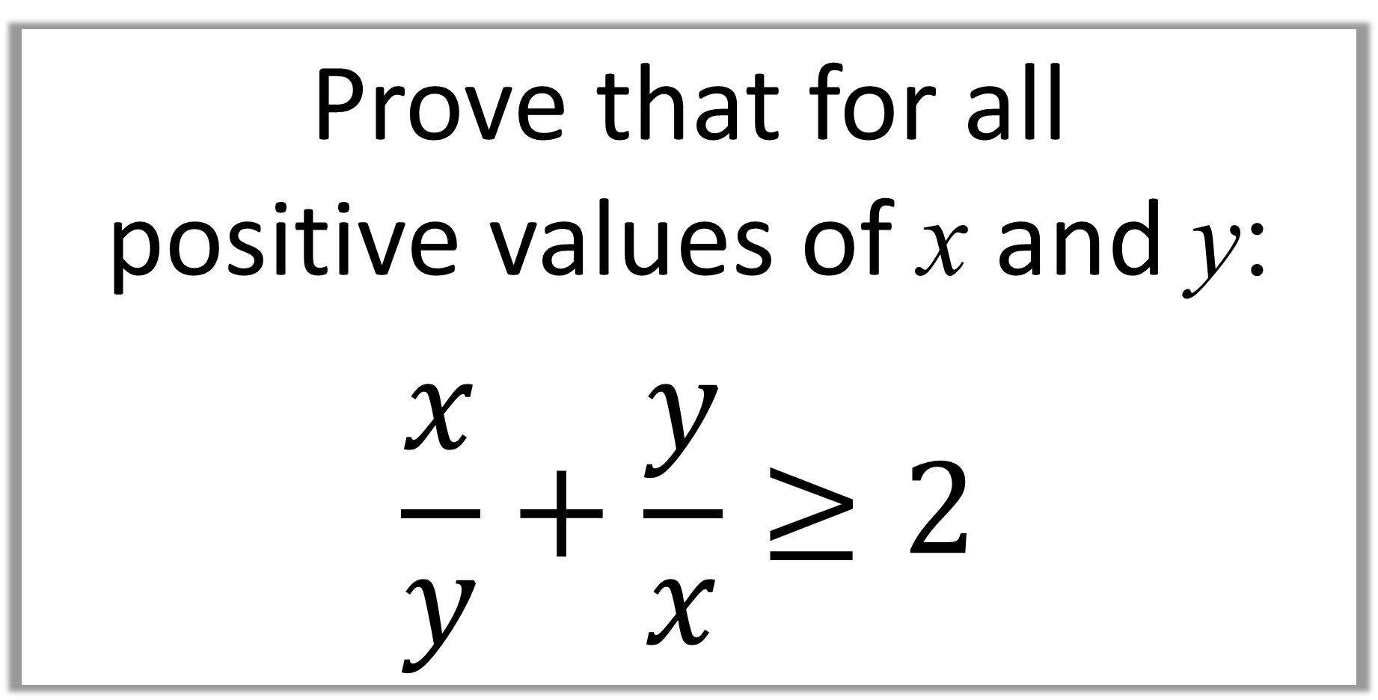
Prove that for all
positive values of x and y:
$$\frac{x}{y}+\frac{y}{x}≥2$$

Slide 6
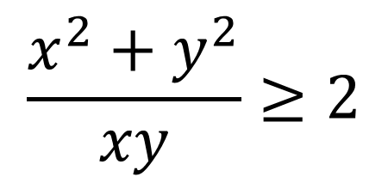
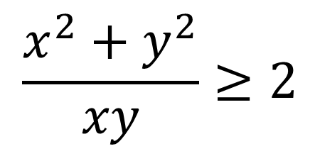
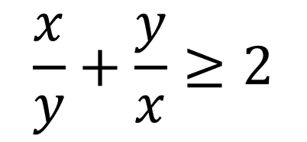
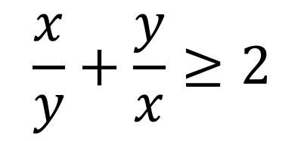
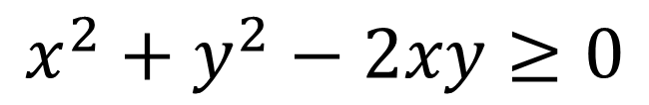
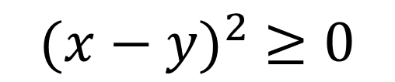
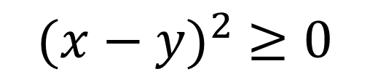
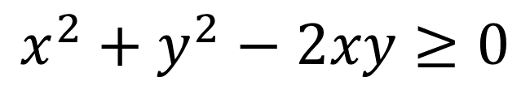
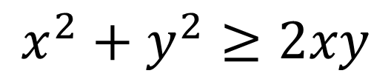
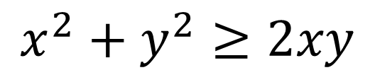
Proof
$$\frac{x}{y}+\frac{y}{x}≥2$$
Know Fact
Jottings
$${(x−y)}^{2} ≥0$$
$$\frac{x^{2}+y^{2}}{xy}≥2$$
$$x^{2}+y^{2}−2xy≥0$$
$$x^{2}+y^{2}≥2xy$$
$$x^{2}+y^{2}≥2xy$$
$$\frac{x^{2}+y^{2}}{xy}≥2$$
$$x^{2}+y^{2}−2xy≥0$$
Know Fact
$${(x−y)}^{2} ≥0$$
Proof
$$\frac{x}{y}+\frac{y}{x}≥2$$
A squared number will always be 0 or positive.

Slide 7
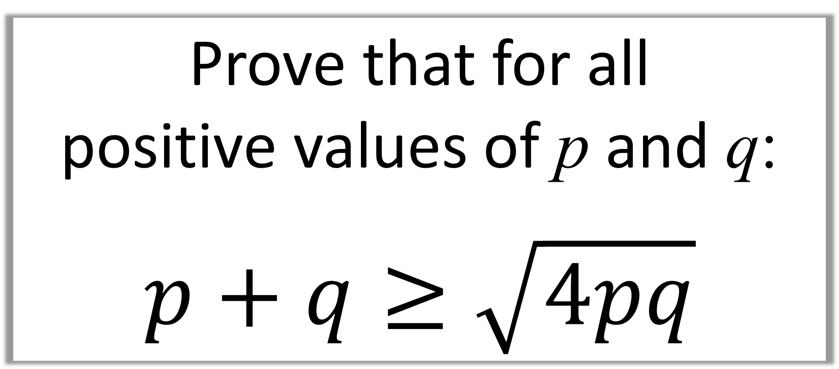
Prove that for all
positive values of p and q:
$$p+q≥\sqrt{4pq}$$

Slide 8
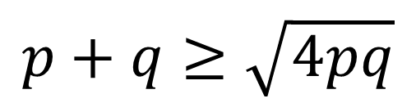
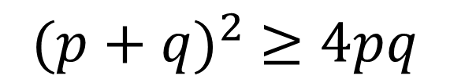
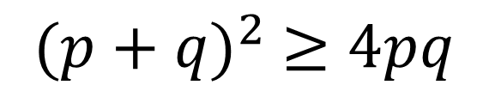
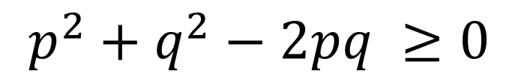
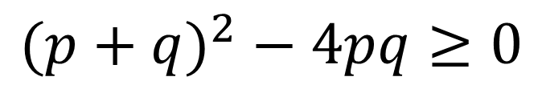
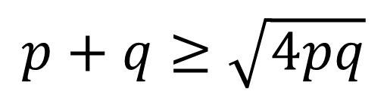
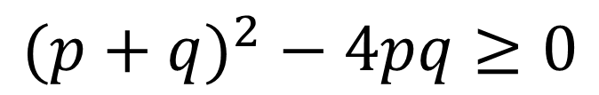
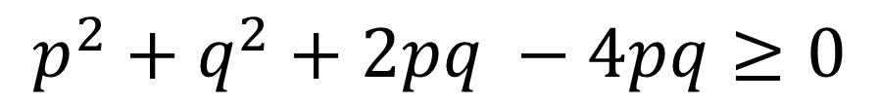
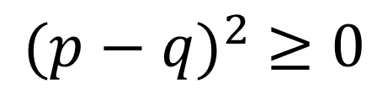
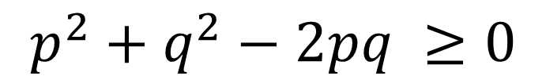
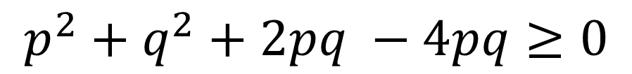
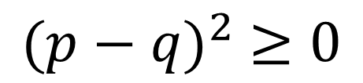
Know Fact
Proof
$$p+q≥\sqrt{4pq}$$
$${(p−q)}^{2} ≥0$$
$${(p+q)}^{2} ≥4pq$$
Jottings
$$p^{2}+q^{2}−2pq ≥0$$
$${(p+q)}^{2} − 4pq≥0$$
$$p^{2}+q^{2}+2pq −4pq≥0$$
$$p^{2}+q^{2}+2pq −4pq≥0$$
$$p^{2}+q^{2}−2pq ≥0$$
$${(p+q)}^{2} − 4pq≥0$$
$${(p+q)}^{2} ≥4pq$$
Know Fact
$${(p−q)}^{2} ≥0$$
Proof
$$p+q≥\sqrt{4pq}$$
A squared number will always be 0 or positive.

