Slide 1
Algebraic Methods
Factor Theorem
Chapter 7
(Part 3 of 5)

Slide 2
The Factor Theorem
Factor Theorem is an
easy way to find
the value of any remainder.

Slide 3
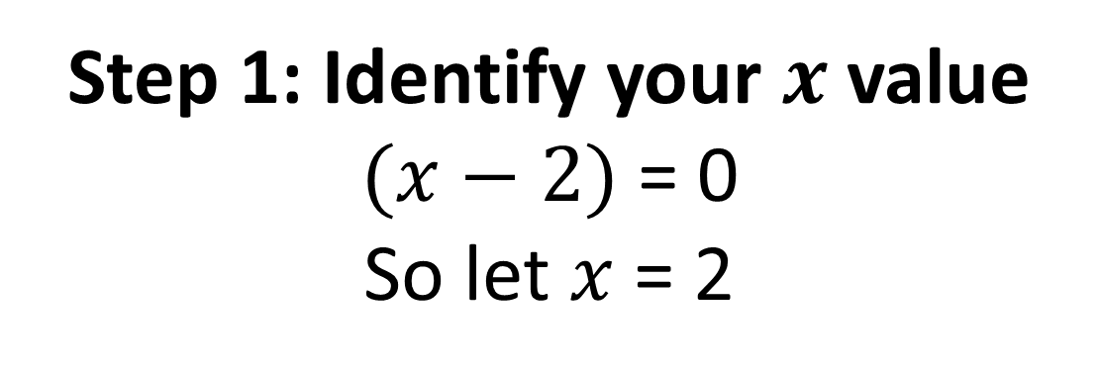

Show that $(x−2)$ is a factor of
$$x^{3}+x^{2}−4x−4$$
Step 1: Identify your $x$ value
$(x−2)$ = 0
So let $x$= 2
Step 2: Substitute the x value into the polynomial
The answer to the substitution is your remainder.

Slide 4

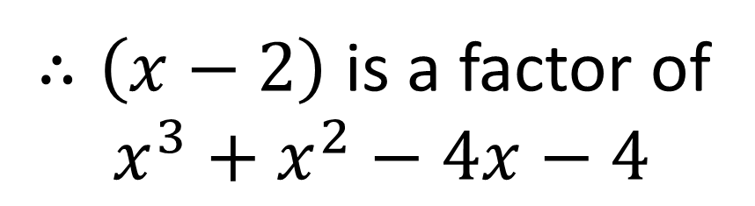
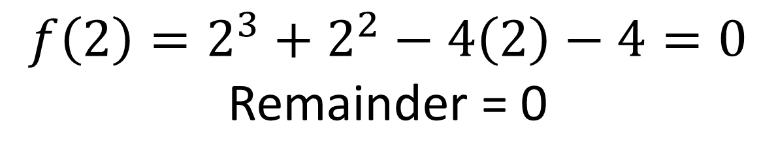
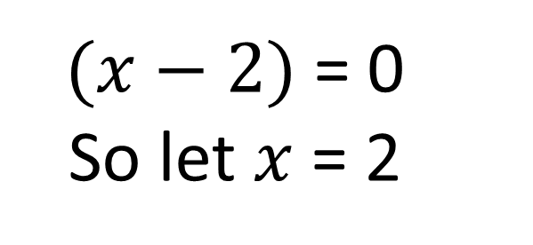
Show that $(x−2)$ is a factor of
$$x^{3}+x^{2}−4x−4$$
$(x−2)$ = 0
So let $x$= 2
$$f\left(2\right)=2^{3}+2^{2}−4\left(2\right)−4=0$$
Remainder = 0
$∴\left(x−2\right)$ is a factor of
$x^{3}+x^{2}−4x−4$

Slide 5
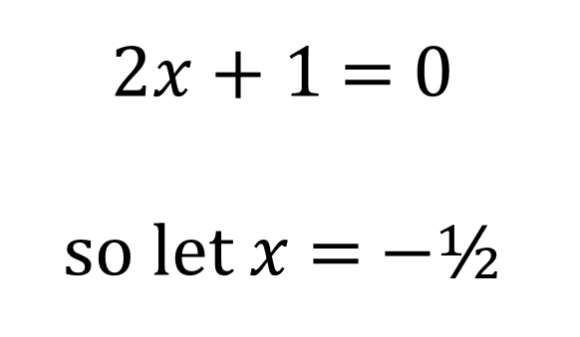
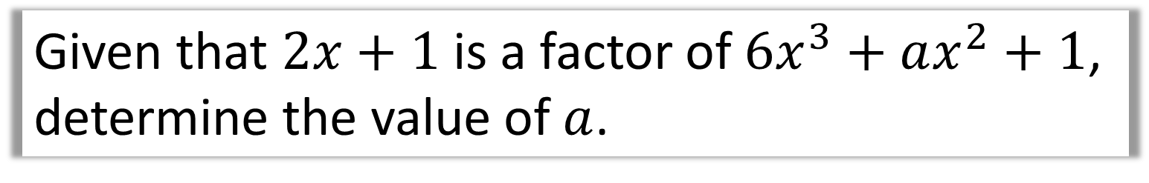
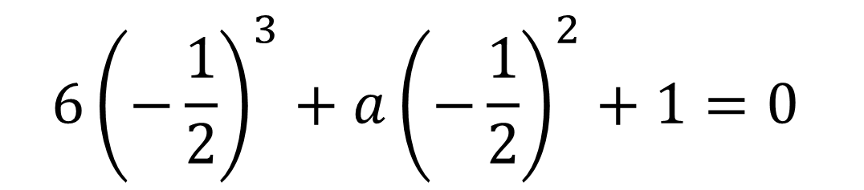

Finding unknown coefficients
Given that $2x+1$ is a factor of $6x^{3}+ax^{2}+1$, determine the value of $a$.
$2x+1$ = 0
so let $x$ = $−$½
$$−\frac{3}{4}+\frac{1}{4}a+1=0$$
$$\frac{1}{4}a=−\frac{1}{4}$$
$$a=−1$$
$$6{\left(−\frac{1}{2}\right)}^{3}+a{\left(−\frac{1}{2}\right)}^{2}+1=0$$

Slide 6
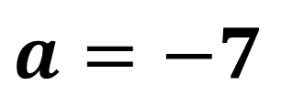
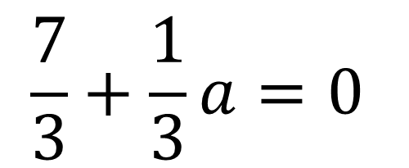
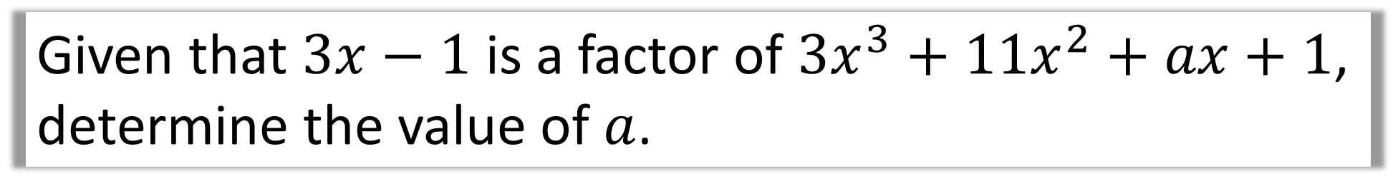
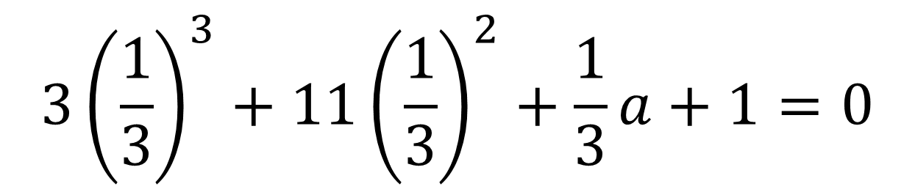
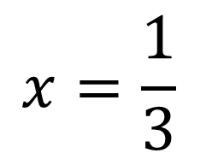
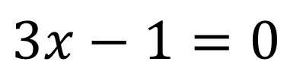
Given that $3x−1$ is a factor of $3x^{3}+11x^{2}+ax+1$, determine the value of $a$.
$3x−1=0$
$$3{\left(\frac{1}{3}\right)}^{3}+11{\left(\frac{1}{3}\right)}^{2}+\frac{1}{3}a+1=0$$
$$x=\frac{1}{3}$$
$$\frac{7}{3}+\frac{1}{3}a=0$$
$$a=−7$$

Slide 7
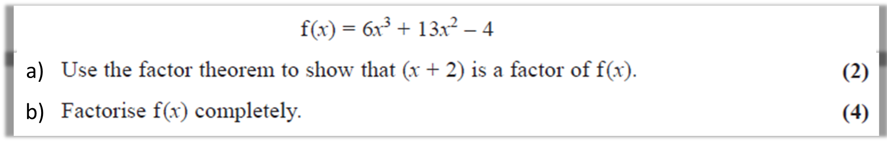
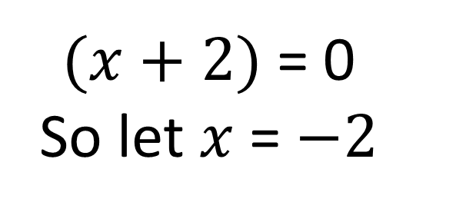
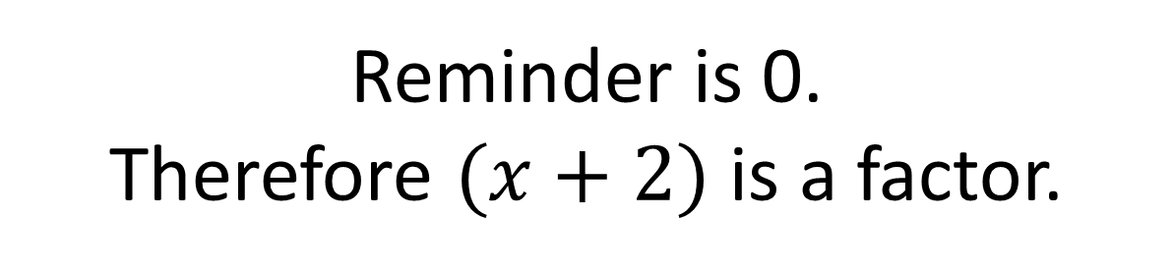
a)
$(x+2)$ = 0
So let $x$= $−2$
$$f\left(−2\right)={6(−2)}^{3}+{13(−2)}^{2}−4=0$$
Reminder is 0.
Therefore $(x+2)$ is a factor.

Slide 8
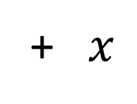
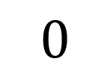

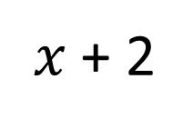


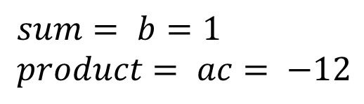

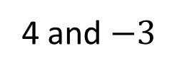
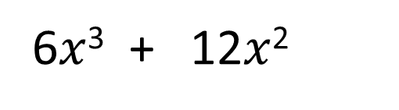

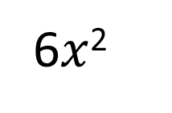
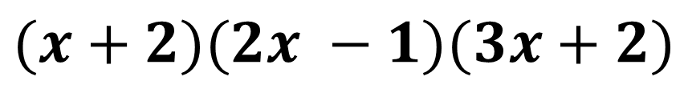


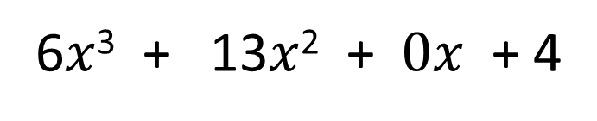

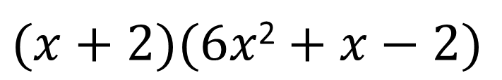
b)
6$x$²
+ $x$
$$−2$$
$(x+2)(6x$² $+ x−2)$
$x$ + 2
6$x$³ + 13$x$² + $0x$ + 4
$$sum= b=1 \\ product= ac= −12$$
6$x$³ + 12$x$²
4 and $−3$
$$x^{2}+0x$$
$$=6x^{2}+4x−3x−2$$
$$x^{2}+2x$$
$$=2x\left(3x+2\right)−1\left(3x+2\right)$$
$$− 2x+4$$
$$=(2x−1)(3x+2)$$
$$−2x−4$$
$$(x+2)(2x −1)(3x+2)$$
$$0$$

