Slide 1
Differentiation
Modelling
Chapter 12
(Part 7 of 8)

Slide 2
Modelling - Show that
Identify two equations then substitute
one into the other.

Slide 3
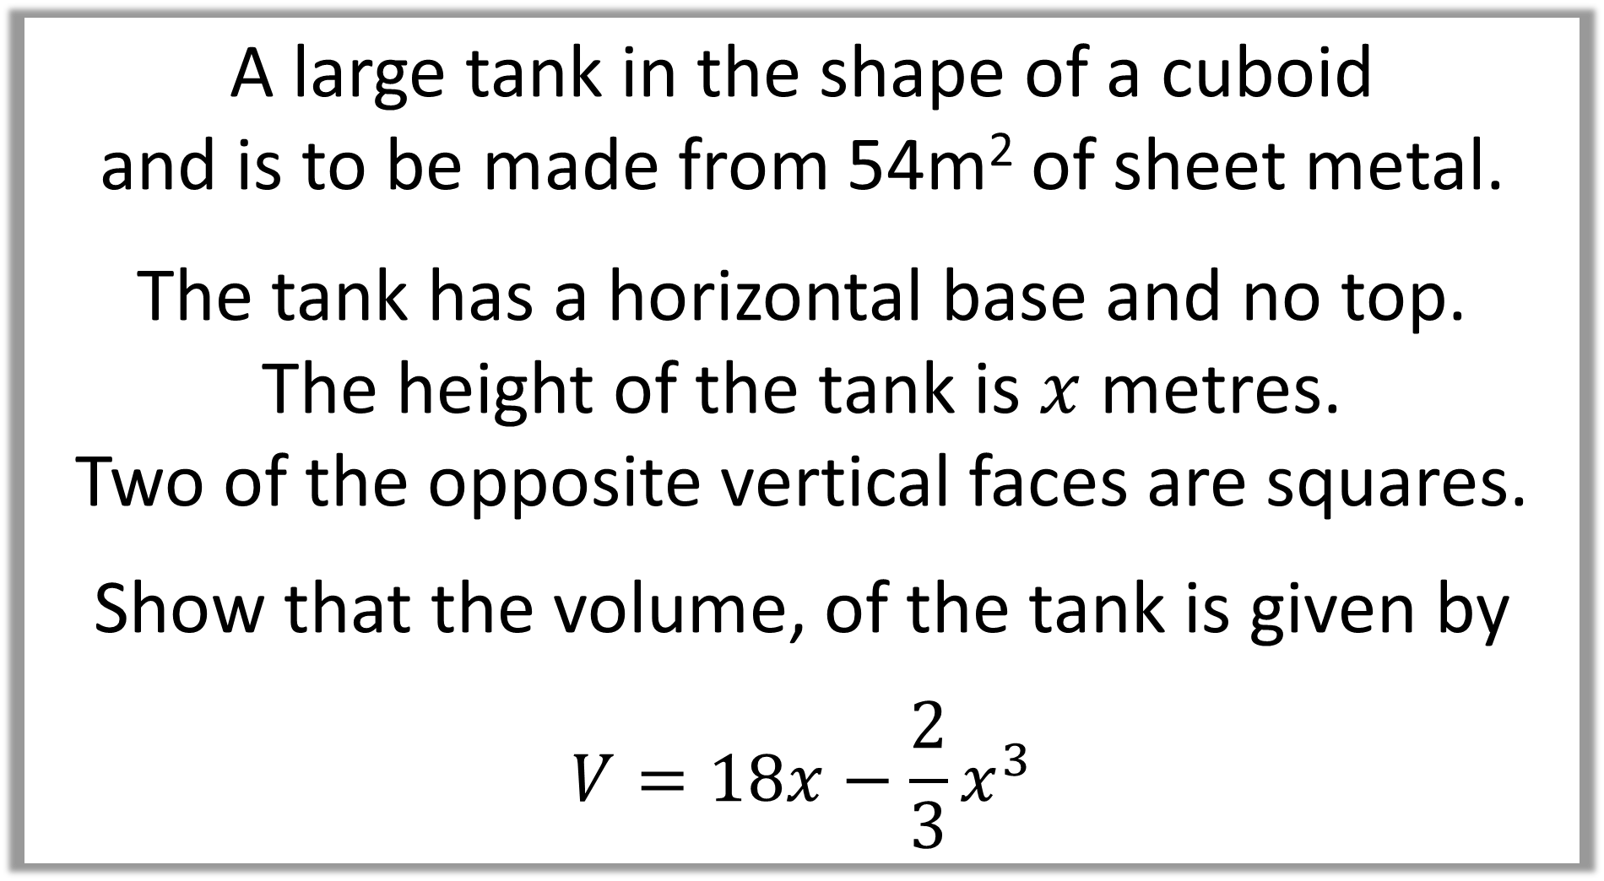
A large tank in the shape of a cuboid
and is to be made from 54m² of sheet metal.
The tank has a horizontal base and no top.
The height of the tank is $x$ metres.
Two of the opposite vertical faces are squares.
Show that the volume, of the tank is given by
$$V=18x−\frac{2}{3}x^{3}$$

Slide 4
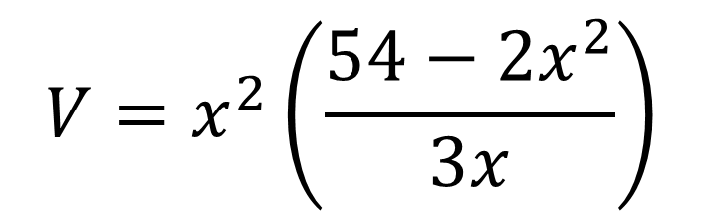



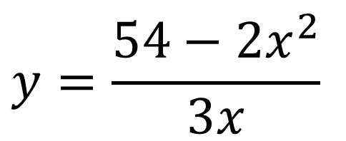
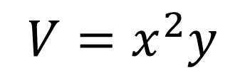
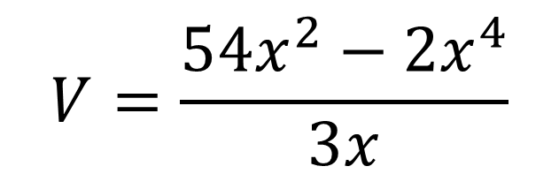
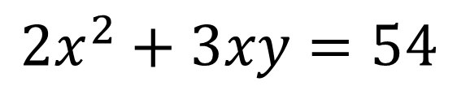

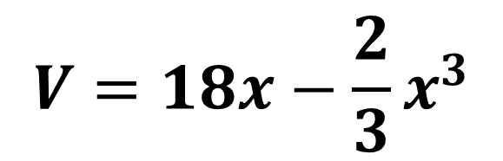
Substitute $y$ into Volume formula
$$x$$
$$V=x^{2}\left(\frac{54−2x^{2}}{3x}\right)$$
$$x$$
$$y$$
Surface Area
$$2x^{2}+3xy=54$$
Simplify
$$V=\frac{54x^{2}−2x^{4}}{3x}$$
Volume
$$V=x^{2}y$$
$$y=\frac{54−2x^{2}}{3x}$$
$$V=18x−\frac{2}{3}x^{3}$$
Make y the for Surface Area

Slide 5
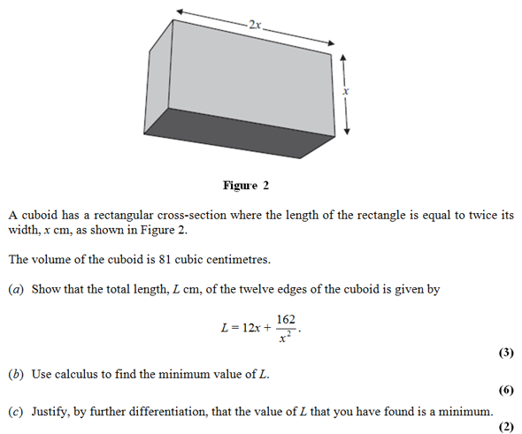

Slide 6
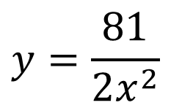



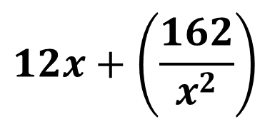

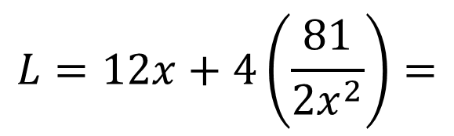


Volume
$$V=2x^{2}y$$
$$81=2x^{2}y$$
Length
$$L=2\left(2x+x+2x+x\right)+4y$$
$$L=12x+ 4y$$
$$V=18x−\frac{2}{3}x^{3}$$
Make $y$ subject for Volume
$$y=\frac{81}{2x^{2}}$$
a)
Substitute
$$L=12x+4\left(\frac{81}{2x^{2}}\right)=$$
$$12x+\left(\frac{162}{x^{2}}\right)$$

Slide 7
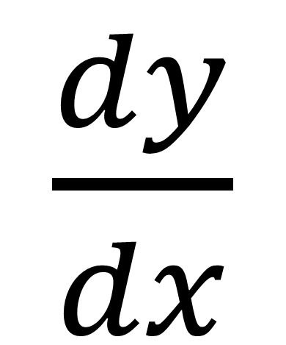
Rate of change
$\frac{dy}{dx}$
the change of y with respect to
the change of x

Slide 8
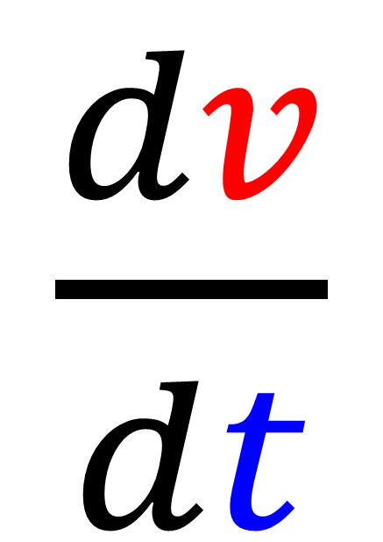
$\frac{dv}{dt}$
the change of volume
with respect to the change of time

Slide 9
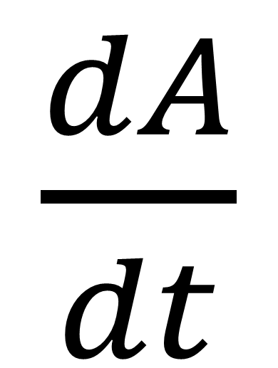
$\frac{dA}{dt}$
the change of Area
with respect to the change of time

Slide 10
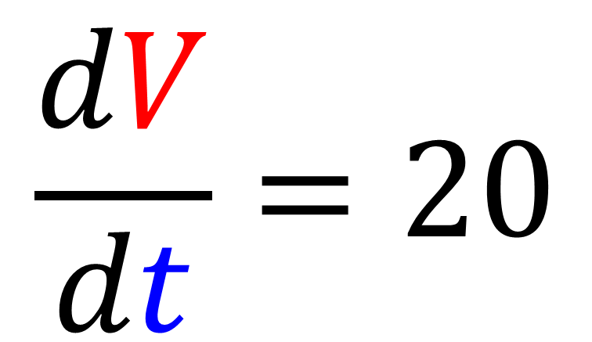
A container fills at a rate of
20 cm³ per second.
Use appropriate notation to represent this
$$\frac{dV}{dt}=20$$

Slide 11
Modelling
Modelling using differentiation can be good for finding
maximum and minimum values
to a given problem.

Slide 12
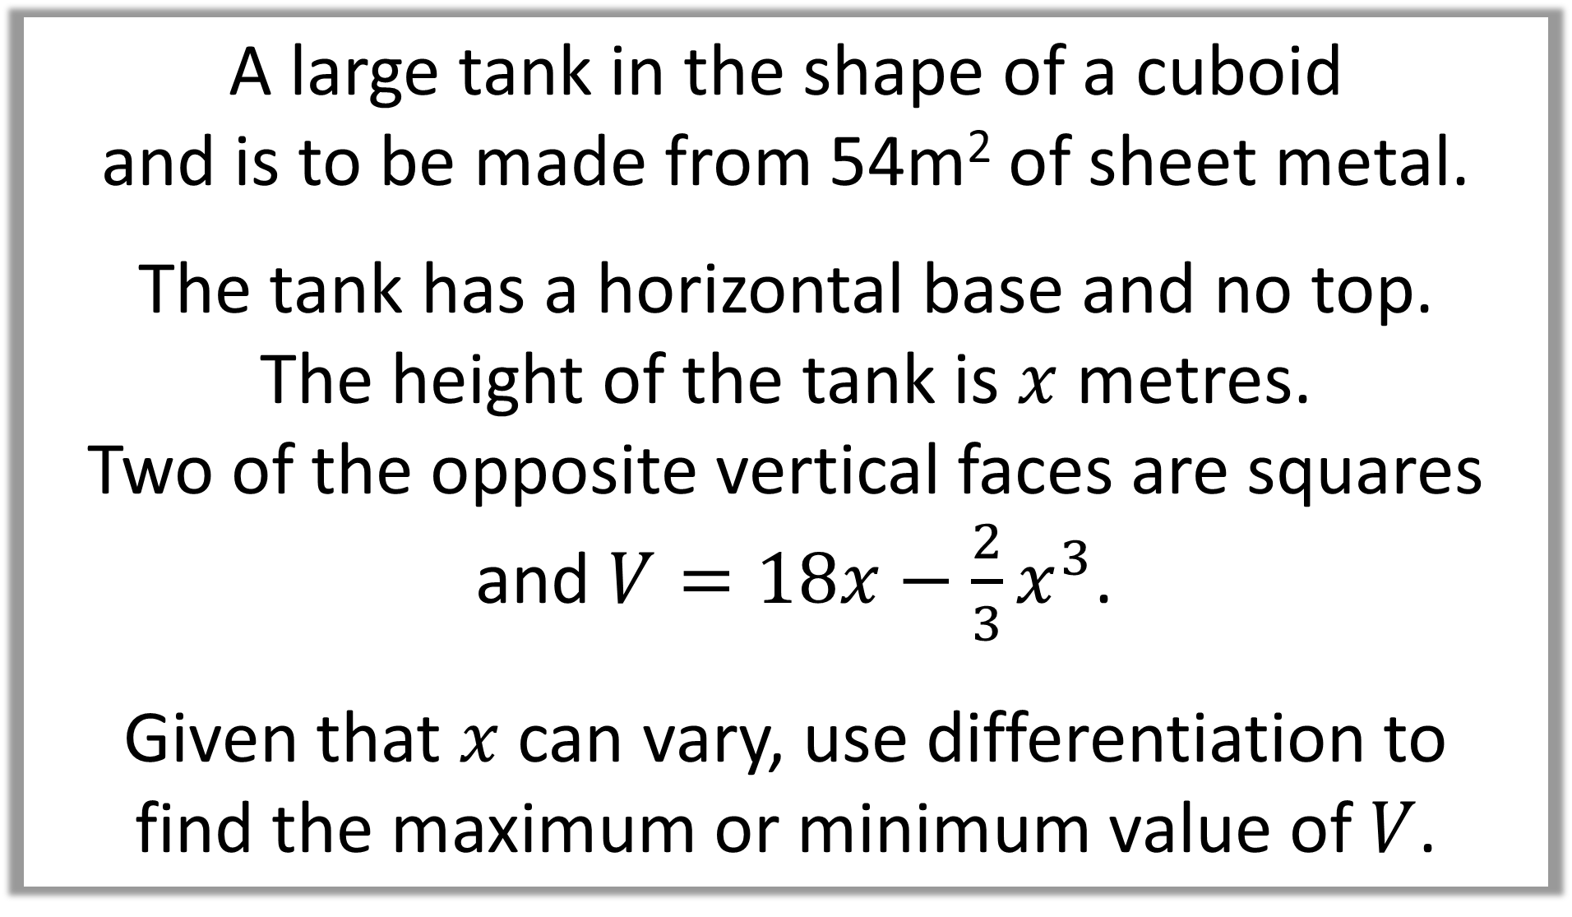
A large tank in the shape of a cuboid
and is to be made from 54m² of sheet metal.
The tank has a horizontal base and no top.
The height of the tank is $x$ metres.
Two of the opposite vertical faces are squares
and $V=18x−\frac{2}{3}x^{3}$.
Given that $x$ can vary, use differentiation to
find the maximum or minimum value of $V$.

Slide 13
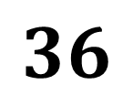
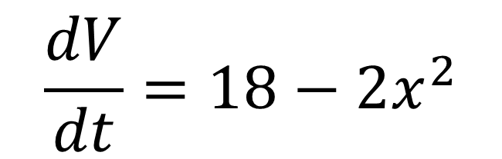
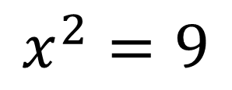
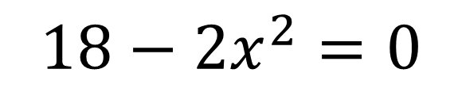
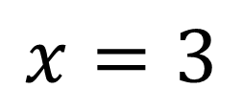
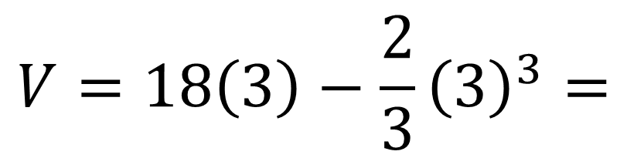
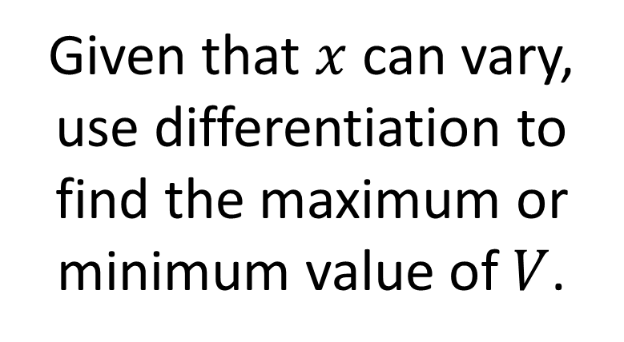
Given that $x$ can vary, use differentiation to
find the maximum or minimum value of $V$.
$$18−2x^{2}=0$$
$$x^{2}=9$$
$$V=18x−\frac{2}{3}x^{3}$$
$$x=3$$
when volume is a maximum
$$\frac{dV}{dt}=18−2x^{2}$$
$$V=18\left(3\right)−\frac{2}{3}{\left(3\right)}^{3}=$$
$$36$$

Slide 15
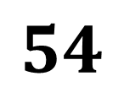
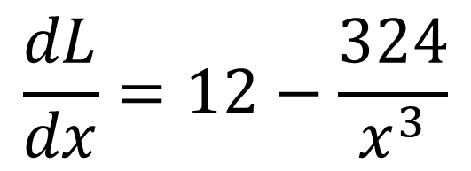
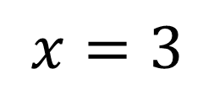
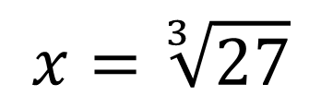
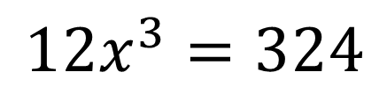
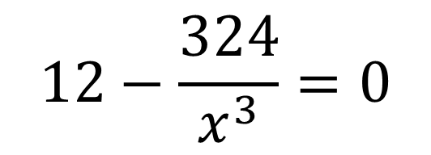
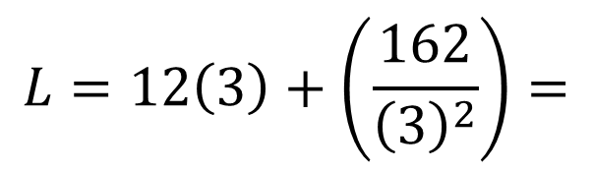
$$\frac{dL}{dx}=12−\frac{324}{x^{3}}$$
$$12−\frac{324}{x^{3}}=0$$
$$12x^{3}=324$$
$$x=\sqrt[3]{27}$$
$$x=3$$
b)
$$L=12\left(3\right)+\left(\frac{162}{{\left(3\right)}^{2}}\right)=$$
$$54$$

Slide 16
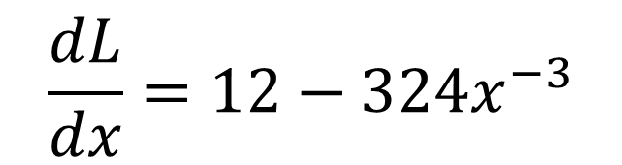
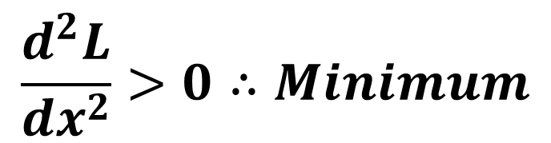
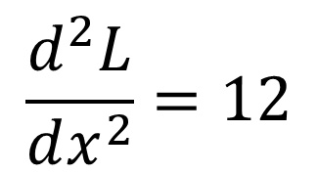
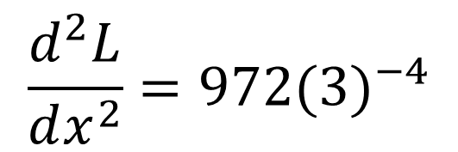
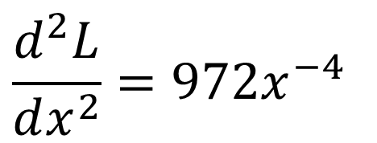
$$\frac{dL}{dx}=12−324x^{−3}$$
$$\frac{d^{2}L}{dx^{2}}=972x^{−4}$$
$$\frac{d^{2}L}{dx^{2}}=972{(3)}^{−4}$$
$$\frac{d^{2}L}{dx^{2}}=12$$
$$\frac{d^{2}L}{dx^{2}}>0∴Minimum$$
c)

