Slide 1
FM: Equations and
Inequalities

Slide 2
Linear Inequalities
When solving inequalities,
you will get an inequality answer.

Slide 3
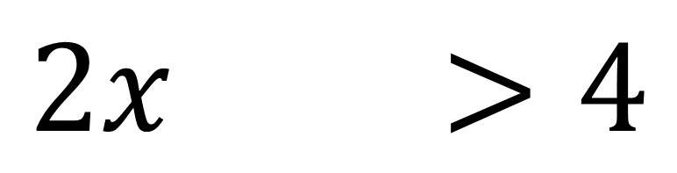
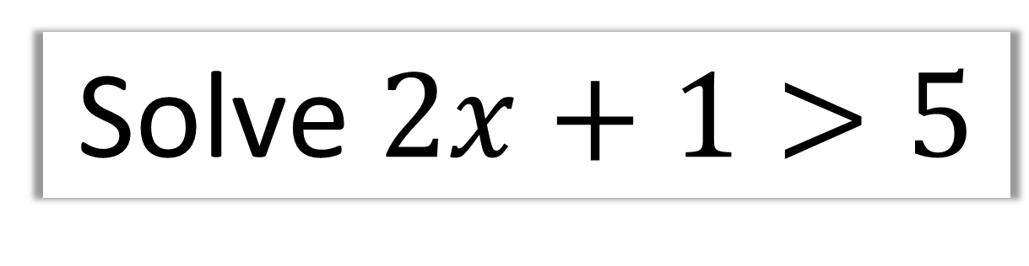
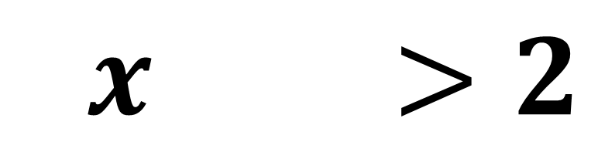
Solve $2x+1>5$
$$2x+1>4$$
$$2x+1>2$$

Slide 4
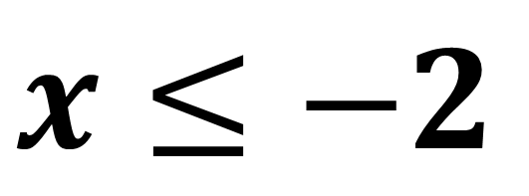
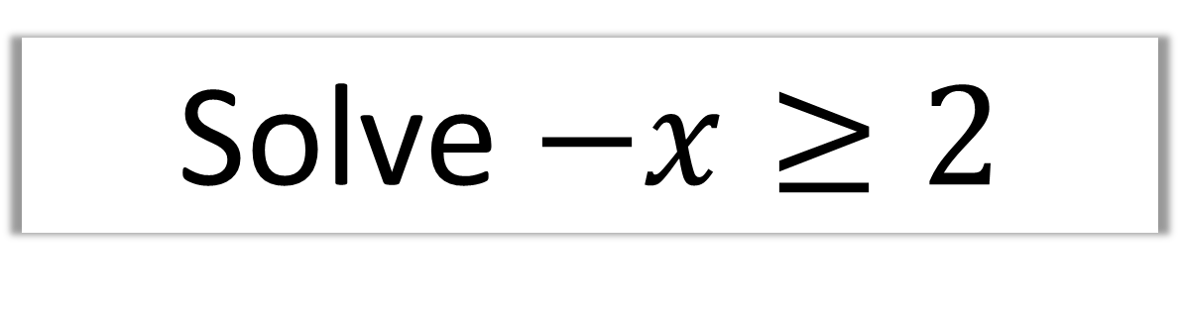
Solve $−x≥2$
$$x≤−2$$
Note:
Multiply or divide both sides of an inequality
by a negative number
reverses the direction of the inequality.

Slide 5
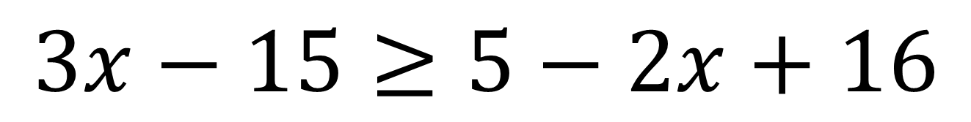
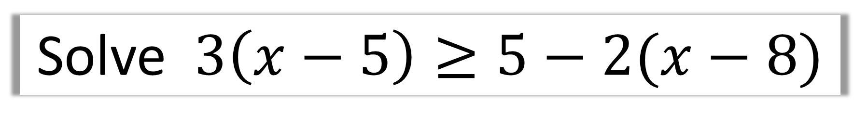
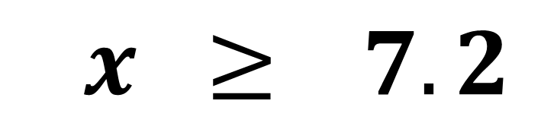
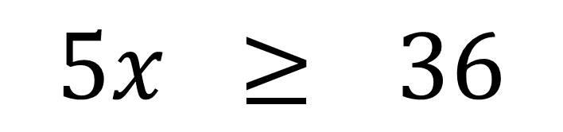
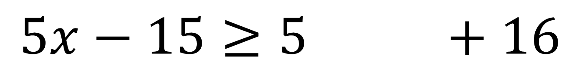
Solve $3\left(x−5\right)≥5−2(x−8)$
$$3x−15≥5−2x+16$$
$$5x−15≥5−2x+16$$
$$5x ≥536$$
$$5x ≥77.2$$

Slide 6
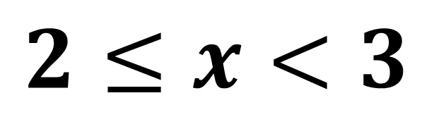
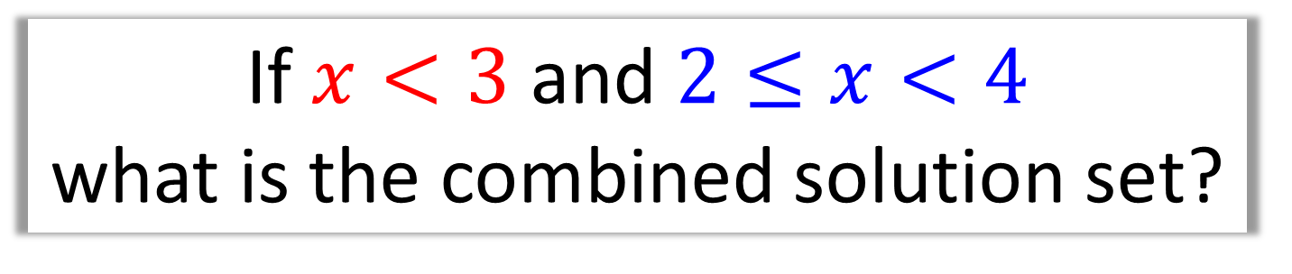
Combining Inequalities
If $x<3$ and $2≤x<4$
what is the combined solution set?
2
3
4
$$2≤x<3$$

Slide 7



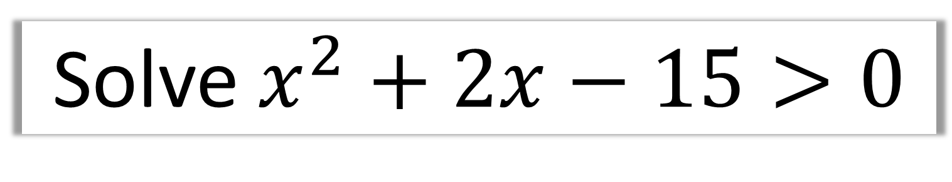



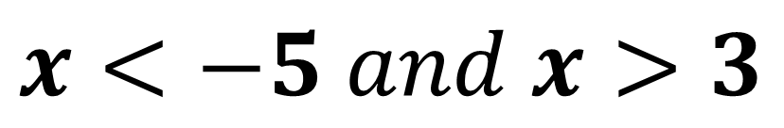
Solve $x^{2}+2x−15>0$
Sketch and Reason
$$y$$
$$x<−5$$
$$x>3$$
$$x$$
$$−5$$
$$3$$
$$x<−5 and x>3$$

Slide 8
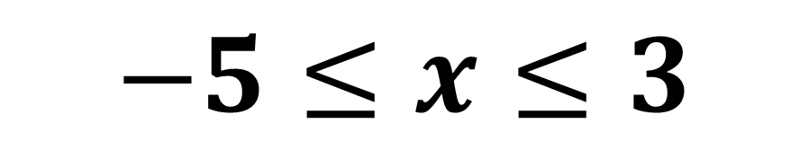





Solve $x^{2}+2x−15≤0$
$$y$$
$$−5$$
$$3$$
$$x$$
$$−5≤x≤3$$

Slide 9

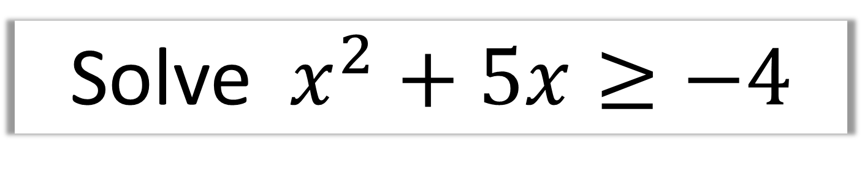

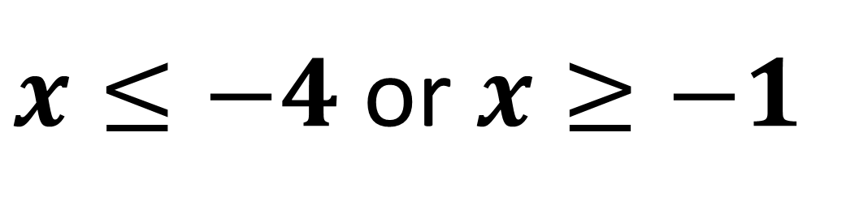


Solve $x^{2}+5x≥−4$
$$y$$
$$x$$
$$−4$$
$$−1$$
$x≤−4$ or $x≥−1$

Slide 10
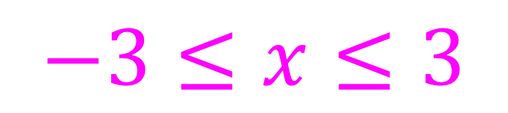


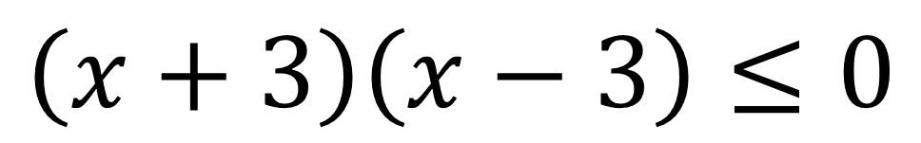




Solve $x^{2}$ $−$ 9 $≤0$
$$\left(x+3\right)\left(x−3\right)≤0$$
$$y$$
$$y=(x+3)(x−3)$$
$$x$$
$$−3$$
$$3$$
$$−3≤x≤3$$

Slide 11
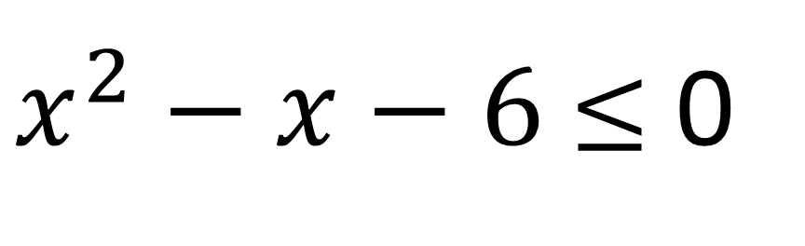

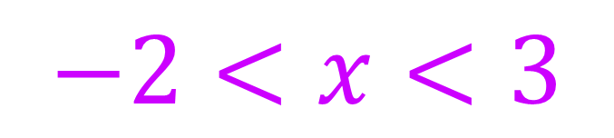




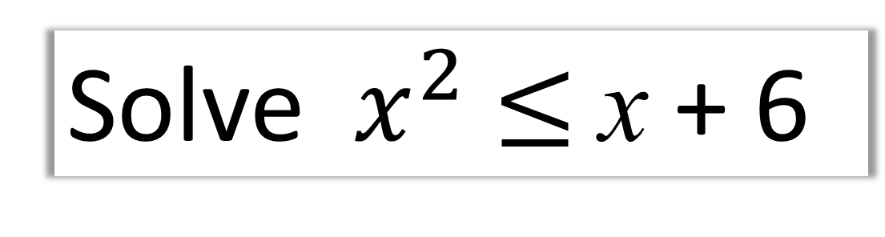
Solve $x^{2}$ $≤$x + 6
$x^{2}−x−6$ $≤$ 0
$$y$$
$$y=(x+2)(x−3)$$
$$x$$
$$−2$$
$$3$$
$$−2<x<3$$

Slide 12
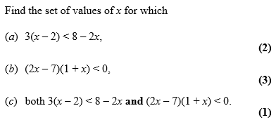
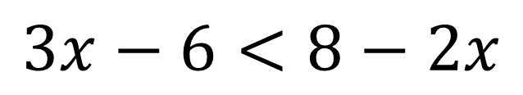
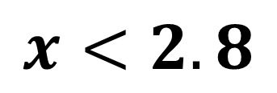
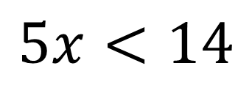
a)
$$3x−6<8−2x$$
$$5x<14$$
$$x<2.8$$

Slide 13
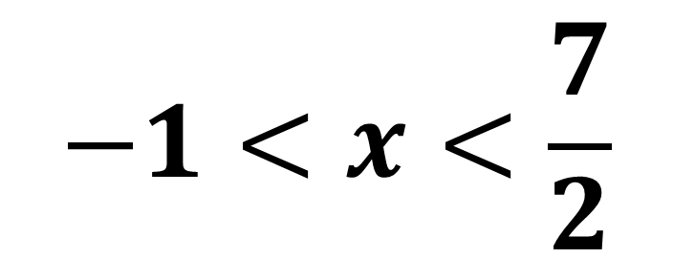
b)
$$−1<x<\frac{7}{2}$$

Slide 14
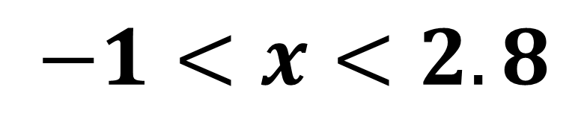
c)
$$−1<x<2.8$$

Slide 15
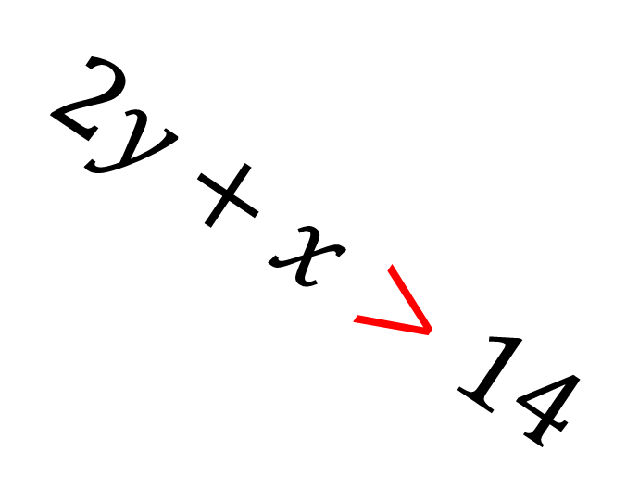
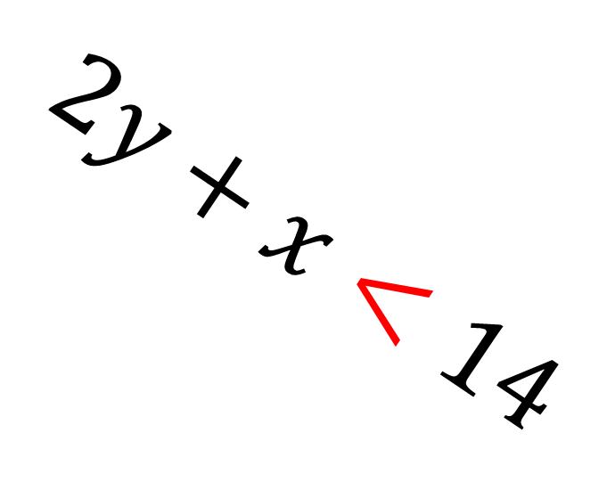
Shading Inequality Regions
$$2y+x<14$$
$$2y+x>14$$

Slide 16
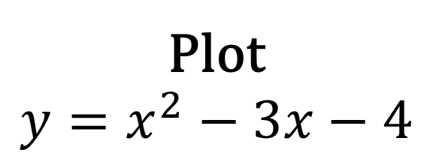
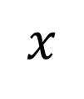
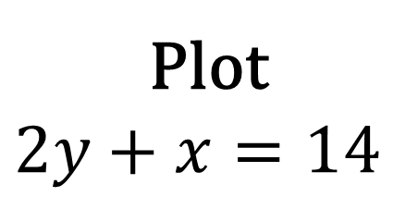
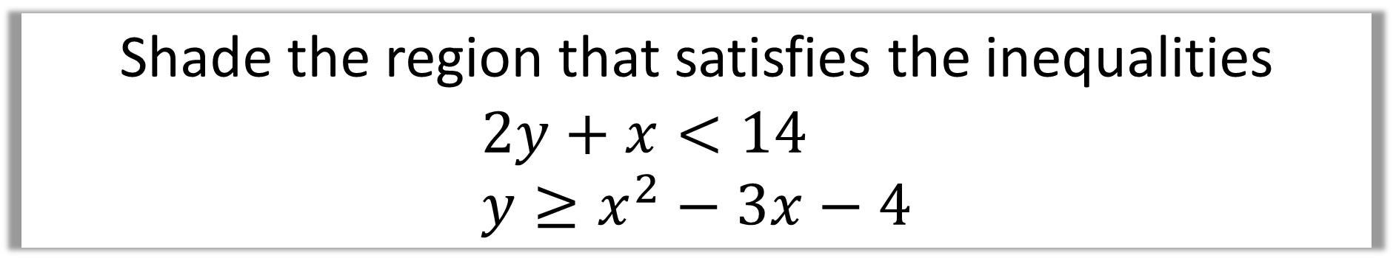


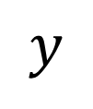
Shade the region that satisfies the inequalities
$$2y+x<14 \\ y≥x^{2}−3x−4$$
$$y$$
Plot
$$y=x^{2}−3x−4$$
Plot
$$2y+x=14$$
$$x$$
$$−1$$
$$4$$
Then shade

