Slide 1
Data Collection
Non-random Sampling
Chapter 1
(Part 2 of 4)

Slide 2
Consider the following scenario:
You wish to conduct a survey in the UK
on whether being left-handed affects IQ.
We need to choose people to assess.
Why would random sampling be problematic?
Because you don’t know
the sampling frame.
i.e. don’t have a list of all left-handed
(and non-left-handed) people in the UK.

Slide 3

Quota Sampling
Set a quota for the number of pieces of data
you want from each strata.
Keep collecting data until you have your quota.

Slide 4
 | Advantages | Disadvantages
Quota Sampling | Small sample can be representative of population | Bias can be introduced
 | Quick and Easy | Population need to be divided into groups
 | Inexpensive | Non-responses are not recorded

Slide 5

Opportunity Sampling
Opportunity sampling is where
you find people at the time of the survey
is being carried out
e.g. exit polls at polling stations.

Slide 6
 | Advantages | Disadvantages
Opportunity Sampling | Easy to carry out | Sample not likely to represent the population
 | Inexpensive | Highly dependent on the researcher.

Slide 7
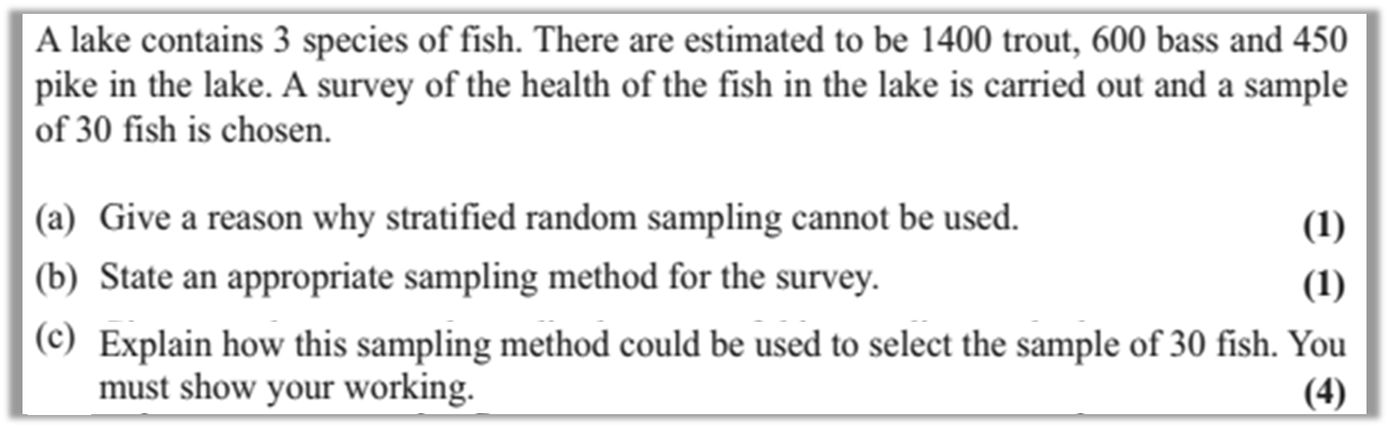
a) Sampling frame within each species of fish in the lake impossible to obtain.
b) Quota Sampling

Slide 8
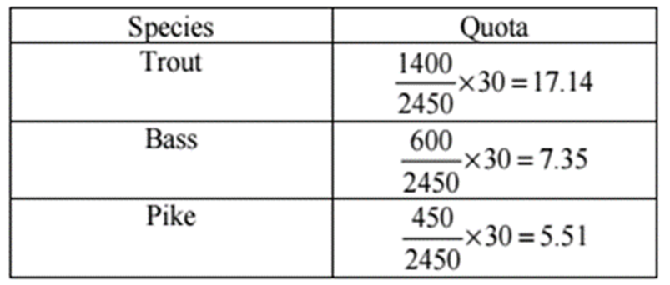
c)
Fish are caught until the quota of 17 trout, 7 Bass and 6 pike are reached. If a fish is caught and the quota is full then ignore.

Slide 9
Which Sampling Method?
“You wish to test lightbulbs produced
by a factory in a daily batch.”
Probably systematic sampling, as the method of choosing items is simpler than simple random sampling (where it would be time-consuming to find specifically chosen random light bulbs).
Sampling frame is known.

Slide 10
Which Sampling Method?
“You wish to survey consumers opinion on your new drink FizzGuzz released in the UK.”
Quota sampling or opportunity sampling.
We’d realistically do not have access to the sampling frame (i.e. a list of all UK residents).

Slide 11
Which Sampling Method?
“You wish to determine students’ favourite TV programmes in your school, that is fairly representative of each year group.”
Stratified sampling. You (probably) have access to the sampling frame (i.e. a list of all students). Stratified sampling ensures that each strata
(year group) is proportionately represented.

