Slide 1
FM: Simultaneous Equations
(Both Linear)

Slide 2
When solving simultaneous equations,
when both are linear equations,
then you have two options to be able to solve them.
Solving by Elimination
Solving by Substitution

Slide 3
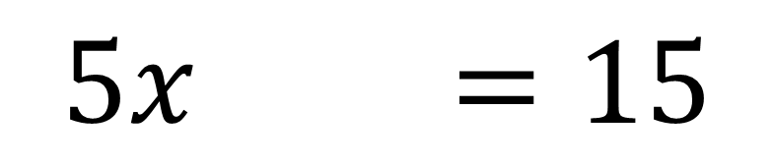
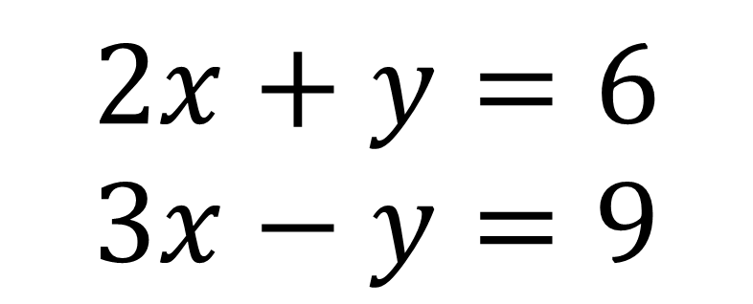
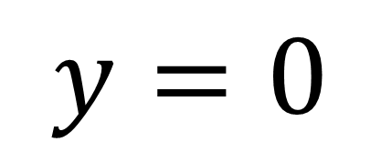
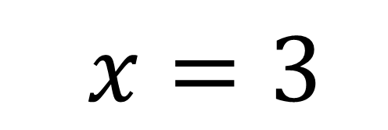
Solving by Elimination
$$2x+y=6 \\ 3x−y=9$$
1
2
$$5x =15$$
1
+
2
$$x=3$$
$$y=0$$

Slide 4
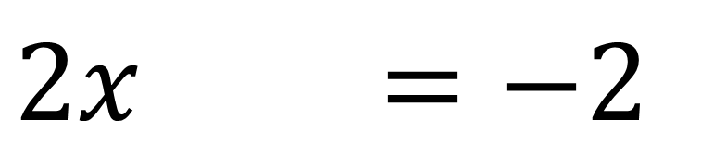
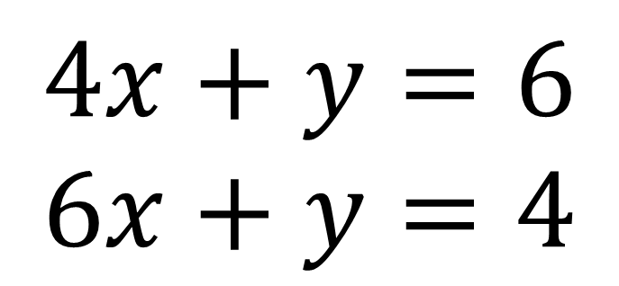

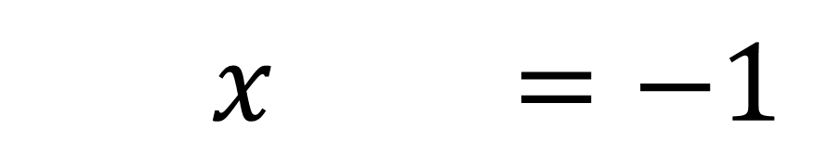
Solving by Elimination
$$4x+y=6 \\ 6x+y=4$$
1
2
$$2x =−2$$
-
2
1
$$x =−1$$
$$y =10$$

Slide 5
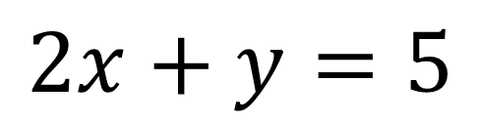
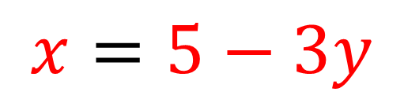
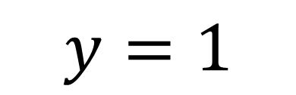
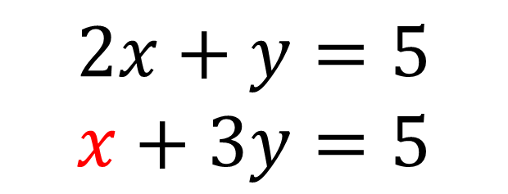


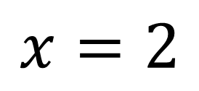

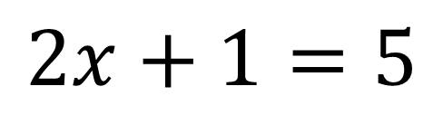
Solving by Substitution
$$2x+y=5$$
$$x+3y=5$$
$$x=5−3y$$
$$2(5−3y)+y=5$$
$$2x+y=5$$
$$10−6y+y=5$$
$$2x+1=5$$
$$10−5y=5$$
$$x=2$$
$$y=1$$

Slide 6

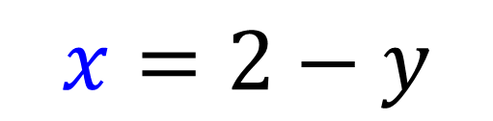
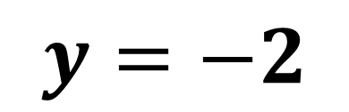
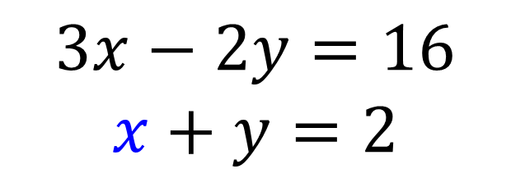


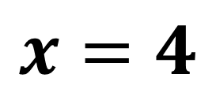


Solving by Substitution
$$3x−2y=16$$
$$x+y=2$$
$$x=2−y$$
$$3(2−y)−2y=16$$
$$x+y=2$$
$$6−3y−2y=16$$
$$x−2=2$$
$$6−5y=16$$
$$x=4$$
$$y=−2$$

