Slide 1

Intermediate Challenge 2
BRONZE

Slide 2
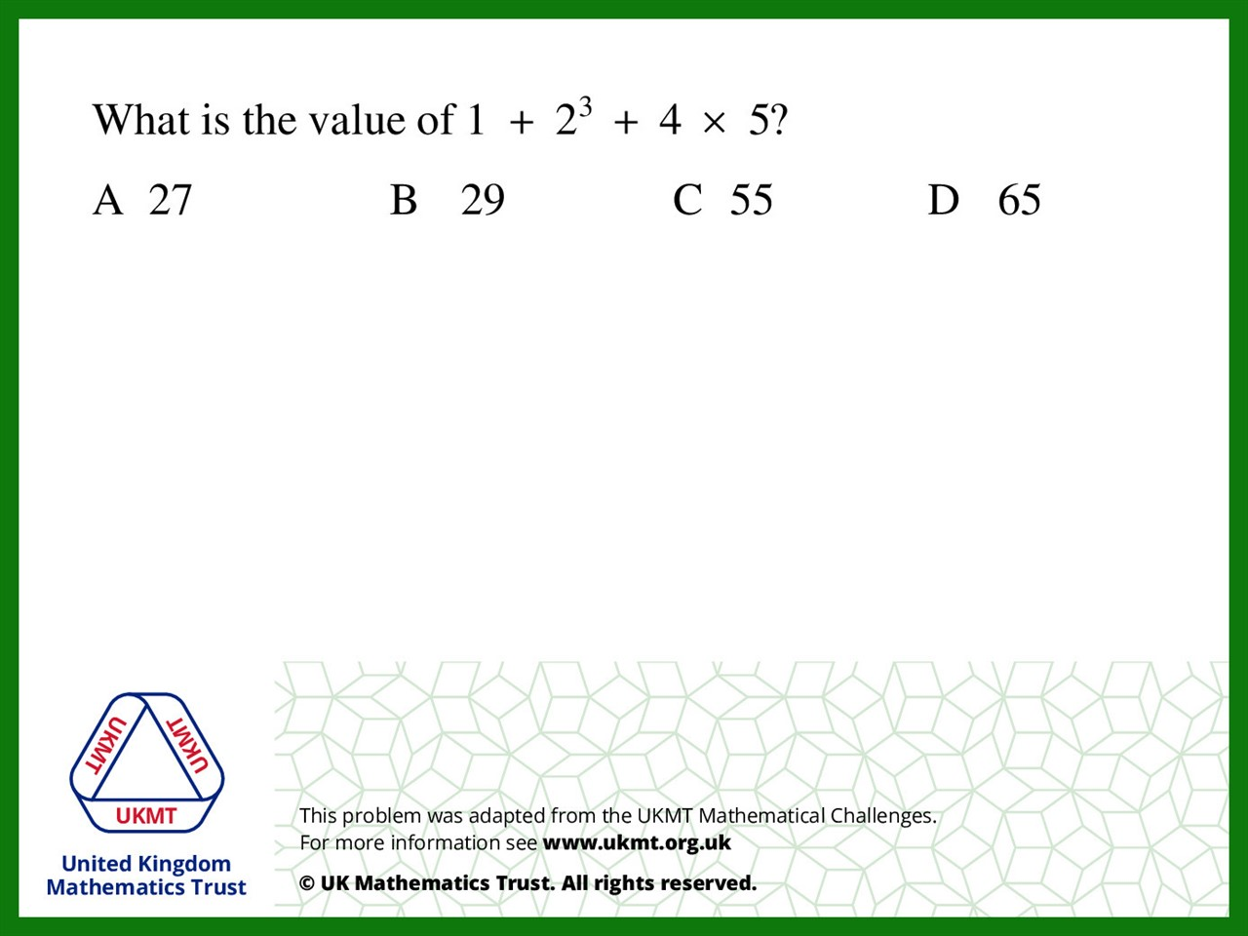
Q1.
2 x 2 x 2 = 8
4 x 5 = 20
1 + 8 = 9
9 + 20 = 29

Slide 3
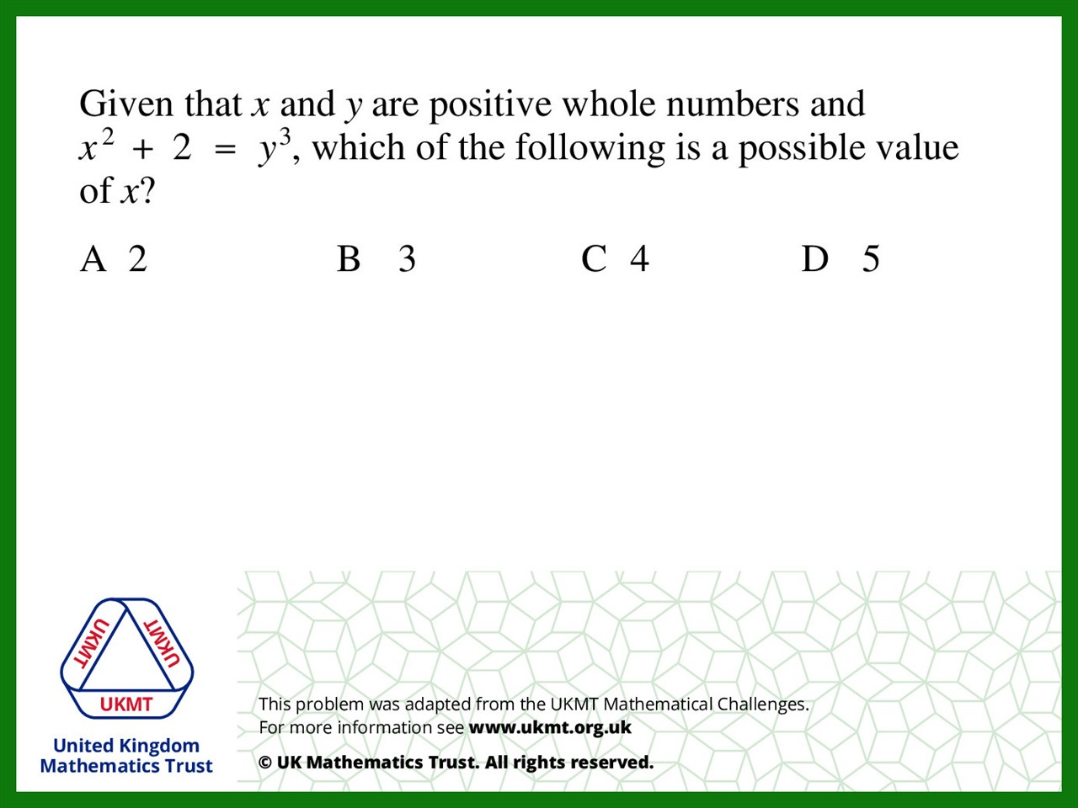
Q2.
because 5 x 5 + 2 = 27 and
27 is a cubed number

Slide 4
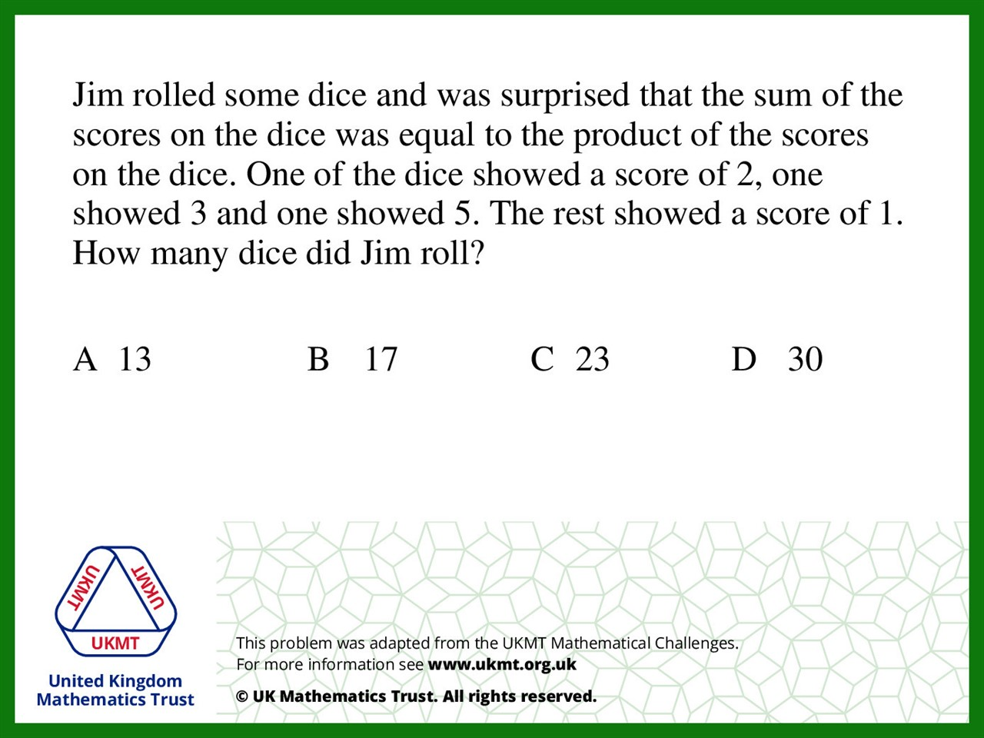
Q3.
2 x 5 x 3 = 30 so the product has to be 30,
2 + 3 + 5 = 10 so there has to be 20 more rolls of 1 to make 30
so added onto the 3 rolls he did already, he rolled 23 dice.

Slide 5
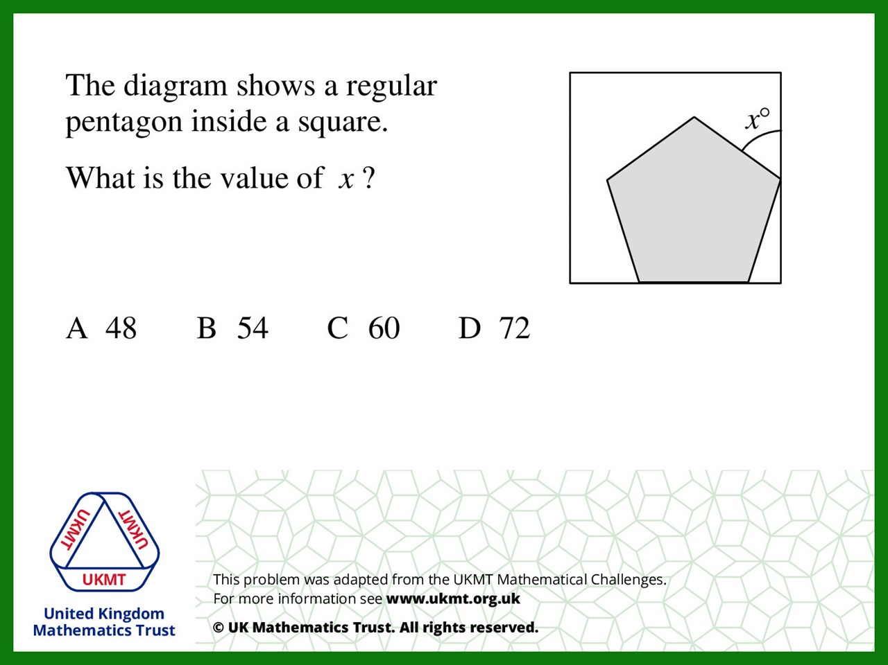
Q4.
Pentagon interior angle is 108 degrees
Angles on a straight line are 180 degrees
so one angle of the both right triangle is 72, another is 90
so the other must be 18.
18 + 108 + x = 180 so x is 54

Slide 6
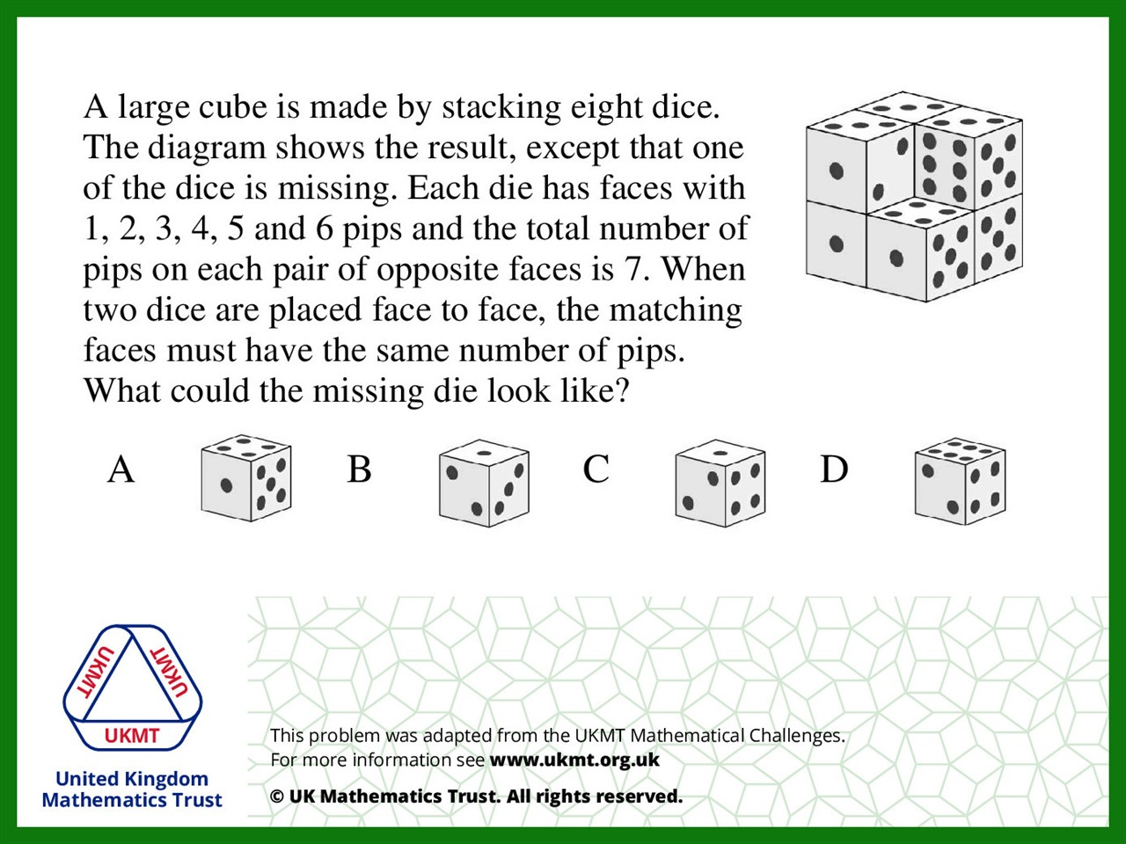
Q5.
Front = 1 Back = 7 – 1 = 6
Bottom = 4 Top = 7 – 4 = 3
Left Side = 2 Right Side = 7 – 2 = 5

