Slide 1
Sequences and Series
Geometric Sequences
Chapter 3
(Part 3 of 8)

Slide 2


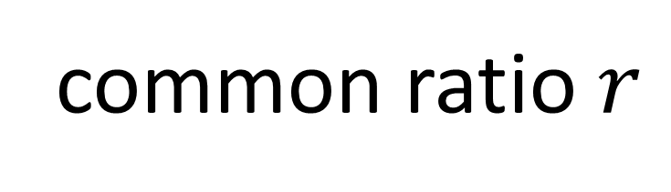

Geometric Sequences
common ratio $r$
$$×2$$
$$×2$$
$$×2$$
3, 6, 12, 24, 48, …
A geometric sequence is one in which there is
a common ratio (multiplier) between terms.

Slide 3
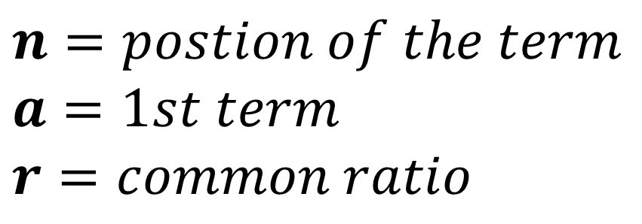
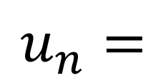
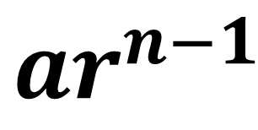
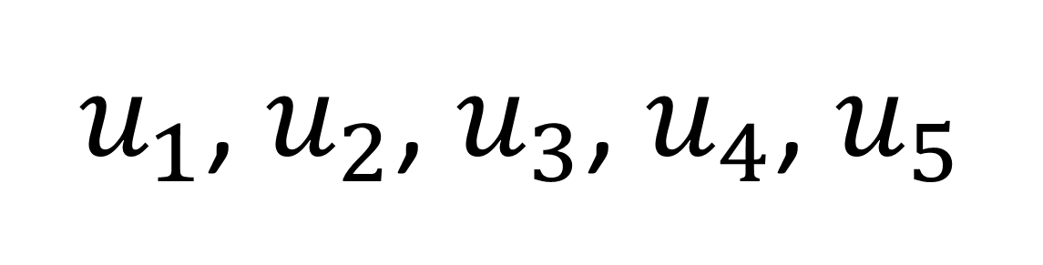

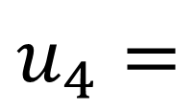
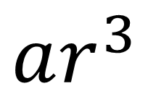
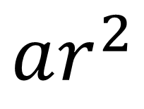

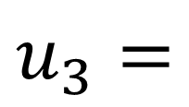

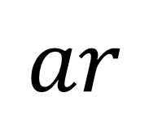
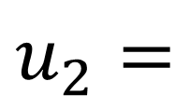

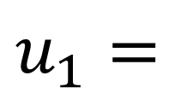
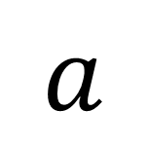
$$n=postion of the term$$
$$a=1st term$$
$$r=common ratio$$
$$×r$$
$$×r$$
$$×r$$
$$×r$$
$u_{1}$, $u_{2}$, $u_{3}$, $u_{4}$, $u_{5}$
$$u_{1}=$$
$$a$$
$$ar$$
$$u_{2}=$$
$$u_{3}=$$
$$ar^{2}$$
$$u_{4}=$$
$$ar^{3}$$
$$u_{n}=$$
$$ar^{n−1}$$

Slide 4
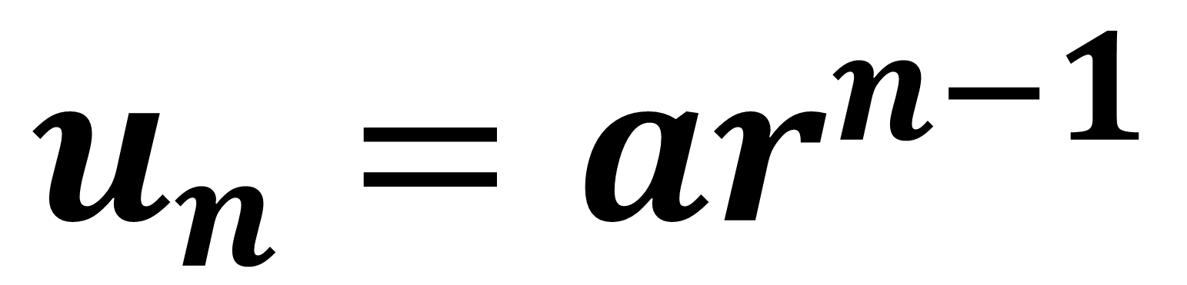

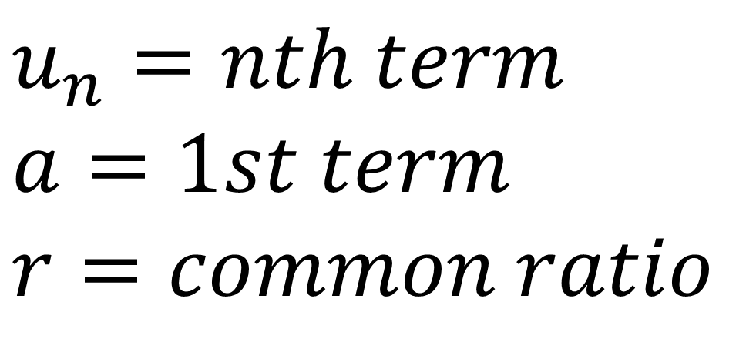
Geometric Sequences $n$^{th} term
$$u_{n}=ar^{n−1}$$
$$u_{n}=nth term$$
$$a=1st term$$
$$r=common ratio$$

Slide 5
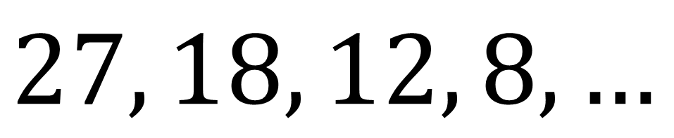

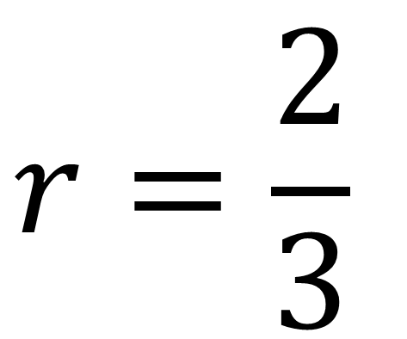
$$27, 18, 12, 8, …$$
What is the common ratio $r?$
$$r=\frac{2}{3}$$

Slide 6
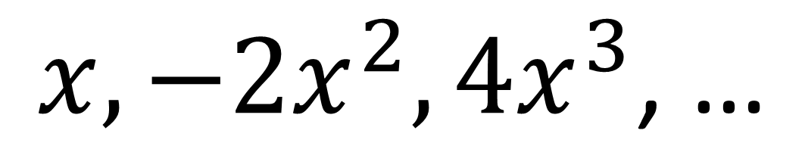
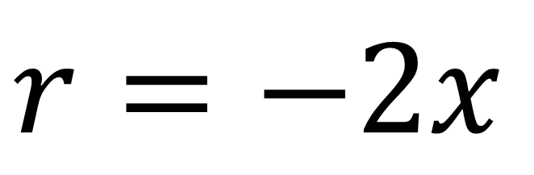
$$x, −2x^{2}, 4x^{3}\text{, …}$$
What is the common ratio $r?$
$$r=−2x$$

Slide 7
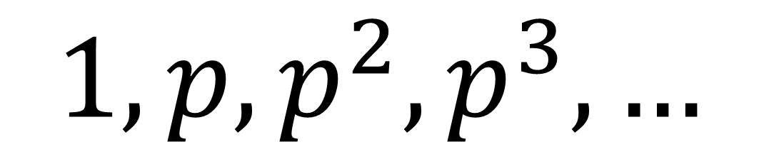
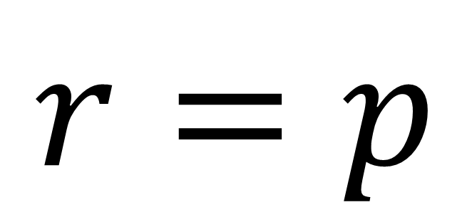
$$1, p, p^{2}, p^{3}, …$$
What is the common ratio $r?$
$$r=p$$

Slide 8
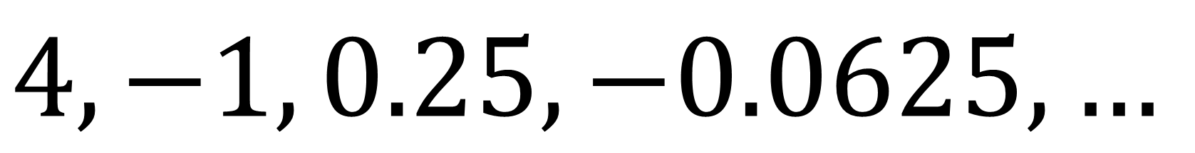
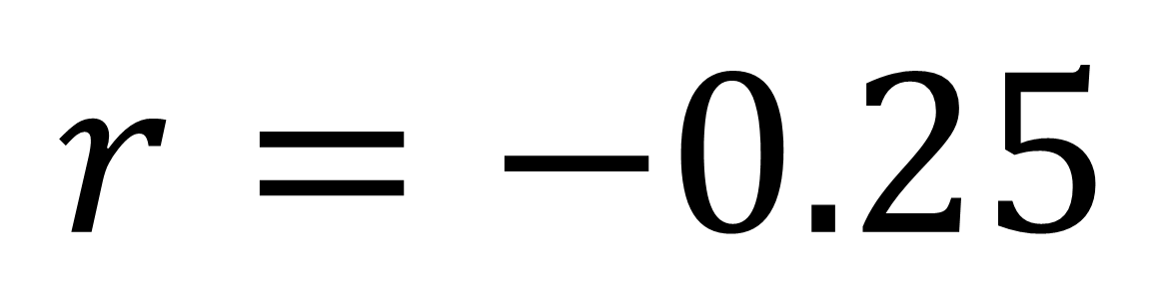
$$4, −1, 0.25, −0.0625, …$$
What is the common ratio $r?$
$$r=−0.25$$

Slide 9
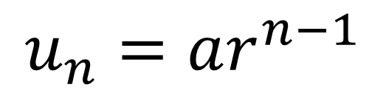
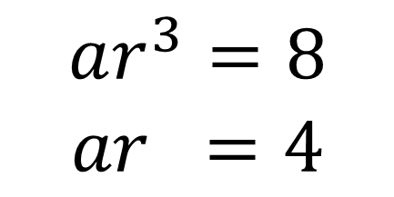
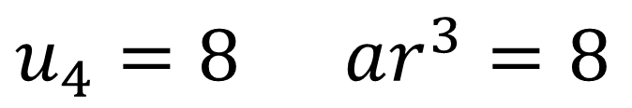
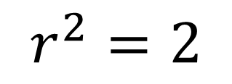
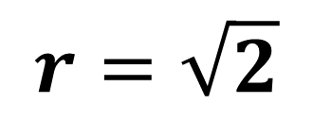
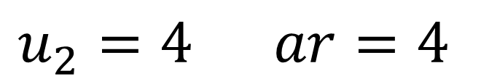
The second term of a geometric sequence is 4 and the 4th term is 8. The common ratio is positive. Find the exact values of:
The common ratio.
The first term.
The 10th term.
a)
$$u_{n}=ar^{n−1}$$
$$ar^{3}=8$$
$$ar =4$$
$$u_{2}=4 ar=4$$
$$r^{2}=2$$
$$u_{4}=8 ar^{3}=8$$
$$r=\sqrt{2}$$

Slide 10
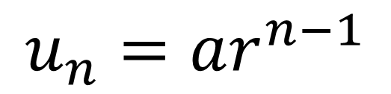
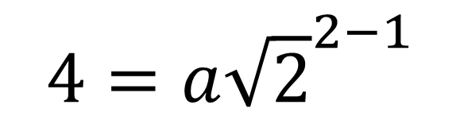
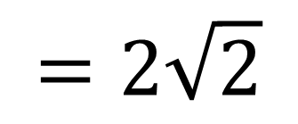
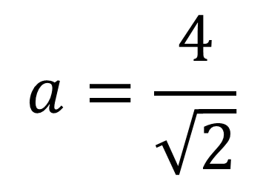
The second term of a geometric sequence is 4 and the 4th term is 8. The common ratio is positive. Find the exact values of:
The common ratio.
The first term.
The 10th term.
$$u_{n}=ar^{n−1}$$
b)
$$4=a{\sqrt{2}}^{2−1}$$
$$a=\frac{4}{\sqrt{2}}$$
$$=2\sqrt{2}$$

Slide 11
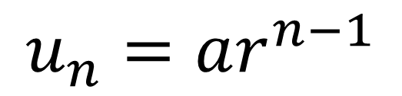
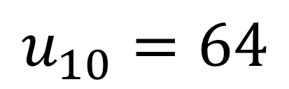
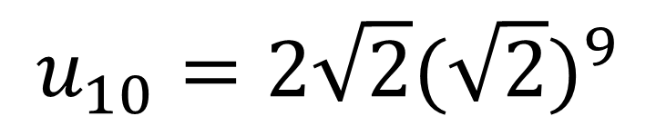
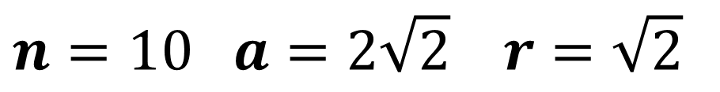
The second term of a geometric sequence is 4 and the 4th term is 8. The common ratio is positive. Find the exact values of:
The common ratio.
The first term.
The 10th term.
$$n=10 a=2\sqrt{2} r=\sqrt{2}$$
c)
$$u_{n}=ar^{n−1}$$
$$u_{10}=2\sqrt{2}{(\sqrt{2})}^{9}$$
$$u_{10}=64$$

Slide 12
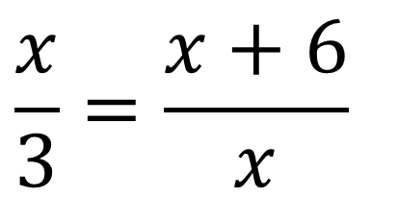
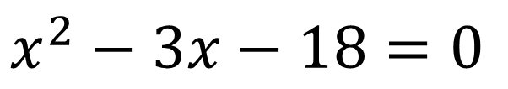
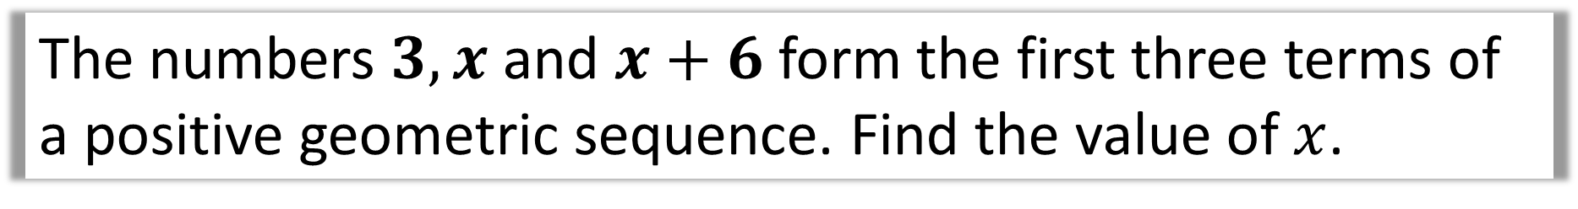
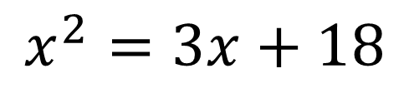
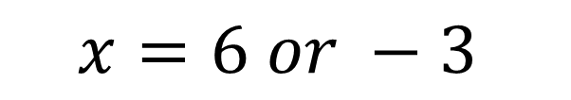
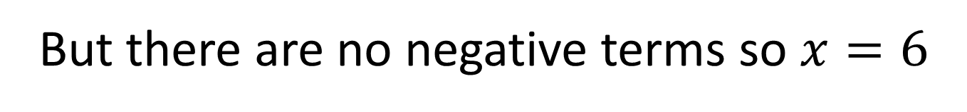
The numbers $3, x$ and $x+6$ form the first three terms of a positive geometric sequence. Find the value of $x$.
$$\frac{x}{3}=\frac{x+6}{x}$$
$$x^{2}=3x+18$$
$$x^{2}−3x−18=0$$
$$x=6 or −3$$
But there are no negative terms so $x=6$

Slide 13


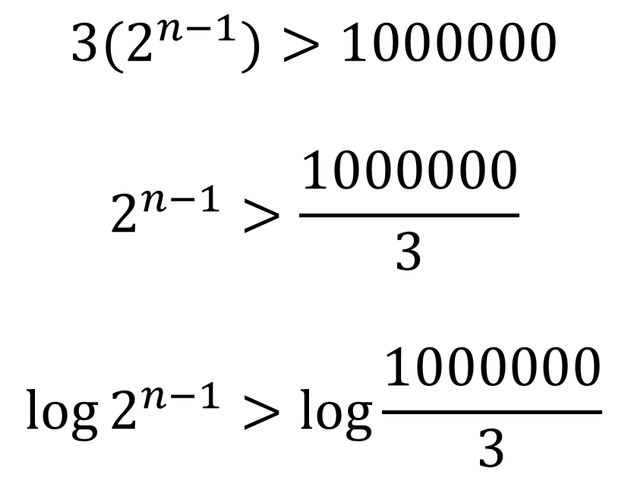

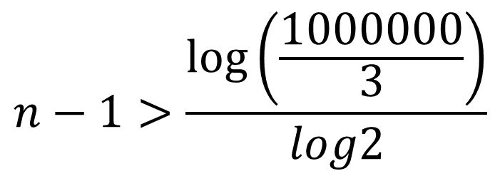
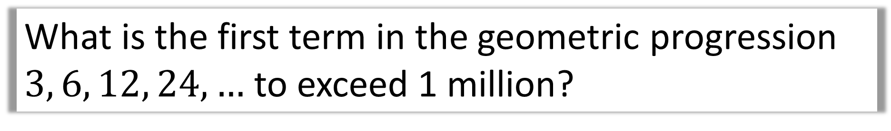
What is the first term in the geometric progression
$3, 6, 12, 24, …$ to exceed 1 million?
$$3(2^{n−1})>1000000$$
$$2^{n−1}>\frac{1000000}{3}$$
$$\log{2^{n−1}>\log{\frac{1000000}{3}}}$$
$$n−1>\frac{\log\left(\frac{1000000}{3}\right)}{log2}$$
$$n−1>18.35$$
$$n>19.35$$
$$n=20$$

Slide 14
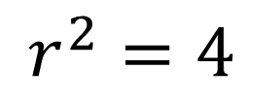
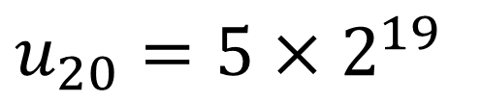
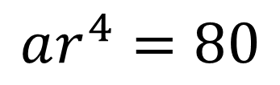
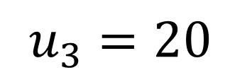






All the terms in a geometric sequence are positive.
The third term of the sequence is 20 and the
fifth term 80. What is the 20th term?
$$u_{5}=80$$
$$ar^{4}=80$$
$$a=\frac{20}{r^{2}}=$$
$$\frac{20}{4}=5$$
$$u_{3}=20$$
$$ar^{2}=20$$
$$r^{2}=4$$
$$u_{20}=5×2^{19}$$
$$r=2$$
$$u_{20}=2621440$$

Slide 15












The second, third and fourth term of a geometric sequence are the following
$$x, x+6, 5x−6$$
a) Determine the possible values of $x$.
b) Given the common ratio is positive, find the common ratio.
c) Hence determine the possible values for the first term of the sequence.
$$\frac{x+6}{x}=\frac{5x−6}{x+6}$$
$$r=\frac{x+6}{x}$$
a)
b)
$${\left(x+6\right)}^{2}=x\left(5x−6\right)$$
$$r=\frac{6+6}{6}=2$$
$$x^{2}+12x+36=5x^{2}−6x$$
$$4x^{2}−18x−36=0$$
c)
$$u_{2}=x=6$$
$$2x^{2}−9x−18=0$$
$$ar=6$$
$$x=−\frac{3}{2} or x=6$$
$$a=\frac{6}{2}=3$$

