Slide 1
Exponentials and Logs
Graphing
Chapter 14
(Part 8 of 9)

Slide 2
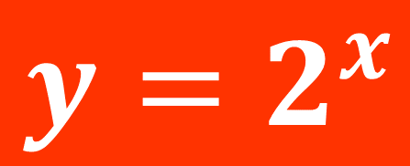
$$y=2^{x}$$
1
Notes:
Get students to sketch axes and tables in their books.

Slide 3
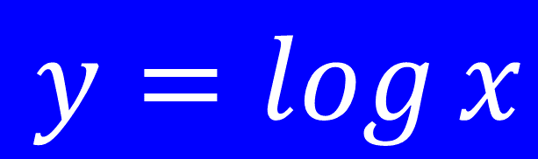
$$y=\log{x}$$
1
Notes:
Get students to sketch axes and tables in their books.

Slide 4
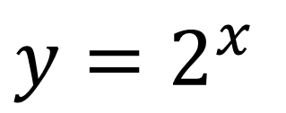
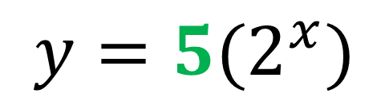
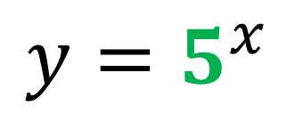
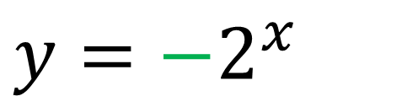
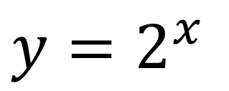
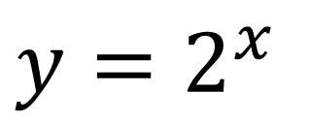
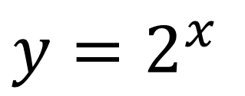
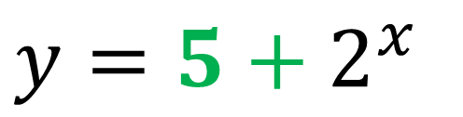
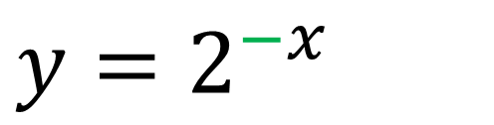
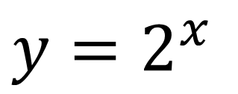
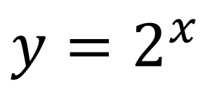
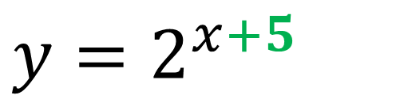
Using Demos Graphing Calculator, plot the following
pairs of graphs and identify the transformation.
A
$y=2^{x}$
and
$$y=5^{x}$$
B
$y=2^{x}$
and
$$y={5(2}^{x})$$
C
$y=2^{x}$
and
$$y=2^{−x}$$
D
$y=2^{x}$
and
$$y={−2}^{x }$$
E
$y=2^{x}$
and
$$y=2^{x+5 }$$
F
$y=2^{x}$
and
$$y={5+2}^{x }$$

Slide 5
f(x) + a | The graph moves up
f(x) – a | The graph moves down
f(x + a) | The graph moves left
f(x – a) | The graph moves right
af(x) | The y-coordinates become (x , ay )
f(ax) | The x-coordinates become ( $\frac{x}{a}$ , y)
–f(x) | The graph is reflected in the x axis
f(–x) | The graph is reflected in the y axis

Slide 6






Increasing the base value has what effect on the graphs?
$$y$$
$$y=3^{x}$$
$$y=2^{x}$$
$$y={1.5}^{x}$$
$$1$$
$$x$$
Increase the base value, increase the gradient

Slide 7



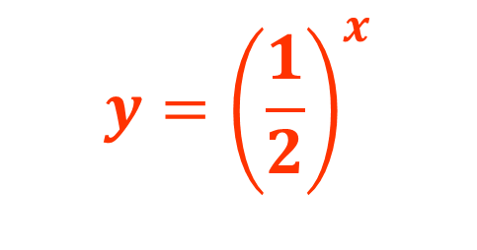
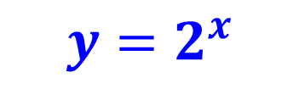
What effect does a fractional base value have
compared to an integer base value?
$$y={\left(\frac{1}{2}\right)}^{x}$$
$$y$$
$$y=2^{x}$$
$$1$$
$$x$$
The graph is reflected in the y axis.

Slide 8






Making the base value a negative has what effect on the graphs?
$$y=3^{−x}$$
$$y$$
$$y=2^{−x}$$
$$y={1.5}^{−x}$$
$$1$$
$$x$$
f(–x) The graph is reflected in the y axis

Slide 9
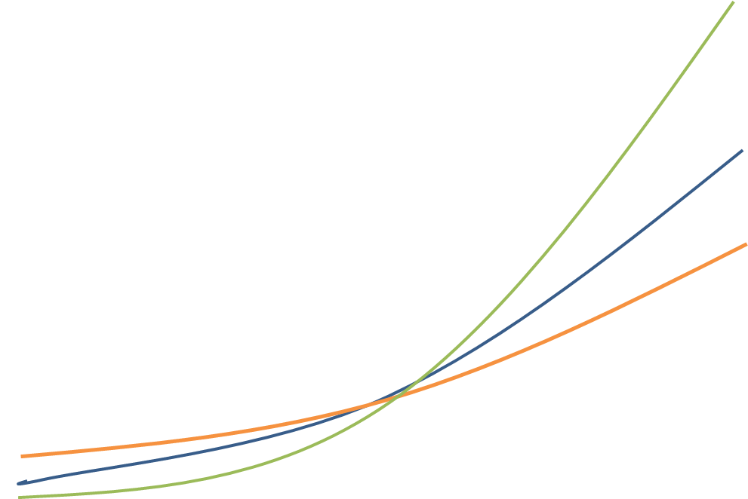






What effect does a negative coefficient have on the graphs?
$$y$$
$$x$$
$$−1$$
$$y=−1{(1.5}^{x})$$
$$y={−1(2}^{x})$$
$$y={−1(3}^{x})$$
–f(x) | The graph is reflected in the x axis

Slide 10


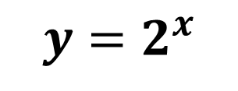
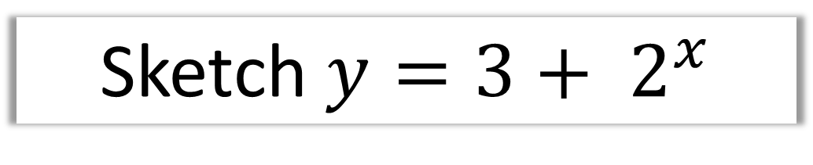

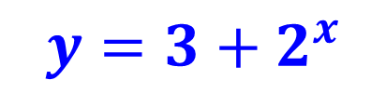
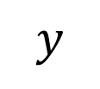
Sketch $y={3+ 2}^{x}$
$$y$$
$$y={3+2}^{x}$$
$$y=2^{x}$$
$$4$$
$$1$$
$$x$$
f(x) + 3 translation up by 3

Slide 11
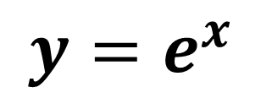
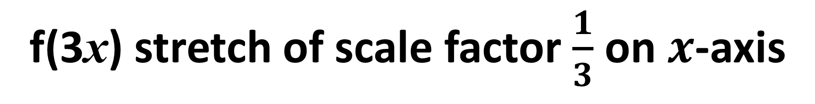
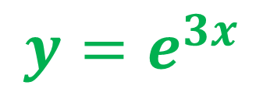
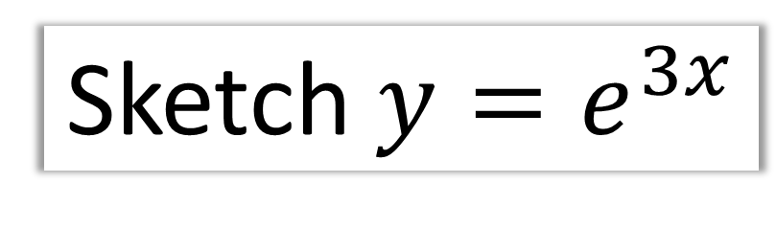



Sketch $y=e^{3x}$
$$y$$
$$y=e^{3x}$$
$$y=e^{x}$$
$$1$$
$$x$$
f(3x) stretch of scale factor $\frac{1}{3}$ on $x$-axis

Slide 12


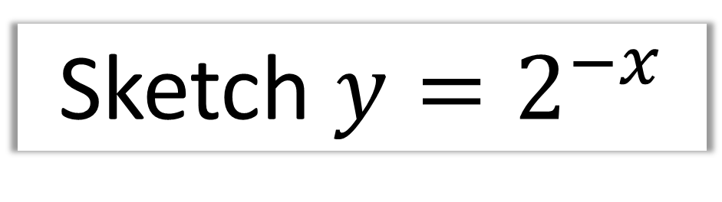
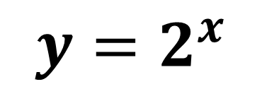
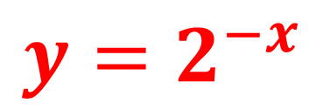

Sketch $y=2^{−x}$
$$y$$
$$y=2^{−x}$$
$$y=2^{x}$$
$$1$$
$$x$$
f(–x) | The graph is reflected in the y axis

Slide 13


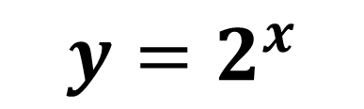
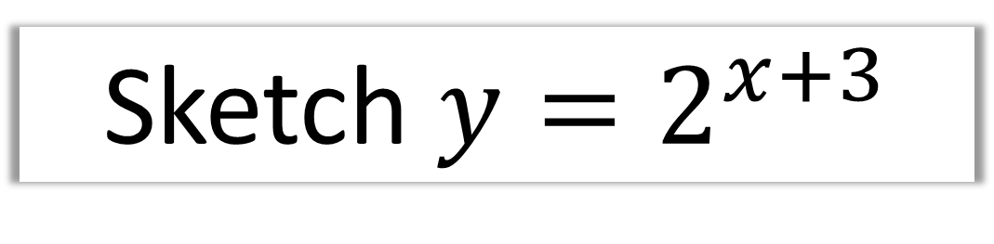

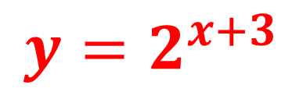

Sketch $y=2^{x+3}$
$$y$$
$$y=2^{x+3}$$
$$y=2^{x}$$
$$8$$
$$1$$
$$x$$
f(x + 3) translation to the left by 3

Slide 14

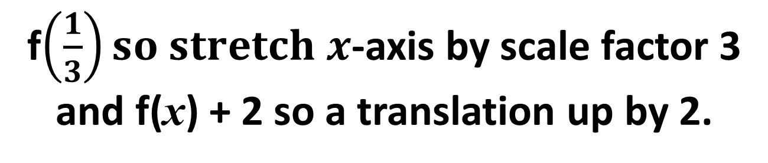
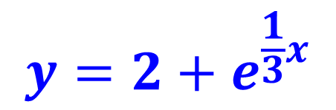
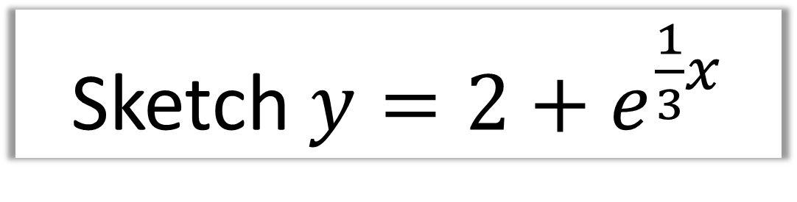


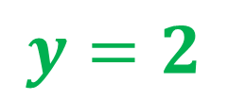


Sketch $y=2+e^{\frac{1}{3}x}$
$$y$$
$$y=e^{x}$$
$$y=2+e^{\frac{1}{3}x}$$
$$3$$
$$y=2$$
$$1$$
$$x$$
f$\left(\frac{1}{3}\right)so stretch x$-axis by scale factor 3
and f(x) + 2 so a translation up by 2.

Slide 15
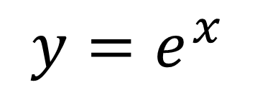

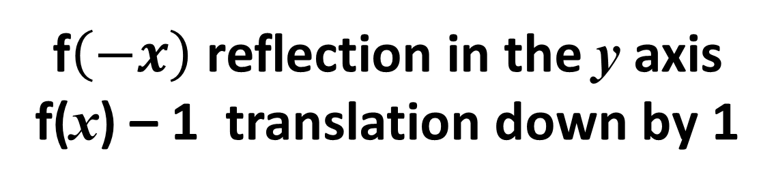
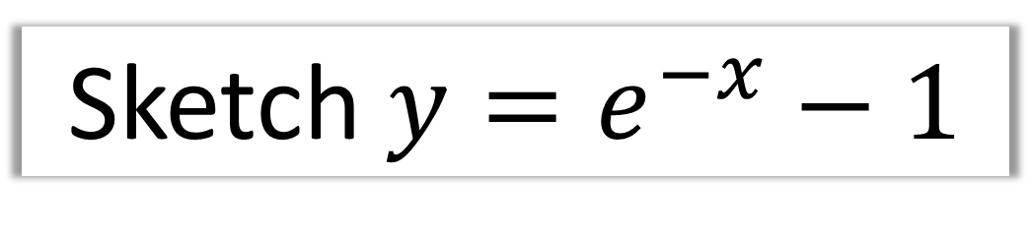

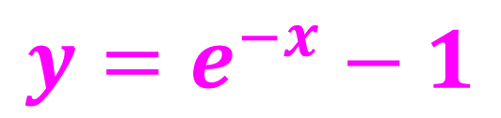

Sketch $y=e^{−x}−1$
$$y$$
$$y=e^{−x}−1$$
$$y=e^{x}$$
$$x$$
$$y=−1$$
f$\left(−x\right)$ reflection in the y axis
f(x) – 1 translation down by 1

Slide 16
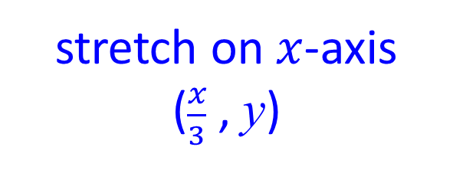

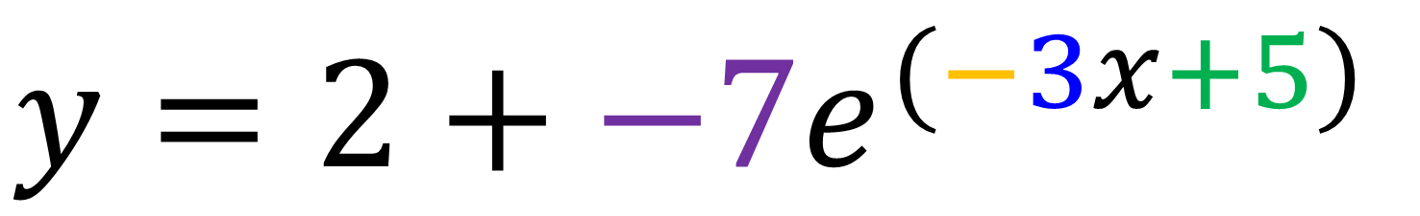
$$y=2+{−7e}^{(−3x+5)}$$
up and down
Reflection
in y axis
left and right
Negative coefficient
reflection on the x axis
stretch on $x$-axis
($\frac{x}{3}$ , y)
stretch on $y$-axis
(x ,-7y)

