Slide 1
Algebraic Methods
Partial Fractions
Chapter 1
(Part 3 of 4)

Slide 2
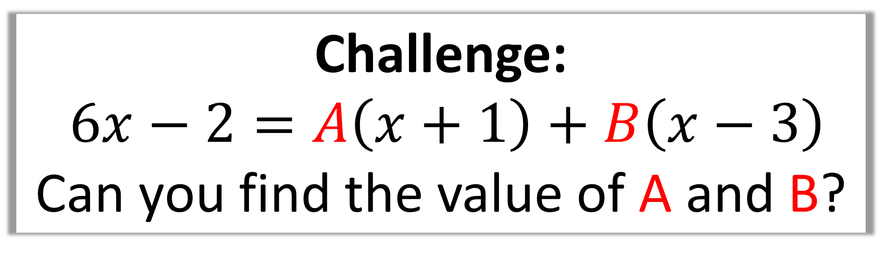
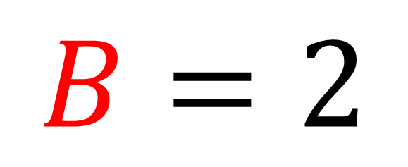
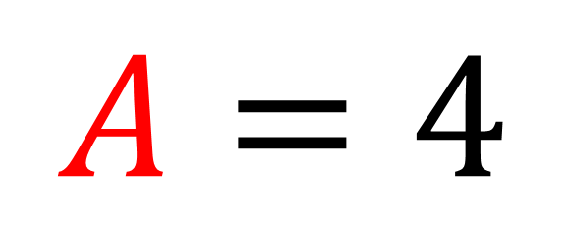
Challenge:
$6x−2=A\left(x+1\right)+B\left(x−3\right)$
Can you find the value of A and B?
$$A=4$$
$$B=2$$

Slide 3
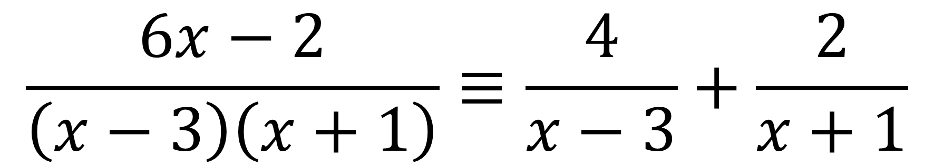
The method of taking a fraction
and spiting it into multiple fractions
is known as ‘Partial Fraction Decomposition’.
$$\frac{6x−2}{\left(x−3\right)\left(x+1\right)}≡\frac{4}{x−3}+\frac{2}{x+1}$$

Slide 4
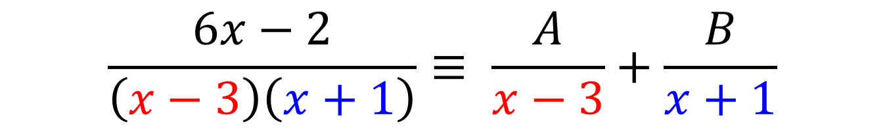
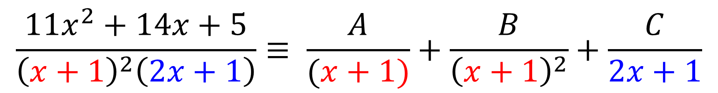
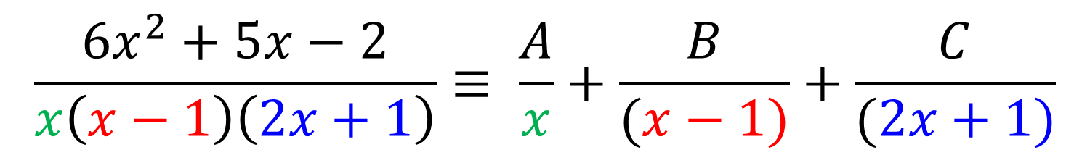
There are 3 main types of questions you could be asked.
$$\frac{6x−2}{\left(x−3\right)\left(x+1\right)}≡ \frac{A}{x−3}+\frac{B}{x+1}$$
$$\frac{6x^{2}+5x−2}{x\left(x−1\right)\left(2x+1\right)}≡ \frac{A}{x}+\frac{B}{(x−1)}+\frac{C}{(2x+1)}$$
$$\frac{11x^{2}+14x+5}{{\left(x+1\right)}^{2}\left(2x+1\right)}≡ \frac{A}{(x+1)}+\frac{B}{{\left(x+1\right)}^{2}}+\frac{C}{2x+1}$$

Slide 5
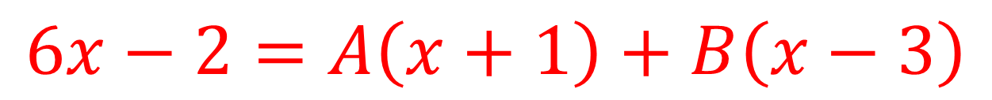
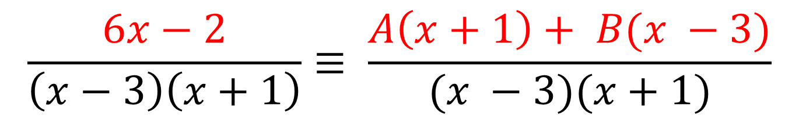
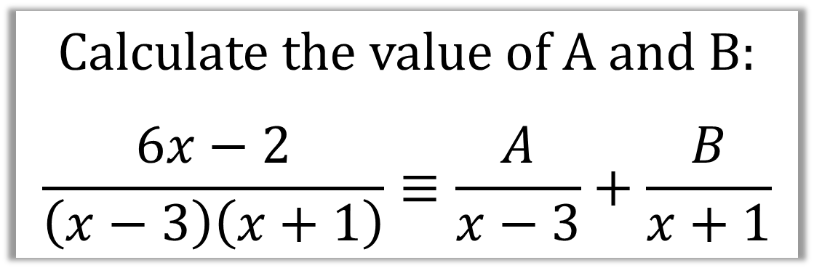
Calculate the value of A and B:
$$\frac{6x−2}{\left(x−3\right)\left(x+1\right)}≡\frac{A}{x−3}+\frac{B}{x+1}$$
Step 1: Turn the partial fractions back into a single fraction
$$\frac{6x−2}{\left(x−3\right)\left(x+1\right)}≡ \frac{A\left(x+1\right)+ B(x −3)}{(x −3)(x+1)}$$
Step 2: Make the numerators equal to each other
$$6x−2=A\left(x+1\right)+B\left(x−3\right)$$

Slide 6
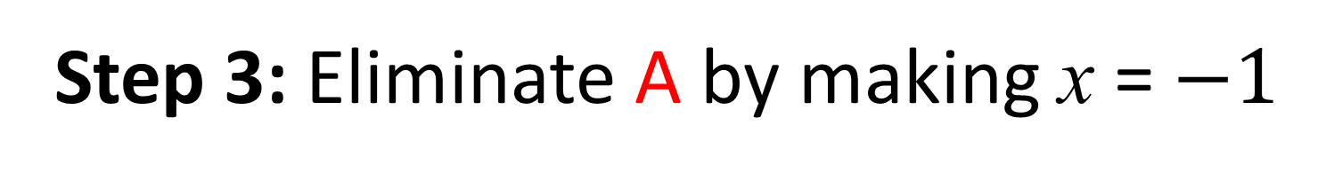
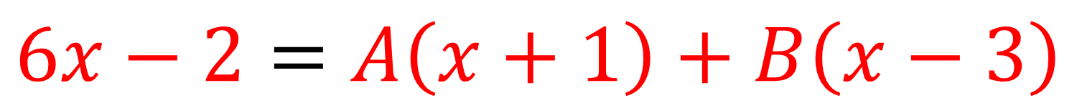
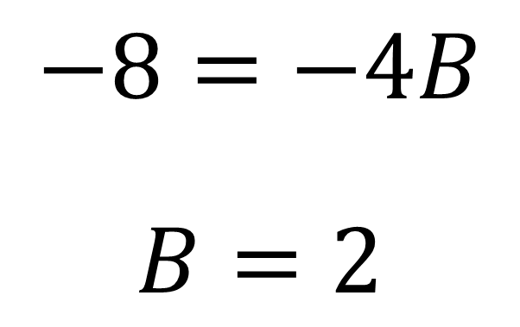
$$6x−2=A\left(x+1\right)+B\left(x−3\right)$$
Step 3: Eliminate A by making x = $−1$
$$6(−1)−2=A\left(−1+1\right)+B\left(−1−3\right)$$
$$−8=−4B$$
$$B=2$$

Slide 7
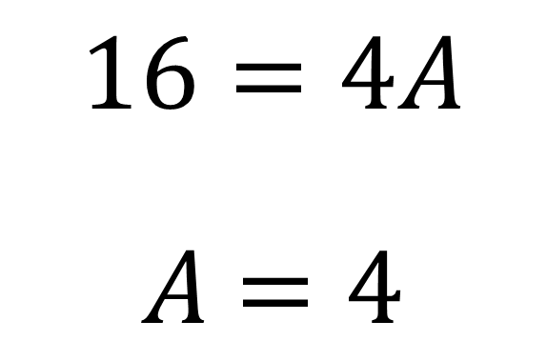
$$6x−2=A\left(x+1\right)+B\left(x−3\right)$$
Step 4: Eliminate B by making x = 3
$$6(3)−2=A\left(3+1\right)+B\left(3−3\right)$$
$$16=4A$$
$A$ $=4$

Slide 8
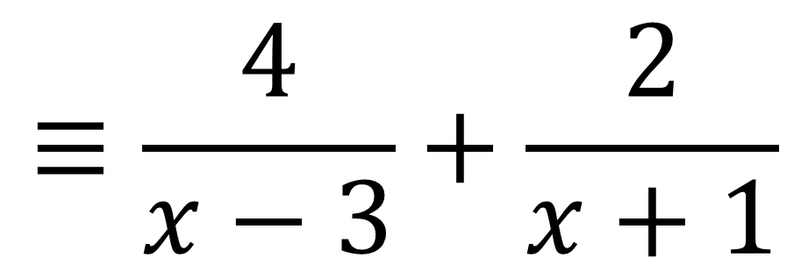
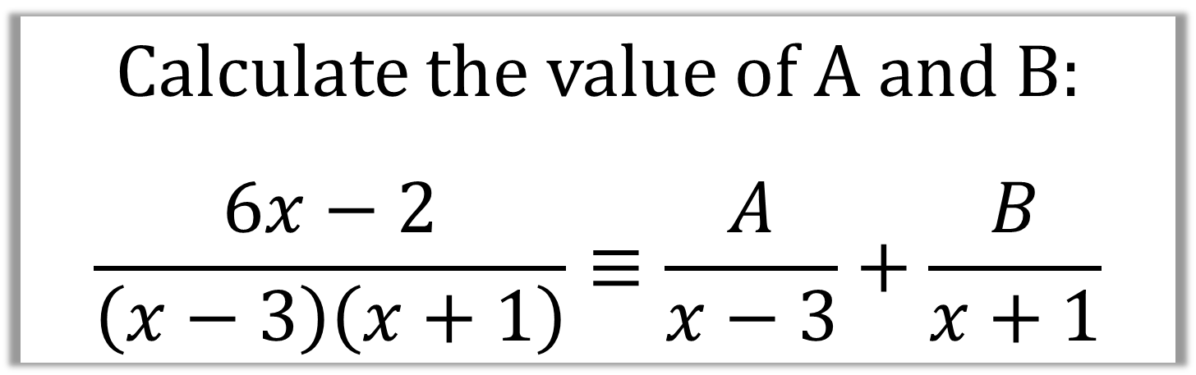
Calculate the value of A and B:
$$\frac{6x−2}{\left(x−3\right)\left(x+1\right)}≡\frac{A}{x−3}+\frac{B}{x+1}$$
$$≡\frac{4}{x−3}+\frac{2}{x+1}$$

Slide 9


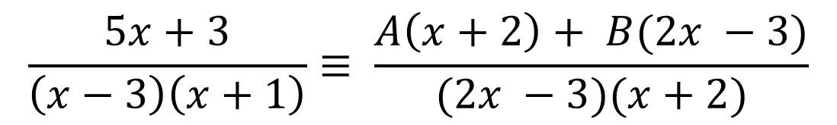
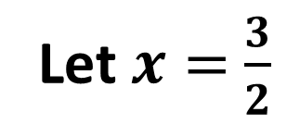
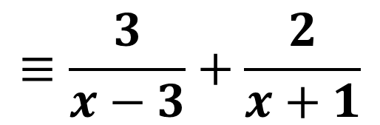

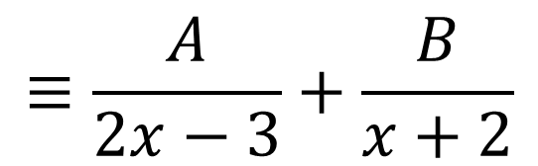
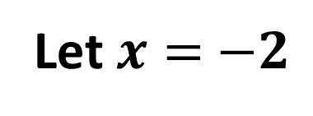


$$≡\frac{A}{2x−3}+\frac{B}{x+2}$$
$$≡\frac{3}{x−3}+\frac{2}{x+1}$$
$$\frac{5x+3}{\left(x−3\right)\left(x+1\right)}≡ \frac{A\left(x+2\right)+ B(2x −3)}{(2x −3)(x+2)}$$
$$5x+3=A\left(x+2\right)+B\left(2x−3\right)$$
Let $x=$ $−2$
Let $x=$ $\frac{3}{2}$
$$−7=B\left(−7\right)$$
$$10.5=A(3.5)$$
$$B=1$$
$$A=3$$

Slide 10
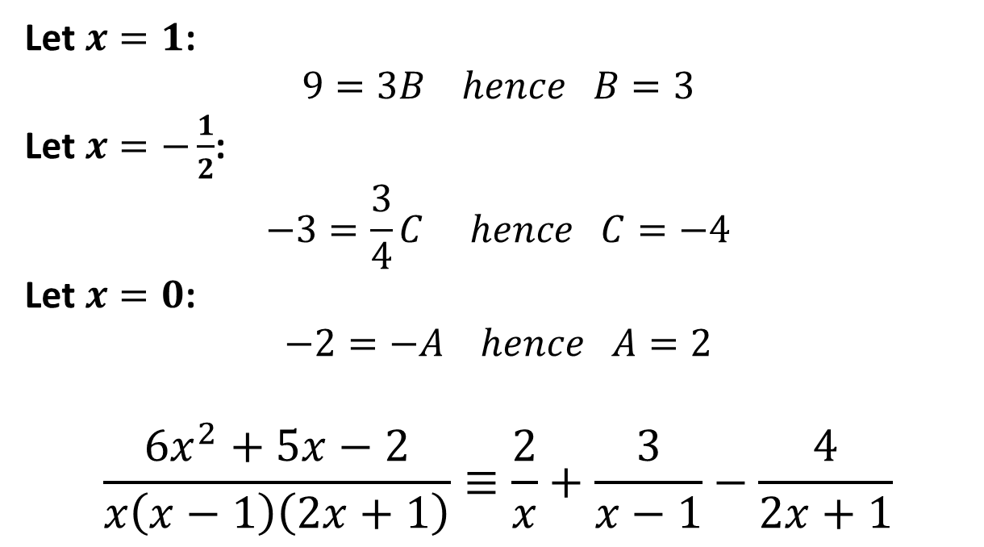
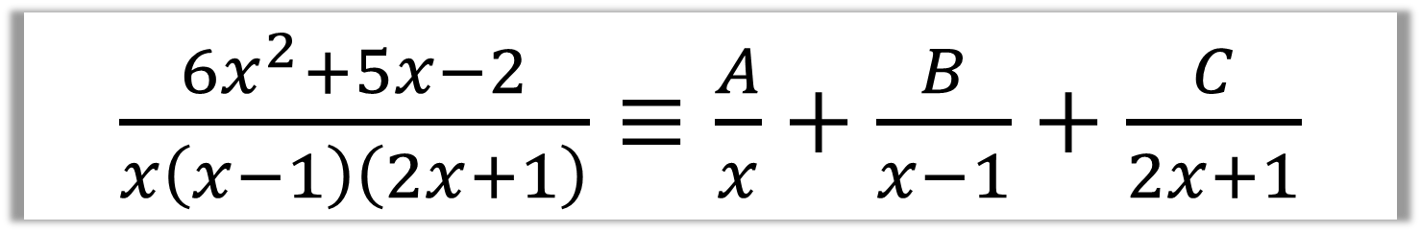
$\frac{6x^{2}+5x−2}{x\left(x−1\right)\left(2x+1\right)}≡\frac{A}{x}+\frac{B}{x−1}+\frac{C}{2x+1}$
$$6x^{2}+5x−2=A\left(x−1\right)\left(2x+1\right)+Bx\left(2x+1\right)+Cx\left(x−1\right)$$
Let $x=1$:
$$9=3B hence B=3$$
Let $x=−\frac{1}{2}$:
$$−3=\frac{3}{4}C hence C=−4$$
Let $x=0$:
$$−2=−A hence A=2$$
$$\frac{6x^{2}+5x−2}{x\left(x−1\right)\left(2x+1\right)}≡\frac{2}{x}+\frac{3}{x−1}−\frac{4}{2x+1}$$

Slide 11
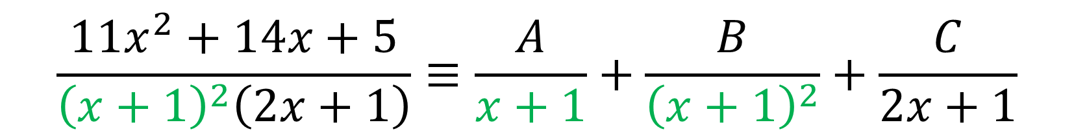
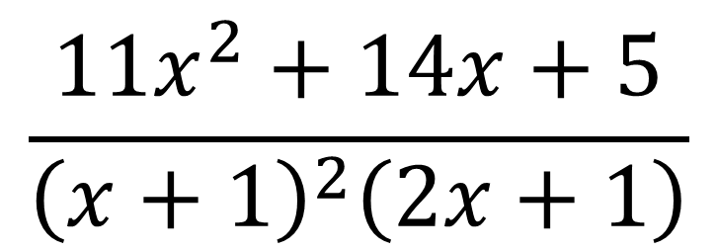
Repeated Factors
$$\frac{11x^{2}+14x+5}{{\left(x+1\right)}^{2}\left(2x+1\right)}$$
Repeated factors
$$\frac{11x^{2}+14x+5}{{\left(x+1\right)}^{2}\left(2x+1\right)}≡\frac{A}{x+1}+\frac{B}{{\left(x+1\right)}^{2}}+\frac{C}{2x+1}$$

Slide 12

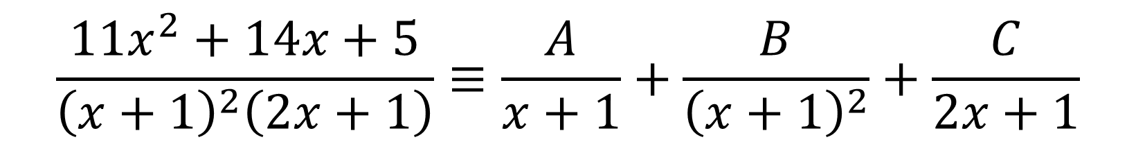
Split $\frac{11x^{2}+14x+5}{{\left(x+1\right)}^{2}\left(2x+1\right)}$ into partial fractions.
$$\frac{11x^{2}+14x+5}{{\left(x+1\right)}^{2}\left(2x+1\right)}≡\frac{A}{x+1}+\frac{B}{{\left(x+1\right)}^{2}}+\frac{C}{2x+1}$$
$$11x^{2}+14x+5 = A\left(x+1\right)\left(2x+1\right)+B\left(2x+1\right)+C{\left(x+1\right)}^{2}$$

Slide 13
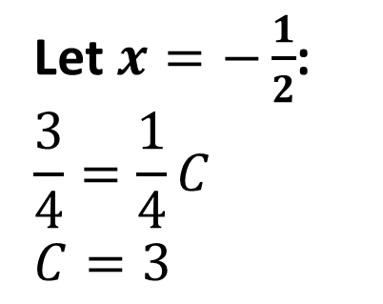
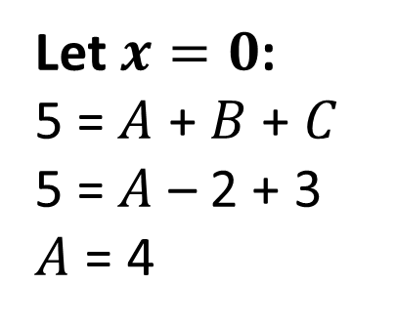
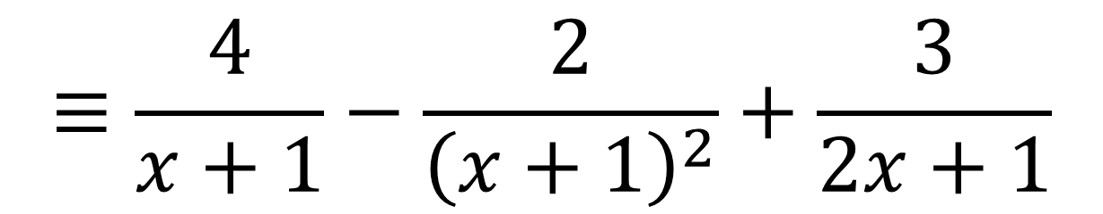
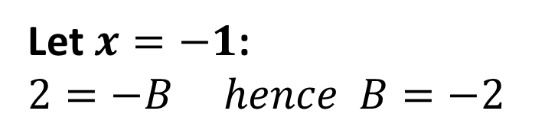
$$11x^{2}+14x+5≡A\left(x+1\right)\left(2x+1\right)+B\left(2x+1\right)+C{\left(x+1\right)}^{2}$$
Let $x=−1$:
$$2=−B hence B=−2$$
Let $x=−\frac{1}{2}$:
$$\frac{3}{4}=\frac{1}{4}C$$
$$C=3$$
Let $x=0$:
5 = $A$ + $B$ + $C$
5 = $A$ – 2 + 3
$A$ = 4
$$≡\frac{4}{x+1}−\frac{2}{{\left(x+1\right)}^{2}}+\frac{3}{2x+1}$$

Slide 14
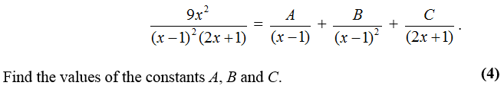
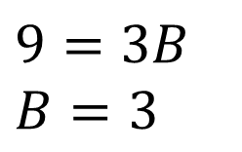
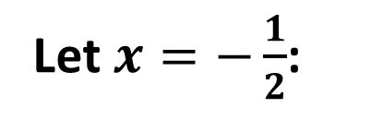
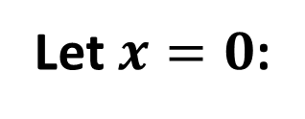
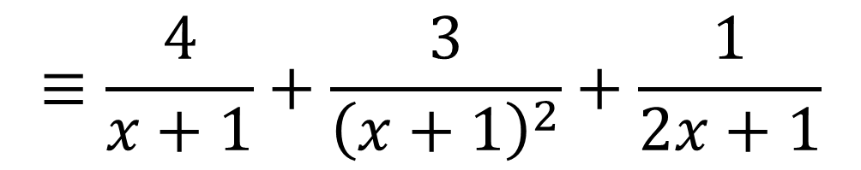
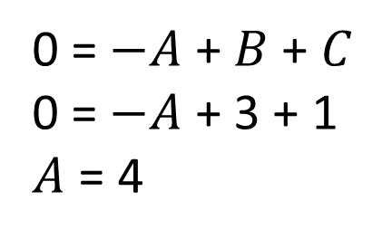
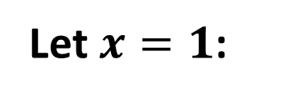
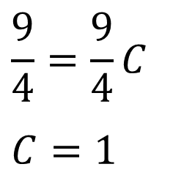
$$9x^{2}≡A\left(x−1\right)\left(2x+1\right)+B\left(2x+1\right)+C{\left(x−1\right)}^{2}$$
Let $x=1$:
Let $x=−\frac{1}{2}$:
Let $x=0$:
0 = $−A$ + $B$ + $C$
0 = $−A$ + 3 + 1
$A$ = 4
$$9=3B$$
$$B=3$$
$$\frac{9}{4}=\frac{9}{4}C$$
$$C=1$$
$$≡\frac{4}{x+1}+\frac{3}{{\left(x+1\right)}^{2}}+\frac{1}{2x+1}$$

