Slide 1

Senior Challenge 4
SILVER

Slide 2
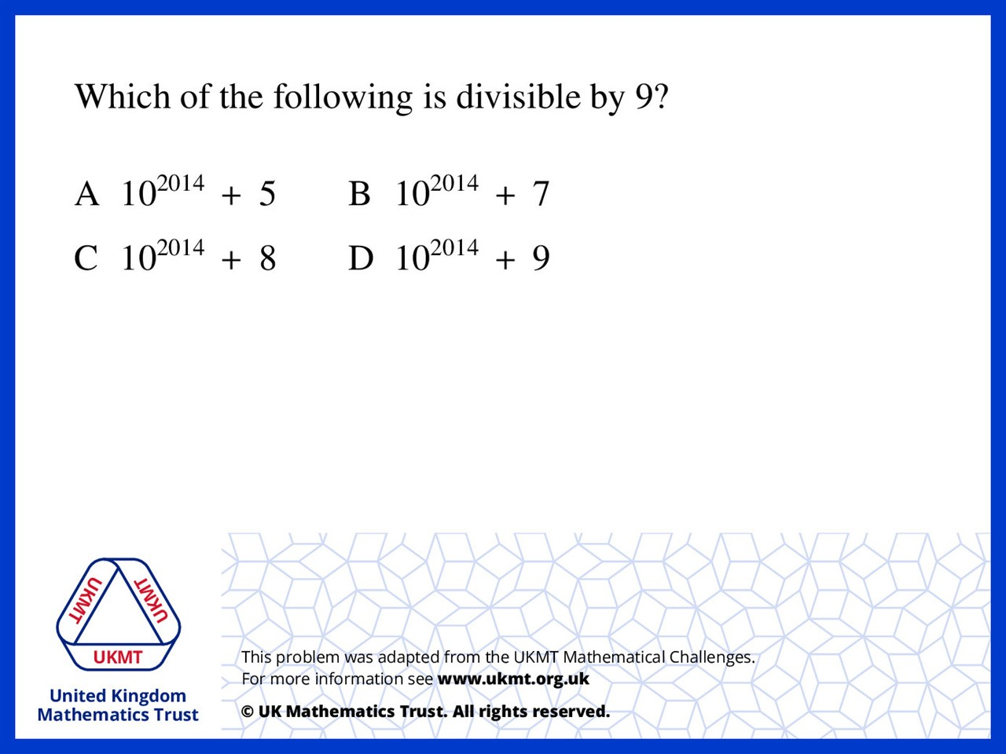
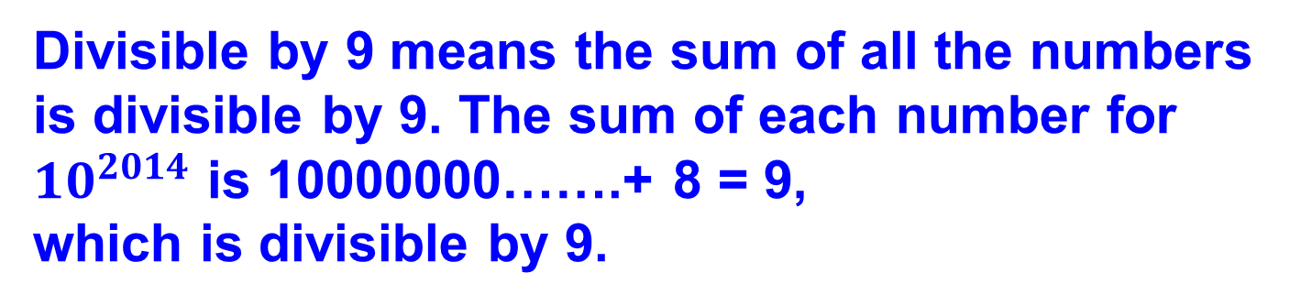
Q1.
Divisible by 9 means the sum of all the numbers is divisible by 9. The sum of each number for ${10}^{2014}$ is 10000000…….+ 8 = 9,
which is divisible by 9.

Slide 3
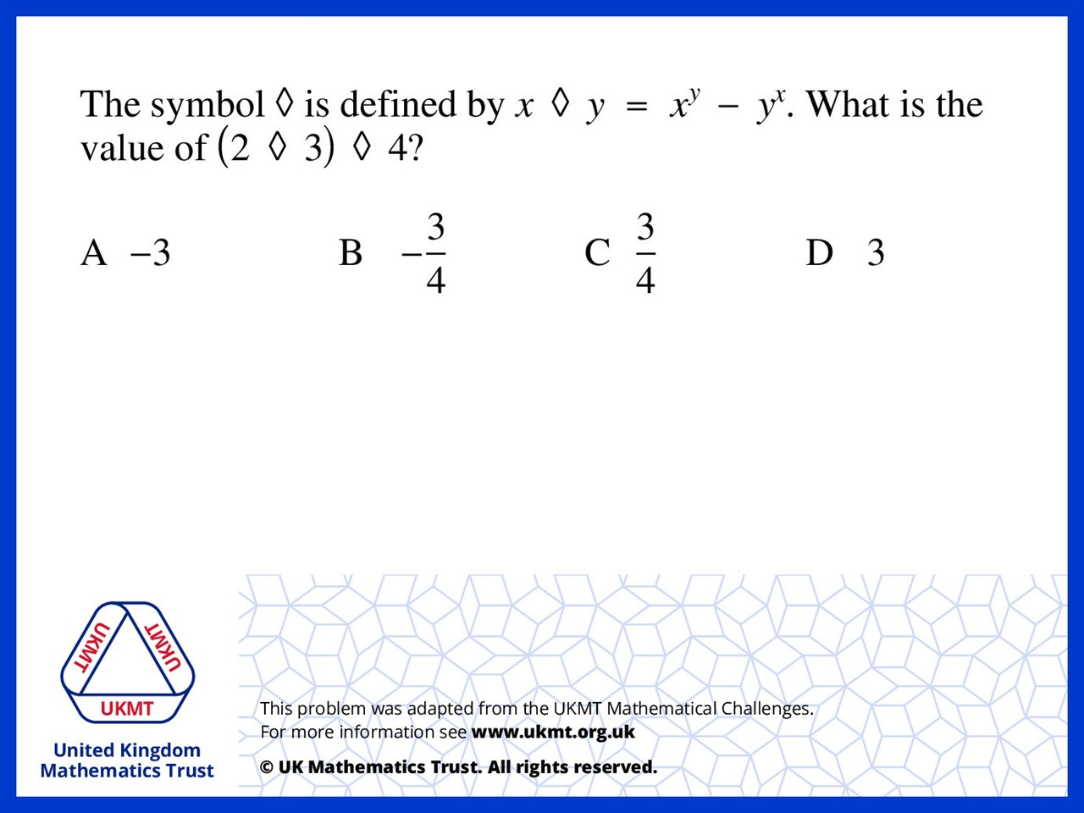
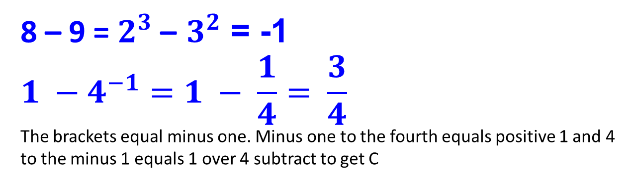
Q2.
8 – 9 = $2^{3}$– $3^{2}$ = -1
$${1 −4}^{−1}=1 − \frac{1}{4}= \frac{3}{4}$$
The brackets equal minus one. Minus one to the fourth equals positive 1 and 4 to the minus 1 equals 1 over 4 subtract to get C

Slide 4
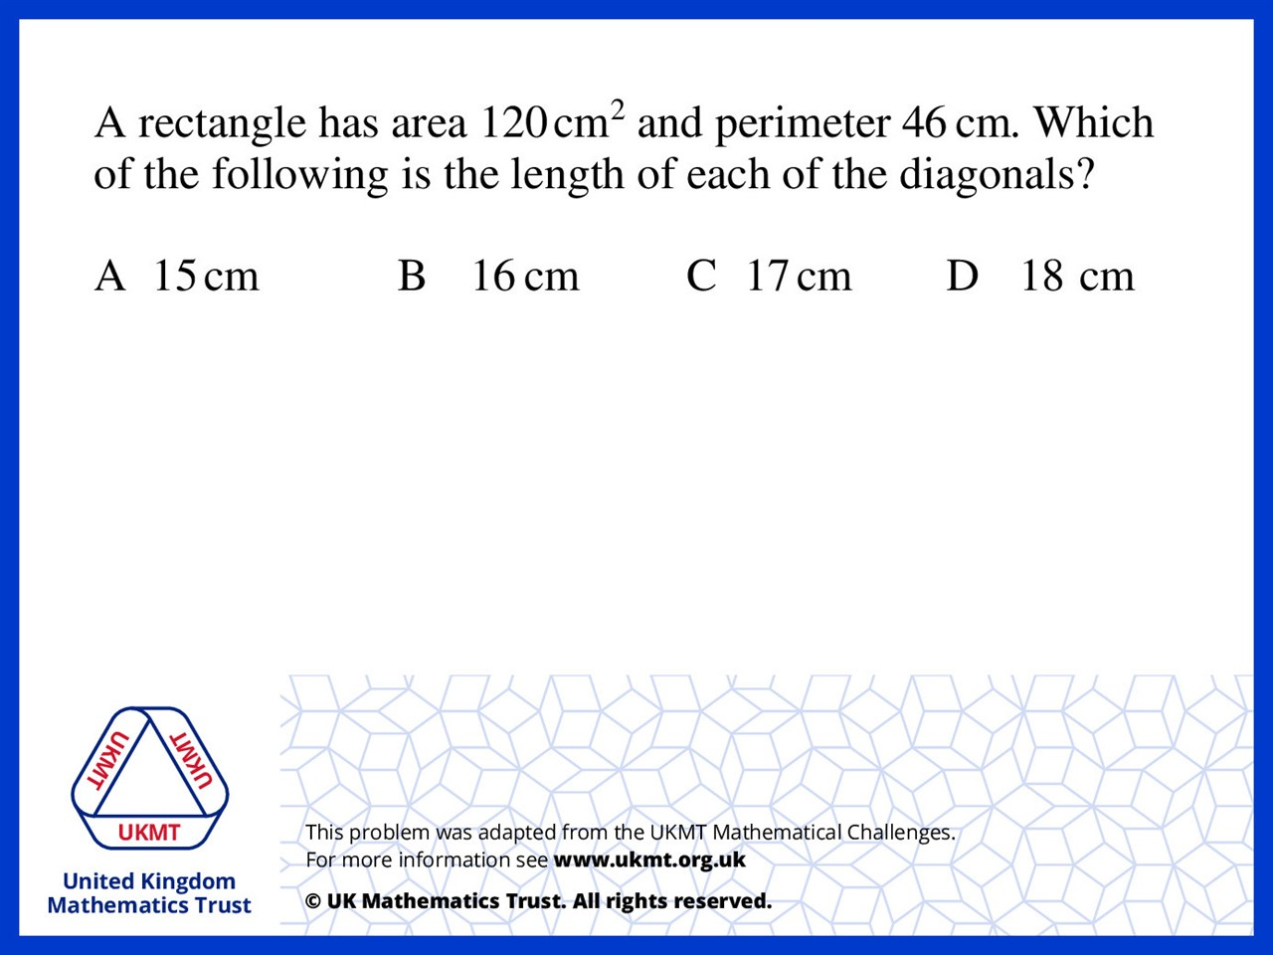
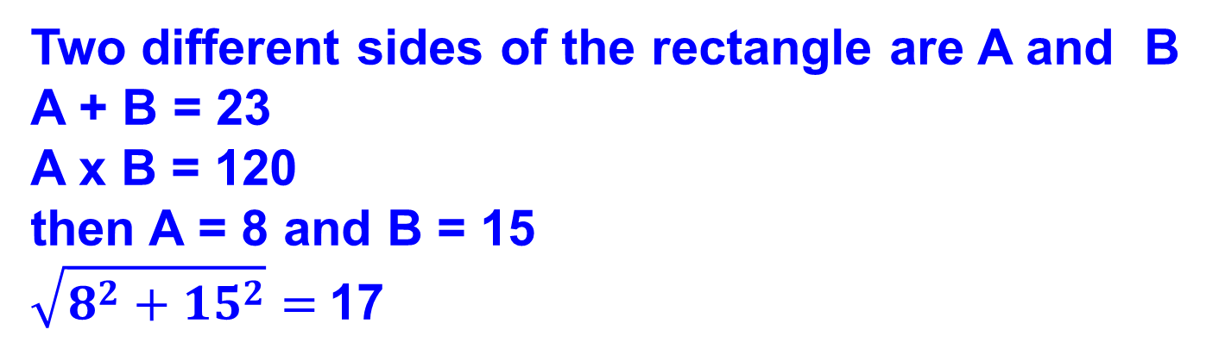
Q3.
Two different sides of the rectangle are A and B
A + B = 23
A x B = 120
then A = 8 and B = 15
$\sqrt{8^{2}+{15}^{2}}=$17

Slide 5
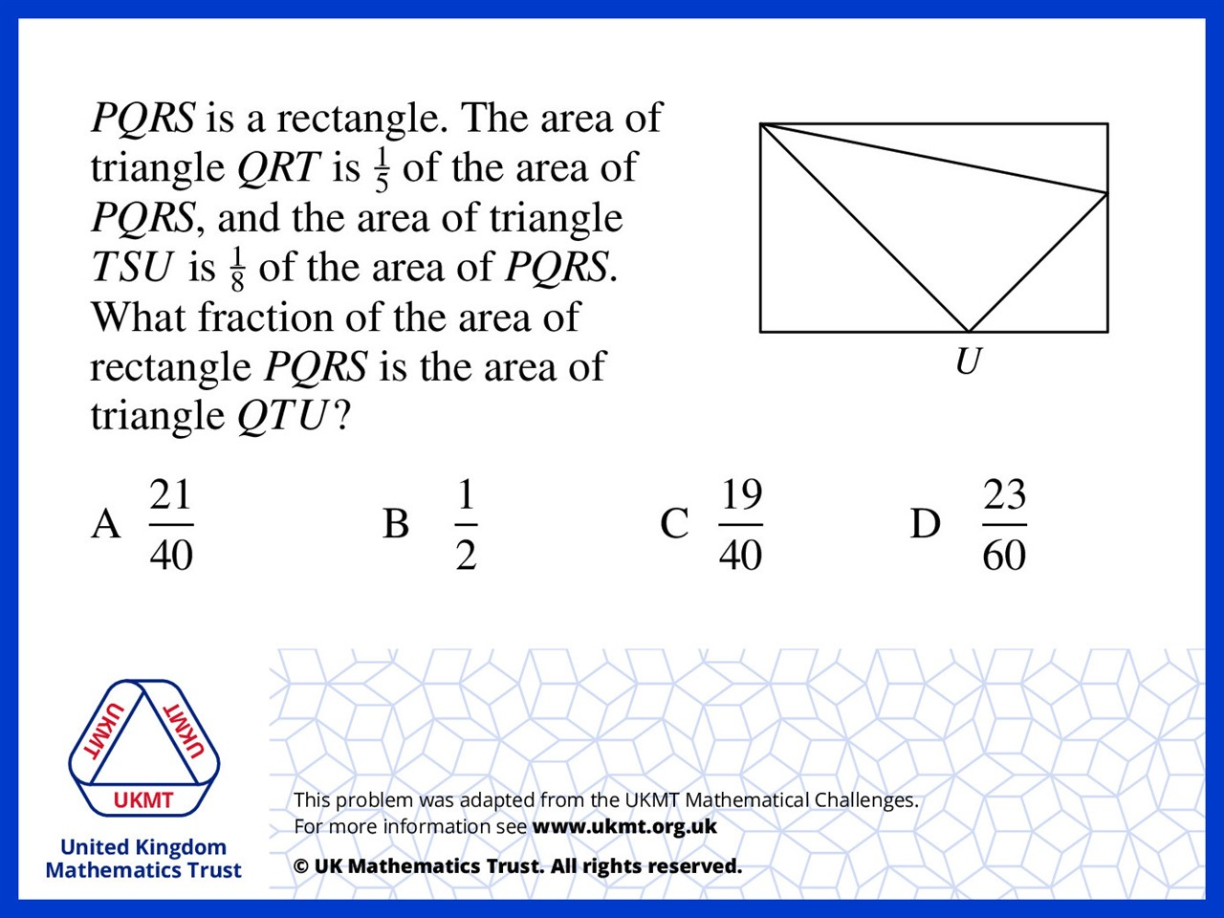
Q4.

Slide 6
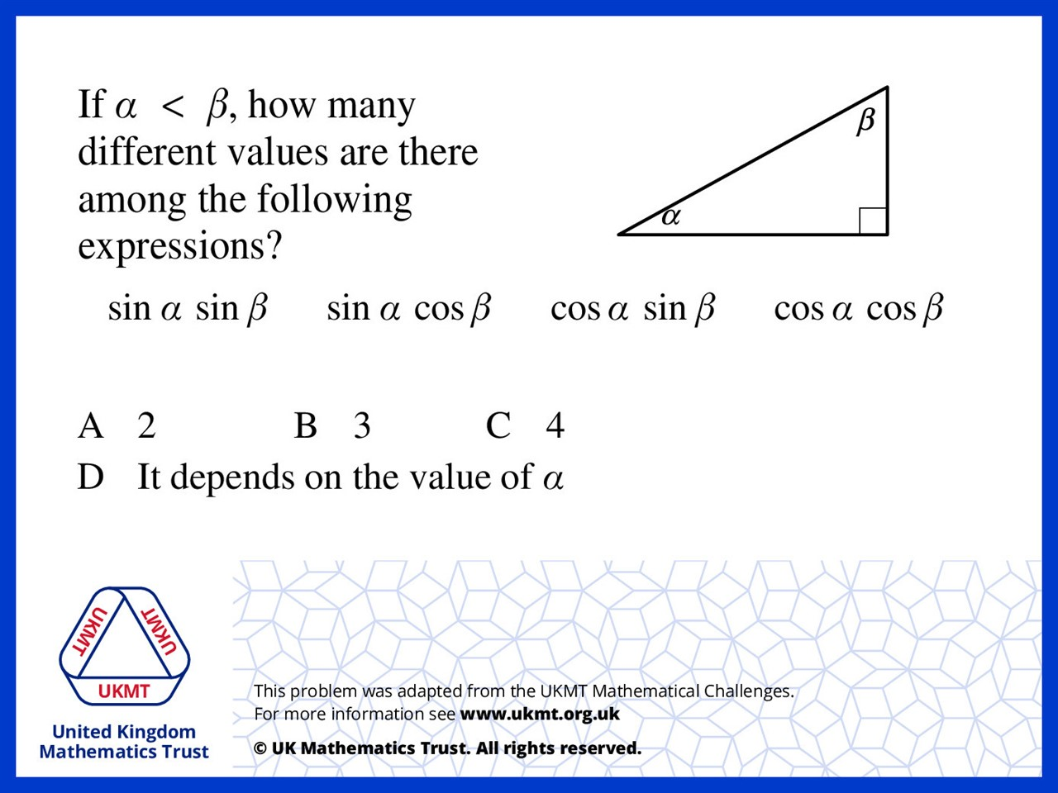
Q5.
(sin a)(sin b) = (cos a)(cos b)
So 3

