Slide 1
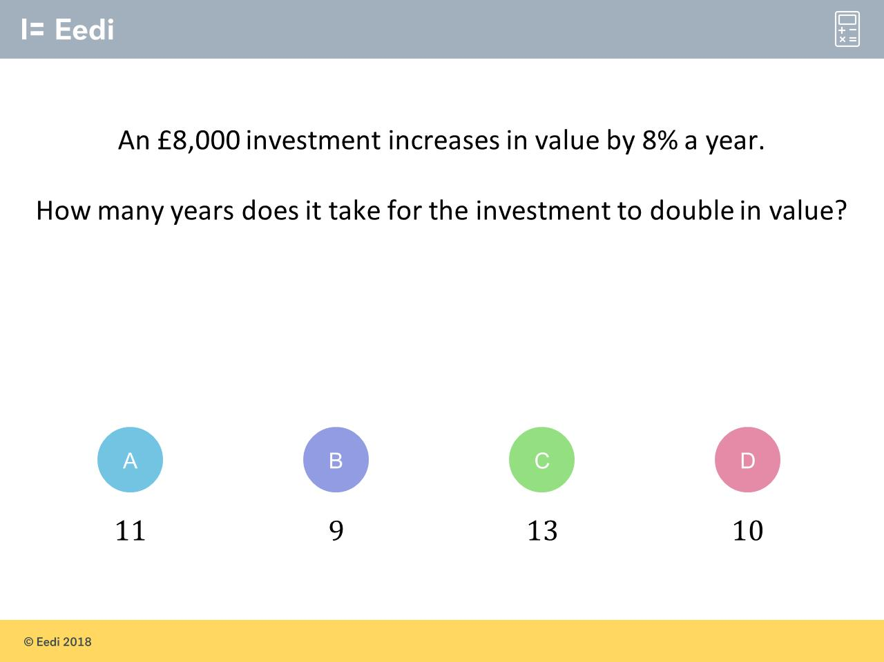
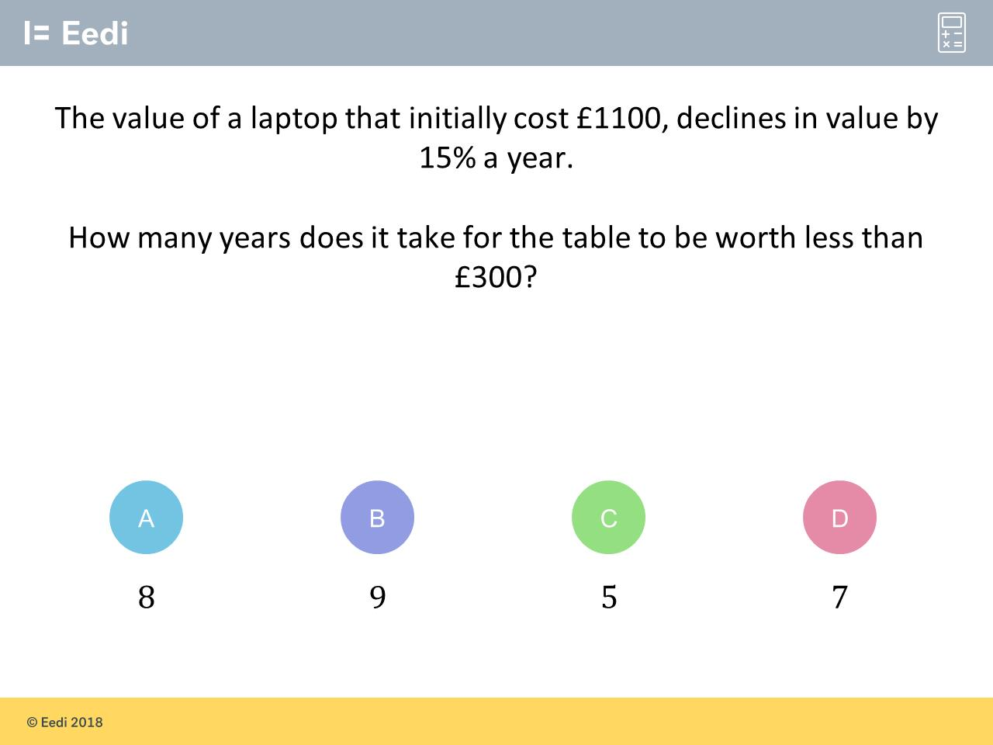
Worst answered question?
Most common wrong answer?

Slide 2
ANSWERS

Slide 3
Worst answered question?

Slide 4
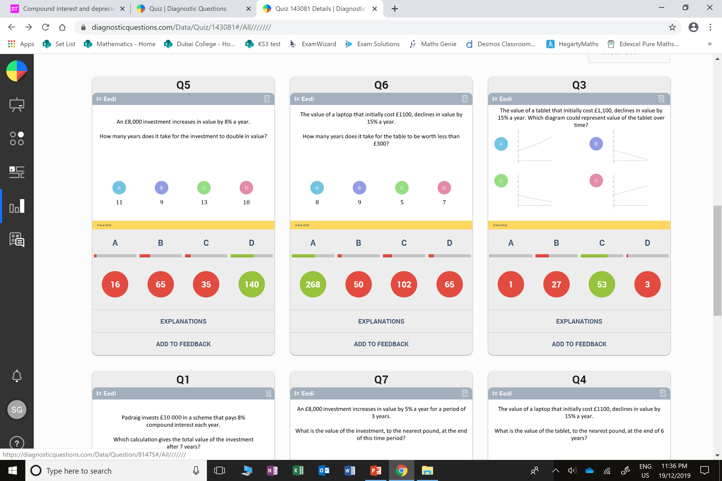
B
They were
one year short.

Slide 5
C
They did
simple interest rather than compound interest.

