Slide 1
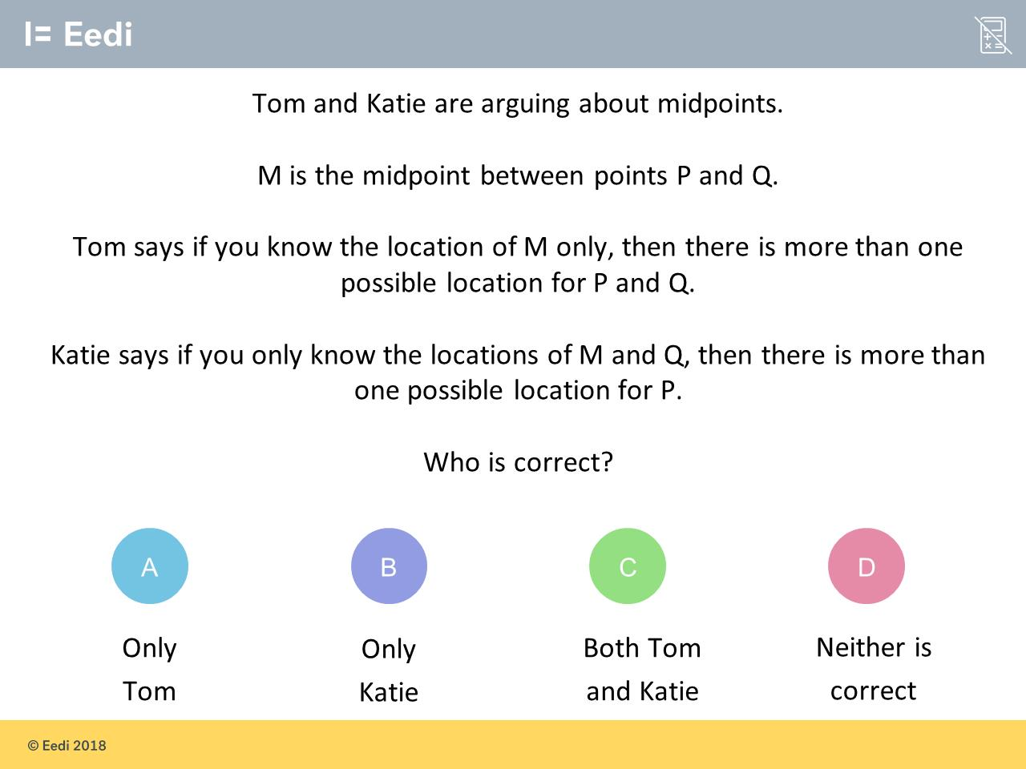
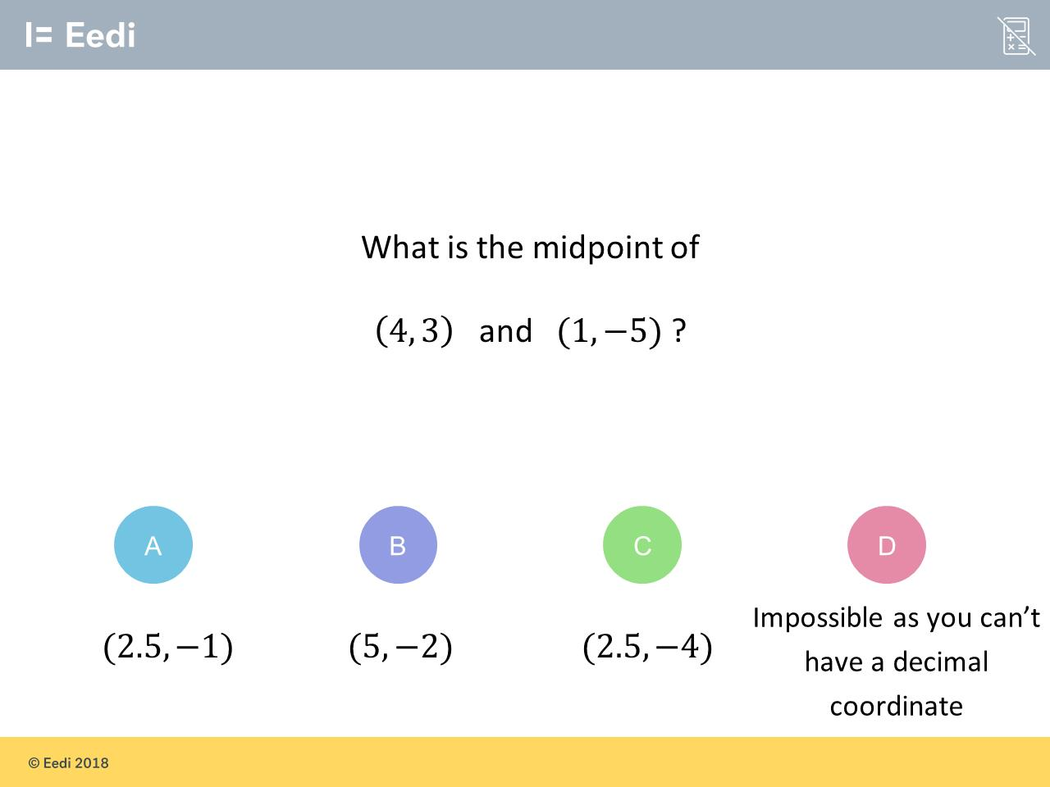
Worst answered question?
Most common wrong answer?

Slide 2
ANSWERS

Slide 3
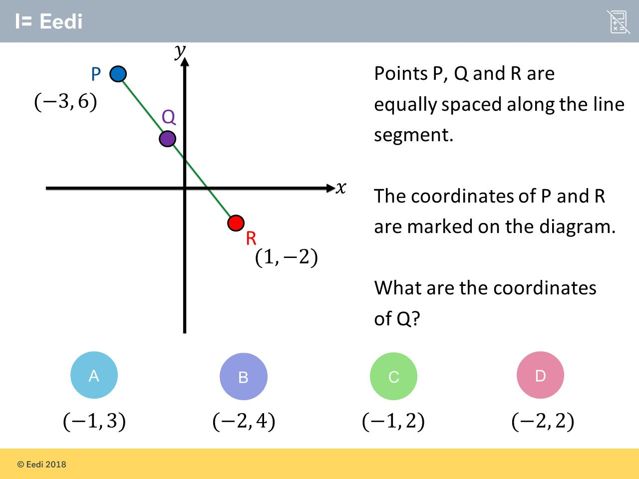
Worst answered question?

Slide 4
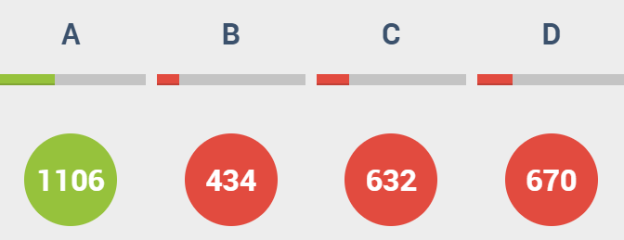
D
Tom’s statement is correct because if you know the location of one point only you can rotation about that point.

Slide 5
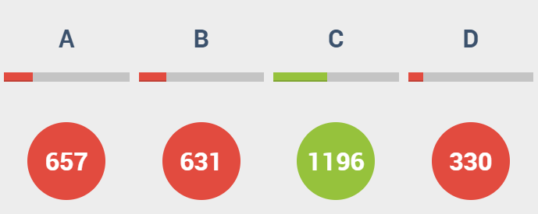
A
The student may be estimating.

