Slide 1
Data Collection
Types of Data
Chapter 1
(Part 3 of 4)

Slide 2
Types of Data
5 Boys
5 Red
5.2cm

Slide 3
Qualitative
Quantitative
Non-numerical values
e.g. colour.
Numerical values.
Discrete
Continuous
Not all values possible
e.g. shoe size, number of children.
Any possible value

Slide 4
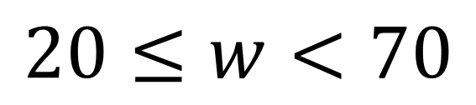
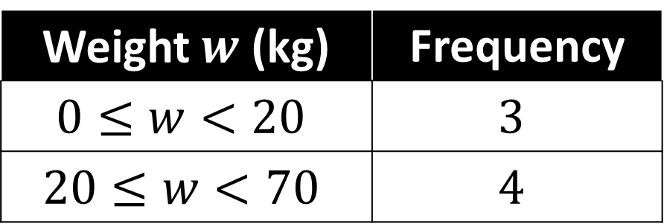
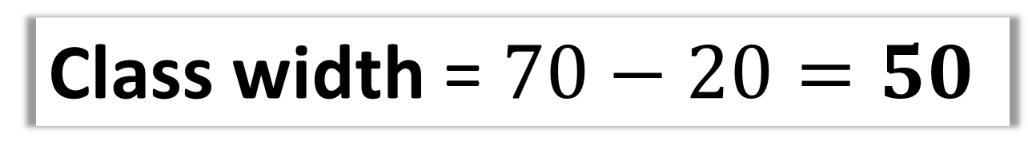
Data can be grouped for practical reasons,
at the expense of losing the exact original values.
Weight $w$ (kg) | Frequency
$$0≤w<20$$ | $$3$$
$$20≤w<70$$ | $$4$$
This is known as a
class interval.
$$20≤w<70$$
Lower class boundary
Midpoint = 45
Upper class boundary
Class width =$70−20=50$

