Slide 1
Investigation: Opposite Corners

Slide 2
1 | 2 | 3 | 4 | 5 | 6 | 7 | 8 | 9 | 10
11 | 12 | 13 | 14 | 15 | 16 | 17 | 18 | 19 | 20
21 | 22 | 23 | 24 | 25 | 26 | 27 | 28 | 29 | 30
31 | 32 | 33 | 34 | 35 | 36 | 37 | 38 | 39 | 40
41 | 42 | 43 | 44 | 45 | 46 | 47 | 48 | 49 | 50
51 | 52 | 53 | 54 | 55 | 56 | 57 | 58 | 59 | 60
61 | 62 | 63 | 64 | 65 | 66 | 67 | 68 | 69 | 70
71 | 72 | 73 | 74 | 75 | 76 | 77 | 78 | 79 | 80
81 | 82 | 83 | 84 | 85 | 86 | 87 | 88 | 89 | 90
91 | 92 | 93 | 94 | 95 | 96 | 97 | 98 | 99 | 100
Take a 2 by 2 Square from the 100 Grid.
2 | 3
12 | 13
Multiply the
opposite corners
and find the difference.

Slide 3
1 | 2 | 3 | 4 | 5 | 6 | 7 | 8 | 9 | 10
11 | 12 | 13 | 14 | 15 | 16 | 17 | 18 | 19 | 20
21 | 22 | 23 | 24 | 25 | 26 | 27 | 28 | 29 | 30
31 | 32 | 33 | 34 | 35 | 36 | 37 | 38 | 39 | 40
41 | 42 | 43 | 44 | 45 | 46 | 47 | 48 | 49 | 50
51 | 52 | 53 | 54 | 55 | 56 | 57 | 58 | 59 | 60
61 | 62 | 63 | 64 | 65 | 66 | 67 | 68 | 69 | 70
71 | 72 | 73 | 74 | 75 | 76 | 77 | 78 | 79 | 80
81 | 82 | 83 | 84 | 85 | 86 | 87 | 88 | 89 | 90
91 | 92 | 93 | 94 | 95 | 96 | 97 | 98 | 99 | 100
2 | 3
12 | 13
2 x 13 = 26
3 x 12 = 36
36 – 26 = 10

Slide 4
Will the difference be the same for other 2 by 2 squares in a 100 grid?
What is the difference of a 3 by 3 square in a 100 grid?
Will the difference be the same for other 3 by 3 squares in a 100 grid?

Slide 5
What about the differences of 4 by 4 squares in a 100 grid?
What about the differences of 5 by 5 squares in a 100 grid?
Can you predict the difference of 6 by 6 squares in a 100 grid?
What about the differences of S by S squares in a 100 grid?
What happens if you have a 9 by 9 grid?
What happens if you have a 8 by 8 grid?
What happens if you have a G by G grid?

Slide 6
1 | 2 | 3 | 4 | 5 | 6 | 7 | 8 | 9 | 10
11 | 12 | 13 | 14 | 15 | 16 | 17 | 18 | 19 | 20
21 | 22 | 23 | 24 | 25 | 26 | 27 | 28 | 29 | 30
31 | 32 | 33 | 34 | 35 | 36 | 37 | 38 | 39 | 40
41 | 42 | 43 | 44 | 45 | 46 | 47 | 48 | 49 | 50
51 | 52 | 53 | 54 | 55 | 56 | 57 | 58 | 59 | 60
61 | 62 | 63 | 64 | 65 | 66 | 67 | 68 | 69 | 70
71 | 72 | 73 | 74 | 75 | 76 | 77 | 78 | 79 | 80
81 | 82 | 83 | 84 | 85 | 86 | 87 | 88 | 89 | 90
91 | 92 | 93 | 94 | 95 | 96 | 97 | 98 | 99 | 100
Choose a square of your choice.
Find the difference of the opposite corners.

Slide 7
1 | 2 | 3 | 4 | 5 | 6 | 7 | 8 | 9 | 10
11 | 12 | 13 | 14 | 15 | 16 | 17 | 18 | 19 | 20
21 | 22 | 23 | 24 | 25 | 26 | 27 | 28 | 29 | 30
31 | 32 | 33 | 34 | 35 | 36 | 37 | 38 | 39 | 40
41 | 42 | 43 | 44 | 45 | 46 | 47 | 48 | 49 | 50
51 | 52 | 53 | 54 | 55 | 56 | 57 | 58 | 59 | 60
61 | 62 | 63 | 64 | 65 | 66 | 67 | 68 | 69 | 70
71 | 72 | 73 | 74 | 75 | 76 | 77 | 78 | 79 | 80
81 | 82 | 83 | 84 | 85 | 86 | 87 | 88 | 89 | 90
91 | 92 | 93 | 94 | 95 | 96 | 97 | 98 | 99 | 100
Choose another square of your choice. Make a prediction for the value of the difference.
Find the difference of the opposite corners.

Slide 8
1 | 2 | 3 | 4 | 5 | 6 | 7 | 8 | 9 | 10
11 | 12 | 13 | 14 | 15 | 16 | 17 | 18 | 19 | 20
21 | 22 | 23 | 24 | 25 | 26 | 27 | 28 | 29 | 30
31 | 32 | 33 | 34 | 35 | 36 | 37 | 38 | 39 | 40
41 | 42 | 43 | 44 | 45 | 46 | 47 | 48 | 49 | 50
51 | 52 | 53 | 54 | 55 | 56 | 57 | 58 | 59 | 60
61 | 62 | 63 | 64 | 65 | 66 | 67 | 68 | 69 | 70
71 | 72 | 73 | 74 | 75 | 76 | 77 | 78 | 79 | 80
81 | 82 | 83 | 84 | 85 | 86 | 87 | 88 | 89 | 90
91 | 92 | 93 | 94 | 95 | 96 | 97 | 98 | 99 | 100
Complete the square.
x
Find the
algebraic difference.

Slide 9
1 | 2 | 3 | 4 | 5 | 6 | 7 | 8 | 9 | 10
11 | 12 | 13 | 14 | 15 | 16 | 17 | 18 | 19 | 20
21 | 22 | 23 | 24 | 25 | 26 | 27 | 28 | 29 | 30
31 | 32 | 33 | 34 | 35 | 36 | 37 | 38 | 39 | 40
41 | 42 | 43 | 44 | 45 | 46 | 47 | 48 | 49 | 50
51 | 52 | 53 | 54 | 55 | 56 | 57 | 58 | 59 | 60
61 | 62 | 63 | 64 | 65 | 66 | 67 | 68 | 69 | 70
71 | 72 | 73 | 74 | 75 | 76 | 77 | 78 | 79 | 80
81 | 82 | 83 | 84 | 85 | 86 | 87 | 88 | 89 | 90
91 | 92 | 93 | 94 | 95 | 96 | 97 | 98 | 99 | 100
Choose a square of your choice.
Find the difference of the opposite corners.

Slide 10
Choose another square of your choice. Make a prediction for the value of the difference.
1 | 2 | 3 | 4 | 5 | 6 | 7 | 8 | 9 | 10
11 | 12 | 13 | 14 | 15 | 16 | 17 | 18 | 19 | 20
21 | 22 | 23 | 24 | 25 | 26 | 27 | 28 | 29 | 30
31 | 32 | 33 | 34 | 35 | 36 | 37 | 38 | 39 | 40
41 | 42 | 43 | 44 | 45 | 46 | 47 | 48 | 49 | 50
51 | 52 | 53 | 54 | 55 | 56 | 57 | 58 | 59 | 60
61 | 62 | 63 | 64 | 65 | 66 | 67 | 68 | 69 | 70
71 | 72 | 73 | 74 | 75 | 76 | 77 | 78 | 79 | 80
81 | 82 | 83 | 84 | 85 | 86 | 87 | 88 | 89 | 90
91 | 92 | 93 | 94 | 95 | 96 | 97 | 98 | 99 | 100
Find the difference of the opposite corners.

Slide 11
1 | 2 | 3 | 4 | 5 | 6 | 7 | 8 | 9 | 10
11 | 12 | 13 | 14 | 15 | 16 | 17 | 18 | 19 | 20
21 | 22 | 23 | 24 | 25 | 26 | 27 | 28 | 29 | 30
31 | 32 | 33 | 34 | 35 | 36 | 37 | 38 | 39 | 40
41 | 42 | 43 | 44 | 45 | 46 | 47 | 48 | 49 | 50
51 | 52 | 53 | 54 | 55 | 56 | 57 | 58 | 59 | 60
61 | 62 | 63 | 64 | 65 | 66 | 67 | 68 | 69 | 70
71 | 72 | 73 | 74 | 75 | 76 | 77 | 78 | 79 | 80
81 | 82 | 83 | 84 | 85 | 86 | 87 | 88 | 89 | 90
91 | 92 | 93 | 94 | 95 | 96 | 97 | 98 | 99 | 100
Complete the square.
x
Find the
algebraic difference.

Slide 12
Complete the square.
1 | 2 | 3 | 4 | 5 | 6 | 7 | 8 | 9 | 10
11 | 12 | 13 | 14 | 15 | 16 | 17 | 18 | 19 | 20
21 | 22 | 23 | 24 | 25 | 26 | 27 | 28 | 29 | 30
31 | 32 | 33 | 34 | 35 | 36 | 37 | 38 | 39 | 40
41 | 42 | 43 | 44 | 45 | 46 | 47 | 48 | 49 | 50
51 | 52 | 53 | 54 | 55 | 56 | 57 | 58 | 59 | 60
61 | 62 | 63 | 64 | 65 | 66 | 67 | 68 | 69 | 70
71 | 72 | 73 | 74 | 75 | 76 | 77 | 78 | 79 | 80
81 | 82 | 83 | 84 | 85 | 86 | 87 | 88 | 89 | 90
91 | 92 | 93 | 94 | 95 | 96 | 97 | 98 | 99 | 100
x
Find the
algebraic difference.

Slide 13
Complete the square.
1 | 2 | 3 | 4 | 5 | 6 | 7 | 8 | 9 | 10
11 | 12 | 13 | 14 | 15 | 16 | 17 | 18 | 19 | 20
21 | 22 | 23 | 24 | 25 | 26 | 27 | 28 | 29 | 30
31 | 32 | 33 | 34 | 35 | 36 | 37 | 38 | 39 | 40
41 | 42 | 43 | 44 | 45 | 46 | 47 | 48 | 49 | 50
51 | 52 | 53 | 54 | 55 | 56 | 57 | 58 | 59 | 60
61 | 62 | 63 | 64 | 65 | 66 | 67 | 68 | 69 | 70
71 | 72 | 73 | 74 | 75 | 76 | 77 | 78 | 79 | 80
81 | 82 | 83 | 84 | 85 | 86 | 87 | 88 | 89 | 90
91 | 92 | 93 | 94 | 95 | 96 | 97 | 98 | 99 | 100
x
Find the
algebraic difference.

Slide 14
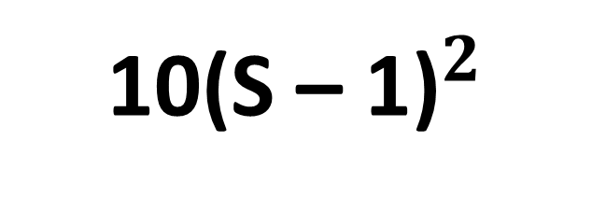
Complete the table for a 100 Grid.
Size of Square | Difference
2
3
4
5
6
S
10
40
90
160
250
10${\text{(}\text{S}\text{ – 1)}}^{2}$

Slide 15
1 | 2 | 3 | 4 | 5 | 6 | 7 | 8 | 9
10 | 11 | 12 | 13 | 14 | 15 | 16 | 17 | 18
19 | 20 | 21 | 22 | 23 | 24 | 25 | 26 | 27
28 | 29 | 30 | 31 | 32 | 33 | 34 | 35 | 36
37 | 38 | 39 | 40 | 41 | 42 | 43 | 44 | 45
46 | 47 | 48 | 49 | 50 | 51 | 52 | 53 | 54
55 | 56 | 57 | 58 | 59 | 60 | 61 | 62 | 63
64 | 65 | 66 | 67 | 68 | 69 | 70 | 71 | 72
73 | 74 | 75 | 76 | 77 | 78 | 79 | 80 | 81
9 by 9 Grid
2 | 3
11 | 12
2 x 12 = 24
3 x 11 = 33
33 – 24 = 9

Slide 16
1 | 2 | 3 | 4 | 5 | 6 | 7 | 8 | 9
10 | 11 | 12 | 13 | 14 | 15 | 16 | 17 | 18
19 | 20 | 21 | 22 | 23 | 24 | 25 | 26 | 27
28 | 29 | 30 | 31 | 32 | 33 | 34 | 35 | 36
37 | 38 | 39 | 40 | 41 | 42 | 43 | 44 | 45
46 | 47 | 48 | 49 | 50 | 51 | 52 | 53 | 54
55 | 56 | 57 | 58 | 59 | 60 | 61 | 62 | 63
64 | 65 | 66 | 67 | 68 | 69 | 70 | 71 | 72
73 | 74 | 75 | 76 | 77 | 78 | 79 | 80 | 81
Complete the square.
x
Find the
algebraic difference.

Slide 17
1 | 2 | 3 | 4 | 5 | 6 | 7 | 8 | 9
10 | 11 | 12 | 13 | 14 | 15 | 16 | 17 | 18
19 | 20 | 21 | 22 | 23 | 24 | 25 | 26 | 27
28 | 29 | 30 | 31 | 32 | 33 | 34 | 35 | 36
37 | 38 | 39 | 40 | 41 | 42 | 43 | 44 | 45
46 | 47 | 48 | 49 | 50 | 51 | 52 | 53 | 54
55 | 56 | 57 | 58 | 59 | 60 | 61 | 62 | 63
64 | 65 | 66 | 67 | 68 | 69 | 70 | 71 | 72
73 | 74 | 75 | 76 | 77 | 78 | 79 | 80 | 81
Complete the square.
x
Find the
algebraic difference.

Slide 18
Complete the square.
1 | 2 | 3 | 4 | 5 | 6 | 7 | 8 | 9
10 | 11 | 12 | 13 | 14 | 15 | 16 | 17 | 18
19 | 20 | 21 | 22 | 23 | 24 | 25 | 26 | 27
28 | 29 | 30 | 31 | 32 | 33 | 34 | 35 | 36
37 | 38 | 39 | 40 | 41 | 42 | 43 | 44 | 45
46 | 47 | 48 | 49 | 50 | 51 | 52 | 53 | 54
55 | 56 | 57 | 58 | 59 | 60 | 61 | 62 | 63
64 | 65 | 66 | 67 | 68 | 69 | 70 | 71 | 72
73 | 74 | 75 | 76 | 77 | 78 | 79 | 80 | 81
x
Find the
algebraic difference.

Slide 19
Complete the square.
1 | 2 | 3 | 4 | 5 | 6 | 7 | 8 | 9
10 | 11 | 12 | 13 | 14 | 15 | 16 | 17 | 18
19 | 20 | 21 | 22 | 23 | 24 | 25 | 26 | 27
28 | 29 | 30 | 31 | 32 | 33 | 34 | 35 | 36
37 | 38 | 39 | 40 | 41 | 42 | 43 | 44 | 45
46 | 47 | 48 | 49 | 50 | 51 | 52 | 53 | 54
55 | 56 | 57 | 58 | 59 | 60 | 61 | 62 | 63
64 | 65 | 66 | 67 | 68 | 69 | 70 | 71 | 72
73 | 74 | 75 | 76 | 77 | 78 | 79 | 80 | 81
x
Find the
algebraic difference.

Slide 20
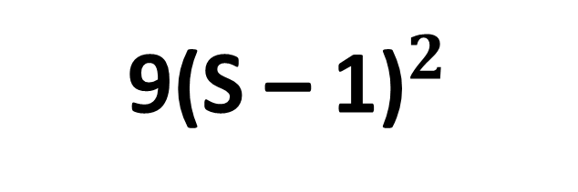
Complete the table for a 9 by 9 Grid.
Size of Square | Difference
2
3
4
5
6
S
9
36
9
144
225
9${\text{(}\text{S}\text{ – 1)}}^{2}$

Slide 21
1 | 2 | 3 | 4 | 5 | 6 | 7 | 8
9 | 10 | 11 | 12 | 13 | 14 | 15 | 16
17 | 18 | 19 | 20 | 21 | 22 | 23 | 24
25 | 26 | 27 | 28 | 29 | 30 | 31 | 32
33 | 34 | 35 | 36 | 37 | 38 | 39 | 40
41 | 42 | 43 | 44 | 45 | 46 | 47 | 48
49 | 50 | 51 | 52 | 53 | 54 | 55 | 56
57 | 58 | 59 | 60 | 61 | 62 | 63 | 64
Complete the square.
x
Find the
algebraic difference.

Slide 22
Find the algebraic difference for each of the squares.
x
x
x

Slide 23
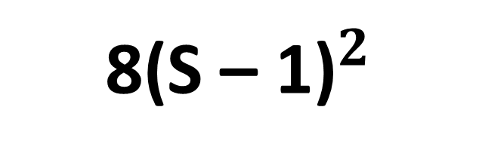
Complete the table for a 8 by 8 Grid.
Size of Square | Difference
2
3
4
5
6
S
8
32
72
128
200
8${\text{(}\text{S}\text{ – 1)}}^{2}$

Slide 24



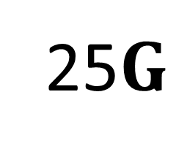
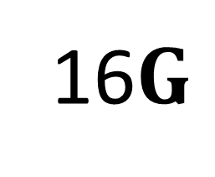
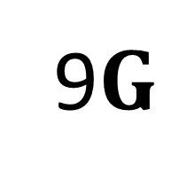
Complete the table for a G by G grid.
Size of Square | Difference
2
3
4
5
6
S
$$G$$
4$G$
9$G$
16$G$
25$G$
$$G{\text{(}\text{S}\text{ – 1)}}^{2}$$

Slide 25
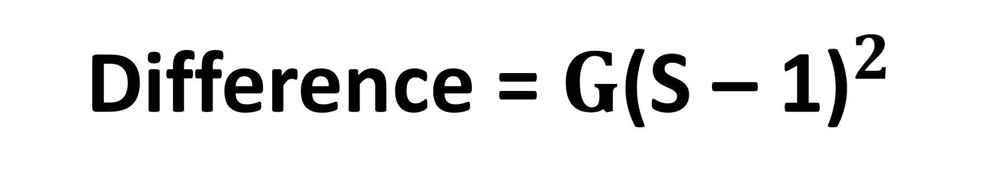
Difference = $G{\text{(}\text{S}\text{ – 1)}}^{2}$
Test the general formula when
5 by 5 Grid using a 3 by 3 Square.
Using the formula
Using the grid

