Slide 1
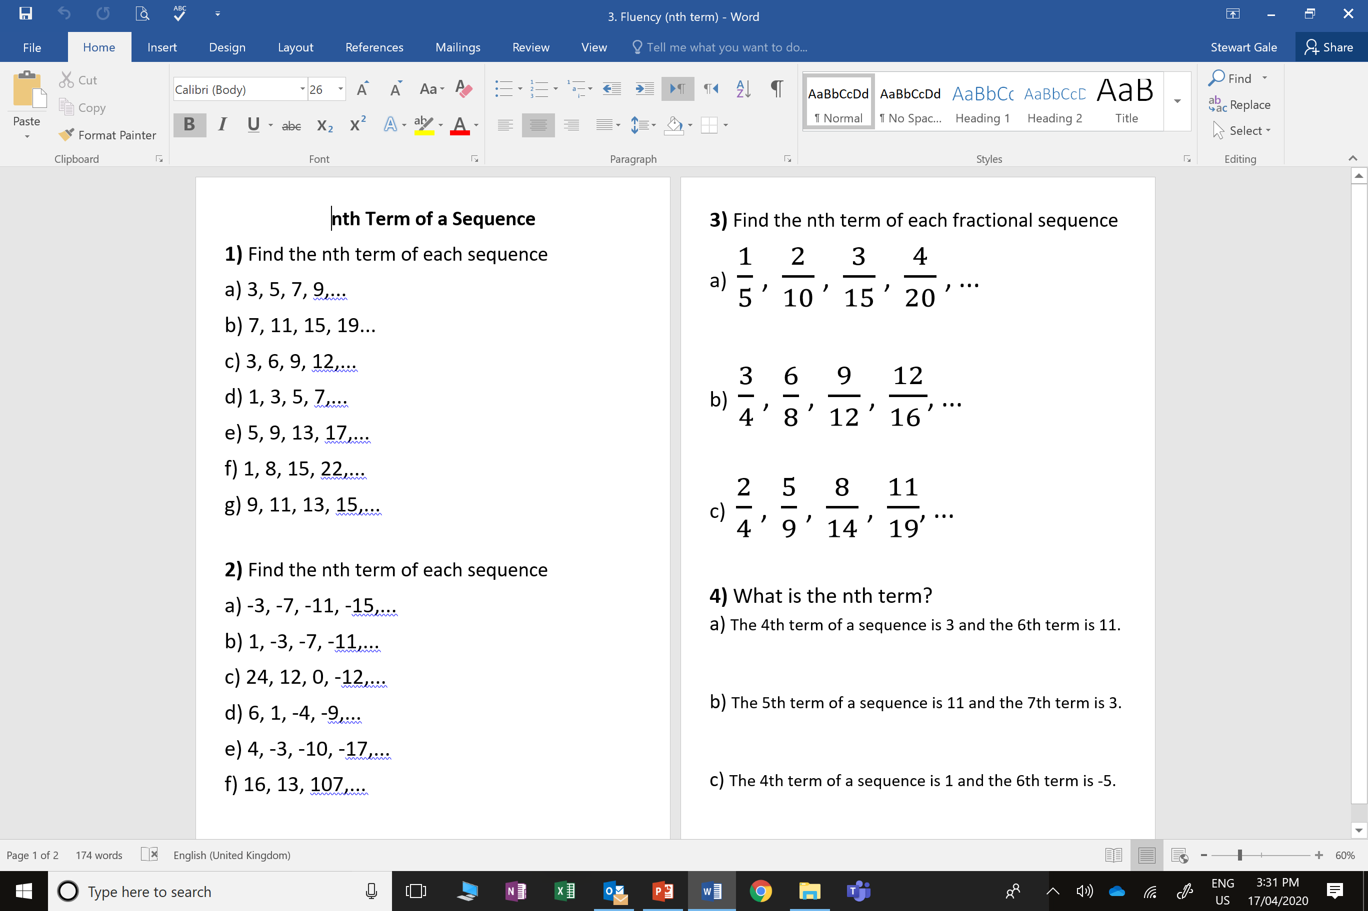
,7

Slide 2
ANSWERS

Slide 3
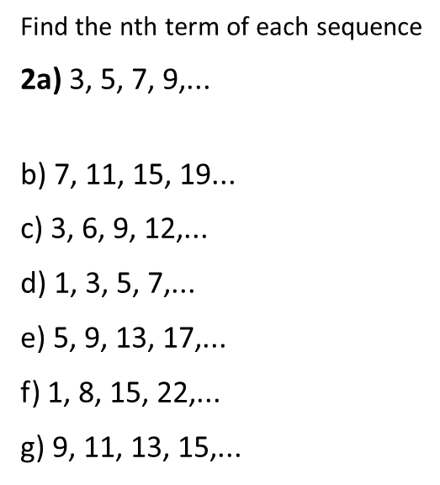
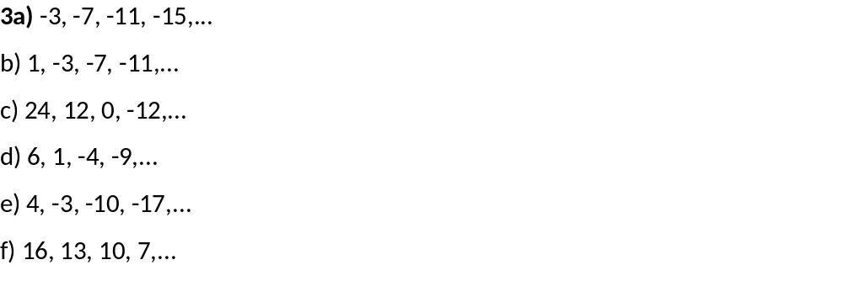
a)
2n + 1
a)
-4n + 1
4n + 3
-4n + 5
3n
-12n + 36
2n - 1
-5n + 11
4n + 1
-7n + 11
7n - 6
2n + 7
-3n + 19

Slide 4
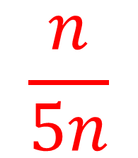
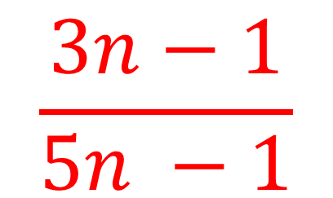
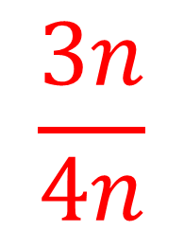
$$\frac{n}{5n}$$
$$\frac{3n}{4n}$$
$$\frac{3n−1}{5n −1}$$

Slide 5
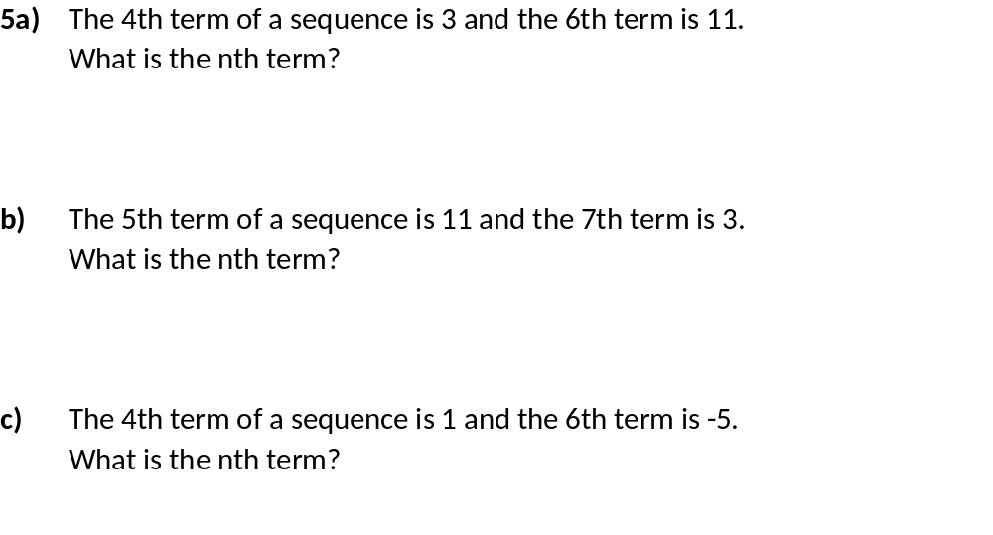
a)
4 | 5 | 6
3 | 7 | 11
4n - 13
5 | 6 | 7
11 | 7 | 3
-4n + 31
4 | 5 | 6
1 | -2 | -5
-3n + 13

