Slide 1
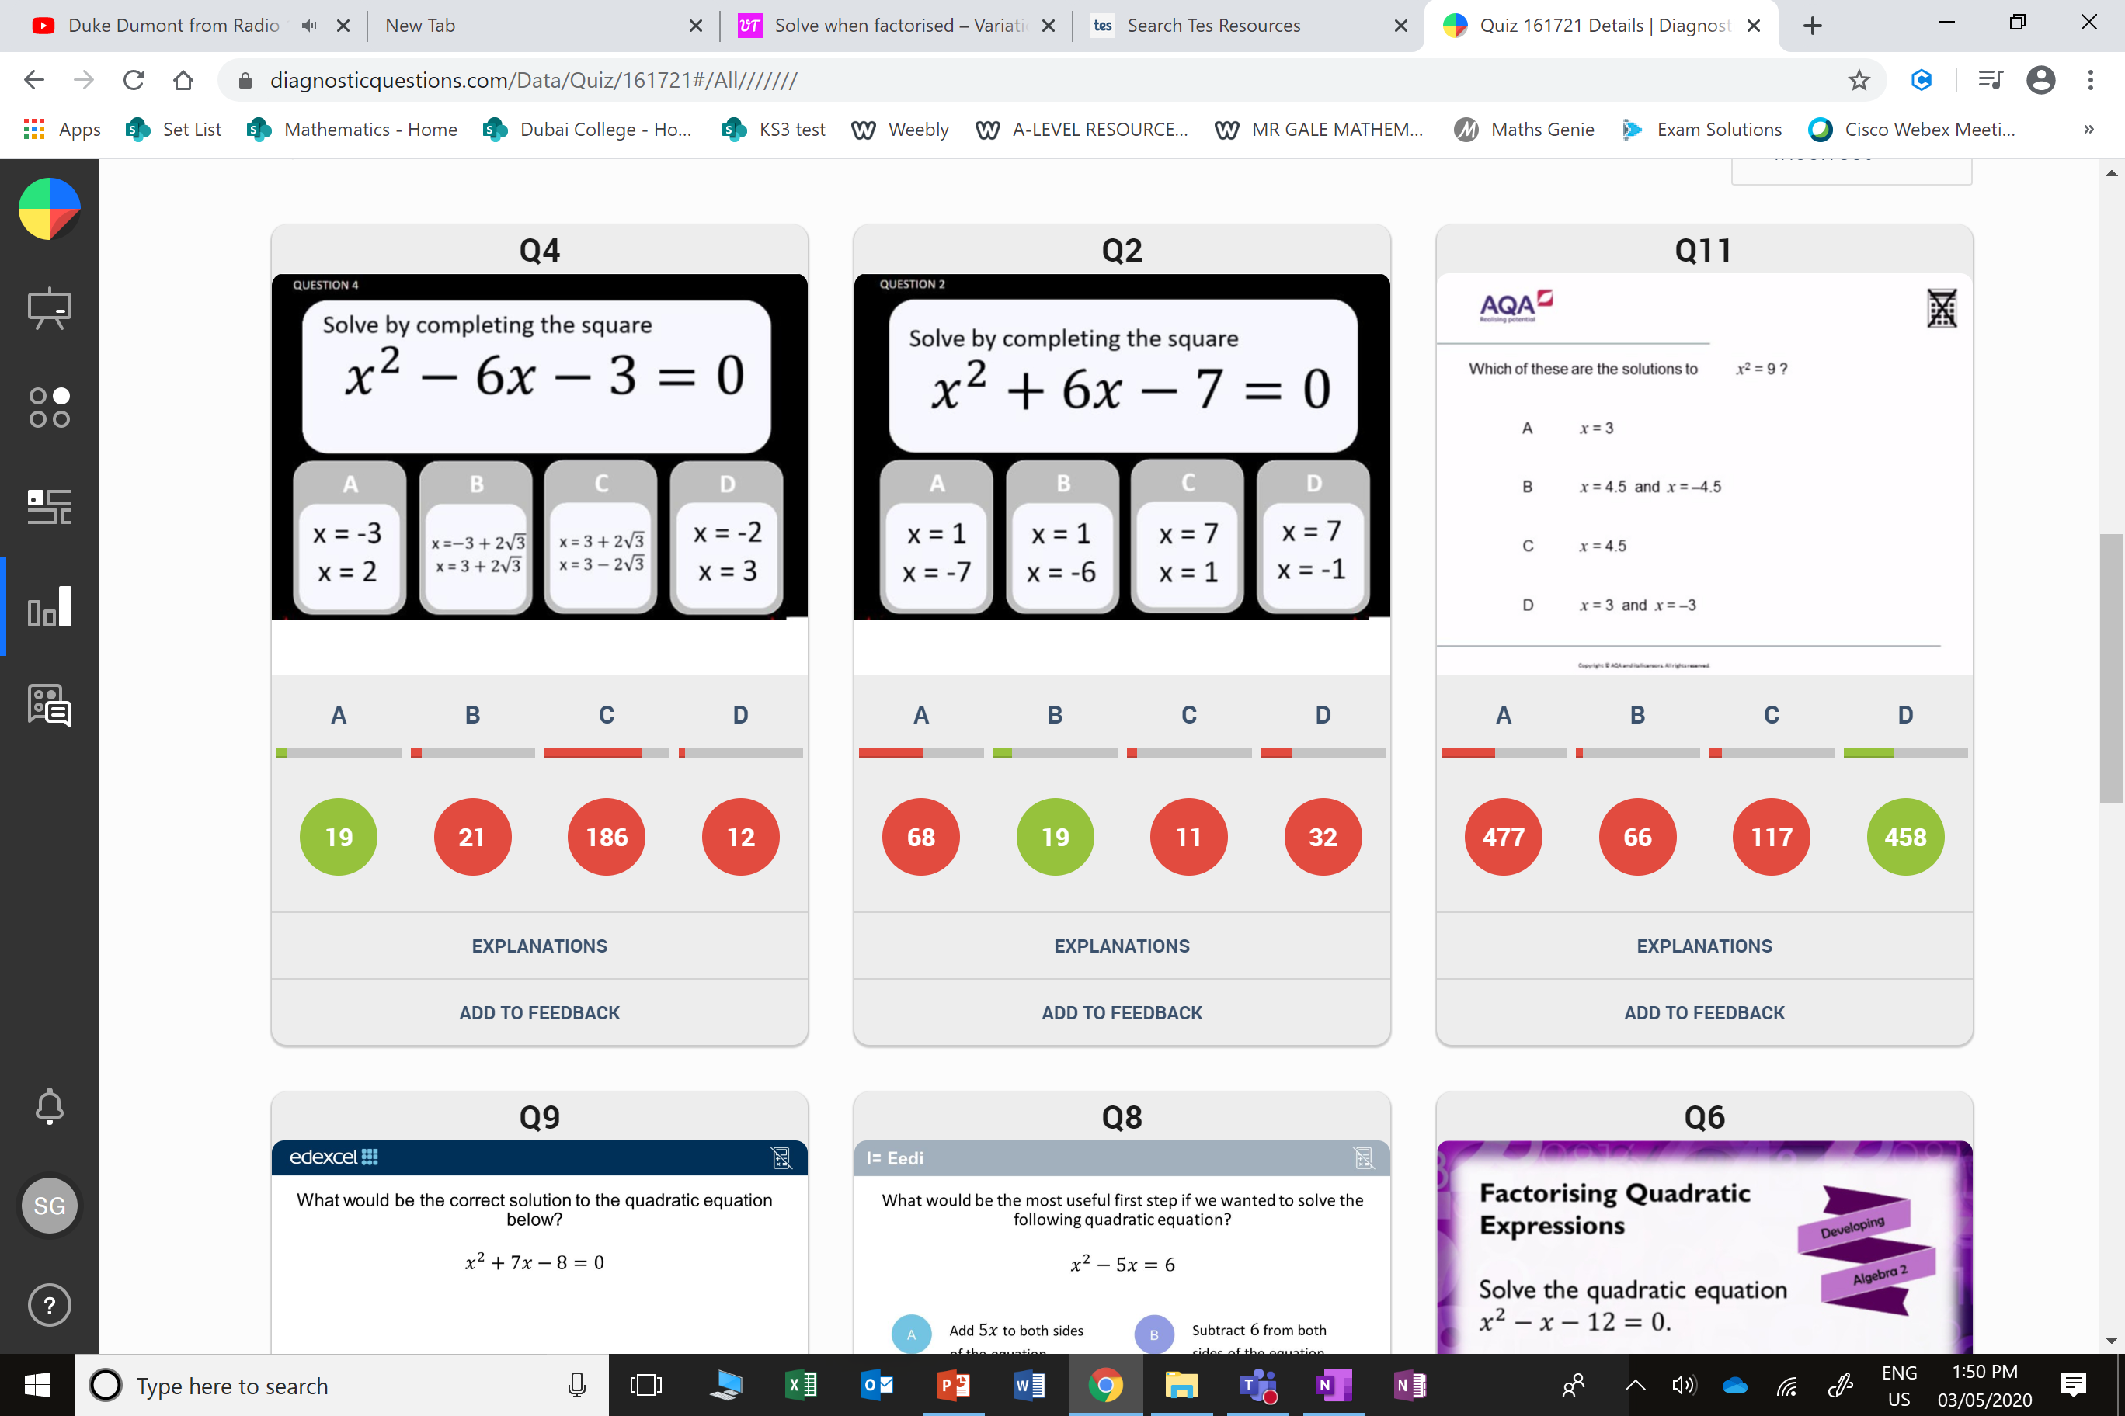
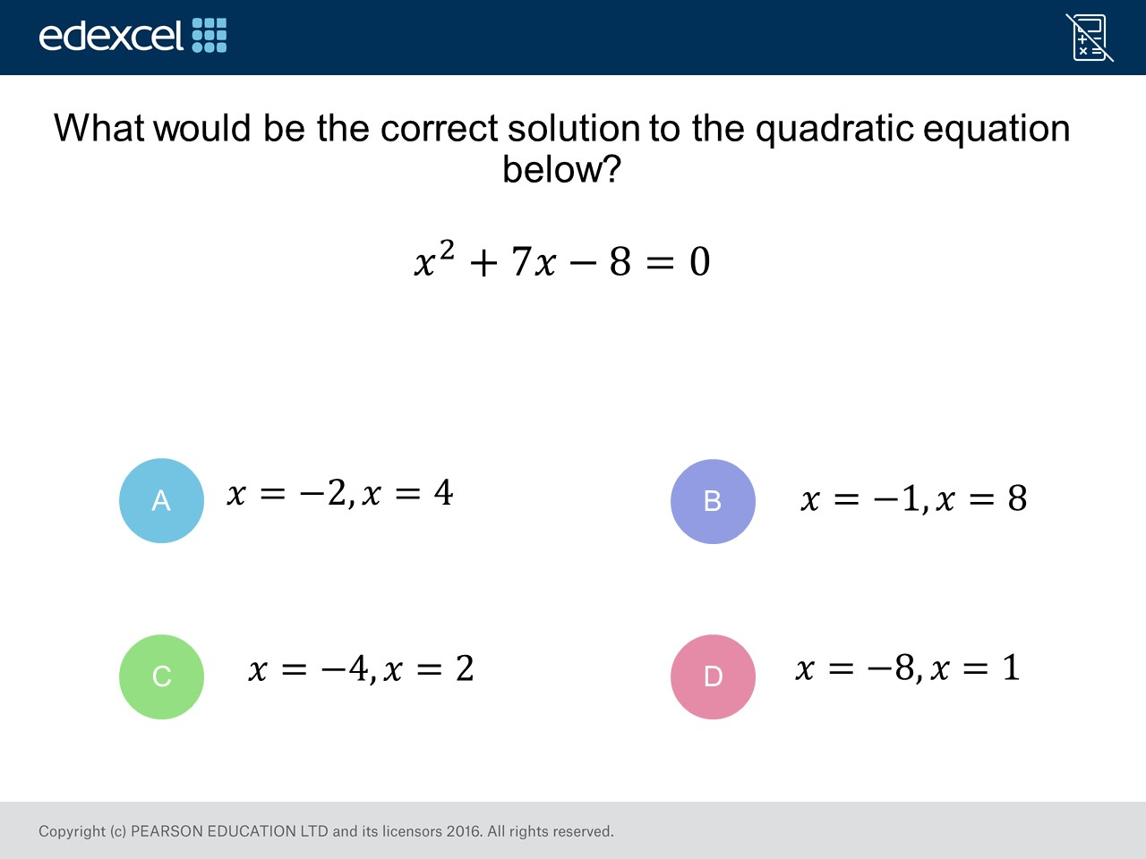
Worst answered question?
Most common wrong answer?

Slide 2
ANSWERS

Slide 3
Worst answered question?

Slide 4
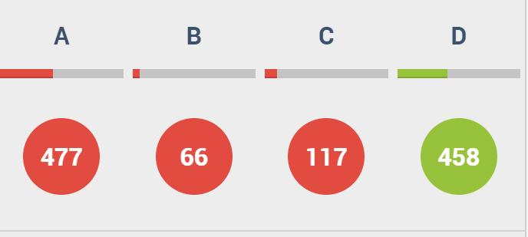
A
They only found one solution.

Slide 5
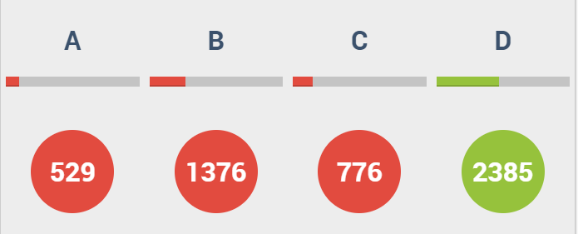
B
The student may have factorised correctly, but has then taken the signs of the numbers inside the brackets.

