Slide 1
FM: Product Rule of Counting

Slide 2
Part 1: Systematic Counting
Sometimes the easiest way to count things is to explicitly list out every possibility!
The key is listing the possibilities in some systematic way that avoids missing out cases or duplicates.

Slide 3
At a restaurant, there is a choice of
Avocado (A), Beans (B) or Cauliflower (C) for starter,
and a choice of Dog (D), Escalopes (E) and Frog Legs (F) for main course.
List out all the nine possible combinations of starter and main course (e.g. ‘BF’).
AD, AE, AF, BD, BE, BF, CD, CE, CF

Slide 4
You have to pick a team of one boy and one girl.
The boys are Adam, Bob and Charles.
The girls are Diane and Elaine.
List out all the possible choices of team.
AD, AE, BD, BE, CD, CE
What do you notice about the total number of combinations, relative to the number of boys (3) and number of girls (2)?
They’ve been multiplied together.
This suggests to get all combinations,
you can multiply the number of choices from each thing you’re combining.

Slide 5

Exercises on provided sheet.
Every day Keith has a breakfast, a lunch and a dinner. The options for each meal are:
One day Keith eats four items.
In how many different ways can he do this?
12

Slide 6
Part 2: Product Rule of Counting
The product rule for counting is
an efficient method for finding
the number of combinations
given a particular condition.

Slide 7

You have to pick a team of one boy and one girl.
The boys are Adam, Bob and Charles.
The girls are Diane and Elaine.
List out all the possible choices of team.
There were 3 boys and 2 girls to choose from,
and we needed one of each.
Without listing, there were $3×2$ total possibilities.

Slide 8
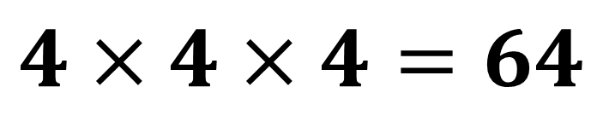
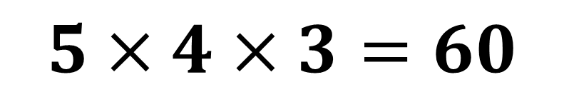
I have 5 choices for a starter,
4 choices for the main course and 3 for the pudding.
How many possible meal selections are there?
$$5×4×3=60$$
For each move in a path, I can move North, South, East or West. I make 3 moves.
How many possible paths are there?
$$4×4×4=64$$

Slide 9



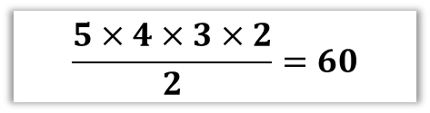


There are 26 letters in the English alphabet.
In pairs, work out how many possibilities there are for each of the following.
Note: a ‘word’ is any possible sequence of characters; it need not be in a dictionary.
Question 1
Question 2
Question 3
The number of possible 2 letter ‘words’ where the letters are unrestricted.
The number of possible 3 letter ‘words’ where the letters are unrestricted.
The number of possible 2 letter ‘words’ where the letters are different.
$$26×26=676$$
$$26^{3}=17576$$
$$26×25=650$$
Question 4
Question 5
Question N
The number of possible 4 letter ‘words’ where each letter cannot be the same as the previous letter, but is otherwise unrestricted.
The number of 4 letters words using each of the letters A, B, C, D exactly once.
The number of 5 letter words using the letters AABCD, each exactly once.
$$\frac{5×4×3×2}{2}=60$$
$$4×3×2×1=24$$
$$26×25×25×25=406250$$

Slide 10
7!
Factorial 7
7 x 6 x 5 x 4 x 3 x 2 x 1 = 5040

Slide 11
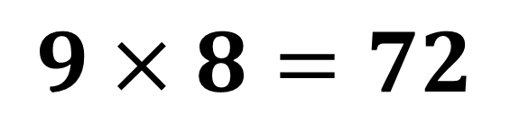
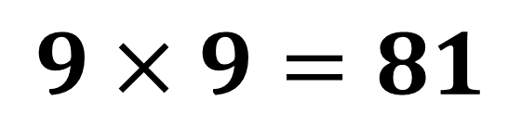
Repeated vs Non-Repeated
A restaurant serves 9 dishes.
Amir and Ben both choose a dish.
How many different ways of choosing are there?
$$9×9=81$$
A restaurant serves 9 dishes.
Amir and Ben choose DIFFERENT dishes.
How many different ways of choosing are there?
$$9×8=72$$

Slide 12
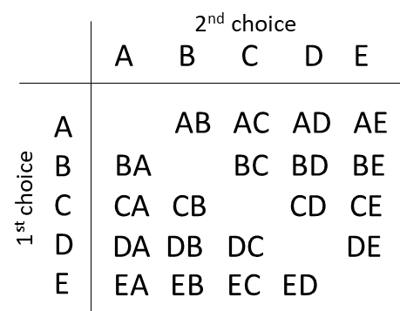
Ordered vs Non-Ordered
EC and CE for example represent the same selection if order does not matter.

Slide 13
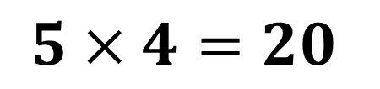
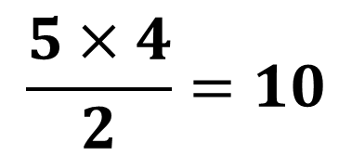
Ordered vs Non-Ordered
I want a football team of two people, consisting of just a goalkeeper and a striker. I have 5 people to choose from. How many possibilities are there?
5 choices for the goalkeeper.
Then 4 choices left for the striker.
$$5×4=20$$
I want a football team of two people. I have 5 people to choose from.
How many possible teams are there?
Again, 5 choices for the first player, and 4 for the second. However, the order in which I choose the players doesn’t matter, e.g. if I pick Alice then Bob, it’s the same team if I picked Bob then Alice. We therefore need to divide by 2 to account for duplicates.
$$\frac{5×4}{2}=10$$

Slide 14

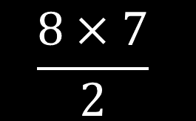


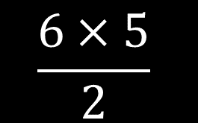

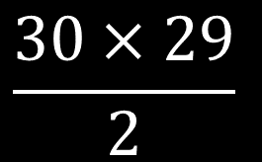
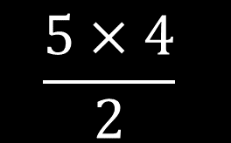
In each case think carefully whether we divide by 2
(if the items in our selection are ‘unordered’) or not.
(Click to vote)
In a race of 8 people, a Gold and a Silver medal are awarded. How many ways can the medals be awarded?
$$8×7$$
$$\frac{8×7}{2}$$
$$30×29$$
$$\frac{30×29}{2}$$
In a class of 30 students I select 2 to give a detention to. How many ways can I do this?
The Queen has a head male corgi that she wants to breed. She picks 2 amongst her 6 female corgis. How many selections can she make?
$$6×5$$
$$\frac{6×5}{2}$$
A bag has 5 differently coloured counters. Alice picks one then Bob picks one.
How many possible selections are there?
$$5×4$$
$$\frac{5×4}{2}$$

Slide 15
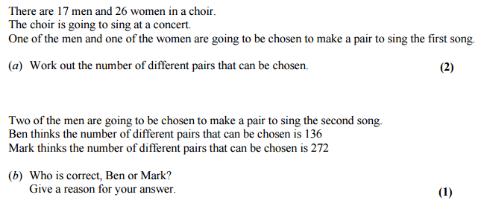
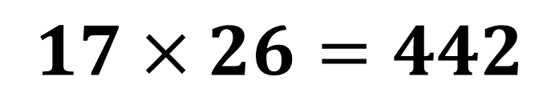
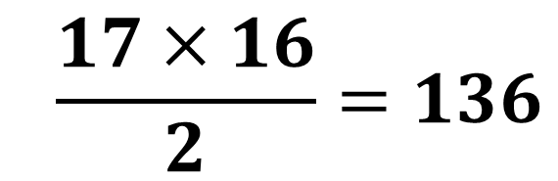
Exam Question
$$17×26=442$$
$$\frac{17×16}{2}=136$$
It’s 136 because the order in the selection does not matter.

Slide 16
Exam Question
Exercises on provided sheet.
There are 95 girls and 87 boys in Year 13 at a school.
One girl is going to be chosen for the role of Head Girl. A different girl is going to be chosen for the role of Deputy Head Girl.
One boy is going to be chosen for the role of Head Boy. A different boy is going to be chosen for the role of Deputy Head Boy.
Work out how many different ways this can be done.
$$95×94×87×86=66814260$$

