Slide 1

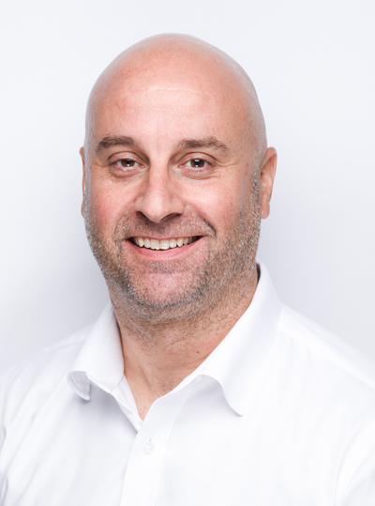
7SGA
Welcome from Mr Gale

Slide 2

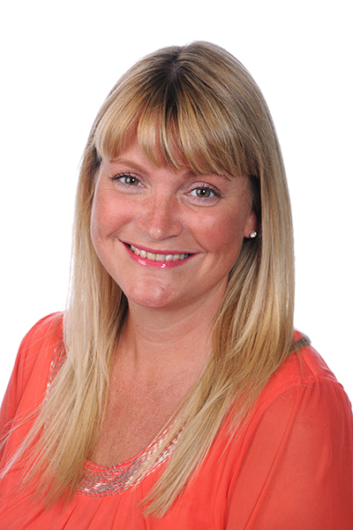
7SGA
5 Years as a form
We lookout for each other
Form Room J103
Head of Year - Mrs Greenlees

Slide 3
Personal Expectations
Be kind.
Make good decisions.
Treat other people as you want to be treated.
Think about others point of view.

Slide 4
Monday Schedule
8.15 Assembly (AUD)
8.45 Tutor Room (J103) – Get to know each other
9.00 Photos (Space Foyer)
9.30 Tutor Room (J103) – Ice Breaker Games
10.00 Break (J103)
10.15 Tour of the School with Liaisons
11.30 Lunch
12.15 Change into kit for team building games
12.30 Team Building Games (Space)
14:00 Change back into uniform
14:15 Home time

Slide 5
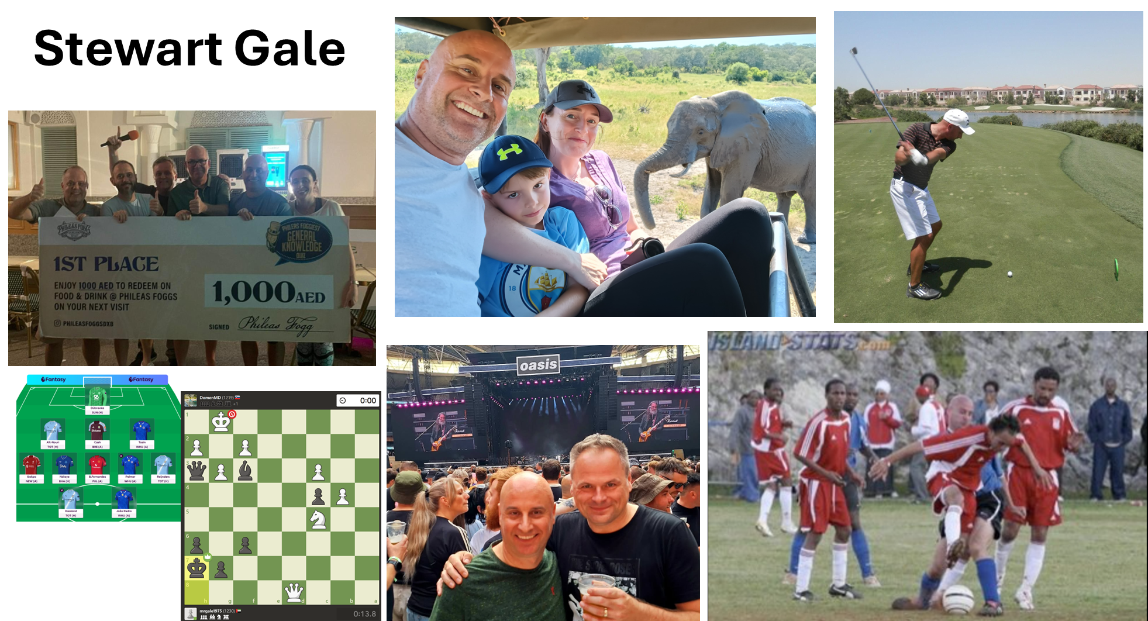
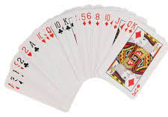

Slide 6
Forename | Surname
Kabir | Agarwal
Mila | Bron
Nish | Byju
Inaaya | Chhabra
Anita | Duarte
Alexandre | Horncastle
Jordan | Jain
Oliver | Jones
Maahir | Katoch
Henry | Kramer
Hayeon | Kwon
Amara | Lanjekar
James | Latto
Muhammed | Mahmood
Amina | Mamedova
Isla | Maxwell
Zenya | Rana
Anaira | Randeva
Amina | Sultanova
Selina Jia Yi | Ting
Moksha | Tiyyagura
Ziyang | Zhang
7SGA
Introduce yourself and your preferred name.
What primary school did you come from?
What countries did you visit this summer?
One highlight of the summer?

Slide 7

House System

Slide 8

Year 7
North
South
7A Ms Com
7B Mr Zeineldin
7C Mr Benade
7D Mr Cooney
7E Mr Zpata
7F Ms Duckling
7G Mr Gale
7H Mr Buoncore

