Slide 1
LO: Trigonometry
(Missing Sides and Angles)

Slide 2
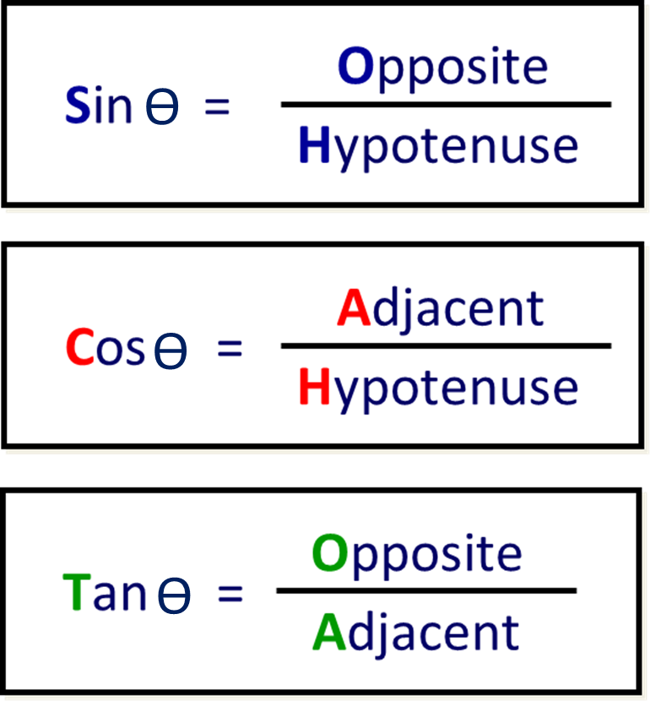

Slide 3
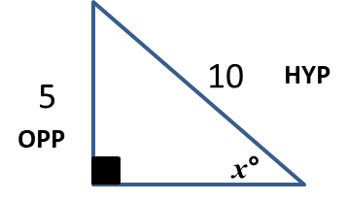
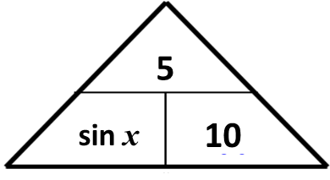
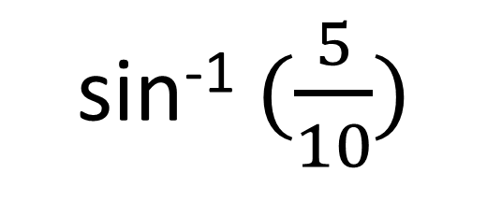
Spot the mistakes!
sin⁻¹ $(\frac{5}{10})$
= 0.087°

Slide 4
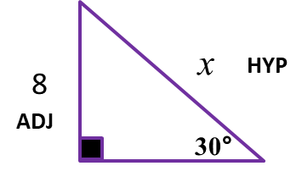
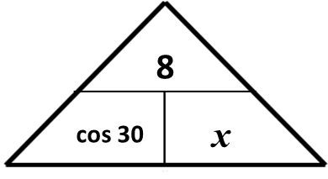
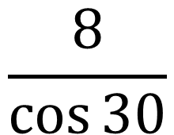
Spot the mistakes!
$$\frac{8}{\cos{30}}$$
= 9.24

Slide 5
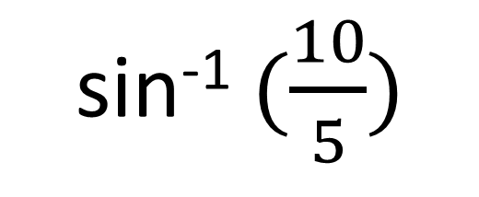
Spot the mistakes!
sin⁻¹ $(\frac{10}{5})$
10
Error
= 0.087°
5

Slide 6

Angles of Elevation:
horizontal and up
Angle of Depression:
horizontal and down

Slide 7
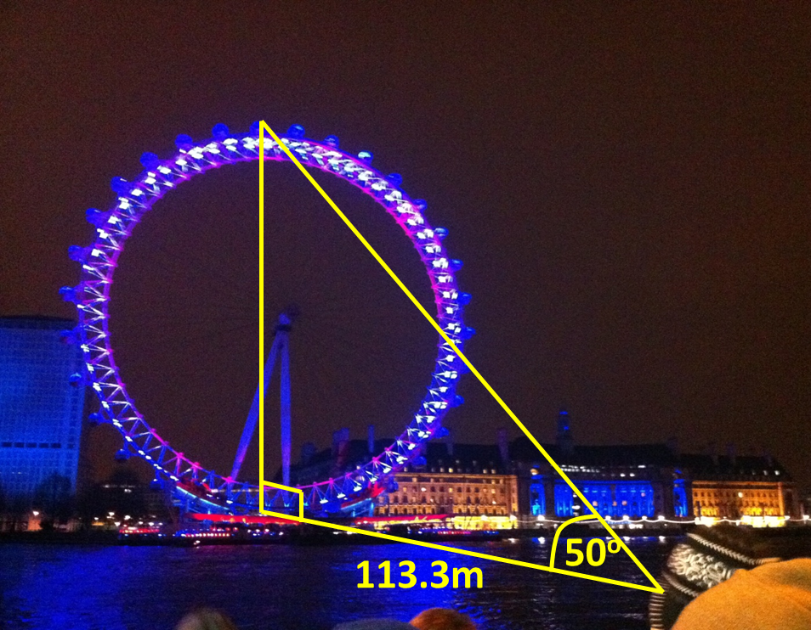
Elevation or Depression?

Slide 8
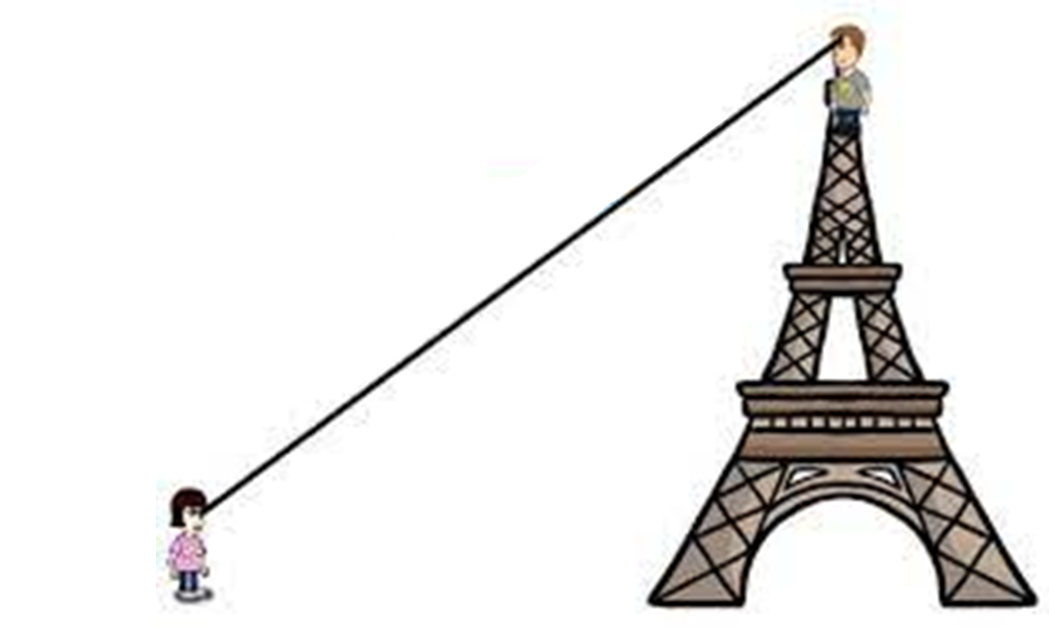
Elevation or Depression?
23°

Slide 9
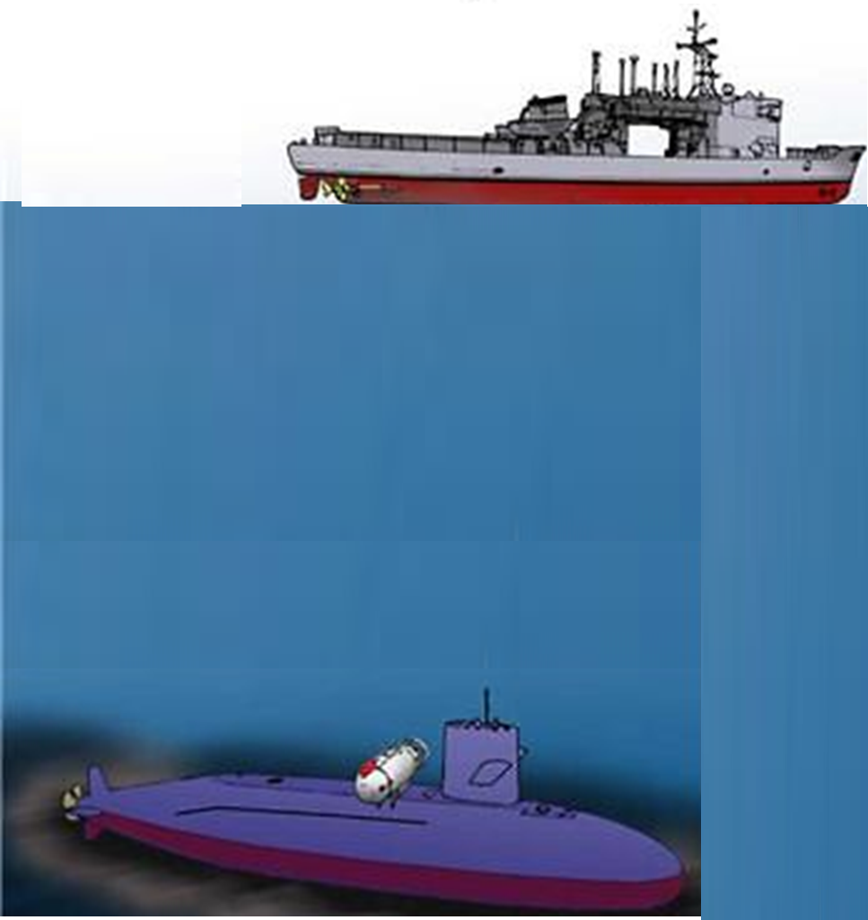
Elevation or Depression?
23°

Slide 10
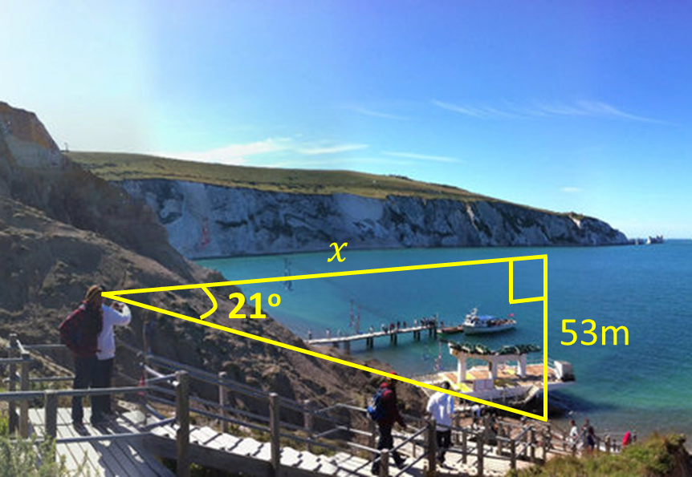
Elevation or Depression?

Slide 11
Elevation or Depression?
23°

Slide 12
Bearings
Northline
Clockwise
3 Figures
130˚

Slide 13
What is the bearing of C from A?
120˚
6 km
B
A
30˚
3.5 km
C

Slide 14

What is the bearing of C from A?
3
3 km
tan x
B
5
A
30˚
tan⁻¹ $(\frac{3}{5})$
31˚
= 0.
5 km
121˚
C

