Slide 1
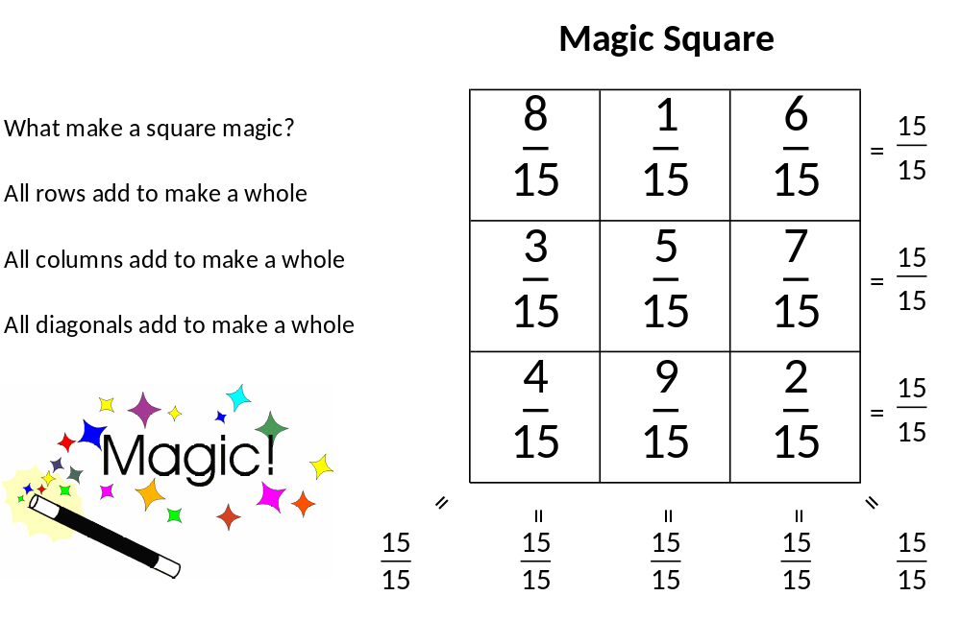

Magic Squares
Rows, Columns and Diagonals all sum
to the same total.

Slide 2
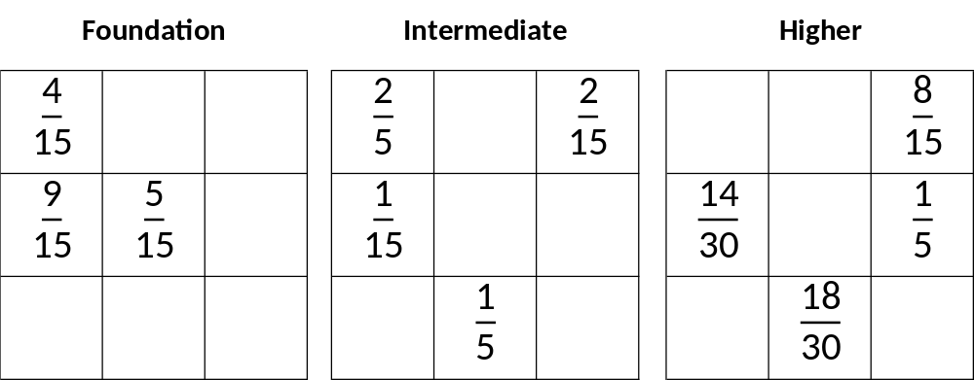

Slide 3
ANSWERS

Slide 4
