Slide 1
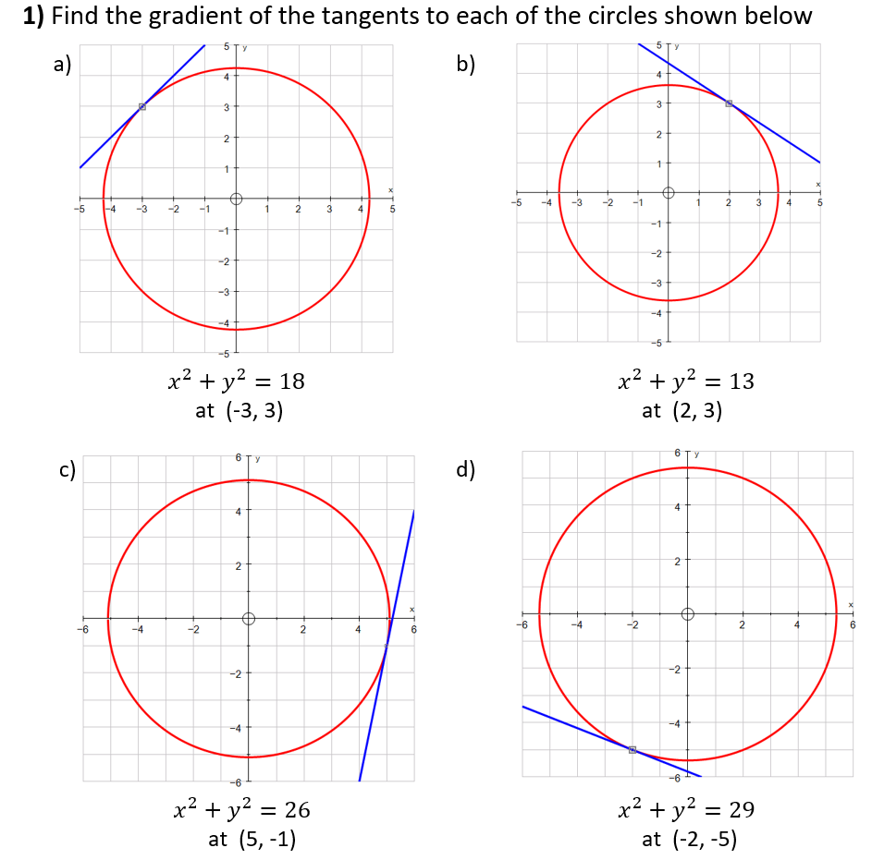
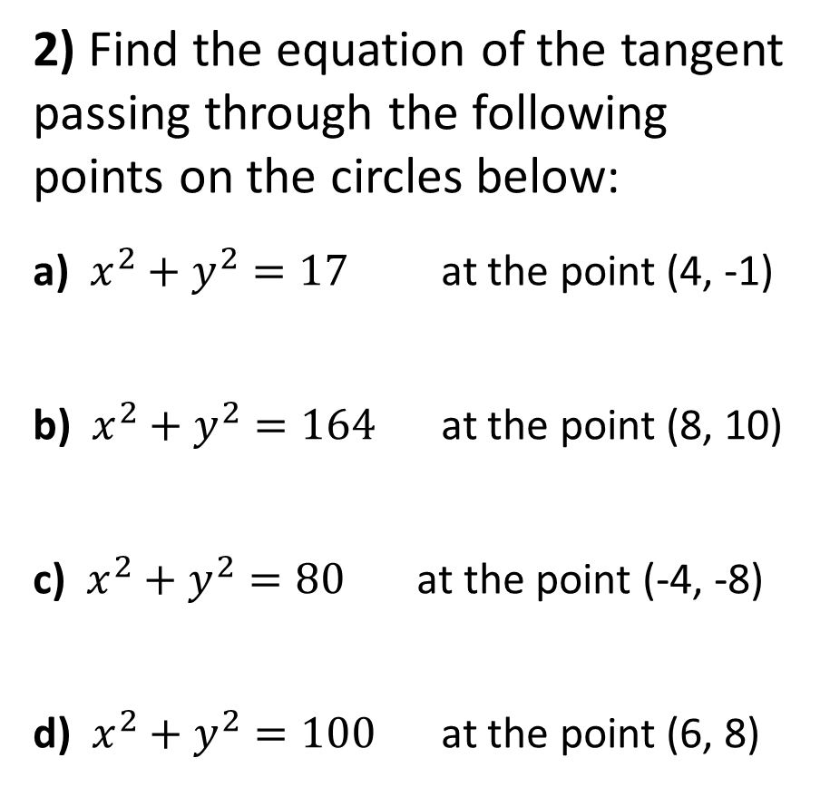
2) Find the equation of the tangent passing through the following points on the circles below:
a) $x^{2}+y^{2}=17$ at the point (4, -1)
b) $x^{2}+y^{2}=164$ at the point (8, 10)
c) $x^{2}+y^{2}=80$ at the point (-4, -8)
d) $x^{2}+y^{2}=100$ at the point (6, 8)

Slide 2
ANSWERS

Slide 3
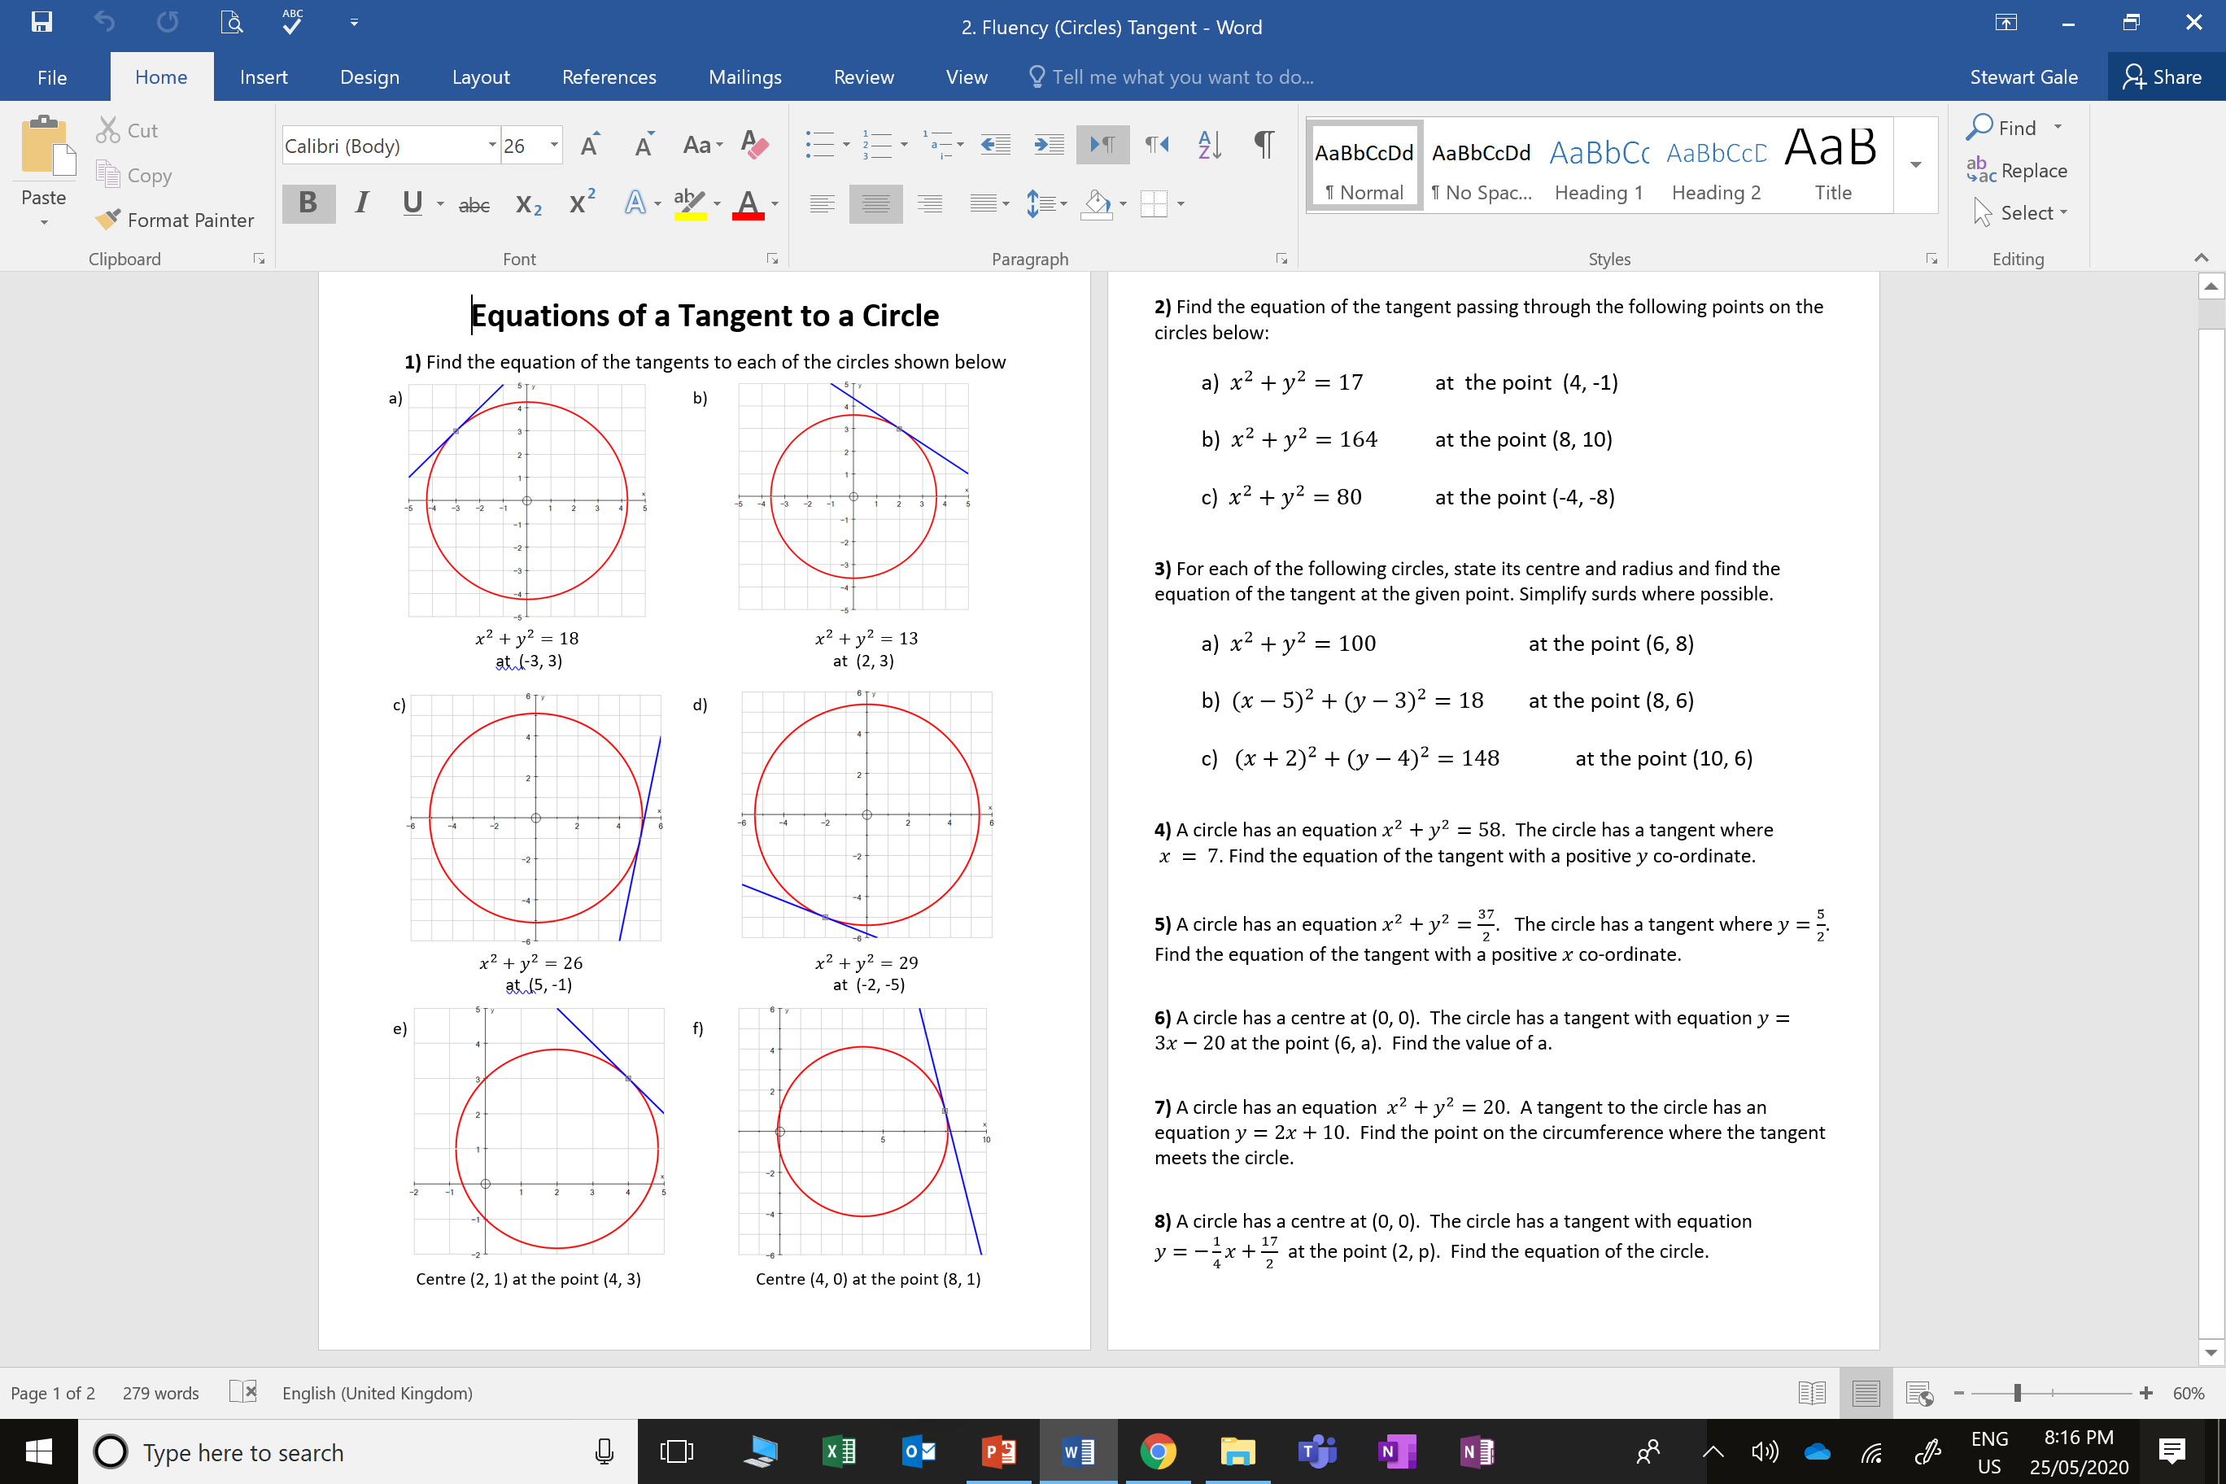
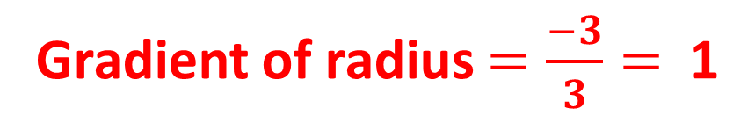
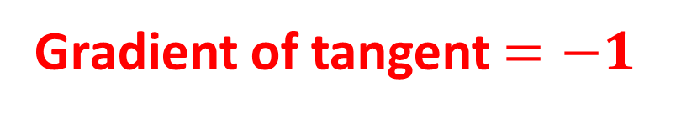
Gradient of radius $=\frac{−3}{3}=$ 1
Gradient of tangent $=−1$

Slide 4

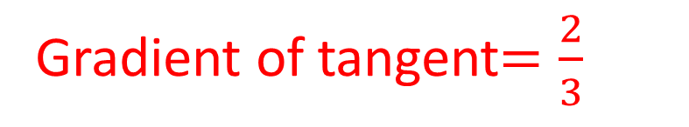
Gradient of radius $=\frac{3}{2}$
Gradient of tangent$=\frac{2}{3}$

Slide 5
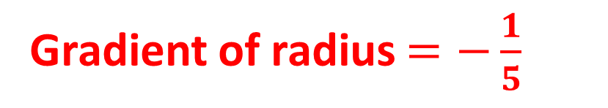

Gradient of radius $=−\frac{1}{5}$
Gradient of tangent $=5$

Slide 6
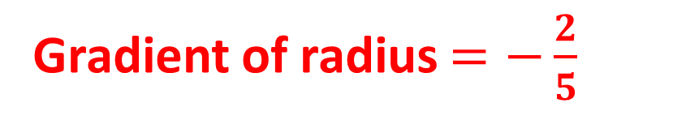
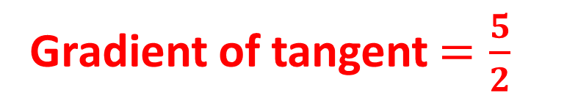
Gradient of radius $=−\frac{2}{5}$
Gradient of tangent $=\frac{5}{2}$

Slide 7
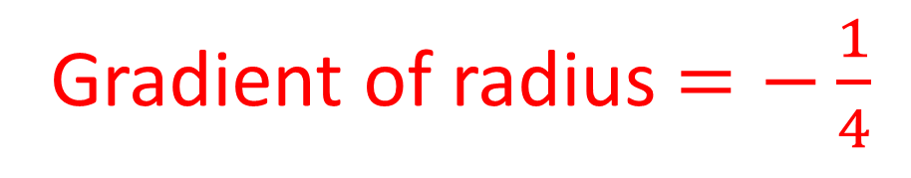
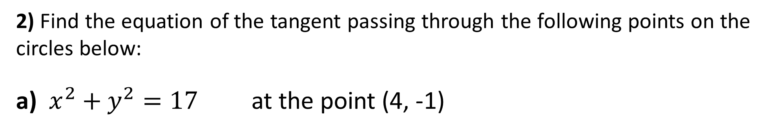
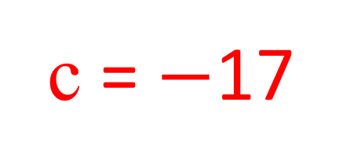
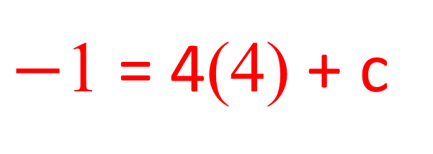
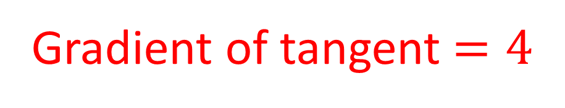
2) Find the equation of the tangent passing through the following points on the circles below:
a) $x^{2}+y^{2}=17$ at the point (4, -1)
y = mx + c
y = 4x + c
Gradient of radius $=−\frac{1}{4}$
$−$1 = 4(4) + c
Gradient of tangent $=4$
c = $−$17
y = 4x – 17

Slide 8
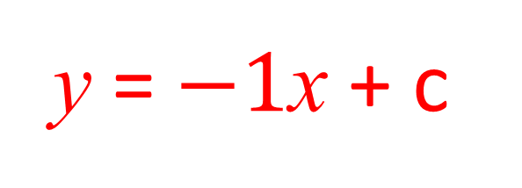
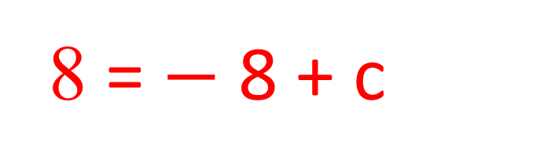
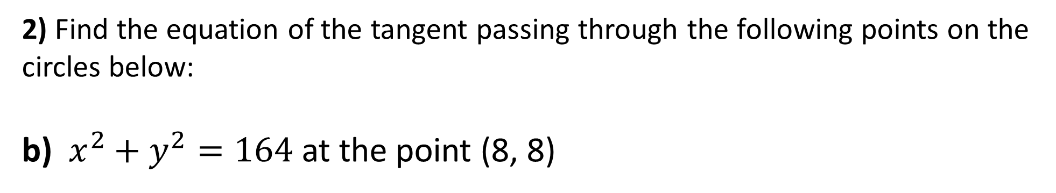
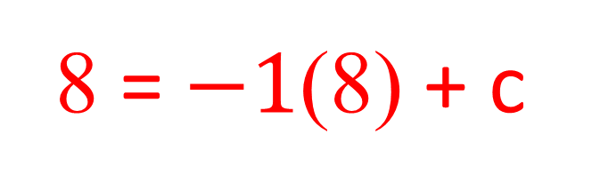
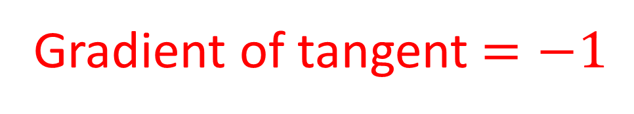
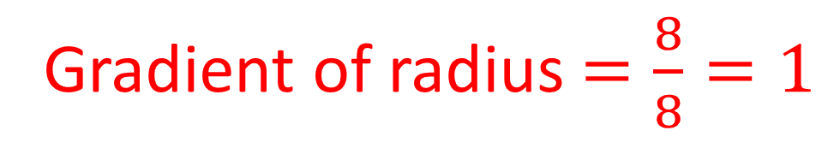
2) Find the equation of the tangent passing through the following points on the circles below:
b) $x^{2}+y^{2}=164$ at the point (8, 8)
y = $−1$x + c
8 = $−1$(8) + c
Gradient of radius $=\frac{8}{8}=1$
8 = $−$8 + c
Gradient of tangent $=−1$
c = 16
y = x + 16

Slide 9
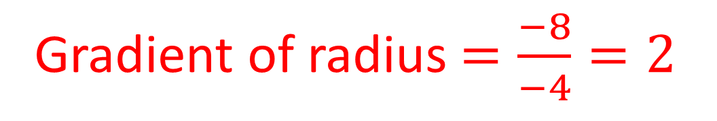
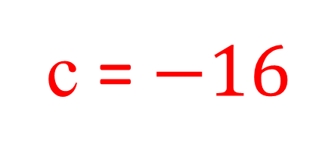
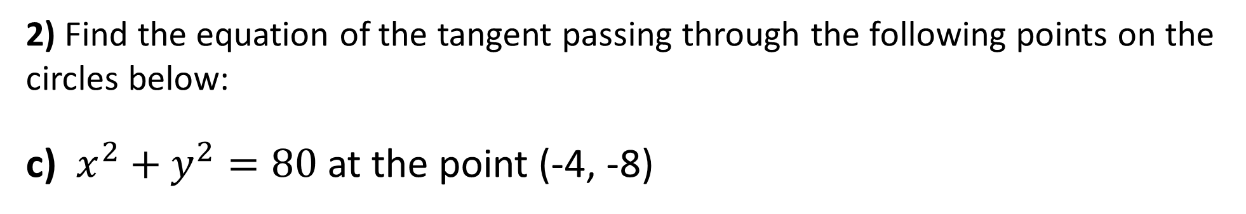
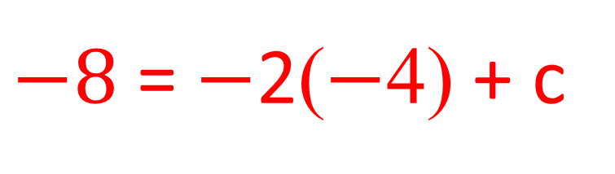
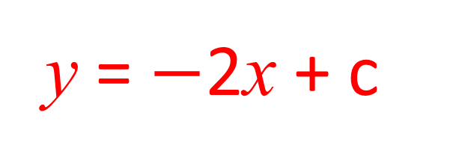
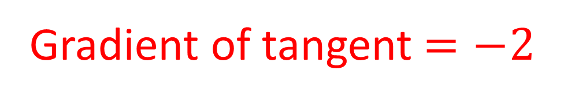
2) Find the equation of the tangent passing through the following points on the circles below:
c) $x^{2}+y^{2}=80$ at the point (-4, -8)
y = mx + c
y = $−$2x + c
Gradient of radius $=\frac{−8}{−4}=2$
$−8$ = $−$2($−$4) + c
Gradient of tangent $=−2$
c = $−16$
y = –2x – 16

Slide 10
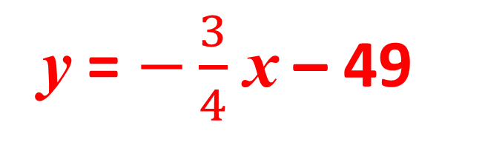
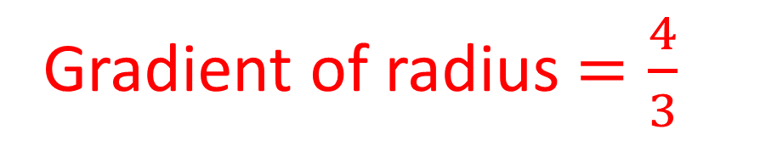
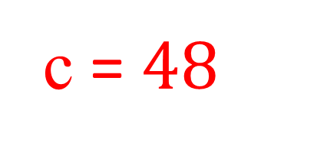
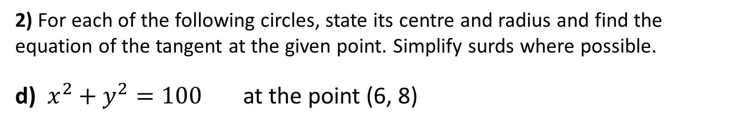
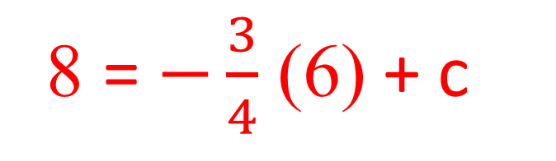
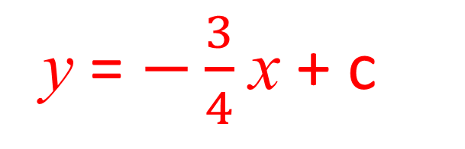
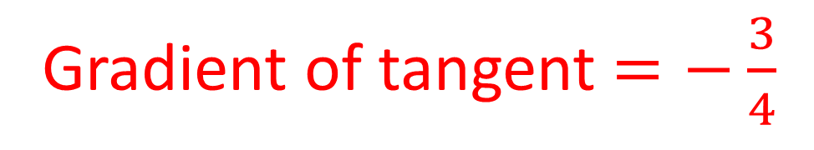
2) For each of the following circles, state its centre and radius and find the equation of the tangent at the given point. Simplify surds where possible.
d) $x^{2}+y^{2}=100$ at the point (6, 8)
y = mx + c
y = $−\frac{3}{4}$x + c
Centre (0, 0)
Radius = 10
8 = $−\frac{3}{4}$ (6) + c
Gradient of radius $=\frac{4}{3}$
c = $48$
Gradient of tangent $=−\frac{3}{4}$
y = $−\frac{3}{4}$ x – 49

