Slide 1
Radians
Small Angle Approximation
Chapter 5
(Part 5 of 5)

Slide 2
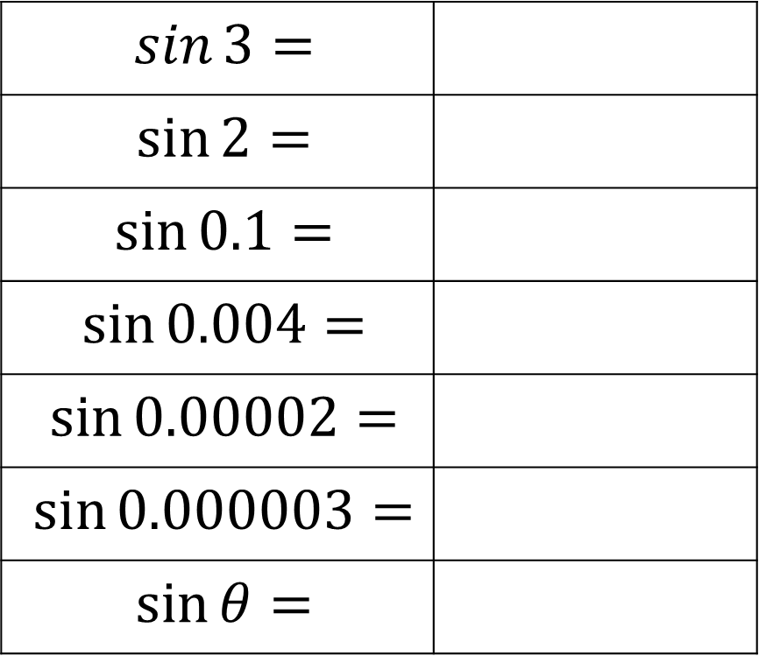
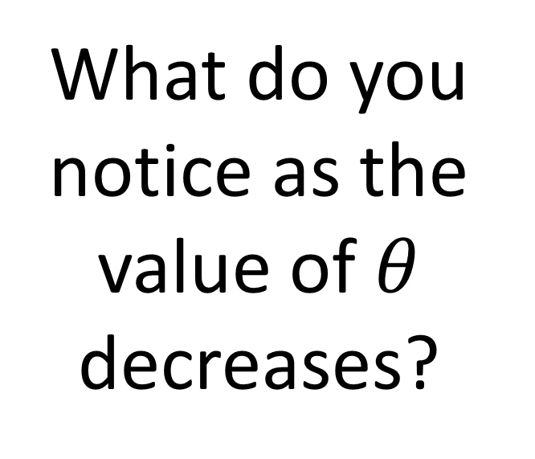

Small Angle Approximations
$$\sin{3}=$$
$$\sin{2}=$$
$$\sin{0.1}=$$
$$\sin{0.004}=$$
$$\sin{0.00002}=$$
$$\sin{0.000003}=$$
$$\sin{θ}=$$
0.14112000
0.90929742
What do you notice as the value of $θ$ decreases?
0.09983341
0.0039999
0.00002
0.000003
$$θ$$

Slide 3
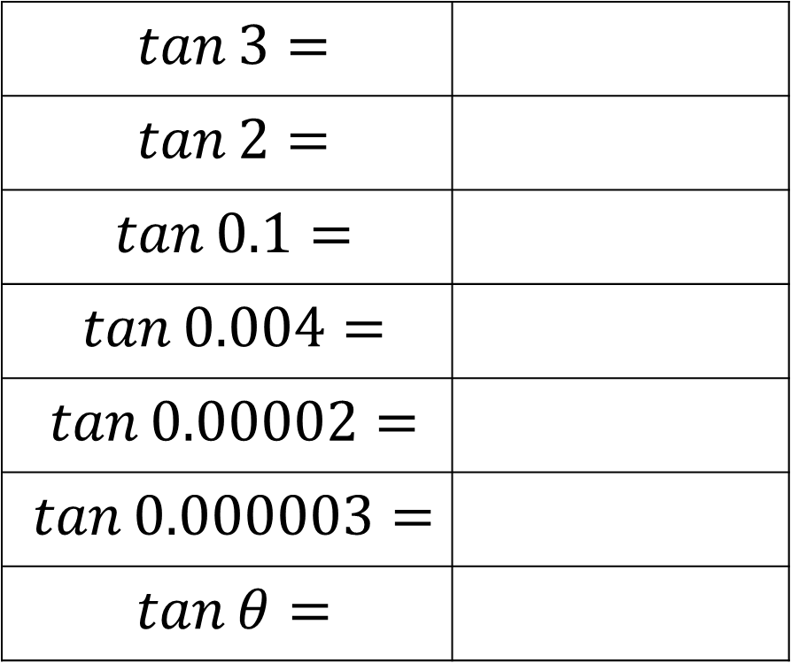
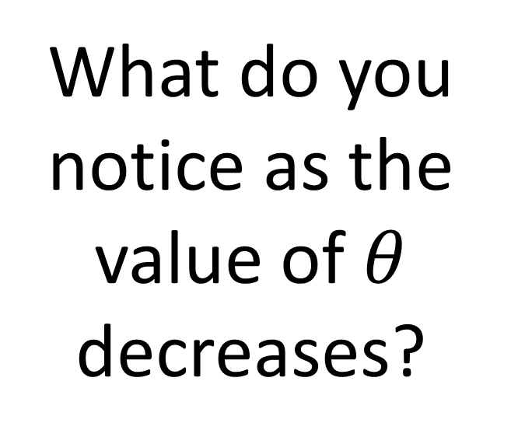
Small Angle Approximations
$$\tan{3}=$$
$$\tan{2}=$$
$$\tan{0.1}=$$
$$\tan{0.004}=$$
$$\tan{0.00002}=$$
$$\tan{0.000003}=$$
$$\tan{θ}=$$
-0.1425465
-2.1850398
What do you notice as the value of $θ$ decreases?
0.10033467
0.00400002
0.00002
0.000003
$$θ$$

Slide 4



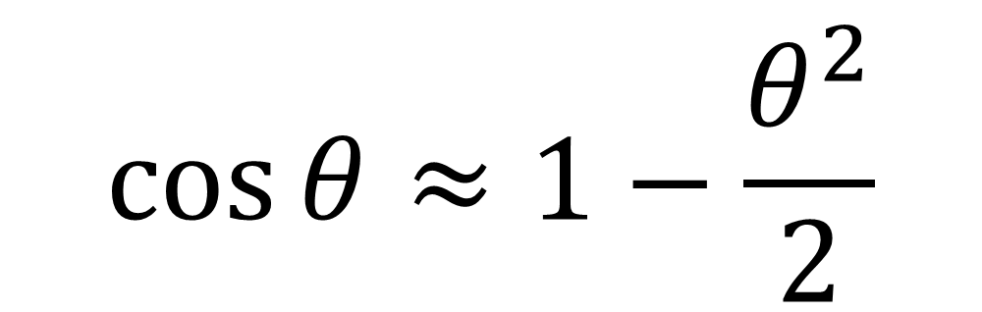
When $θ$ is small
and measured in radians:
$$\sin{θ}≈θ$$
$$\tan{θ}≈θ$$
$$\cos{θ}≈1−\frac{θ^{2}}{2}$$

Slide 5
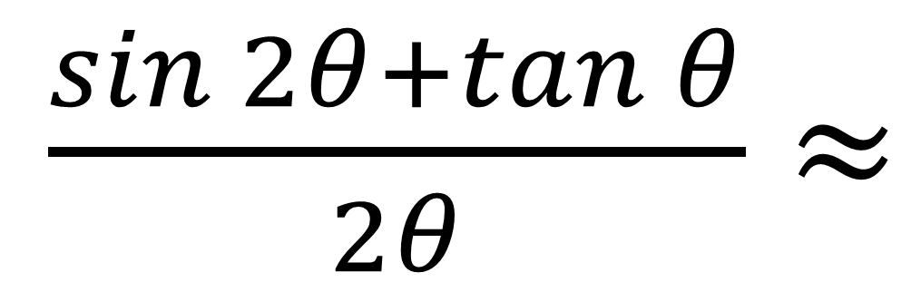
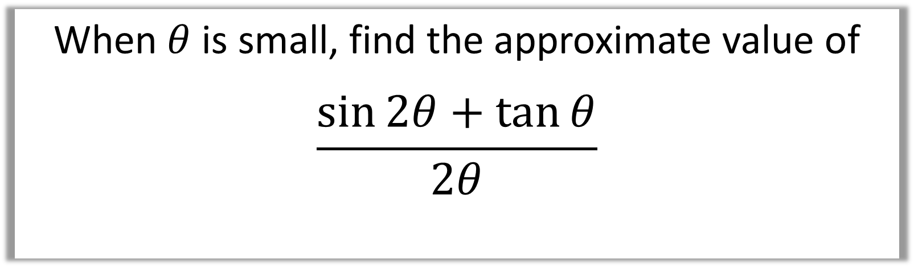

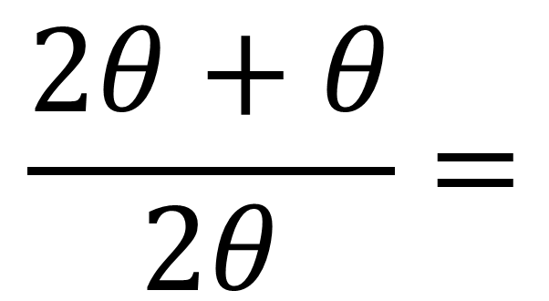
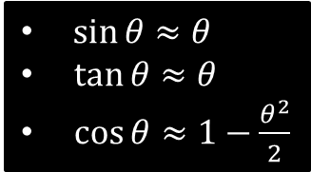
When $θ$ is small, find the approximate value of
$$\frac{\sin{2θ}+\tan{θ}}{2θ}$$
$\sin{θ}≈θ$
$\tan{θ}≈θ$
$\cos{θ}≈1−\frac{θ^{2}}{2}$
$\frac{\sin{2θ}+\tan{θ}}{2θ}≈$
$$\frac{2θ+θ}{2θ}=$$
$$\frac{3}{2}$$

Slide 6
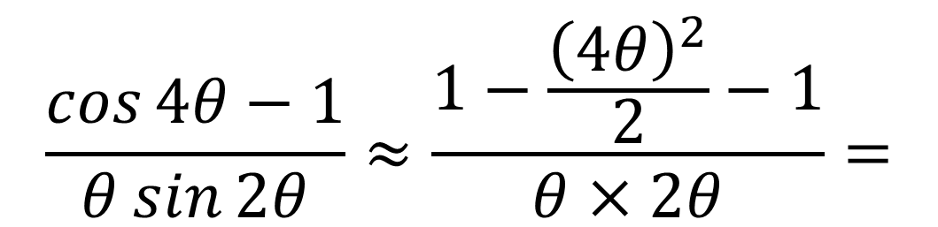



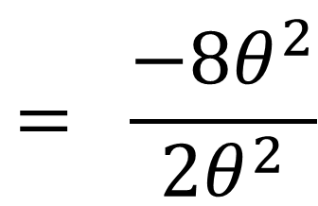
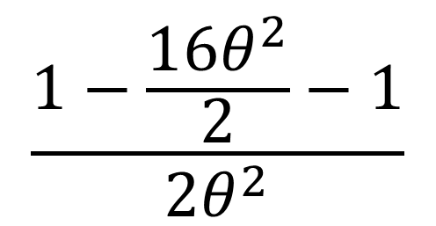
When $θ$ is small, find the approximate value of
$\frac{\cos{4θ}−1}{θ\sin{2θ}}$
$\sin{θ}≈θ$
$\tan{θ}≈θ$
$\cos{θ}≈1−\frac{θ^{2}}{2}$
$$\frac{\cos{4θ}−1}{θ\sin{2θ}}≈\frac{1−\frac{{\left(4θ\right)}^{2}}{2}−1}{θ×2θ}=$$
$$\frac{1−\frac{16θ^{2}}{2}−1}{2θ^{2}}$$
$$= \frac{−8θ^{2}}{2θ^{2}}$$
$$= −4$$

Slide 7
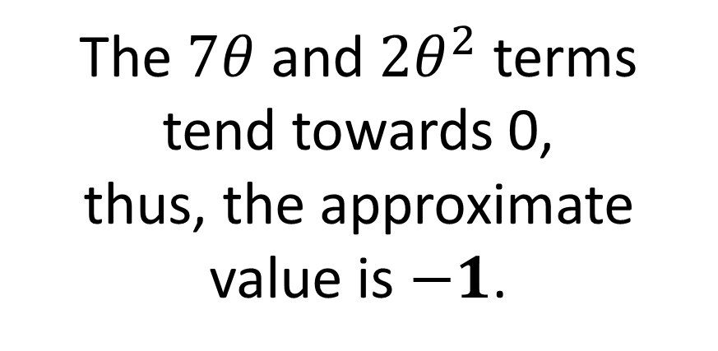
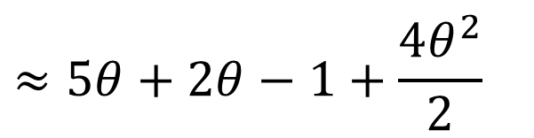
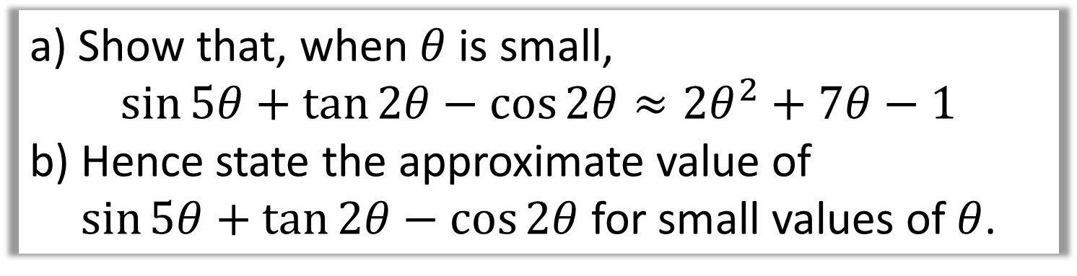
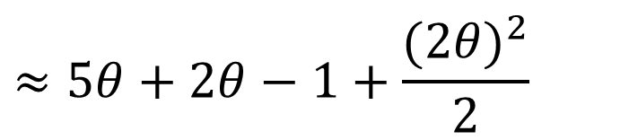

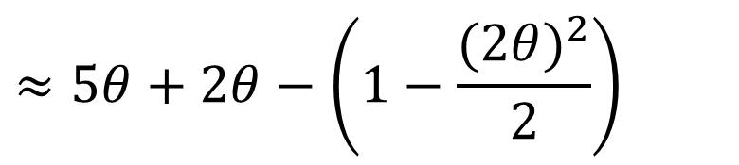
a) Show that, when $θ$ is small,
$$\sin{5θ}+\tan{2θ}−\cos{2θ}≈2θ^{2}+7θ−1$$
b) Hence state the approximate value of
$\sin{5θ}+\tan{2θ}−\cos{2θ}$ for small values of $θ$.
$$≈5θ+2θ−\left(1−\frac{(2{θ)}^{2}}{2}\right)$$
b)
a)
The $7θ$ and $2θ^{2}$ terms
tend towards 0,
thus, the approximate value is $−1$.
$$≈5θ+2θ−1+\frac{(2{θ)}^{2}}{2}$$
$$≈5θ+2θ−1+\frac{4θ^{2}}{2}$$
$$=7θ−1+2θ^{2}$$

