Slide 1
Forces and Motions
Pulleys – Two Vertical
SUVAT
Chapter 10
(Part 7 of 9)

Slide 2
SUVAT and Pullies
Sometimes you need to use the SUVAT equations to find speeds and distances travelled by the particles.

Slide 3
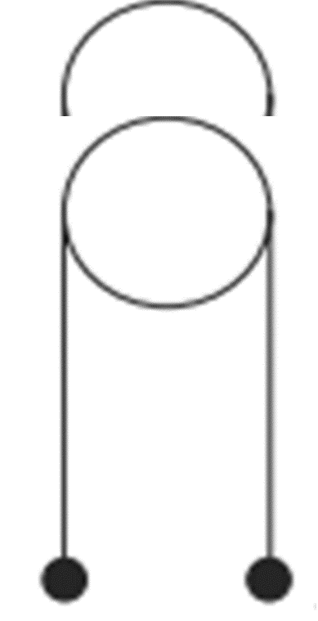


Q is heavier than P.
Q is released.
Split particle P journey into two parts.
$$P$$
$$Q$$

Slide 4
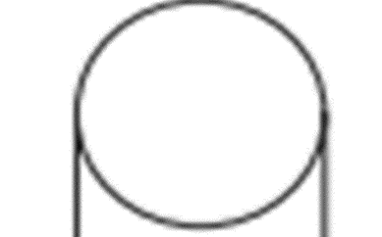
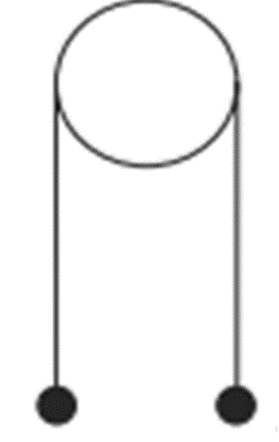
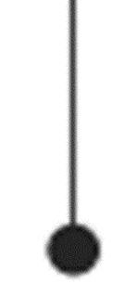




$$P$$
$$P$$
$$P$$
$$Q$$
$$Q$$
$$Q$$

Slide 5

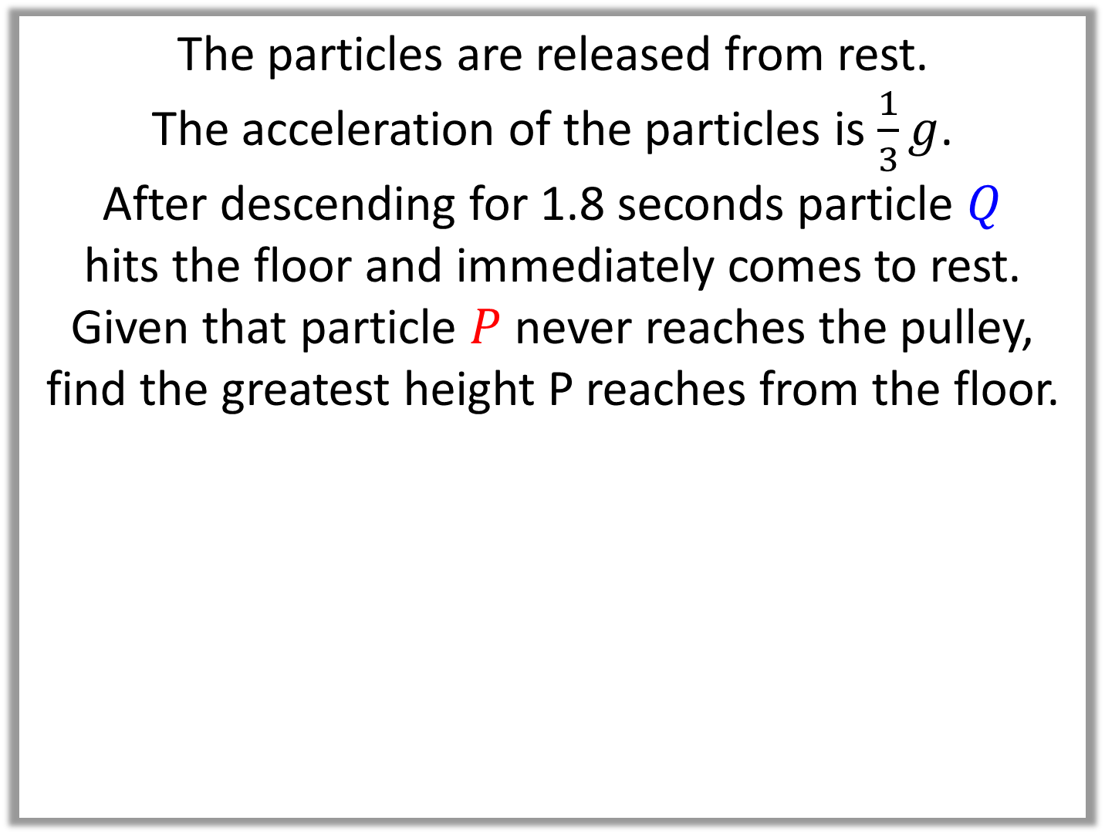



The particles are released from rest.
The acceleration of the particles is $\frac{1}{3}g$.
After descending for 1.8 seconds particle $Q$
hits the floor and immediately comes to rest.
Given that particle $P$ never reaches the pulley,
find the greatest height P reaches from the floor.
$$P$$
$$Q$$
$$1.5m$$
$$3m$$

Slide 6
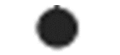

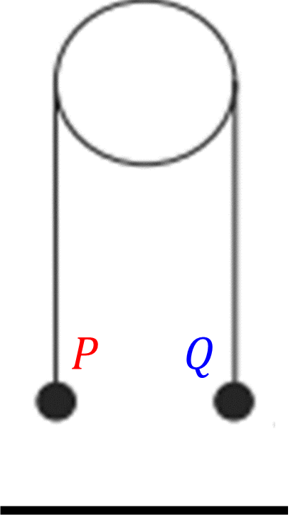





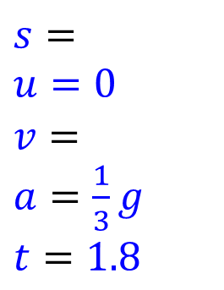
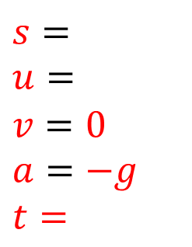
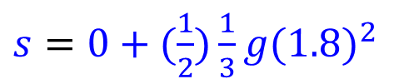

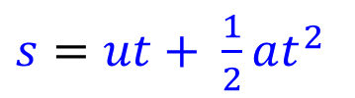
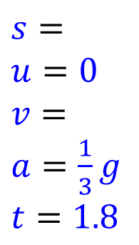
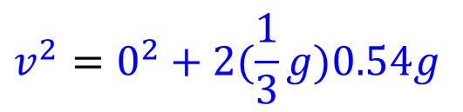
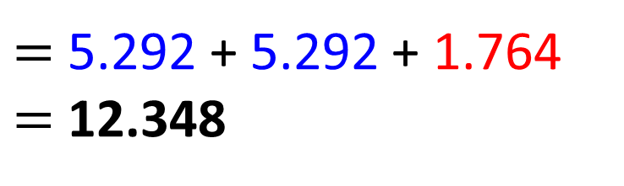


Height Above the Ground
$$s=$$
$$u=$$
$$v=0$$
$$a=−g$$
$t=$
$$v^{2}=u^{2}+2as$$
$=$ 5.292 + 5.292 + 1.764
$=$ 12.348
$$5.88$$
$$0^{2}={(5.88)}^{2} + 2\left(−g\right)s$$
$$s=1.764$$
$$s=$$
$u=0$
$$v=$$
$a=\frac{1}{3}g$
$t=1.8$
$$5.292$$
$$v^{2}=u^{2}+2as$$
$$v^{2}=0^{2}+2(\frac{1}{3}g)0.54g$$
$$v=5.88$$
$$s=$$
$u=0$
$$v=$$
$a=\frac{1}{3}g$
$t=1.8$
$s=ut+ \frac{1}{2}at^{2}$
$s=0+(\frac{1}{2})\frac{1}{3}g{(1.8)}^{2}$
$$s=5.292$$

