Slide 1
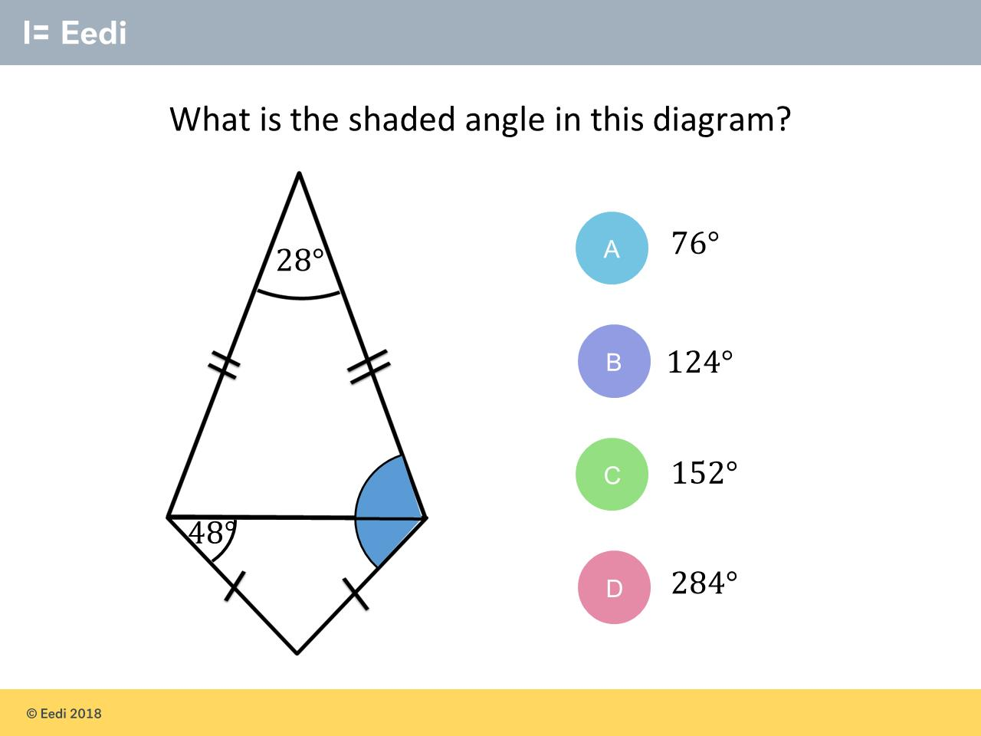
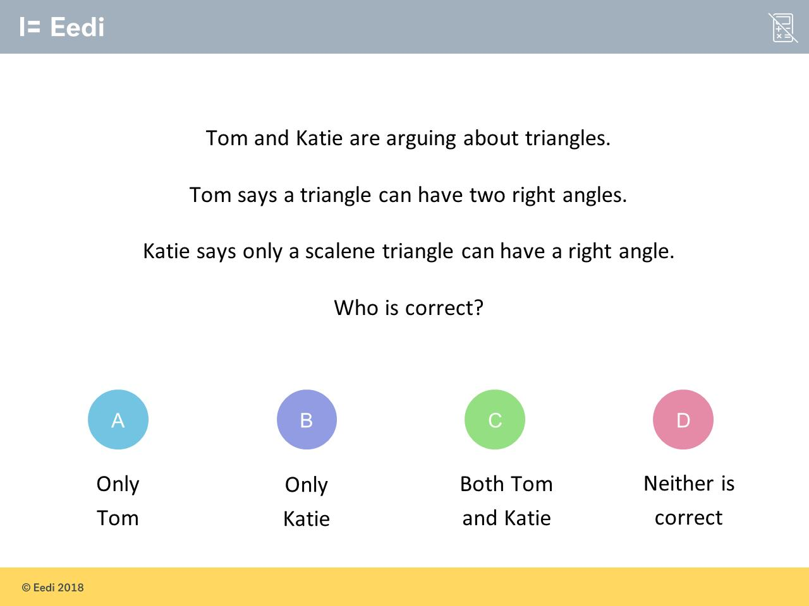
Worst answered question?
Most common wrong answer?

Slide 2
ANSWERS

Slide 3
Worst answered question?

Slide 4
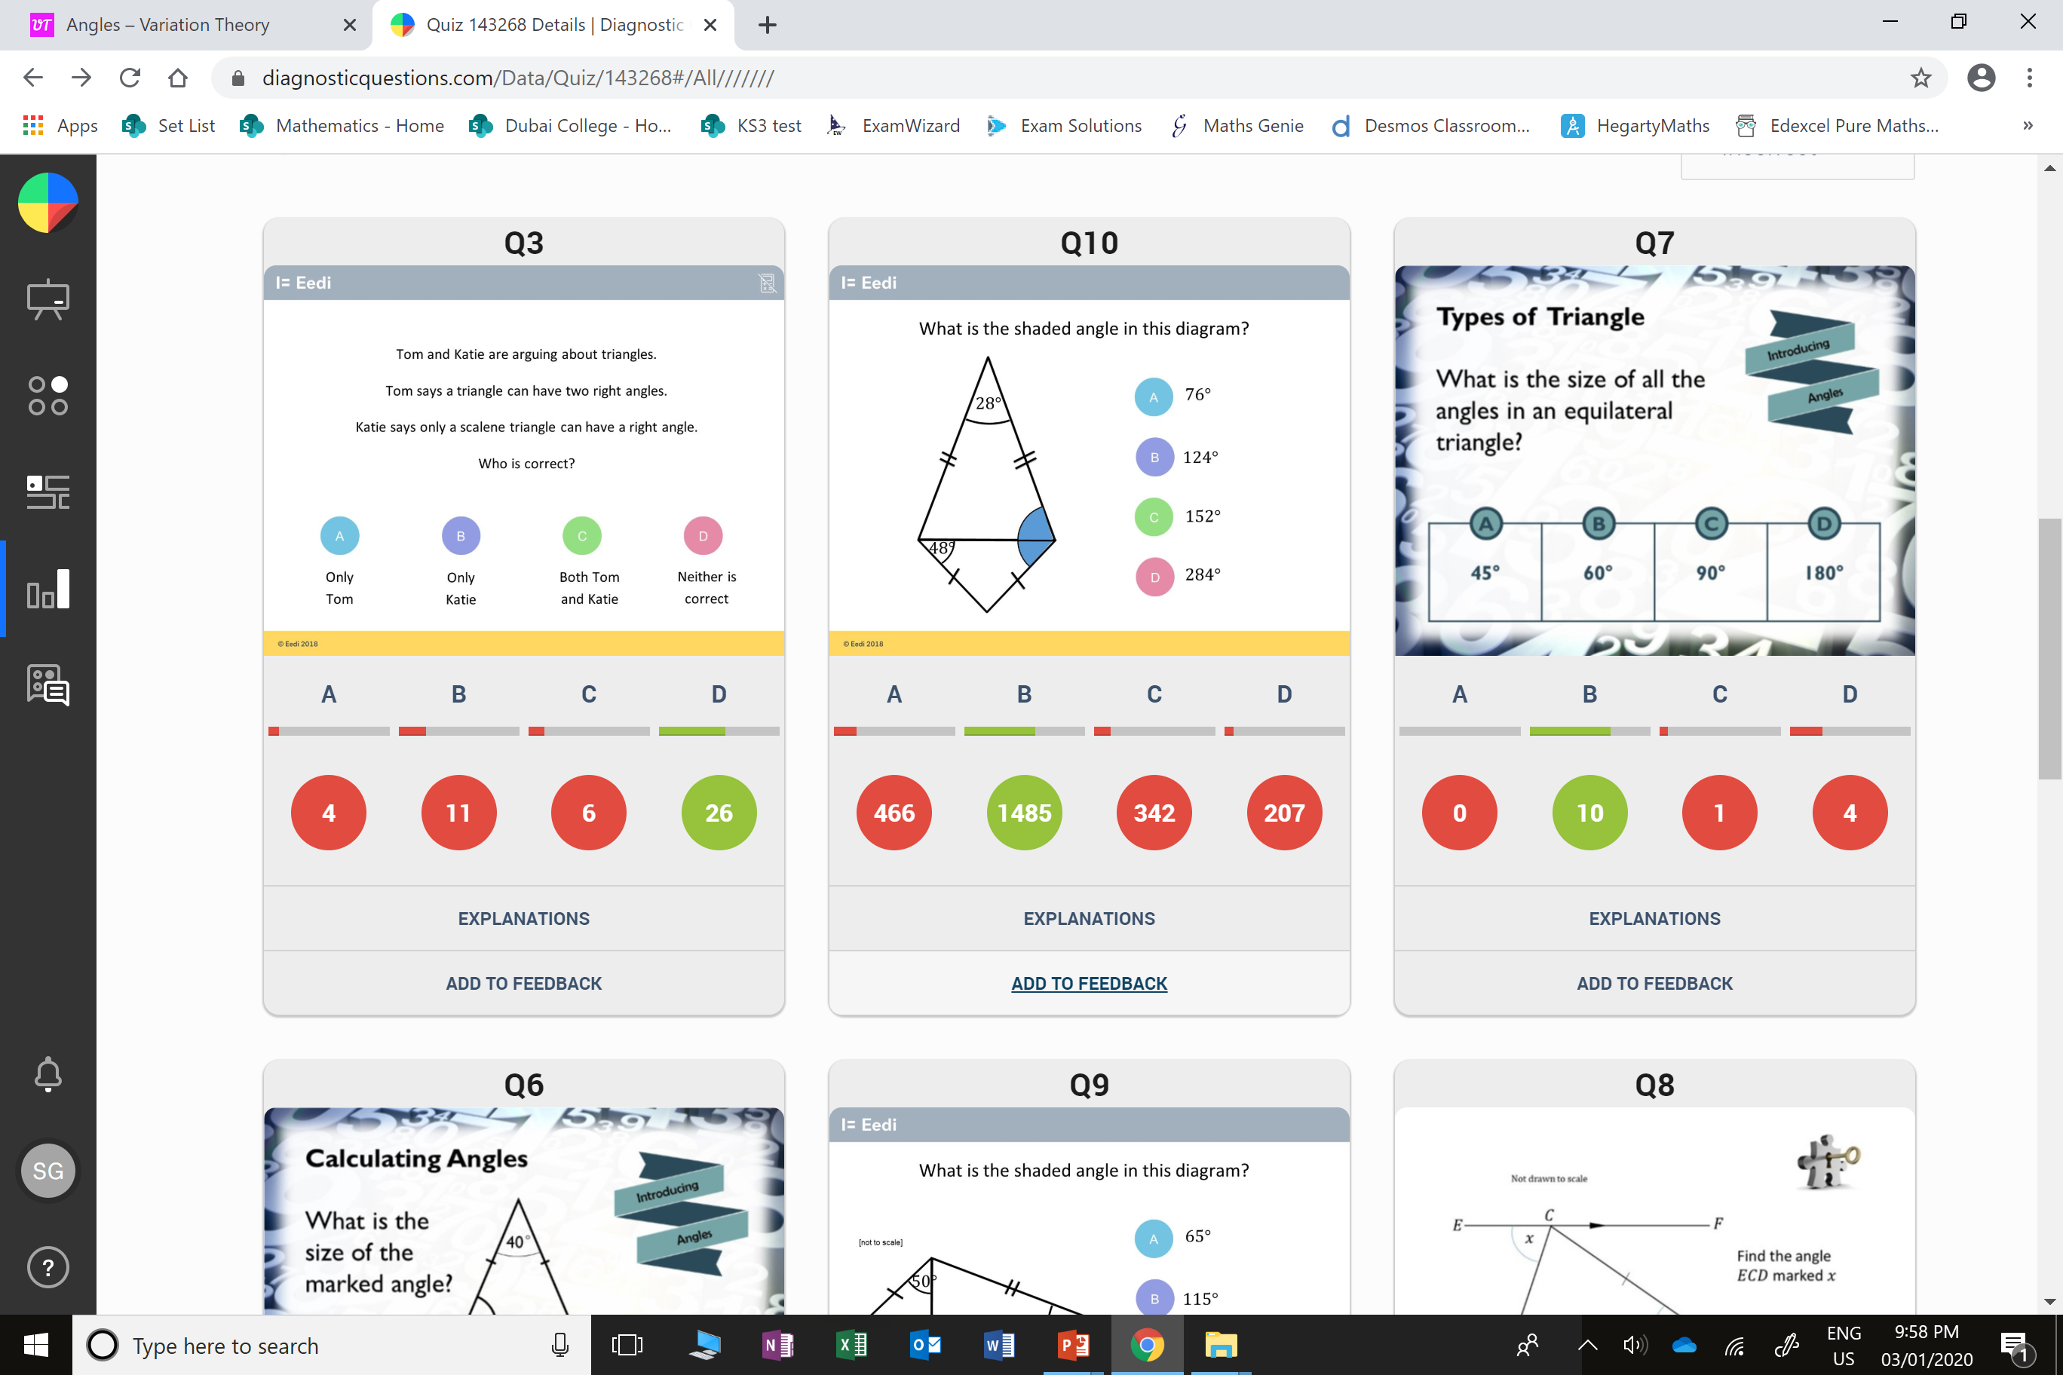
B
They didn’t realise that a isosceles triangle can have
a right angle.

Slide 5
A
The students only found
the top angle.

