Slide 1
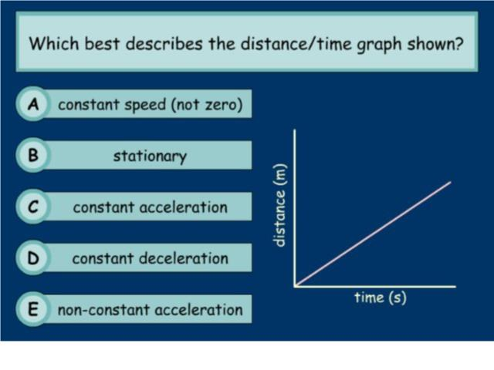
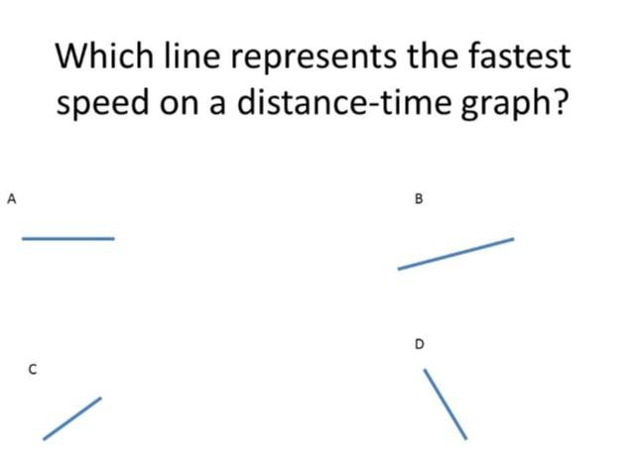
Worst answered question?
Most common wrong answer?

Slide 2
ANSWERS

Slide 3
Worst answered question?

Slide 4

C
They think a down slope is slowing down.

Slide 5
C
They think it is a
speed time graph.

