Slide 1
1) $£1000 invested over 4$years at a rate of 10% per annum
2) $£1000 invested over 2$years at a rate of 10% per annum
3) $£1000 depreciating over 2$years at a rate of 10% per annum
4) $£1000 depreciating over 4$years at a rate of 10% per annum
5) $£1000 invested over 4$years at a rate of 5% per annum
6) $£1000 depreciating over 4$years at a rate of 5% per annum
7) $£1000 invested over 8$years at a rate of 5% per annum
8) $£1000 depreciating over 8 years$ at a rate of 5% per annum

Slide 2
1) A jacket costing £30 increased in price by 10% and then by a further 15%.
How much did it cost after the increases?
2) A jumper costing £30 increased in price by 35% and then by a further 22%.
How much did it cost after the increases?
3) A pair of shoes cost £45. In a sale they decreased in price by 4% and then by a further 18%.
How much did they cost after the decreases?
4) Dave invested £400 in a bank account that paid compound interest of 8% per year.
How much did he have in his account two years later?
5) Marie invested £3000 in a bank account that paid compound interest of 7% per year.
How much did she have in her account four years later?
6) There were 8000 bees in a nest. Each year the number of bees decreased by 25%.
How many bees were left after 3 years?
7) On July 1st 2014, James invested £2000 at 4.5% per annum compound interest.
Work out the value of James’ investment on July 1st 2016 (two years later)
8) John invested £2000 for three years in an Internet Savings Account.
He is paid 5% per annum compound interest. Work out the total interest earned after three years.

Slide 3
ANSWERS

Slide 4
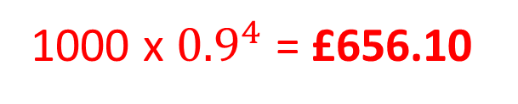

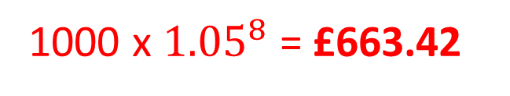
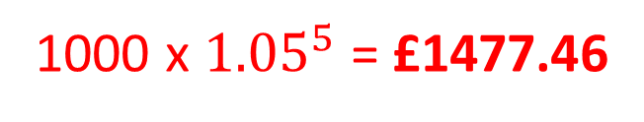
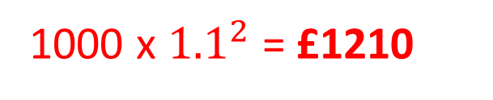
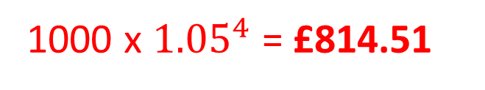
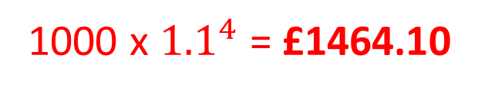
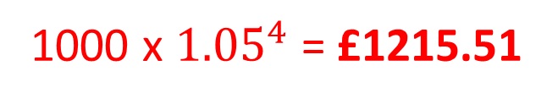
1) $£1000 invested over 4$years at a rate of 10% per annum
1000 x ${1.1}^{4}$ = £1464.10
2) $£1000 invested over 2$years at a rate of 10% per annum
1000 x ${1.1}^{2}$ = £1210
3) $£1000 depreciating over 2$years at a rate of 10% per annum
1000 x ${0.9}^{2}$ = £810
4) $£1000 depreciating over 4$years at a rate of 10% per annum
1000 x ${0.9}^{4}$ = £656.10
5) $£1000 invested over 4$years at a rate of 5% per annum
1000 x ${1.05}^{4}$ = £1215.51
6) $£1000 depreciating over 4$years at a rate of 5% per annum
1000 x ${1.05}^{4}$ = £814.51
7) $£1000 invested over 8$years at a rate of 5% per annum
1000 x ${1.05}^{5}$ = £1477.46
8) $£1000 depreciating over 8 years$ at a rate of 5% per annum
1000 x ${1.05}^{8}$ = £663.42

Slide 5

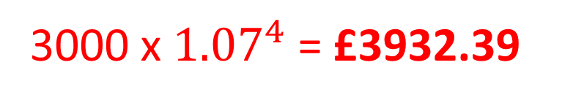
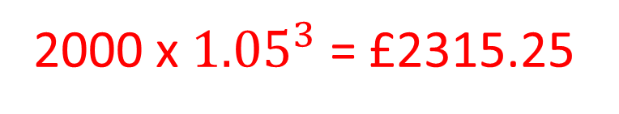
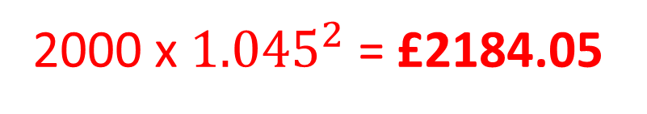
1) A jacket costing £30 increased in price by 10% and then by a further 15%.
How much did it cost after the increases?
2) A jumper costing £30 increased in price by 35% and then by a further 22%.
How much did it cost after the increases?
3) A pair of shoes cost £45. In a sale they decreased in price by 4% and then by a further 18%.
How much did they cost after the decreases?
4) Dave invested £400 in a bank account that paid compound interest of 8% per year.
How much did he have in his account two years later?
5) Marie invested £3000 in a bank account that paid compound interest of 7% per year.
How much did she have in her account four years later?
6) There were 8000 bees in a nest. Each year the number of bees decreased by 25%.
How many bees were left after 3 years?
7) On July 1st 2014, James invested £2000 at 4.5% per annum compound interest.
Work out the value of James’ investment on July 1st 2016 (two years later)
8) John invested £2000 for three years in an Internet Savings Account.
He is paid 5% per annum compound interest. Work out the total interest earned after three years.
30 x 1.1 x 1.15 = £37.95
30 x 1.35 x 1.22 = £49.41
45 x 0.96 x 0.82 = £35.42
400 x 1.08 x 1.08 = £466.56
3000 x ${1.07}^{4}$ = £3932.39
8000 x ${0.75}^{3}$ = 3375
2000 x ${1.045}^{2}$ = £2184.05
2000 x ${1.05}^{3}$ = £2315.25
£315.25

