Slide 1
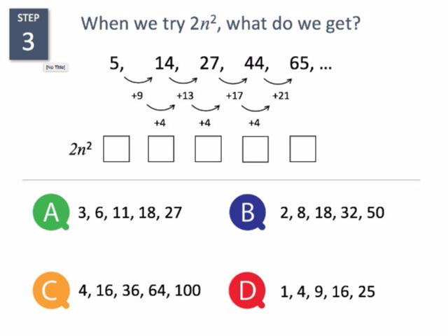
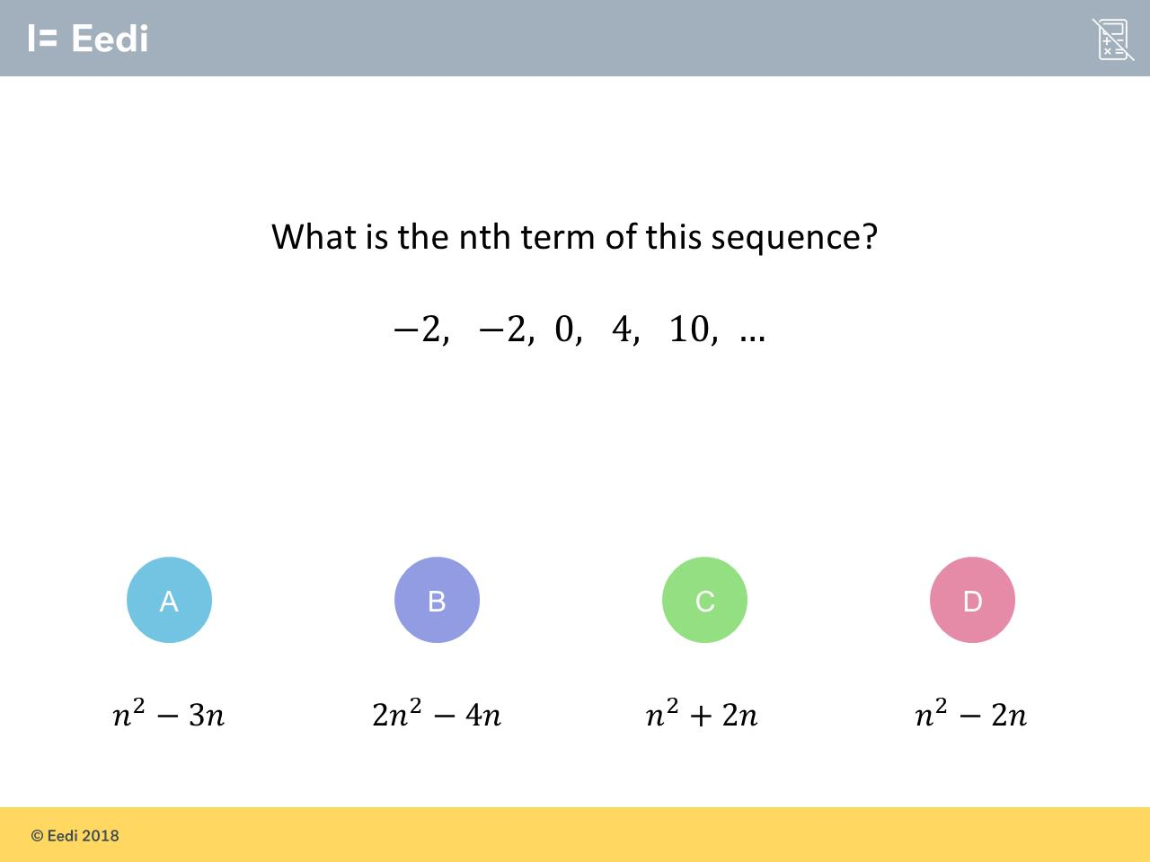
Worst answered question?
Most common wrong answer?

Slide 2
ANSWERS

Slide 3
Worst answered question?

Slide 4
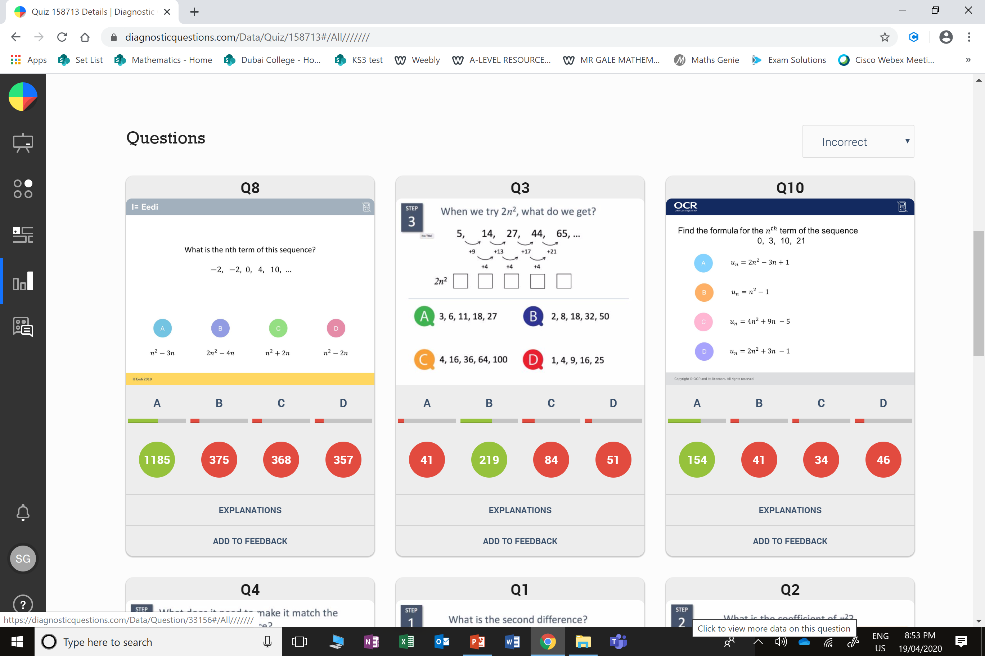
B
The student may not realise that you need to halve the 2nd difference to get the value of n².

Slide 5
C
They multiplied by 2 then squared.

