Slide 1
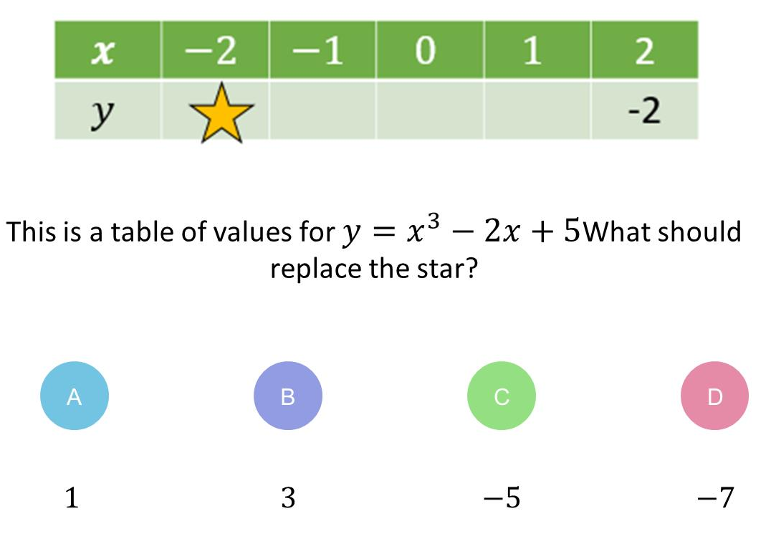
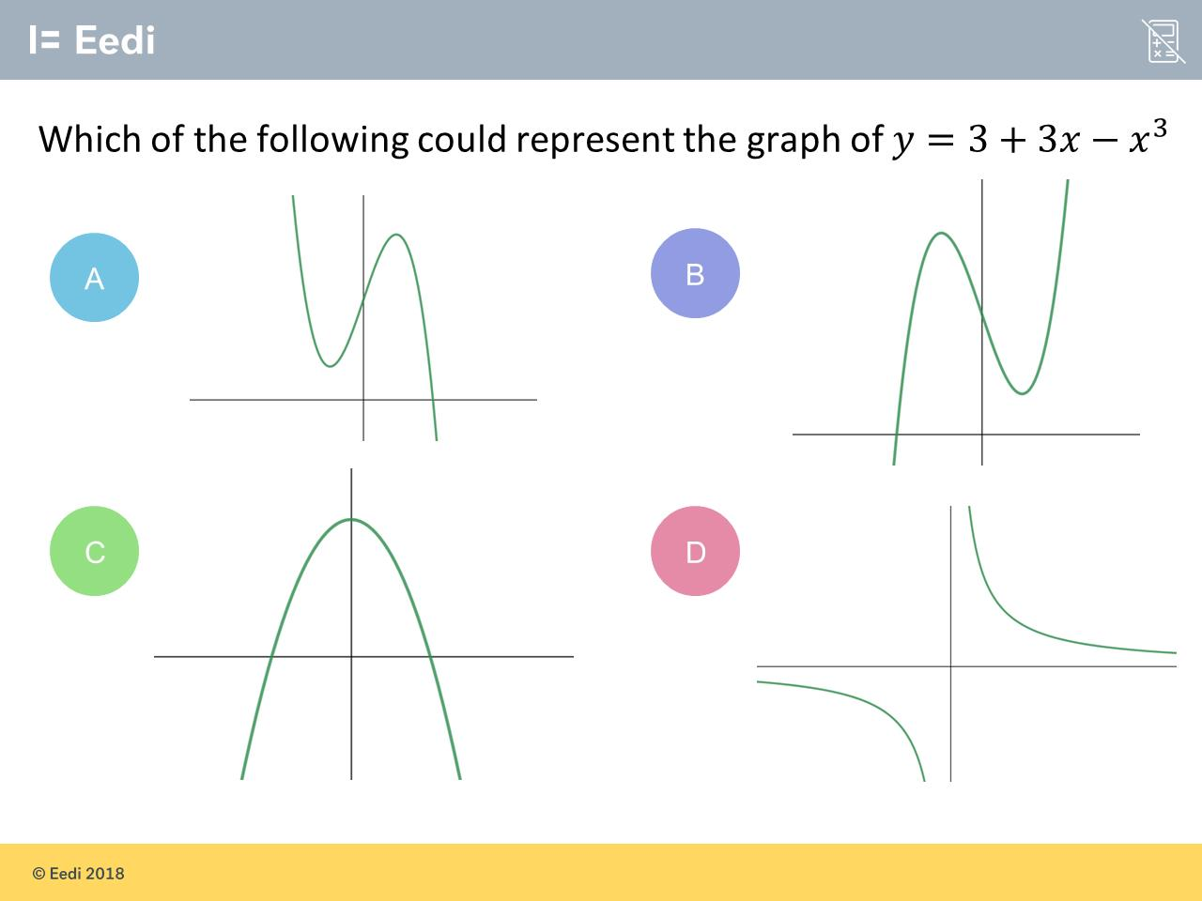
Worst answered question?
Most common wrong answer?

Slide 2
ANSWERS

Slide 3
Worst answered question?

Slide 4
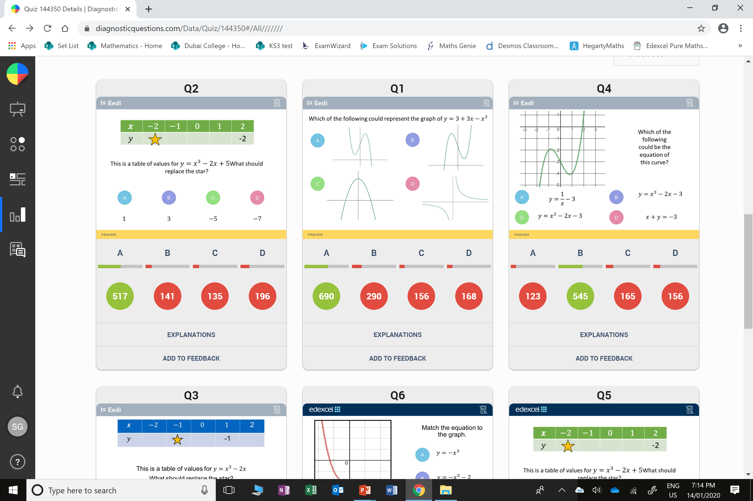
D
They did -2(-2) equal to -4

Slide 5
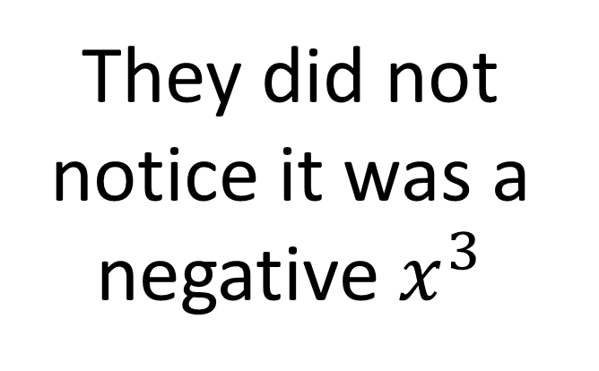
B
They did not notice it was a negative $x^{3}$

