Slide 1
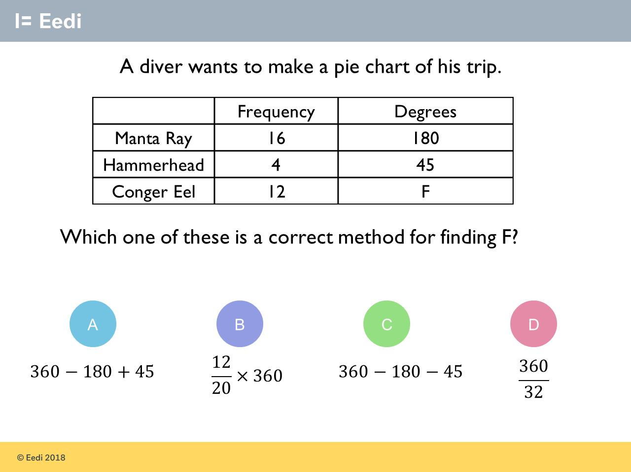
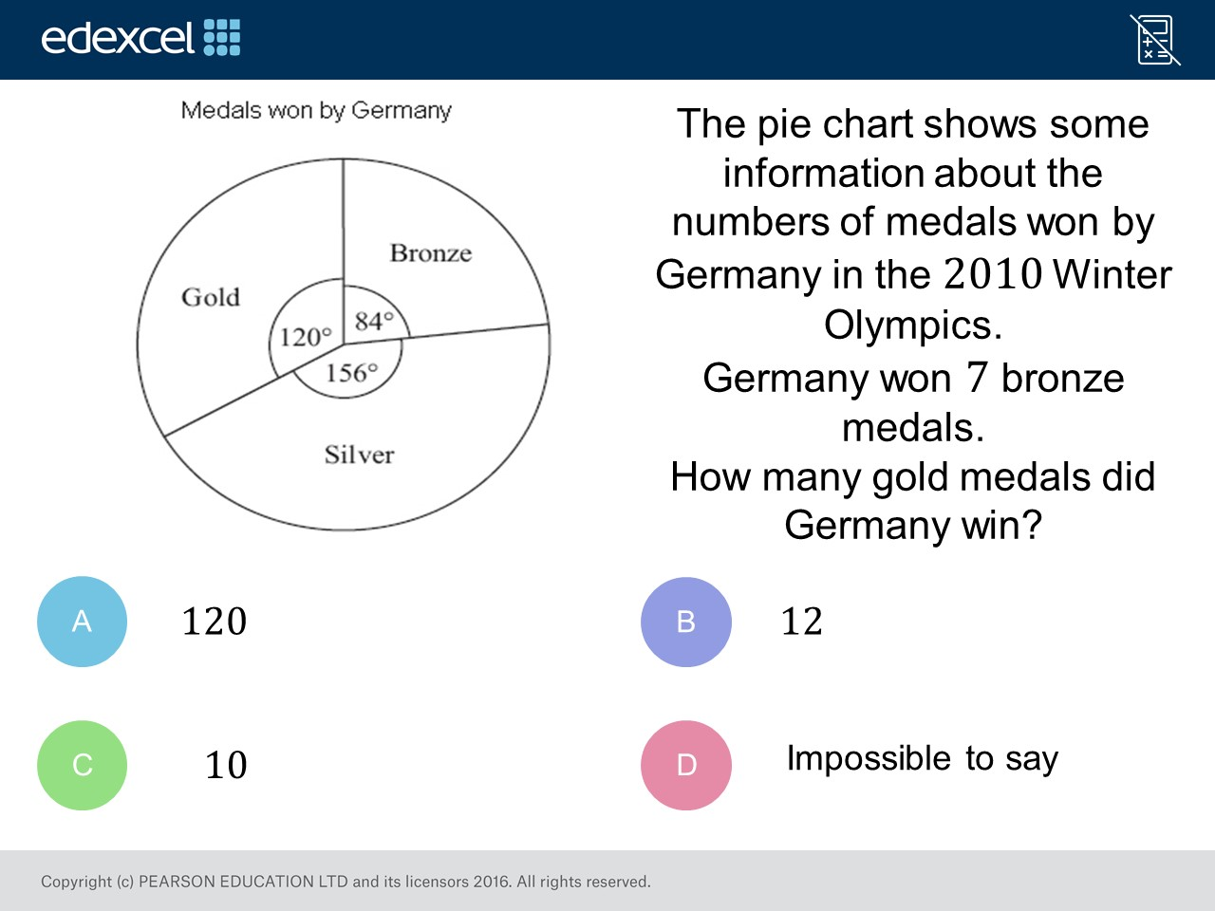
Worst answered question?
Most common wrong answer?

Slide 2
ANSWERS

Slide 3
Worst answered question?

Slide 4
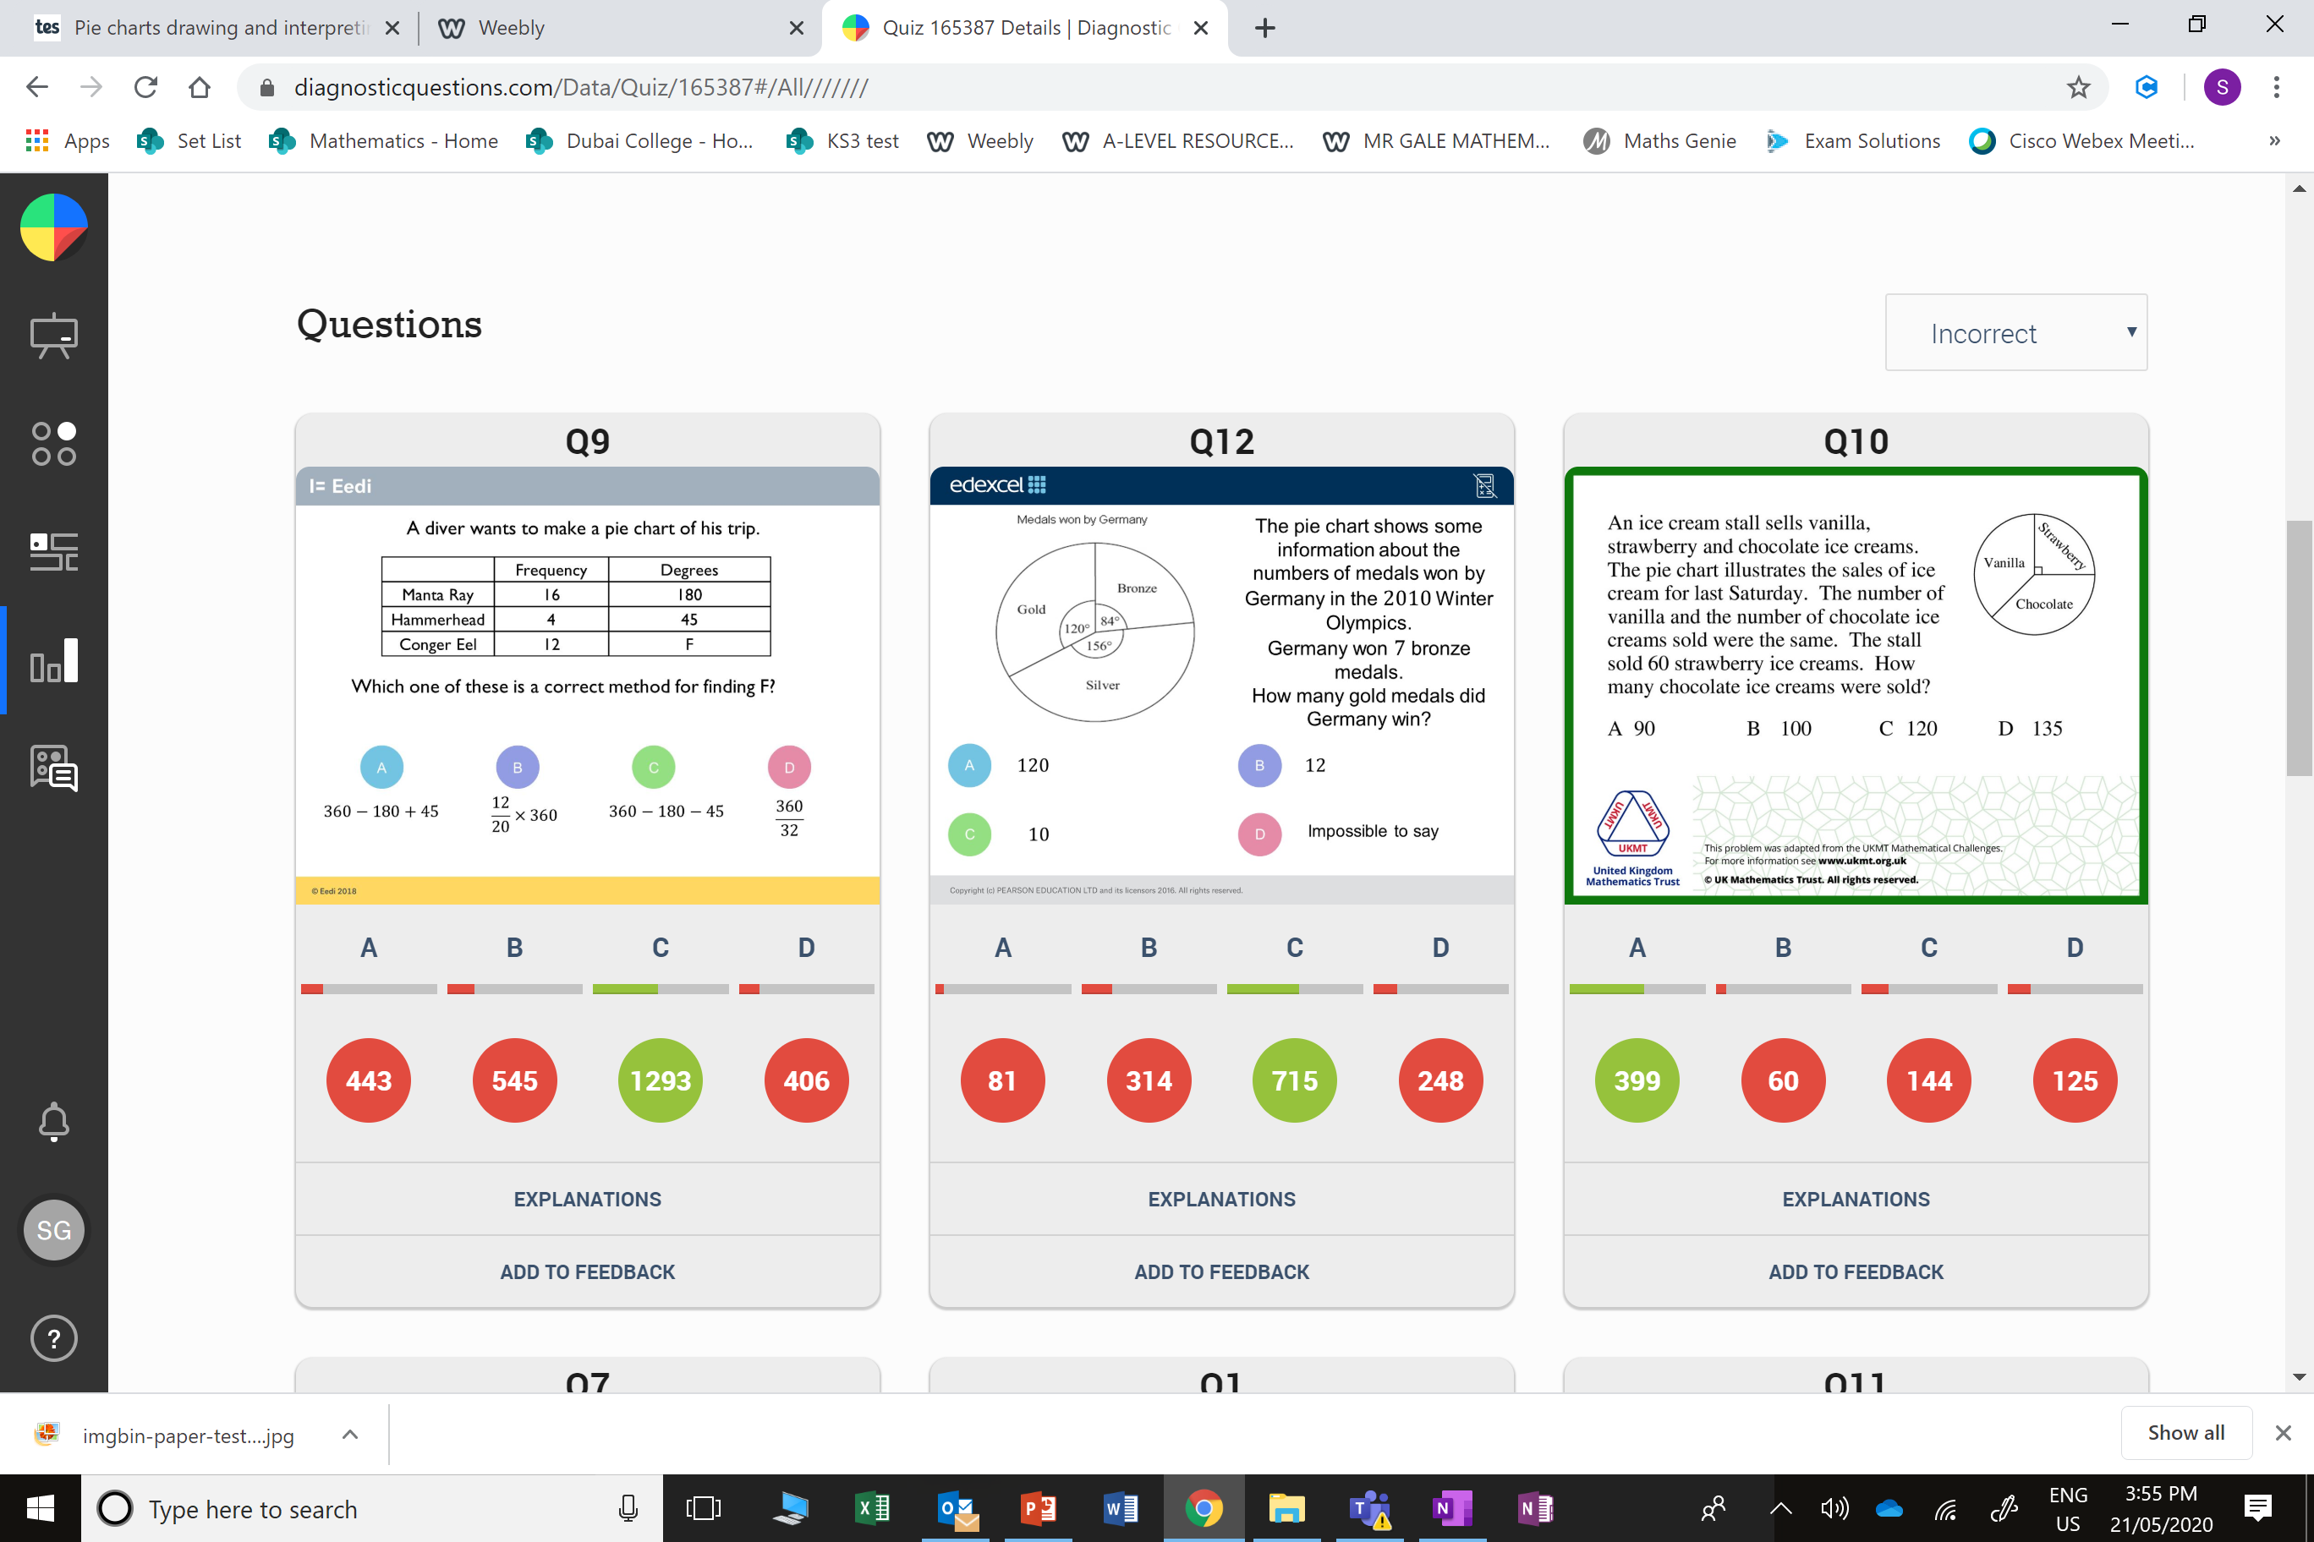
B
The student has divided by 20, rather than 1
6 + 4 + 12 = 32.

Slide 5
B
They have just divided by 10.

