Slide 1
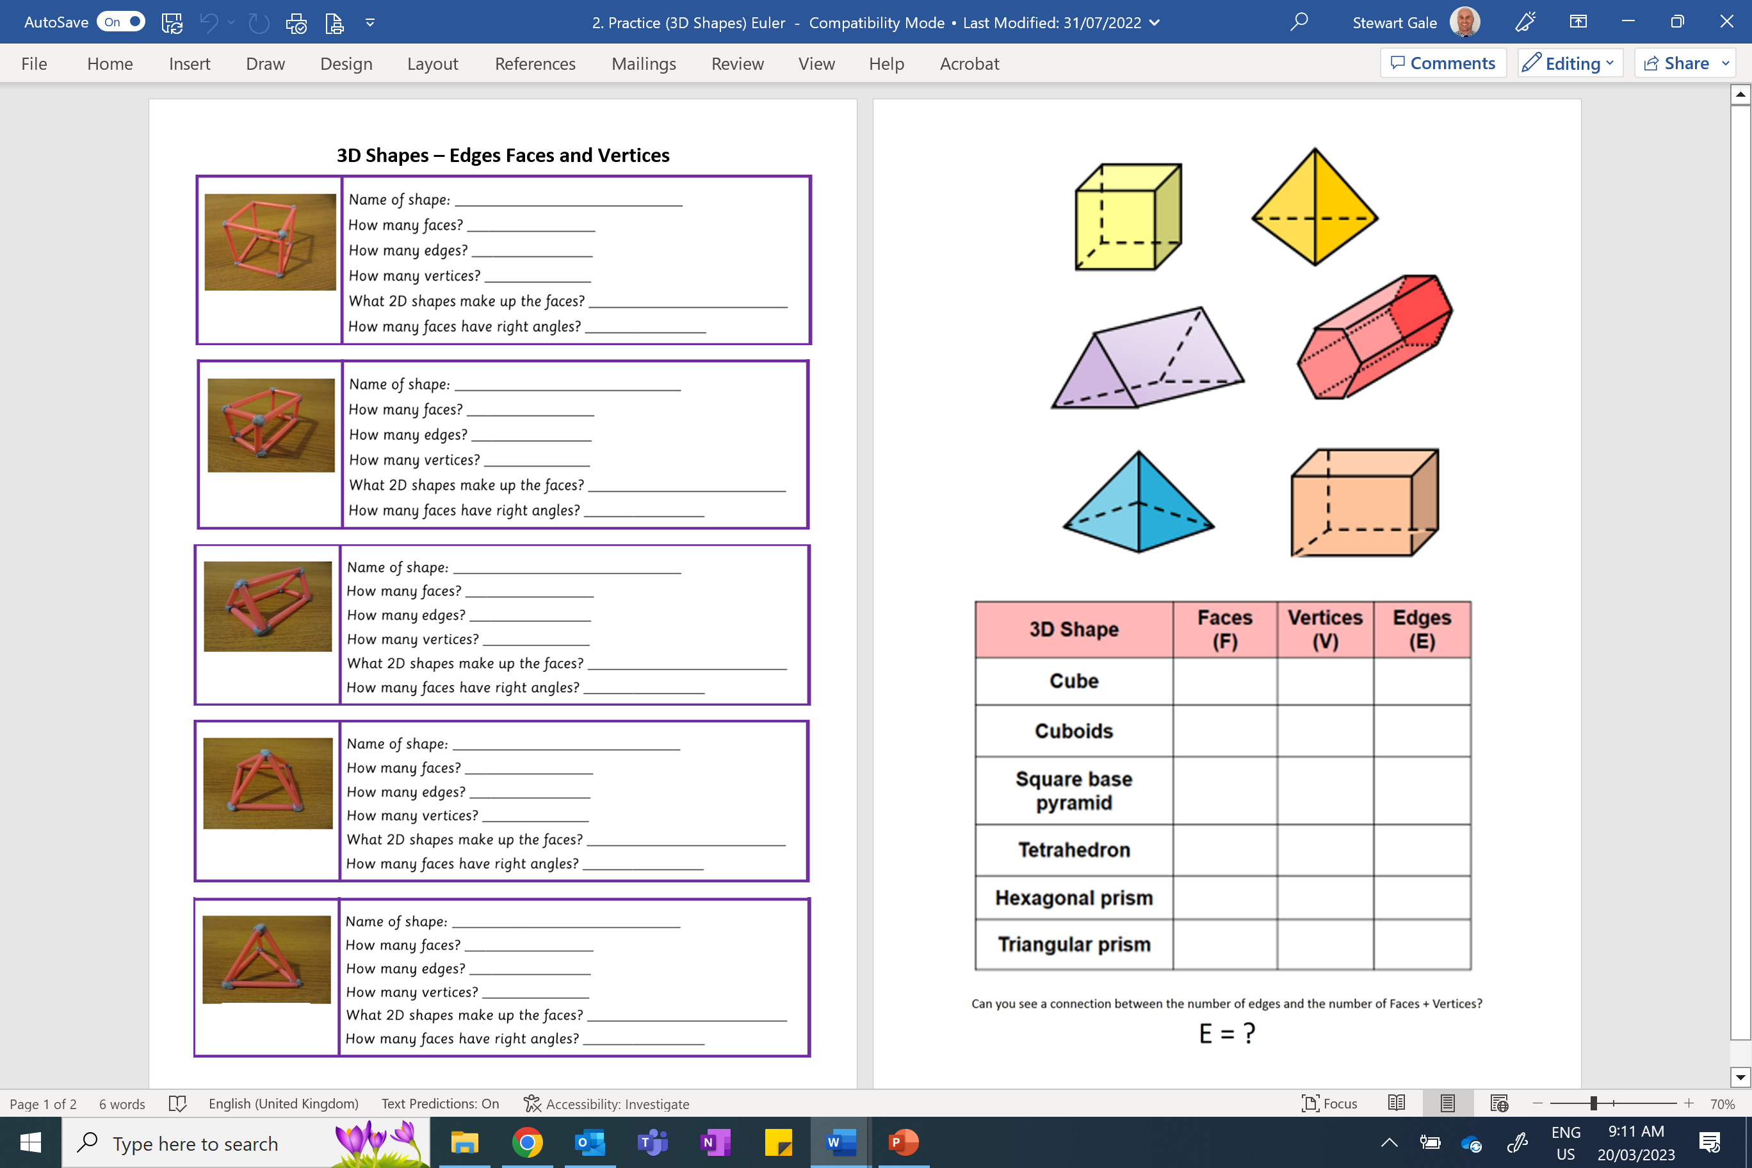

Slide 2
ANSWERS

Slide 3
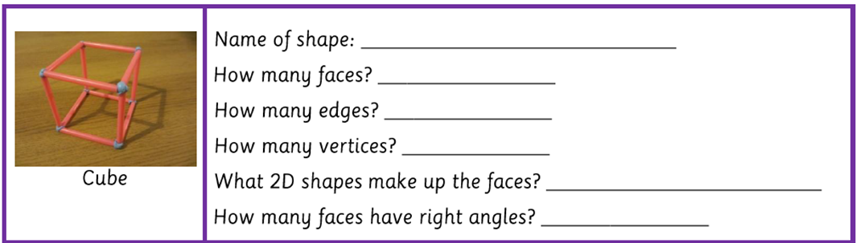
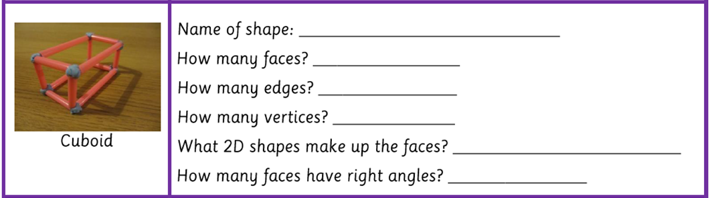
Cube
6
12
8
Squares
6
Cuboid
6
12
8
Squares and Rectangles
6

Slide 4
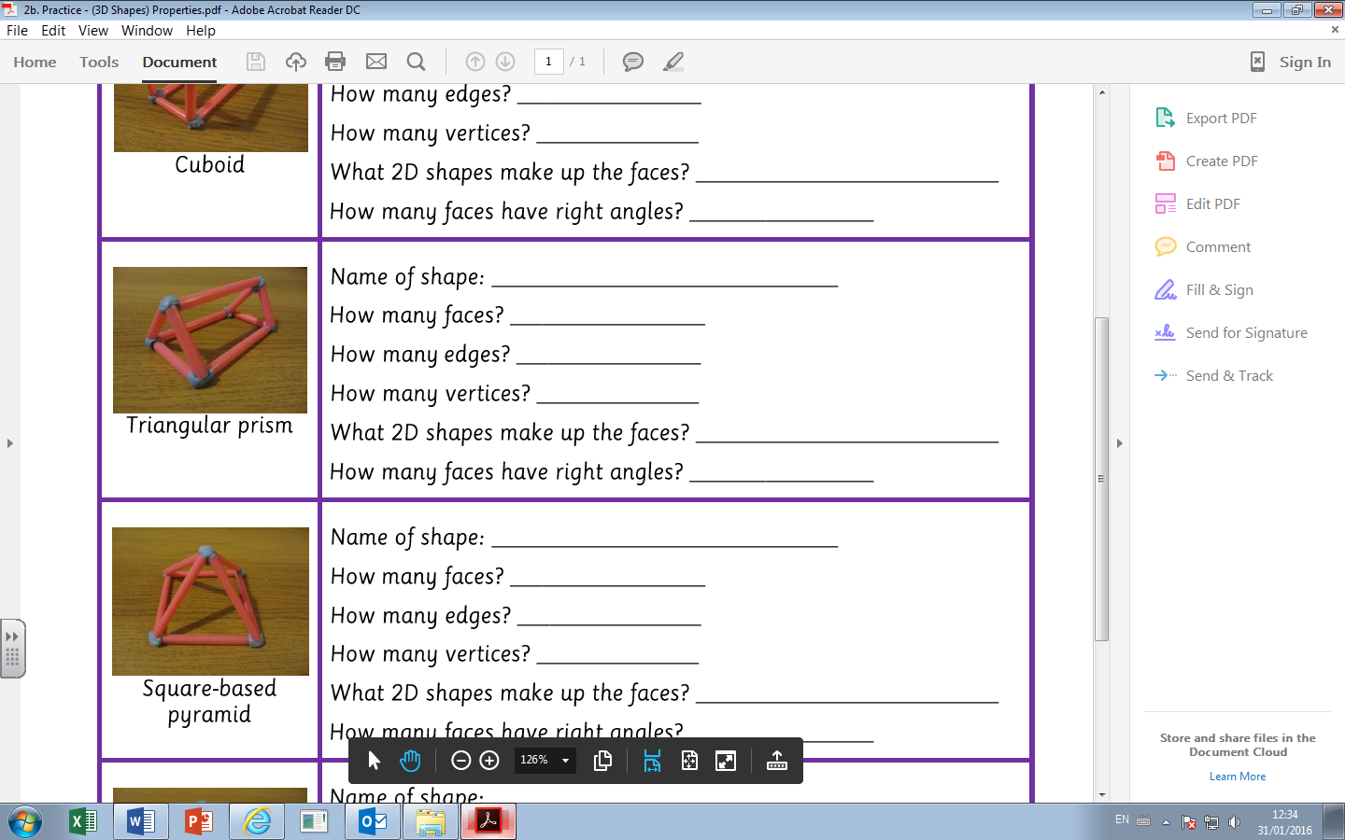
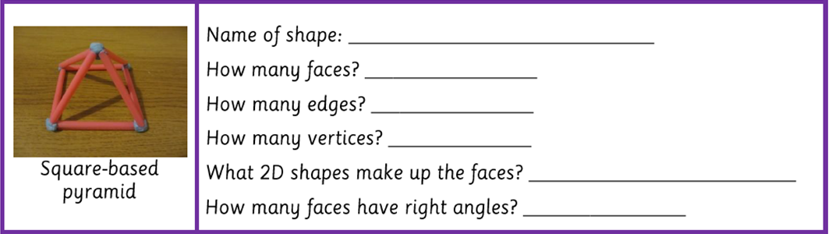
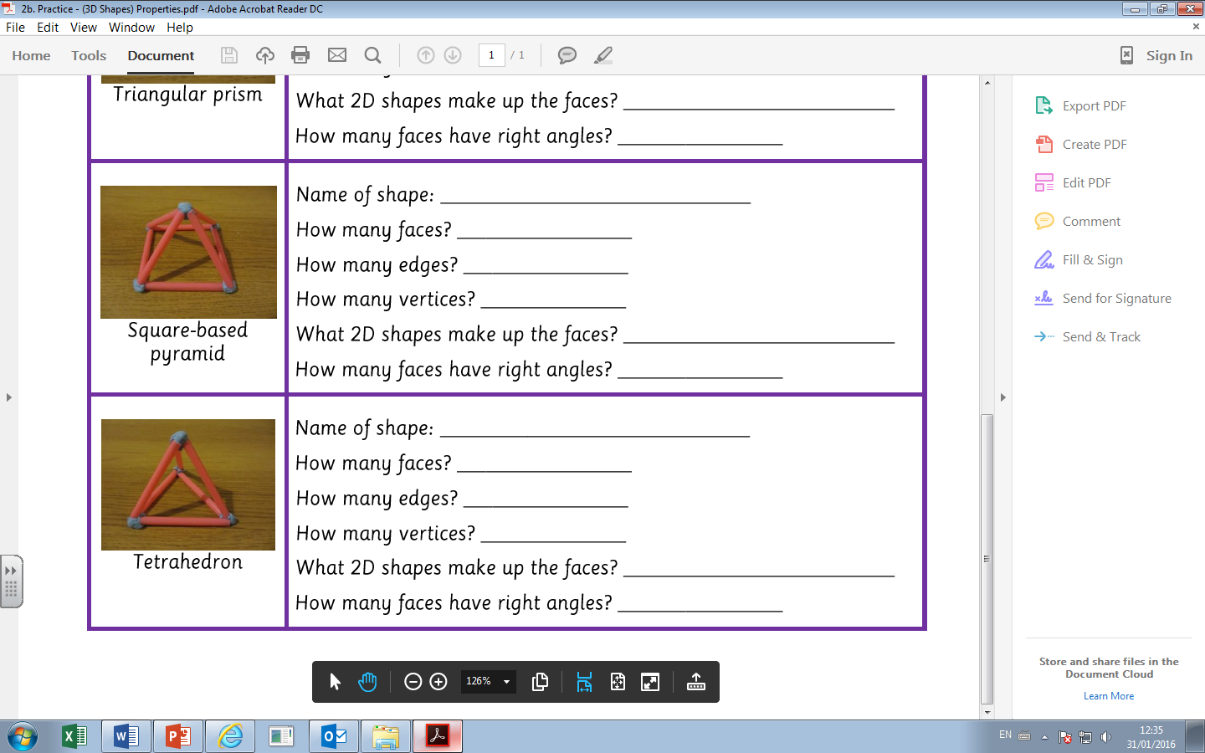
Triangular Prism
5
9
6
Triangles and Rectangles
3
Square based pyramid
5
8
5
Triangles and a Square
1
Triangular Based Pyramid
4
6
4
Triangles
0

