Slide 1
Identities and Equations
Trigonometric Identities
Chapter 10
(Part 1 of 4)

Slide 2

Trigonometry Identities
$≡$ means ‘identical to’
LHS is always equal to
the RHS for all values.

Slide 3

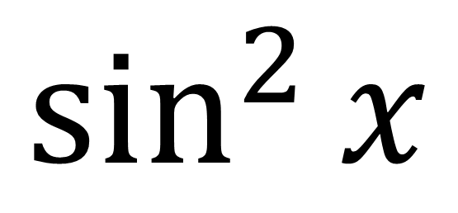

New Notation
$$\sin^{2}{x}$$
$${=(\sin{x})}^{2}$$
$$=sin{x\sin{x}}$$

Slide 4



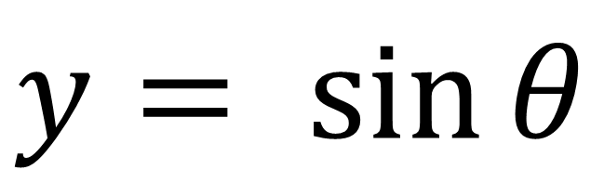

$$\frac{y}{1}$$
$\sin{θ=}$
$$1$$
y
$y= sin{θ}$
$$θ$$
x

Slide 5

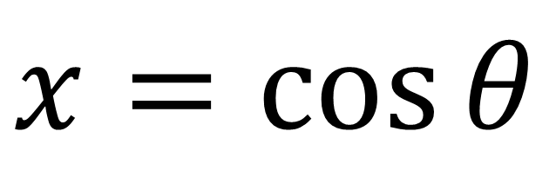

$$\frac{x}{1}$$
$\cos{θ=}$
$$1$$
y
$x=cos{θ}$
$$θ$$
x

Slide 6





Pythagoras gives you...
$$1$$
y
$\sin{θ}$
$sin^{2}θ+cos^{2}θ=1$
$$θ$$
x
$\cos{θ}$

Slide 7

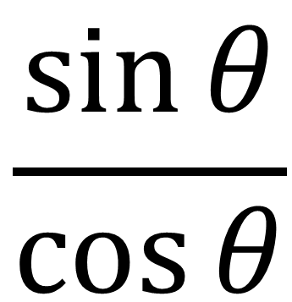




$$\frac{\sin{θ}}{\cos{θ}}$$
$\tan{θ=}$
$$1$$
$\sin{θ}$
$$θ$$
$\cos{θ}$

Slide 8


Trigonometry identities to memories
$$\tan{x}≡\frac{\sin{x}}{\cos{x}}$$
$$\sin^{2}{x}+\cos^{2}{x}≡1$$

Slide 9


$$\tan{θ}=\frac{\sin{θ}}{\cos{θ}}$$
From this identities you can also get the following:
$$\tan{2θ}=\frac{\sin{2θ}}{\cos{2θ}}$$

Slide 10


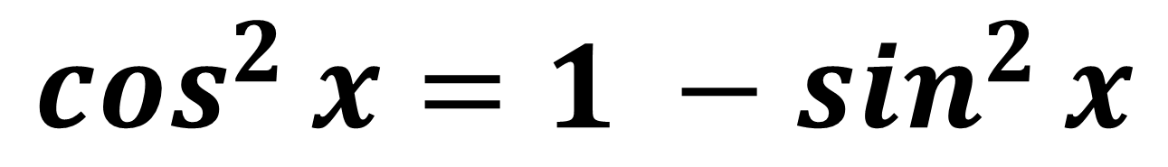
$$\sin^{2}{x}+\cos^{2}{x}=1$$
From this identities you can also get the following:
$$\sin^{2}{x}=1 −\cos^{2}{x}$$
$$\cos^{2}{x}=1 −\sin^{2}{x}$$

Slide 11
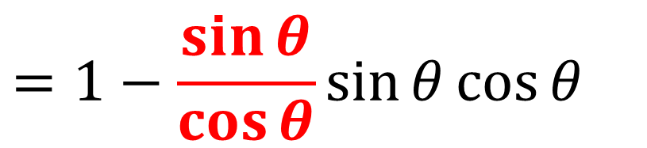
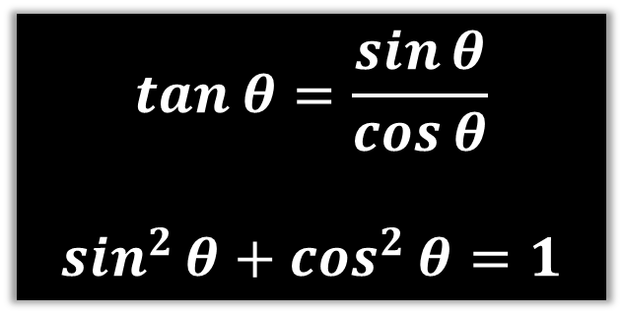
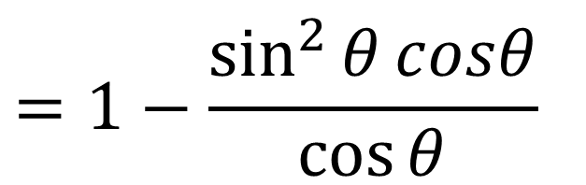

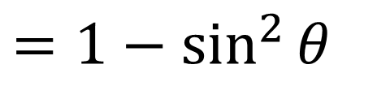
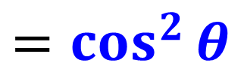

Prove that $1−\tan{θ}\sin{θ}\cos{θ}≡\cos^{2}{θ}$
LHS = $1−\tan{θ}\sin{θ}\cos{θ}$
$$\tan{θ}=\frac{\sin{θ}}{\cos{θ}}$$
$$\sin^{2}{θ}+\cos^{2}{θ}=1$$
$$=1−\frac{\sin{θ}}{\cos{θ}}\sin{θ}\cos{θ}$$
$$=1−\frac{\sin^{2}{θ}cosθ}{\cos{θ}}$$
$$=1−\sin^{2}{θ}$$
$$=\cos^{2}{θ}$$

Slide 12
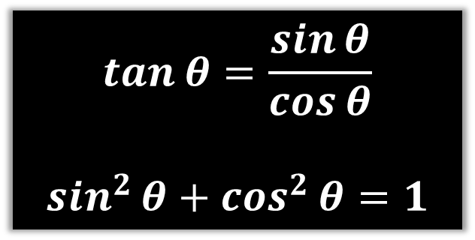
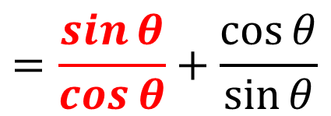
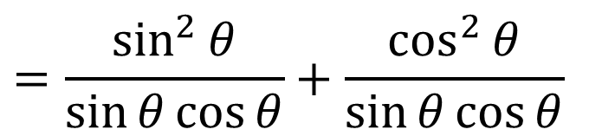

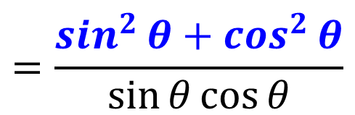
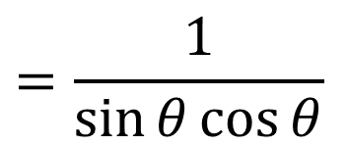

Prove that $\tan{θ}+\frac{1}{\tan{θ}}≡\frac{1}{\sin{θ}\cos{θ}}$
$$LHS=tan{θ}+\frac{1}{\tan{θ}}$$
$$\tan{θ}=\frac{\sin{θ}}{\cos{θ}}$$
$$\sin^{2}{θ}+\cos^{2}{θ}=1$$
$$=\frac{\sin{θ}}{\cos{θ}}+\frac{\cos{θ}}{\sin{θ}}$$
$$=\frac{\sin^{2}{θ}}{\sin{θ}\cos{θ}}+\frac{\cos^{2}{θ}}{\sin{θ}\cos{θ}}$$
$$=\frac{\sin^{2}{θ}+\cos^{2}{θ}}{\sin{θ}\cos{θ}}$$
Turn into a single fraction.
$$=\frac{1}{\sin{θ}\cos{θ}}$$

Slide 13
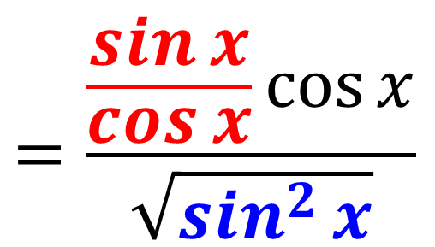

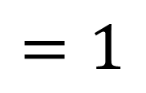
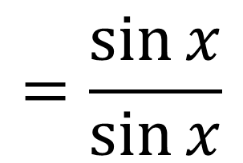

Prove that $\frac{\tan{x}\cos{x}}{\sqrt{1−\cos^{2}{x}}}≡1$
LHS $=$ $\frac{\tan{x}\cos{x}}{\sqrt{1−\cos^{2}{x}}}$
$$=\frac{\frac{\sin{x}}{\cos{x}}\cos{x}}{\sqrt{\sin^{2}{x}}}$$
$$=\frac{\sin{x}}{\sin{x}}$$
$$=1$$

Slide 14
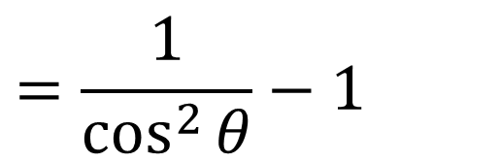


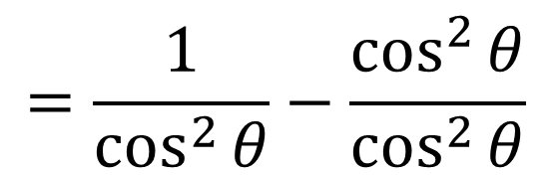
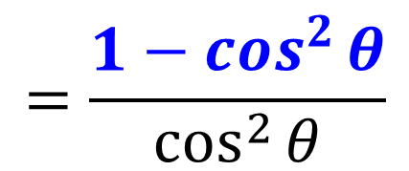
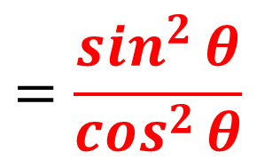
Prove that $\tan^{2}{θ}≡\frac{1}{\cos^{2}{θ}}−1$
$${LHS=tan}^{2}{θ}$$
$$=\frac{\sin^{2}{θ}}{\cos^{2}{θ}}$$
$$=\frac{1−\cos^{2}{θ}}{\cos^{2}{θ}}$$
$$=\frac{1}{\cos^{2}{θ}}−\frac{\cos^{2}{θ}}{\cos^{2}{θ}}$$
Split in to two fractions
$$=\frac{1}{\cos^{2}{θ}}−1$$

Slide 15
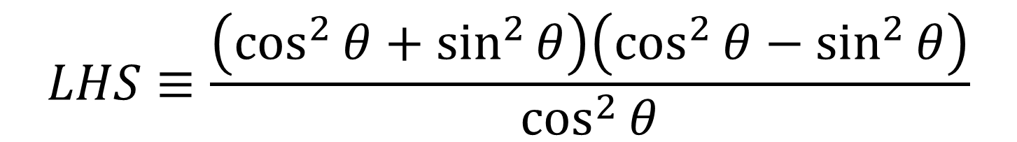


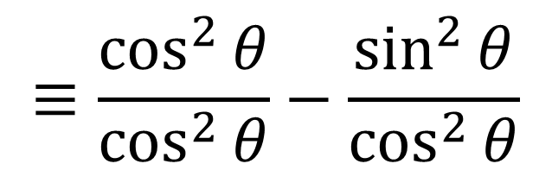
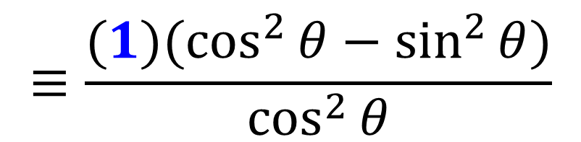
Prove that $\frac{\cos^{4}{θ}−\sin^{4}{θ}}{\cos^{2}{θ}}≡1−\tan^{2}{θ}$
$$LHS≡\frac{\left(\cos^{2}{θ}+\sin^{2}{θ}\right)\left(\cos^{2}{θ}−\sin^{2}{θ}\right)}{\cos^{2}{θ}}$$
$$≡\frac{{(1)(cos}^{2}{θ}−\sin^{2}{θ)}}{\cos^{2}{θ}}$$
$$≡\frac{\cos^{2}{θ}}{\cos^{2}{θ}}−\frac{\sin^{2}{θ}}{\cos^{2}{θ}}$$
$$≡1−\tan^{2}{θ}$$

