Slide 1
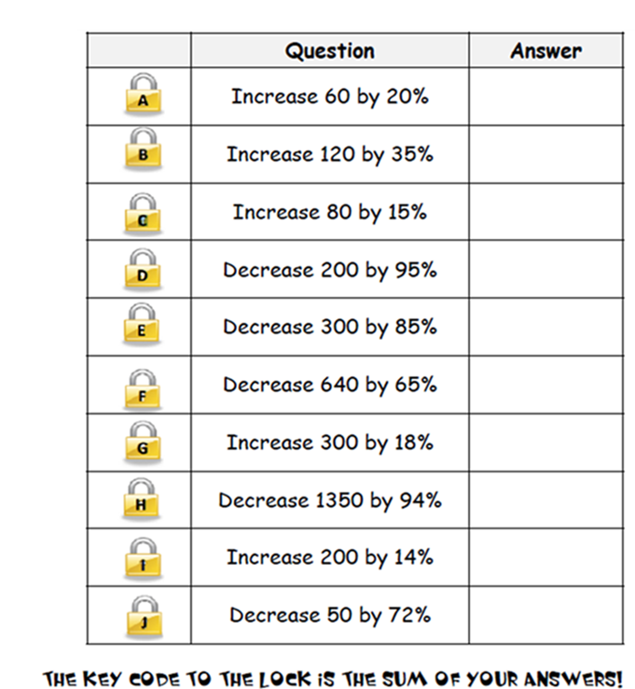
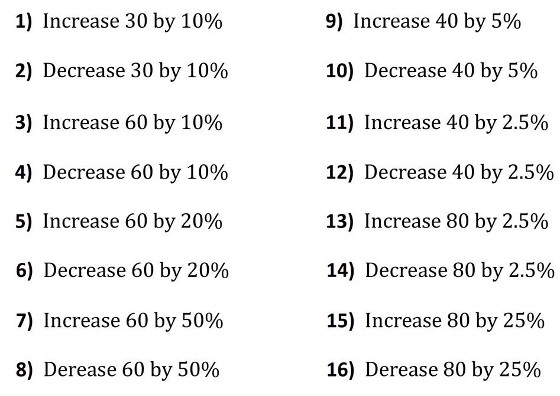


Slide 2
ANSWERS

Slide 3
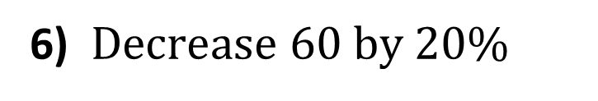
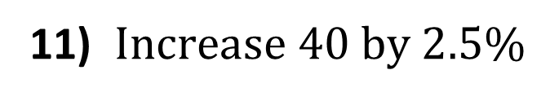
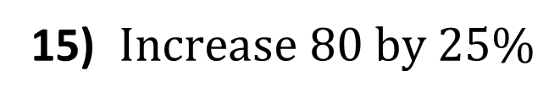
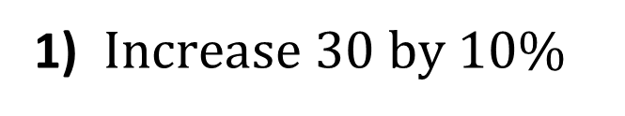
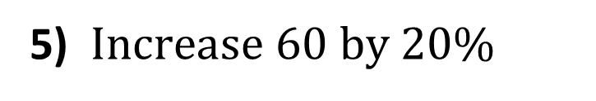
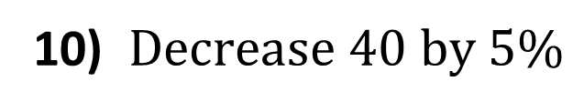
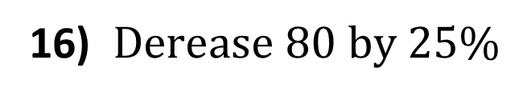
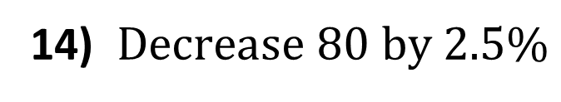
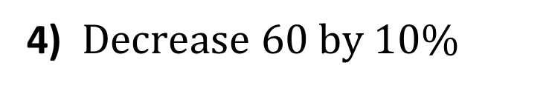
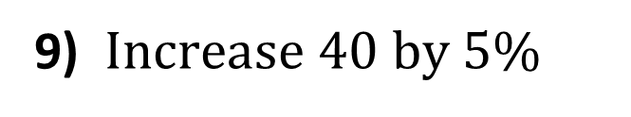
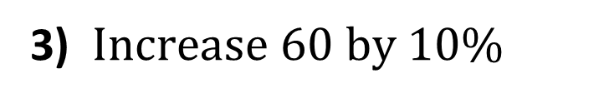
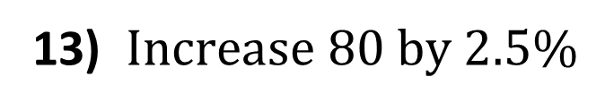
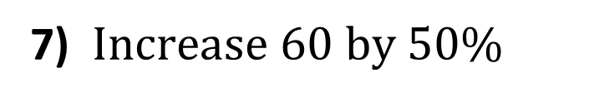
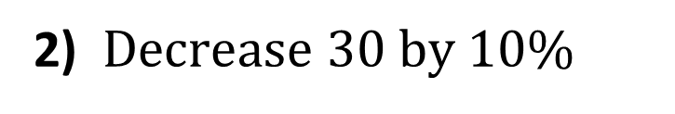
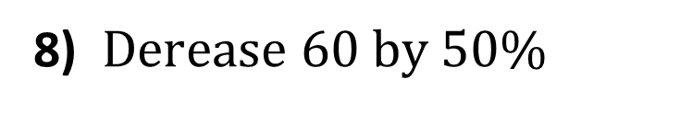
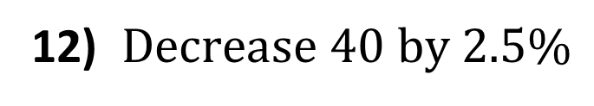
33
42
1) $Increase 30 by 10\%$
9) $Increase 40 by 5\%$
27
38
2) $Decrease 30 by 10\%$
10) $Decrease 40 by 5\%$
66
41
3) $Increase 60 by 10\%$
11) $Increase 40 by 2.5\%$
54
39
4) $Decrease 60 by 10\%$
12) $Decrease 40 by 2.5\%$
72
82
5) $Increase 60 by 20\%$
13) $Increase 80 by 2.5\%$
48
78
6) $Decrease 60 by 20\%$
14) $Decrease 80 by 2.5\%$
90
100
7) $Increase 60 by 50\%$
15) $Increase 80 by 25\%$
30
60
8) $Derease 60 by 50\%$
16) $Derease 80 by 25\%$

Slide 4
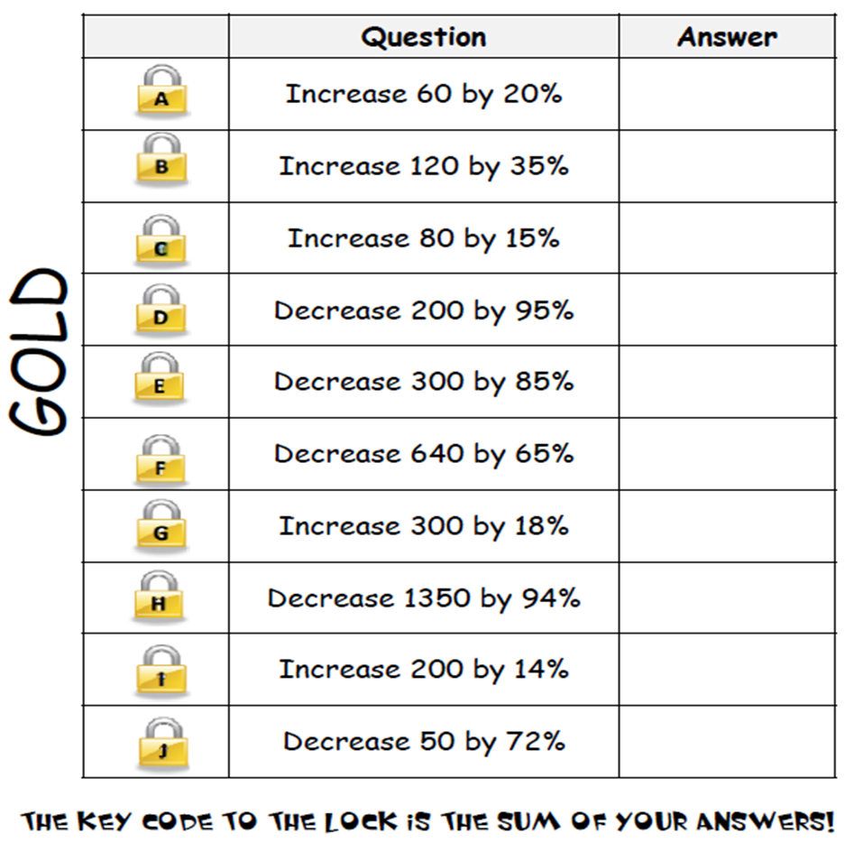
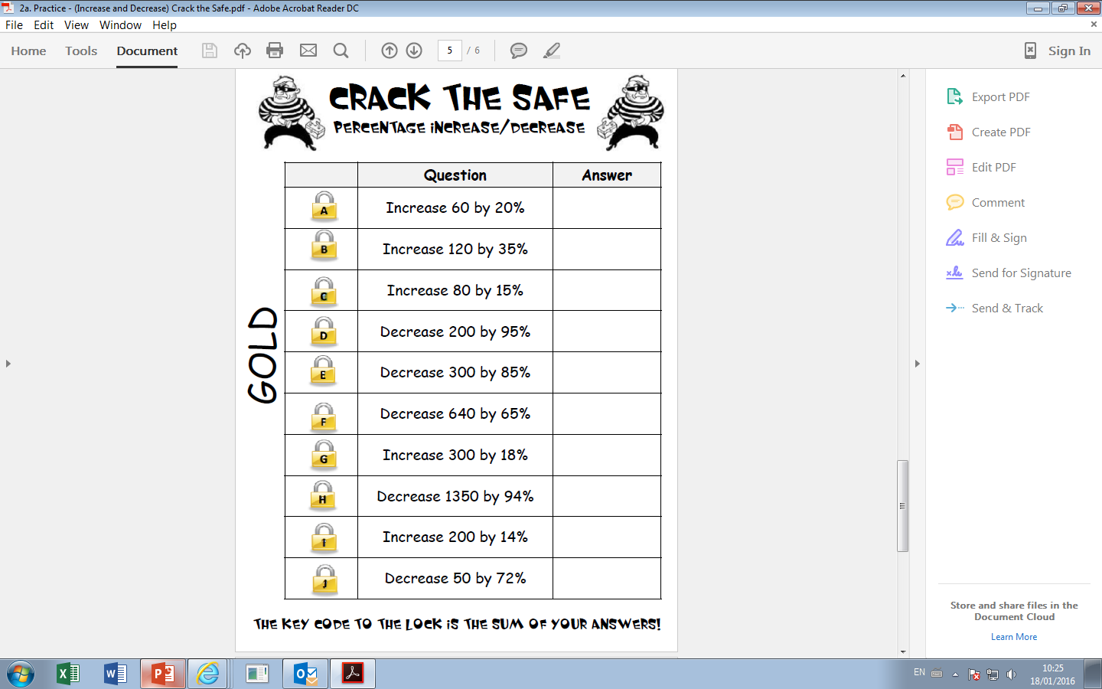
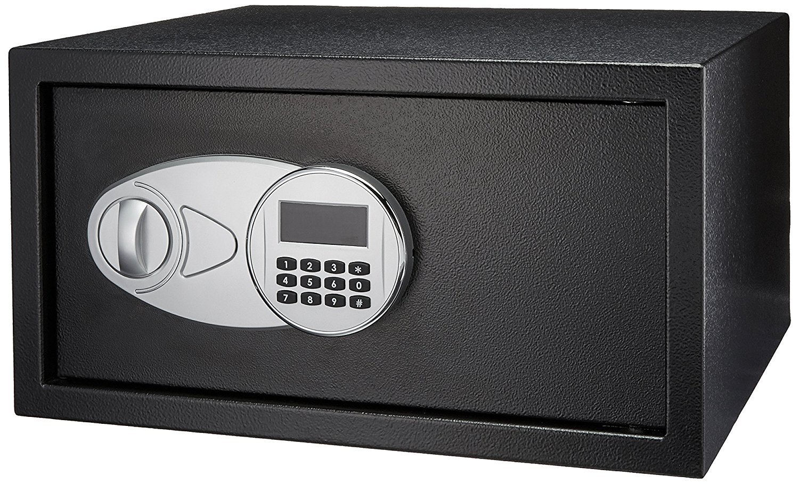
72
162
92
10
45
224
354
81
228
1282
14

