Slide 1
LO: LCM and HCF with Venn Diagrams

Slide 2
What are the product of
prime numbers of 42?
42
2
21
7
3
42 = 2 × 3 × 7

Slide 3
What are the product of
prime numbers of 60?
60
6
10
2
3
2
5
60 = 2 × 2 × 3 × 5

Slide 4
Find the HCF and LCM of 42 and 60.
42
60
21
6
10
2
3
2
5
7
3
2
42 = 2 × 3 × 7
60 = 2 × 2 × 3 × 5
7
2
2
420
LCM =
2 x 2 x 3 x 5 x 7 =
3
5
HCF =
6
2 x 3 =

Slide 5
Find the HCF and LCM of 36 and 2100.
2100
36
12
30
70
3
5
10
7
4
3
6
2
2
5
2
2
3
36 = 2 × 2 × 3 × 3
2100 = 2 × 2 × 3 × 5 × 5 × 7
2
7
3
2
5
LCM =
5
3
2 x 2 x 3 x 3 x 5 x 5 x 7 =
6300
HCF =
2 x 2 x 3 =
12

Slide 6
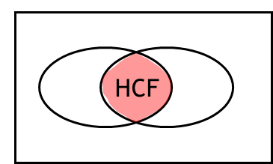
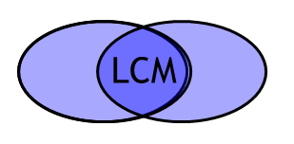
HCF = Multiply the numbers in the overlap
LCM = Multiply all numbers

Slide 7


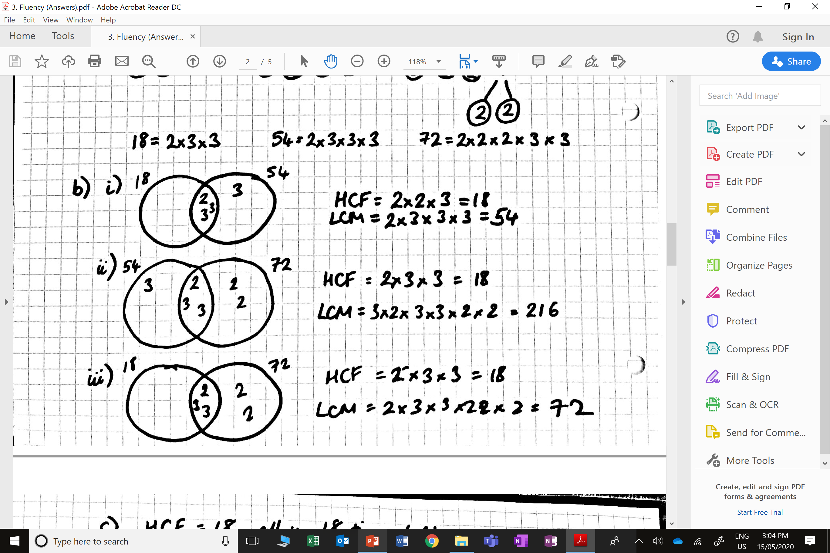
Ben exercises every 54 days and Isabel every 72 days.
Ben and Isabel both exercised today.
How many days will it be until
they exercise together again?
216 days

Slide 8
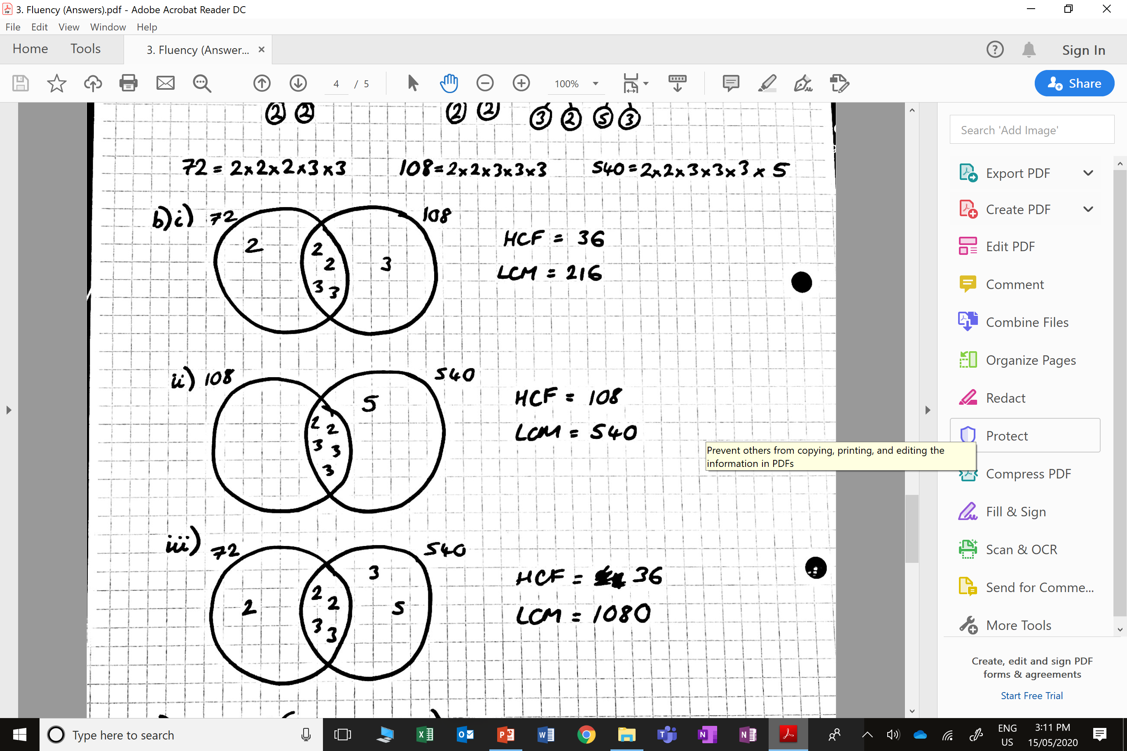

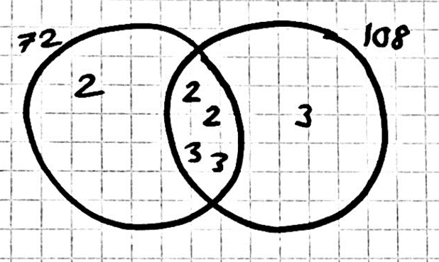
Samantha has two pieces of cloth.
One piece is 72cm wide and the other piece is 108cm wide.
She wants to cut both pieces into strips of
equal width that are as wide as possible.
How wide should she cut the strips?
36cm strips

