Slide 1
LO: Surds
(Surds and Brackets)

Slide 2
Expand and Simplify.
(x – 2)(x – 7) =
x² – 9x + 14

Slide 3
Expand and Simplify.
(2x – 2)(x – 7) =
2x² – 14x – 2x + 14 =
2x² – 16x + 14

Slide 4
Expand and Simplify.
(x – y)(x – y) =
x² – xy – xy + y² =
x² – 2xy + y²

Slide 5
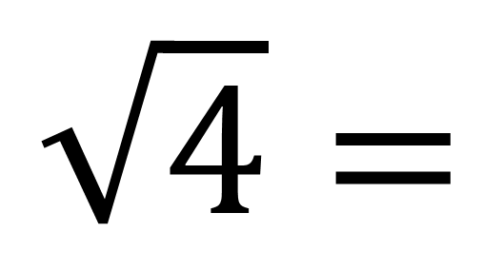
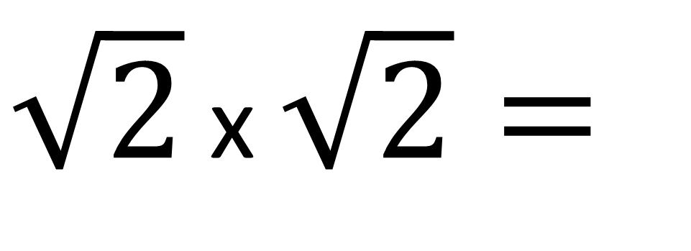
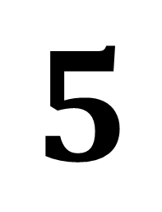
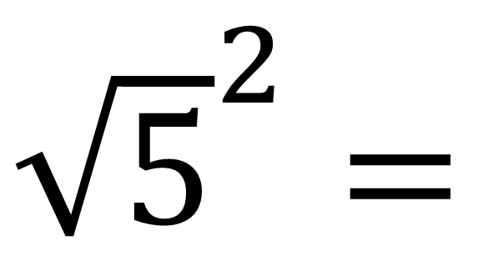
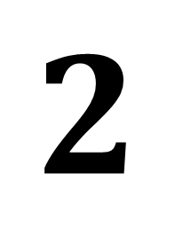
LO: Surds and Expanding Brackets
$\sqrt{2}$ x $\sqrt{2}=$
$$\sqrt{4}=$$
$$2$$
${\sqrt{5}}^{2}=$
$$5$$

Slide 6
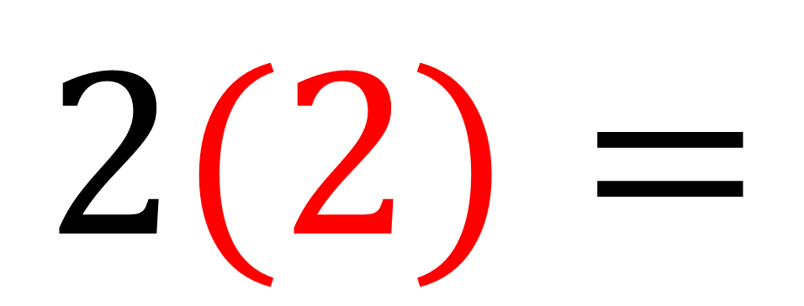
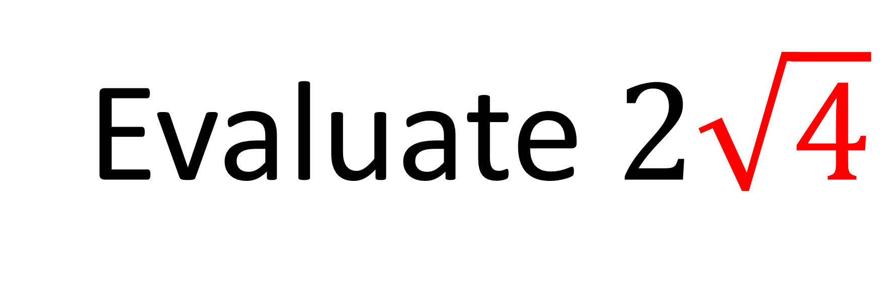
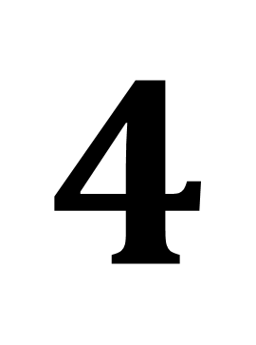
Evaluate $2\sqrt{4}$
$$2(2)=$$
$$4$$

Slide 7
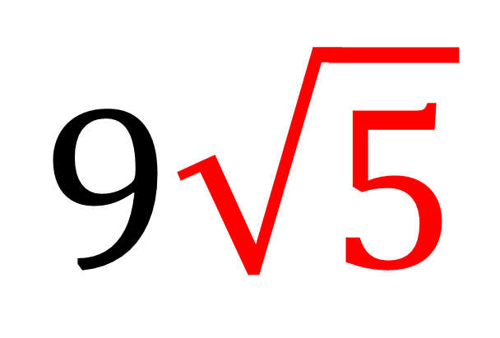
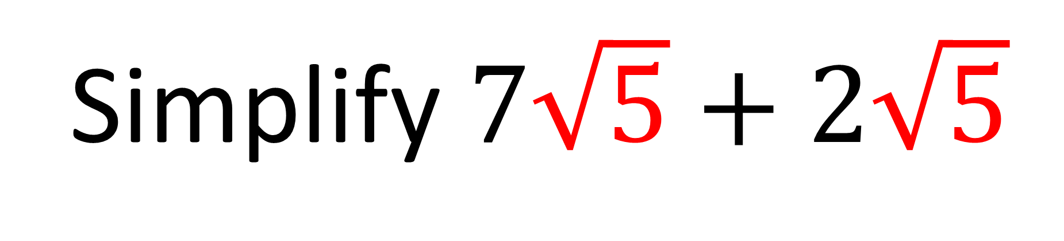
Simplify $7\sqrt{5}+2\sqrt{5}$
$$9\sqrt{5}$$

Slide 8
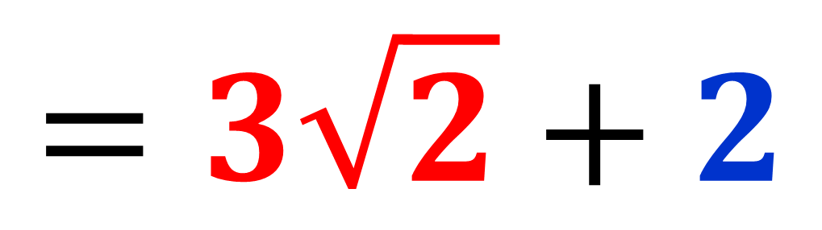
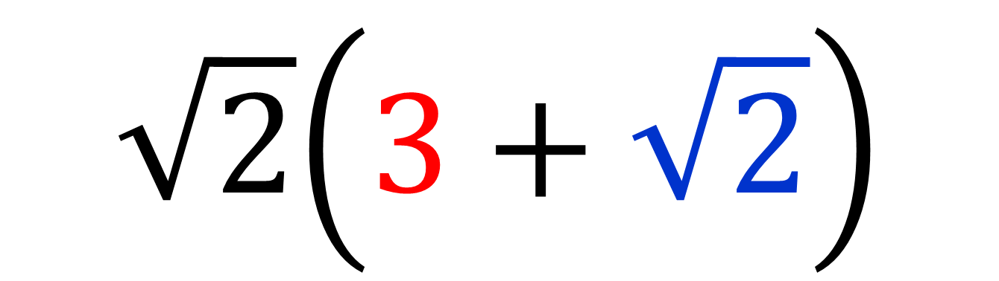
Expand and Simplify
$$\sqrt{2}\left(3+\sqrt{2}\right)$$
$$=3\sqrt{2}+2$$

Slide 9
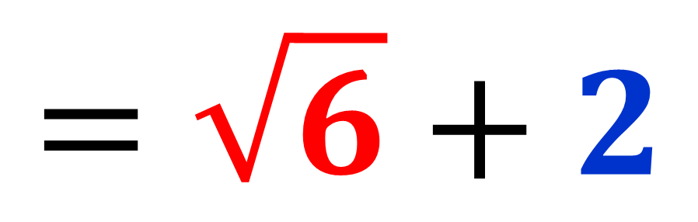
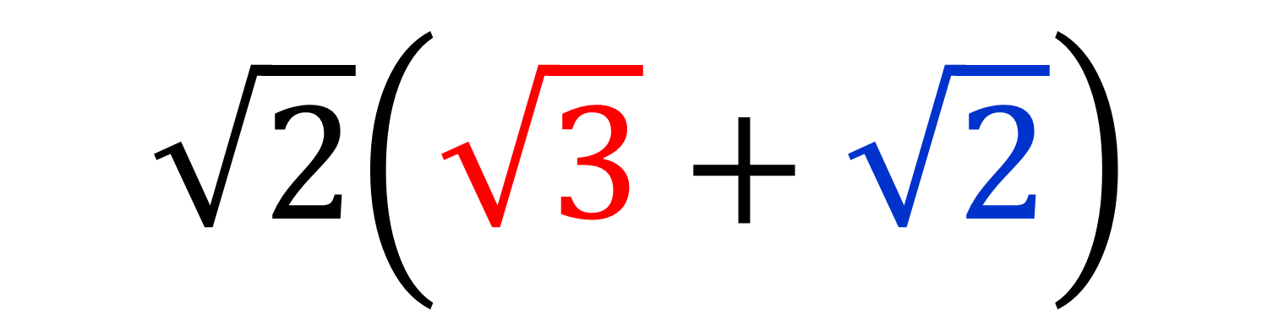
Expand and Simplify
$$\sqrt{2}\left(\sqrt{3}+\sqrt{2}\right)$$
$$=\sqrt{6}+2$$

Slide 10
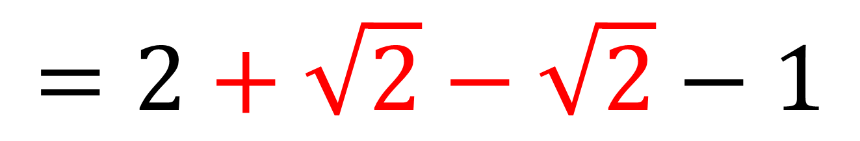
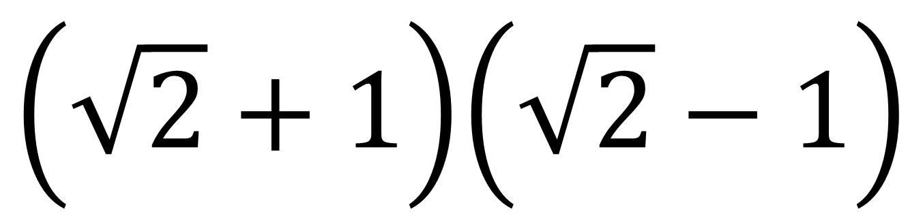
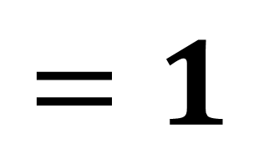
Expand and Simplify
$$\left(\sqrt{2}+1\right)\left(\sqrt{2}−1\right)$$
$$=2+\sqrt{2}−\sqrt{2}−1$$
$$=1$$

Slide 11
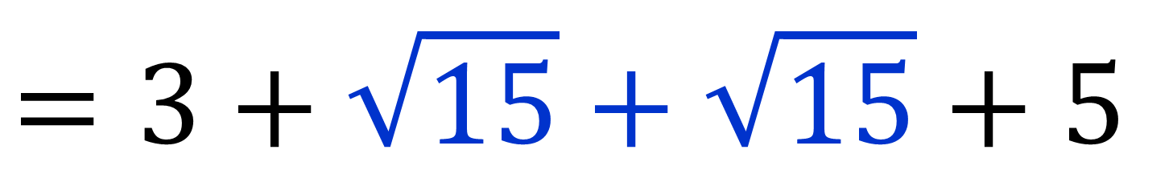
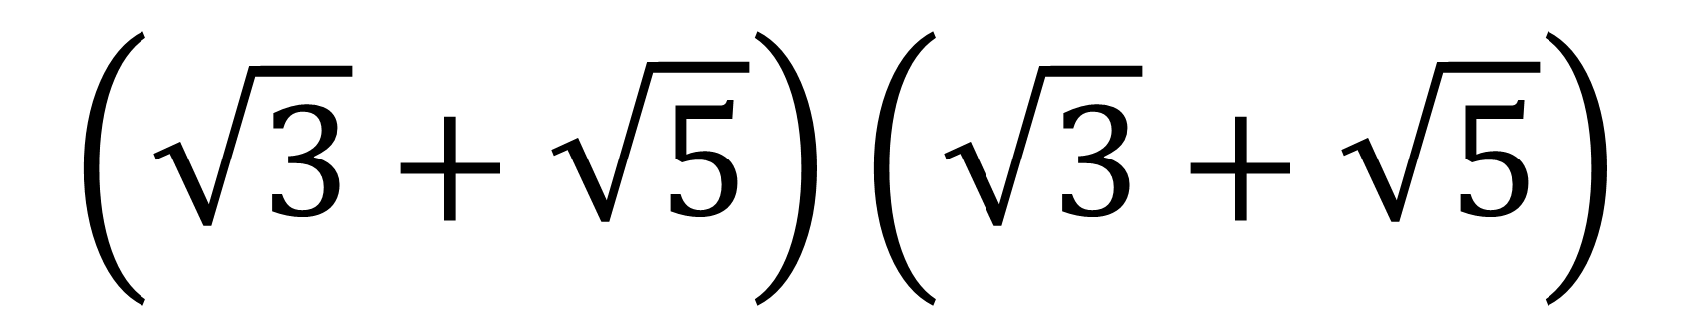
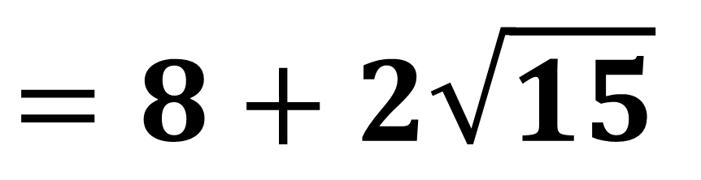
Expand and Simplify
$$\left(\sqrt{3}+\sqrt{5}\right)\left(\sqrt{3}+\sqrt{5}\right)$$
$$=3+\sqrt{15}+\sqrt{15}+5$$
$$=8+2\sqrt{15}$$

Slide 12
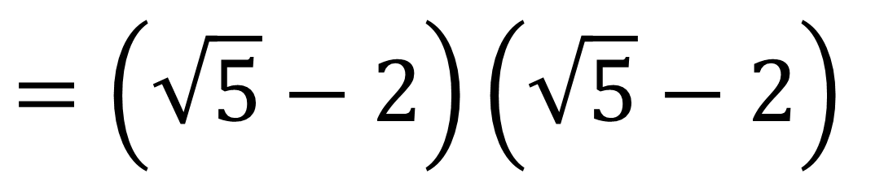
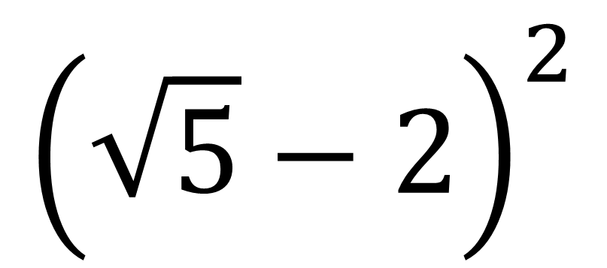
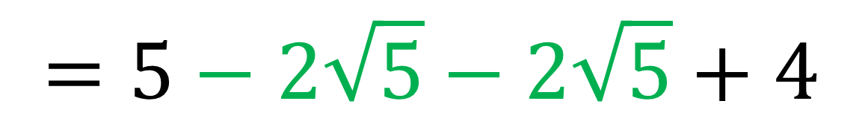
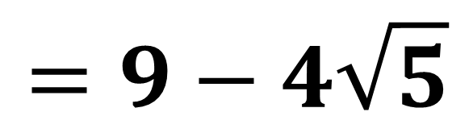
Expand and Simplify
$${\left(\sqrt{5}−2\right)}^{2}$$
$$=\left(\sqrt{5}−2\right)\left(\sqrt{5}−2\right)$$
$$=5−2\sqrt{5}−2\sqrt{5}+4$$
$$=9−4\sqrt{5}$$

Slide 13
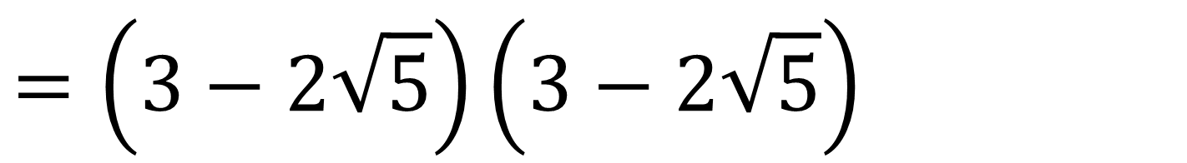
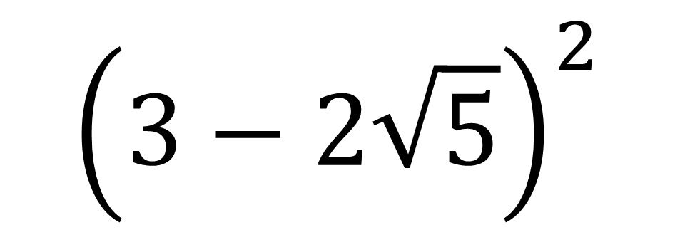
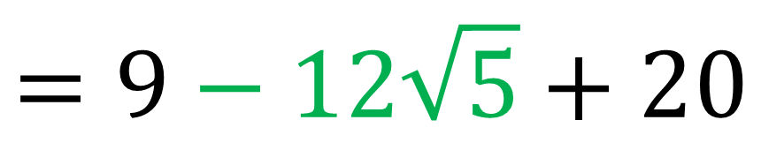
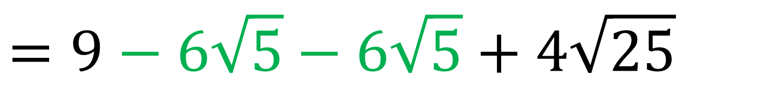
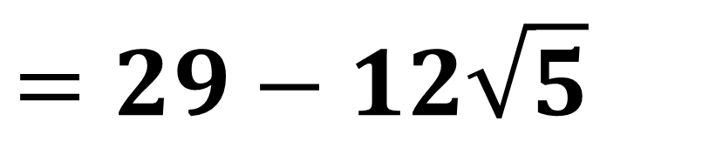
Expand and Simplify
$${\left(3−2\sqrt{5}\right)}^{2}$$
$$=\left(3−2\sqrt{5}\right)\left(3−2\sqrt{5}\right)$$
$$=9−6\sqrt{5}−6\sqrt{5}+4\sqrt{25}$$
$$=9−12\sqrt{5}+20$$
$$=29−12\sqrt{5}$$

Slide 14
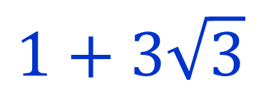
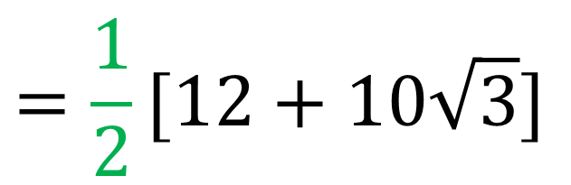
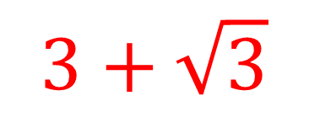
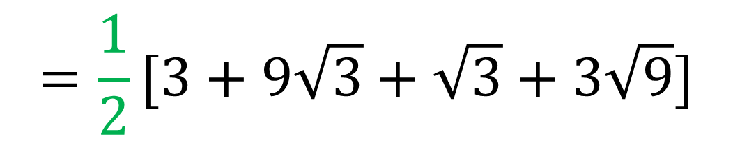
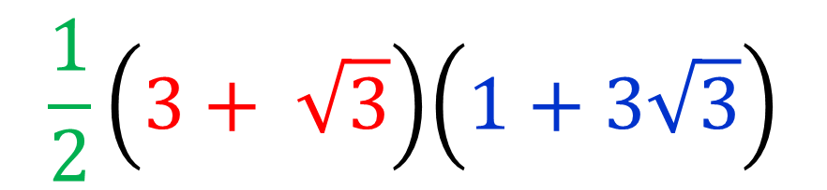
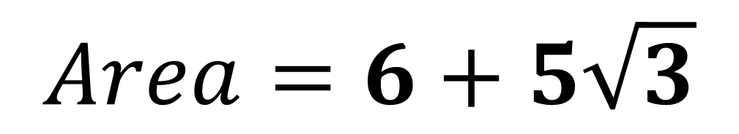
Calculate the Area
$$\frac{1}{2}\left(3+ \sqrt{3}\right)\left(1+3\sqrt{3}\right)$$
$$=\frac{1}{2}[3+9\sqrt{3}+\sqrt{3}+3\sqrt{9}]$$
$$3+\sqrt{3}$$
$$=\frac{1}{2}[12+10\sqrt{3}]$$
$$1+3\sqrt{3}$$
$$Area=6+5\sqrt{3}$$

