Slide 1
Functions and Graphs
Sketching Modulus Graphs
Chapter 2
(Part 5 of 6)

Slide 2


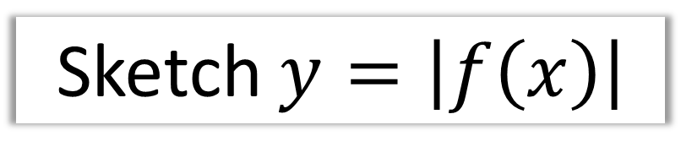






Sketch $y=\left|f\left(x\right)\right|$
$$y$$
$$y=f(x)$$
$$y=|f\left(x\right)|$$
$$3$$
$$x$$
$$−1$$
$$3$$
$$−3$$

Slide 3

Sketching $y=\left|f\left(x\right)\right|$
Reflect everything below the x axis

Slide 4


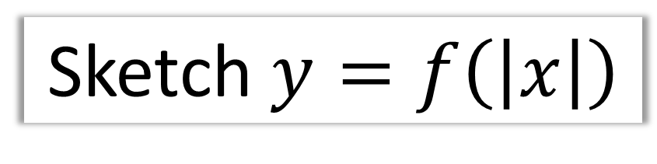






Sketch $y=f\left(\left|x\right|\right)$
$$y$$
$$y=f(x)$$
$$x$$
$$−3$$
$$−1$$
$$3$$
$$y=f\left(\left|x\right|\right)$$
$$−3$$

Slide 5

Sketch $y=f\left(\left|x\right|\right)$
Reflect everything right of the y axis

Slide 6
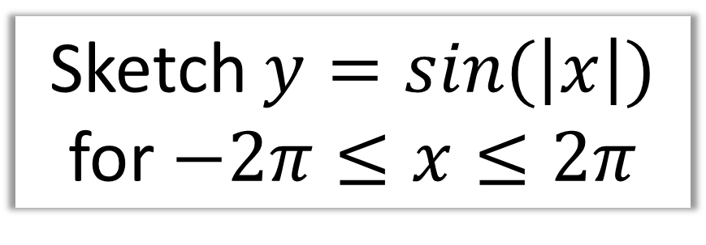


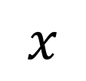



Sketch $y=sin⁡(\left|x\right|)$
for $−2π≤x≤2π$
$$y$$
$$−360°$$
$$360°$$
$$x$$
$$−180°$$
$$180°$$

Slide 7
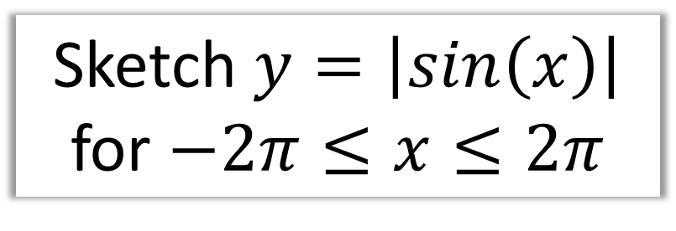






Sketch $y=\left|\sin\left(x\right)\right|$
for $−2π≤x≤2π$
$$y$$
$$x$$
$$−360°$$
$$−180°$$
$$180°$$
$$360°$$

Slide 8
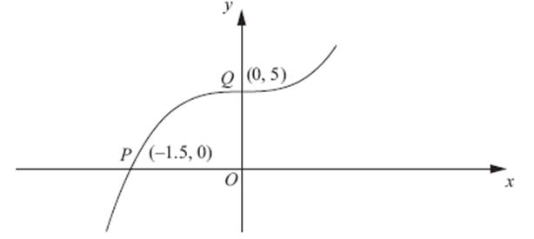

$$\text{Sketch} y=\left|f(x)\right|$$

Slide 9

$$\text{Sketch} y=f(\left|x\right|)$$

Slide 10
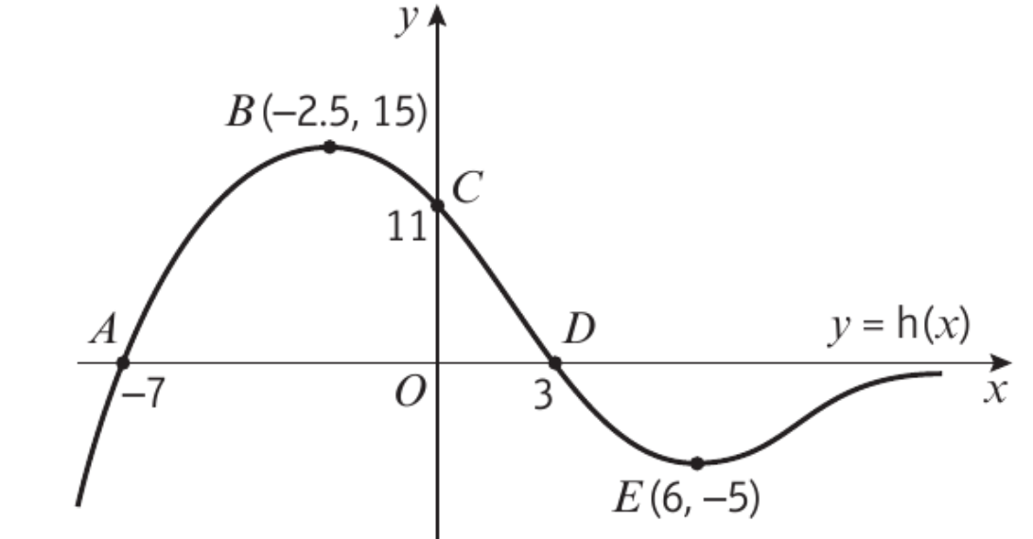
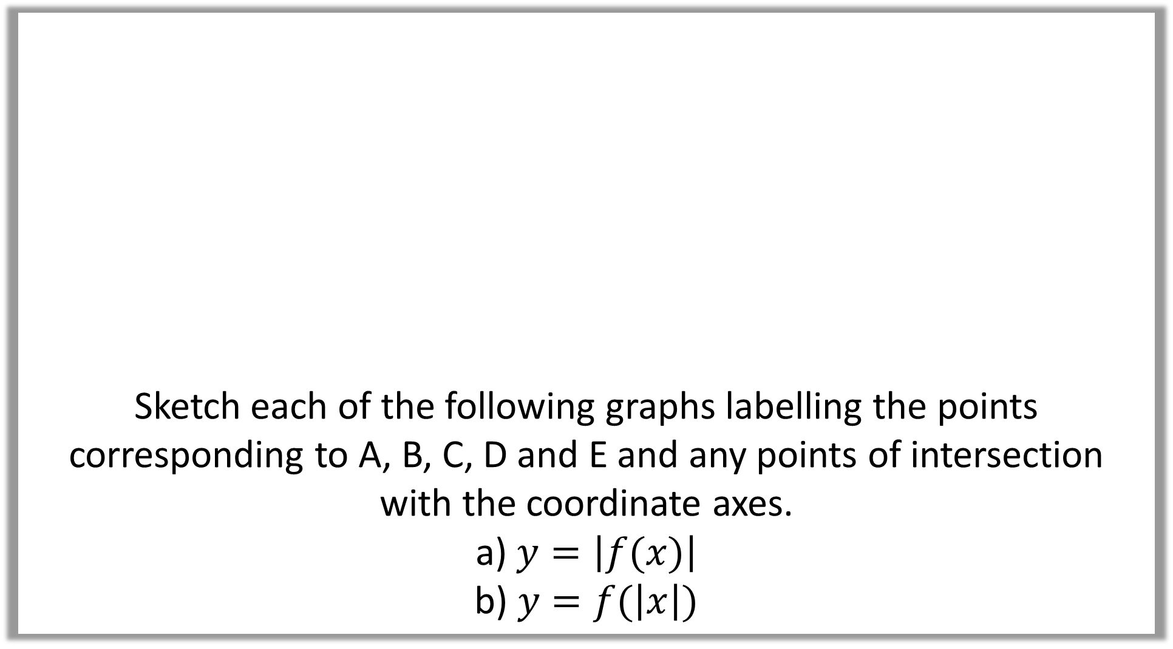
Sketch each of the following graphs labelling the points corresponding to A, B, C, D and E and any points of intersection with the coordinate axes.
a) $y=\left|f(x)\right|$
b) $y=f(\left|x\right|)$

Slide 11
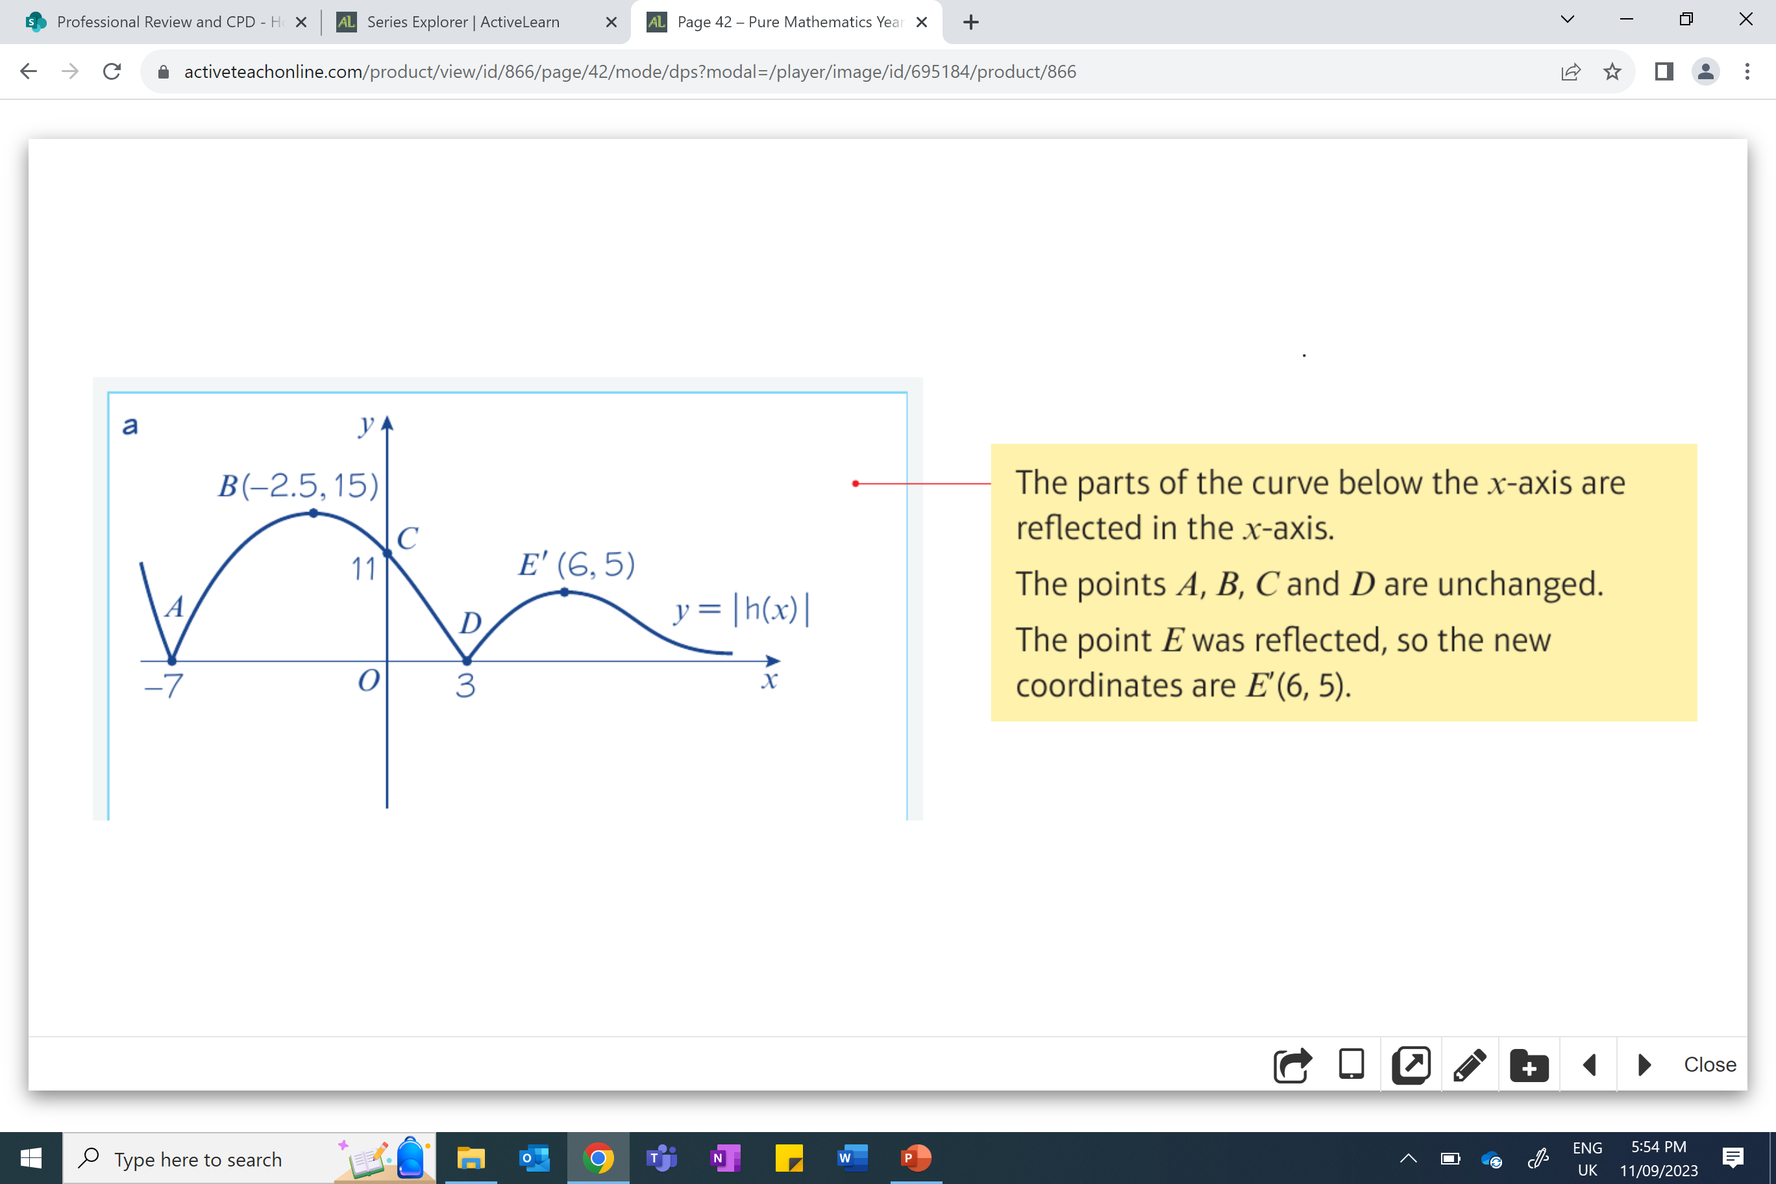
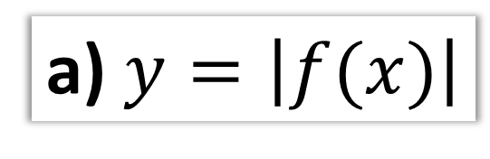
a) $y=\left|f(x)\right|$

Slide 12
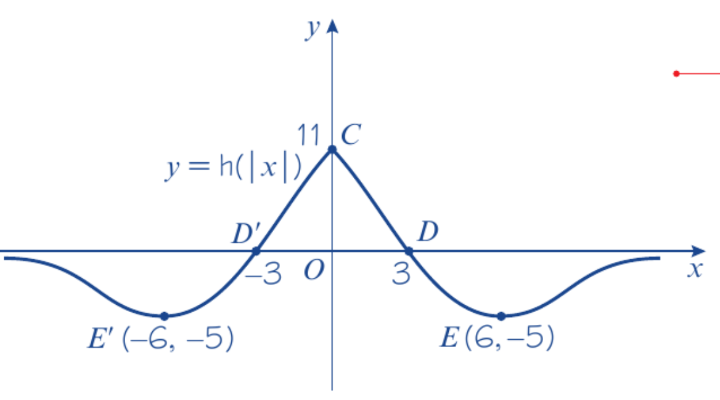
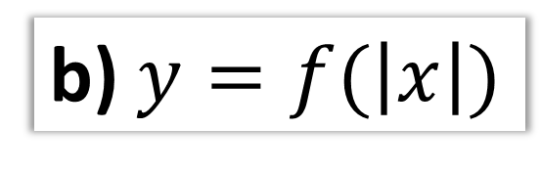
b)$y=f(\left|x\right|)$

Slide 13
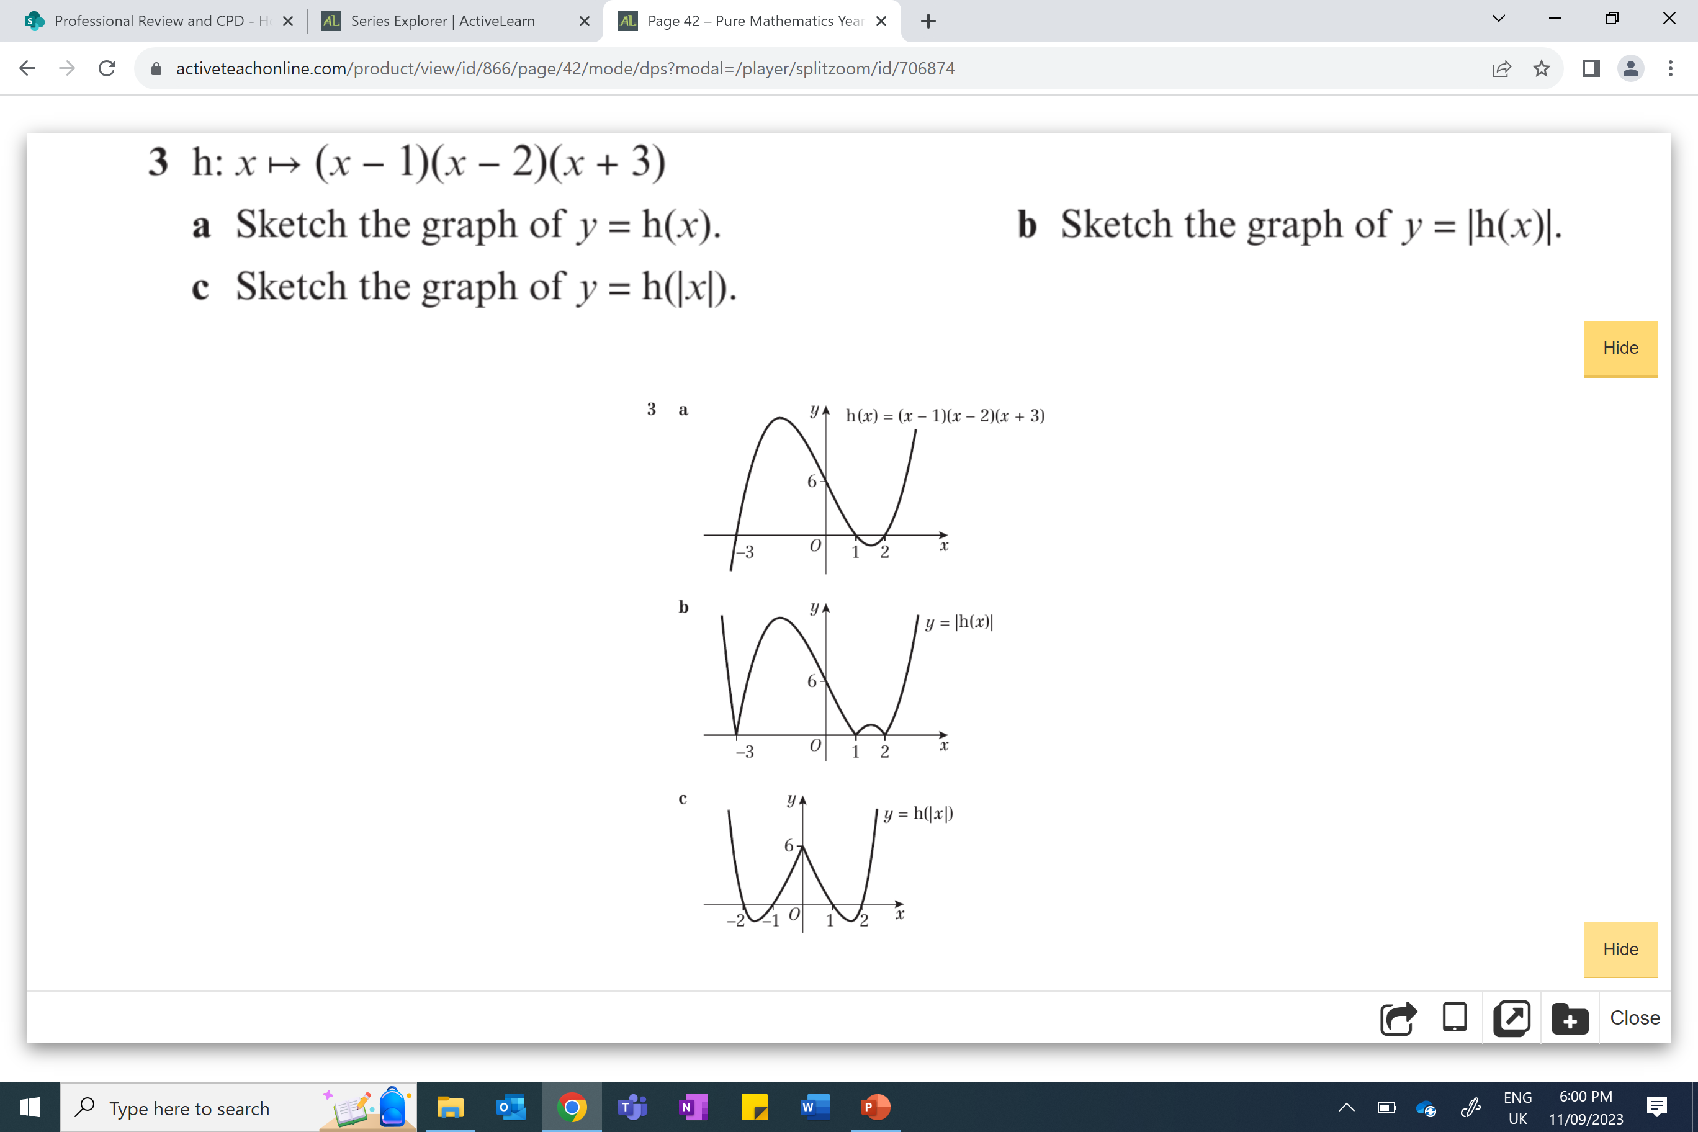
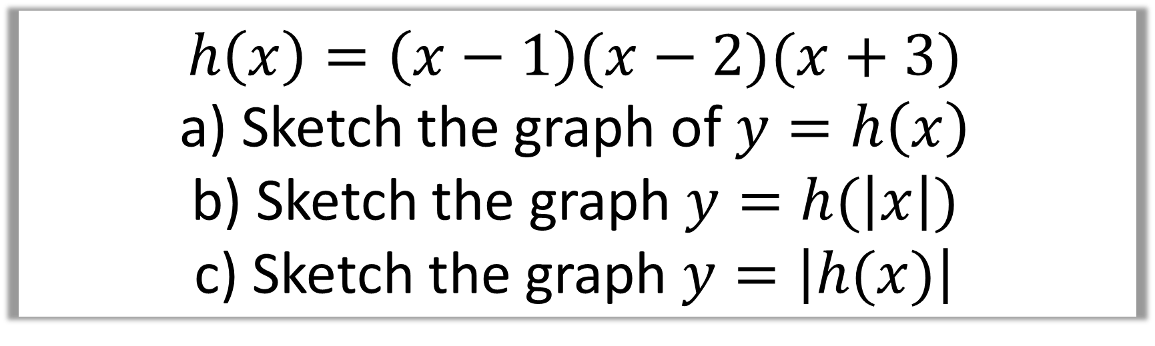
$$h\left(x\right)=\left(x−1\right)(x−2)(x+3)$$
a) Sketch the graph of $y=h\left(x\right)$
b) Sketch the graph $y=h(\left|x\right|)$
c) Sketch the graph $y=\left|h(x)\right|$
a)

Slide 14

$$h\left(x\right)=\left(x−1\right)(x−2)(x+3)$$
a) Sketch the graph of $y=h\left(x\right)$
b) Sketch the graph $y=h(\left|x\right|)$
c) Sketch the graph $y=\left|h(x)\right|$
b)

Slide 15

$$h\left(x\right)=\left(x−1\right)(x−2)(x+3)$$
a) Sketch the graph of $y=h\left(x\right)$
b) Sketch the graph $y=h(\left|x\right|)$
c) Sketch the graph $y=\left|h(x)\right|$
c)

