Slide 1
LO: Fractional, Zero and Negative Indices

Slide 2

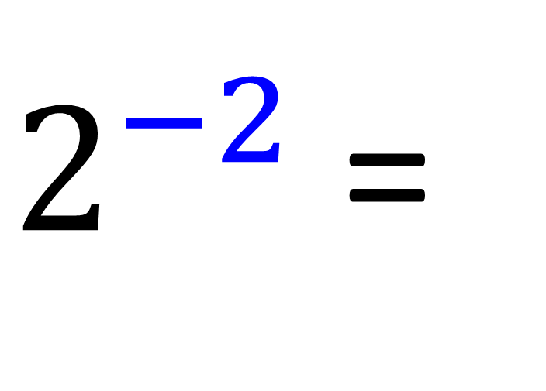
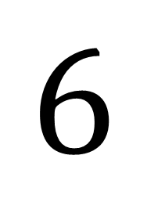
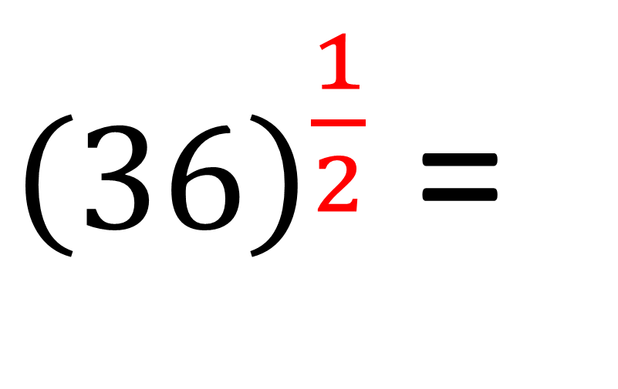
$$\frac{1}{4}$$
$2^{−2}$ =
${\left(36\right)}^{\frac{1}{2}}$ =
$$6$$

Slide 3
Negative Indices
With negative indices
you take the
reciprocal of your answer.

Slide 4

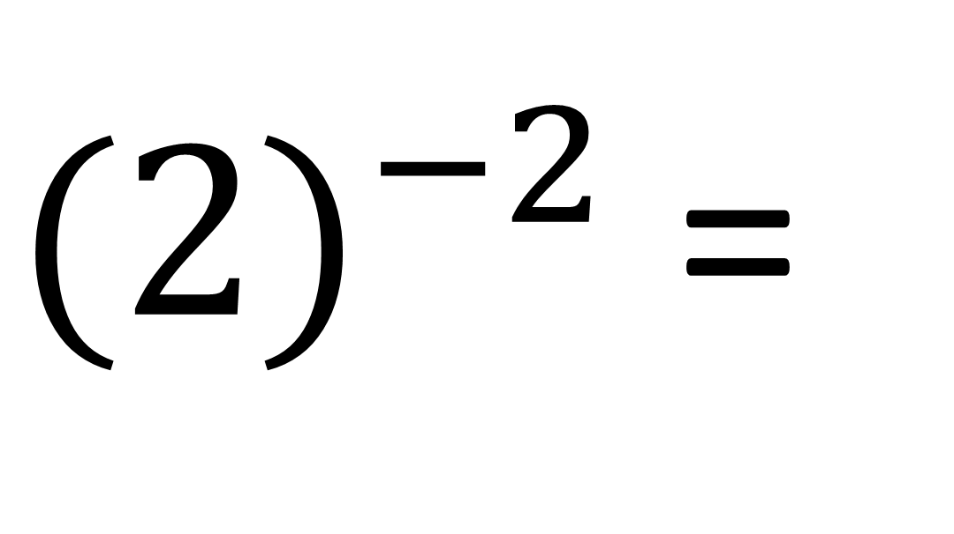
Evaluate
$$\frac{1}{4}$$
${(2)}^{−2}$ =

Slide 5

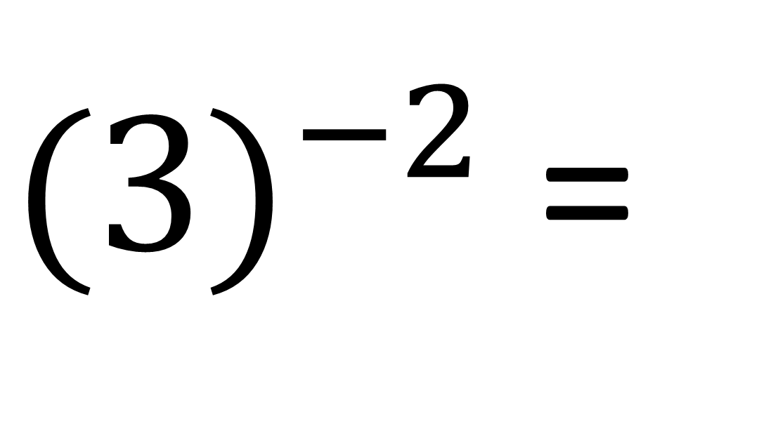
Evaluate
$$\frac{1}{9}$$
${(3)}^{−2}$ =

Slide 6
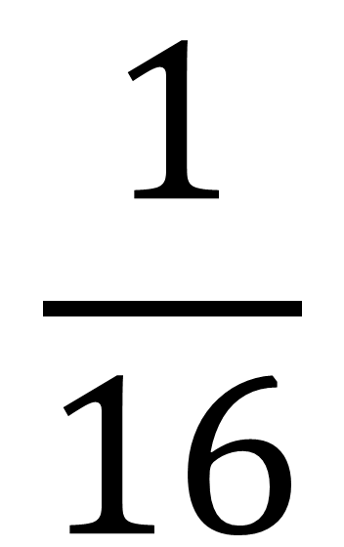
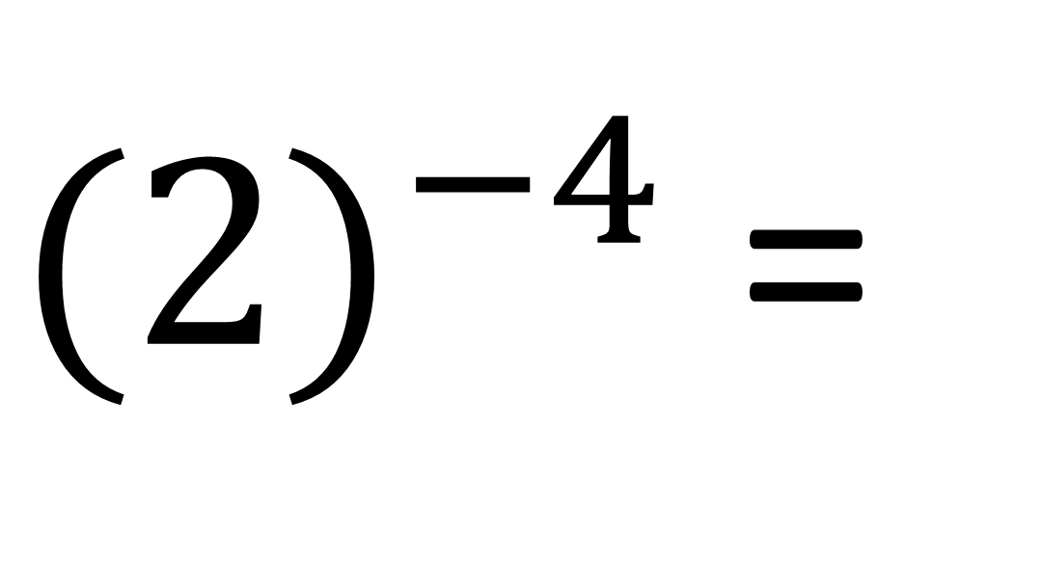
Evaluate
$$\frac{1}{16}$$
${(2)}^{−4}$ =

Slide 7
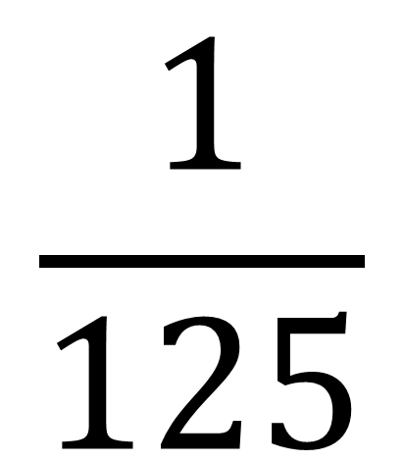
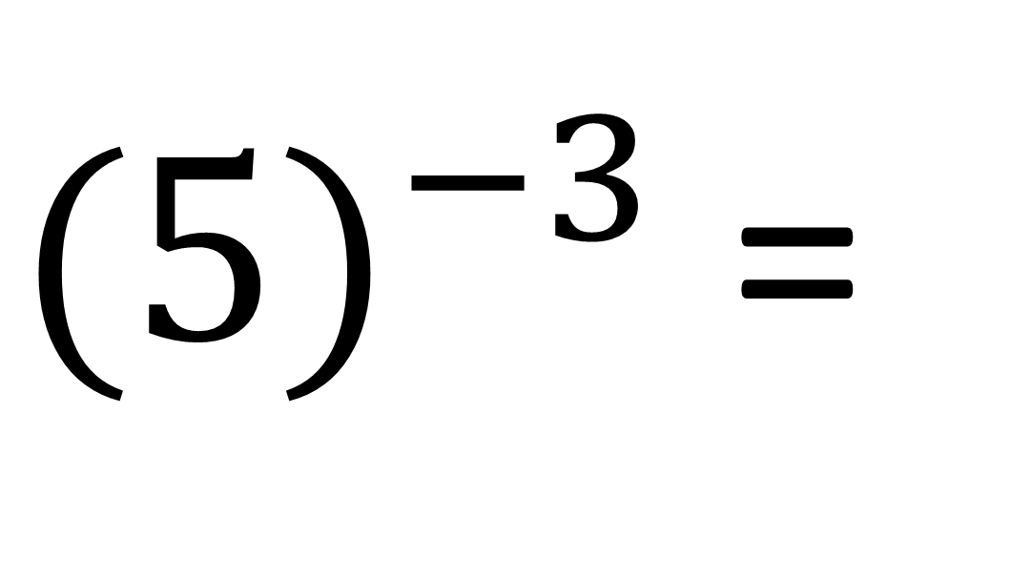
Evaluate
$$\frac{1}{125}$$
${(5)}^{−3}$ =

Slide 8
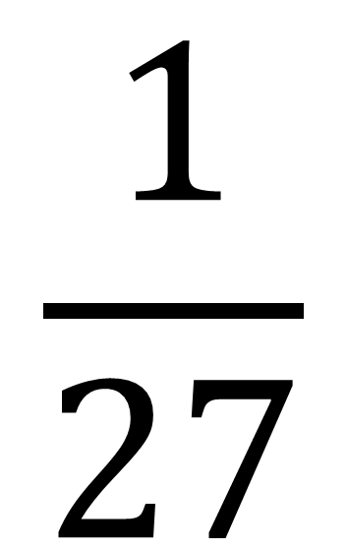
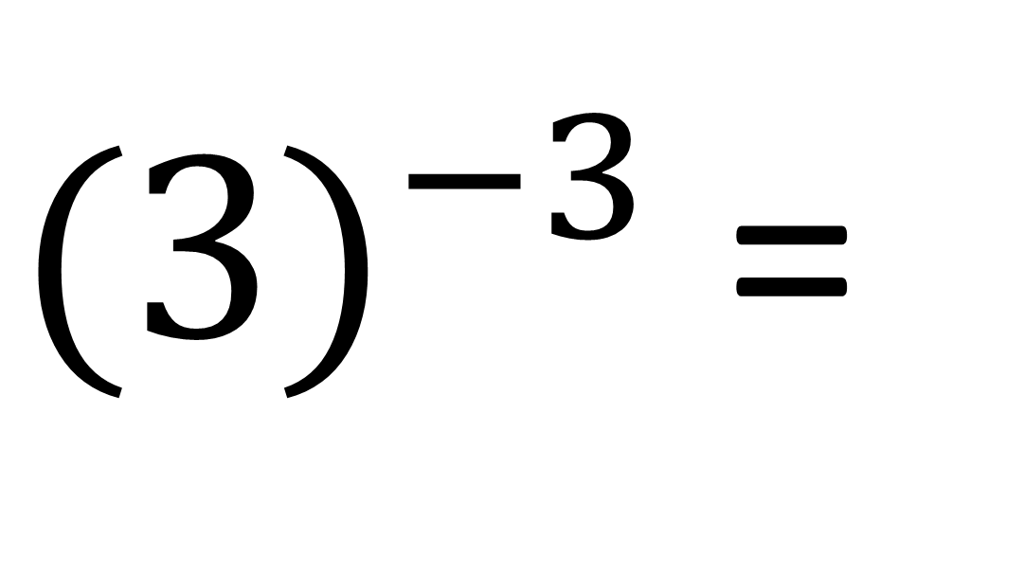
Evaluate
$$\frac{1}{27}$$
${(3)}^{−3}$ =

Slide 9
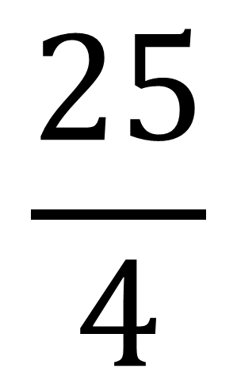
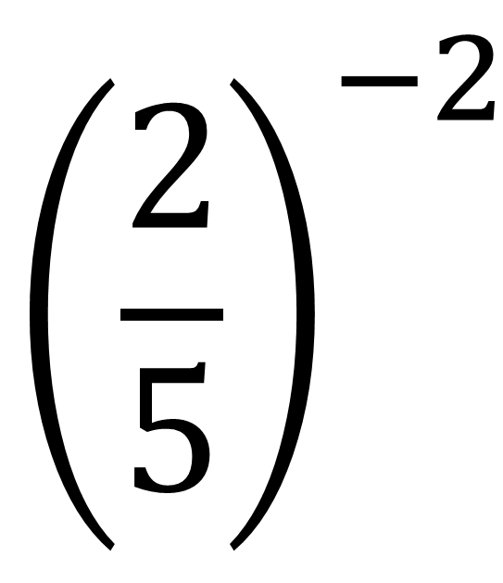
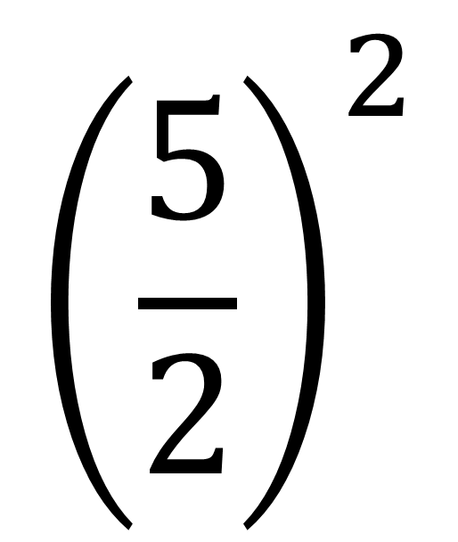
Evaluate
$${\left(\frac{2}{5}\right)}^{−2}$$
$${\left(\frac{5}{2}\right)}^{2}$$
$$\frac{25}{4}$$
=
=

Slide 10
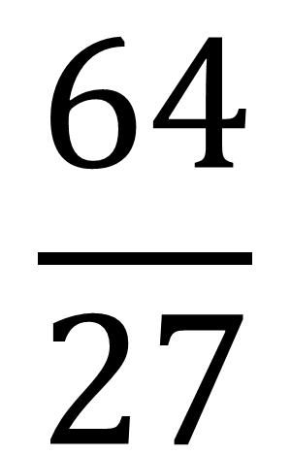
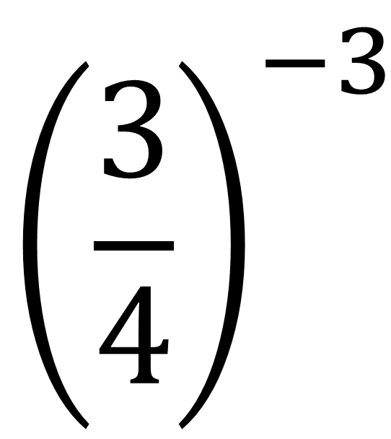
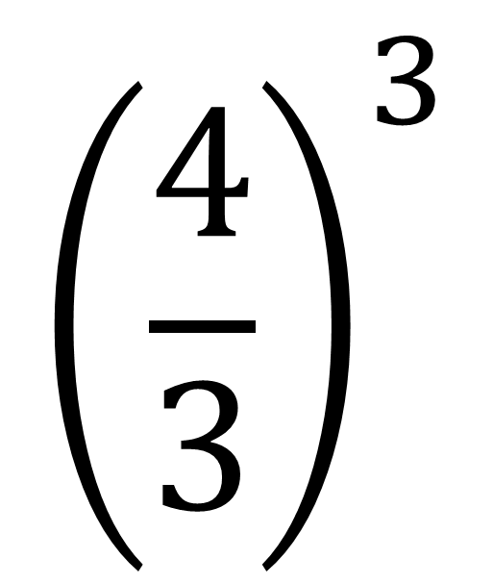
Evaluate
$${\left(\frac{3}{4}\right)}^{−3}$$
$${\left(\frac{4}{3}\right)}^{3}$$
$$\frac{64}{27}$$
=
=

Slide 11
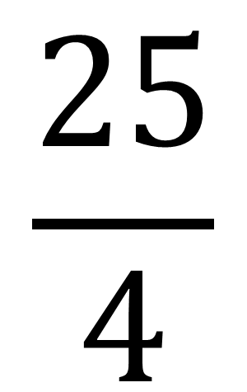
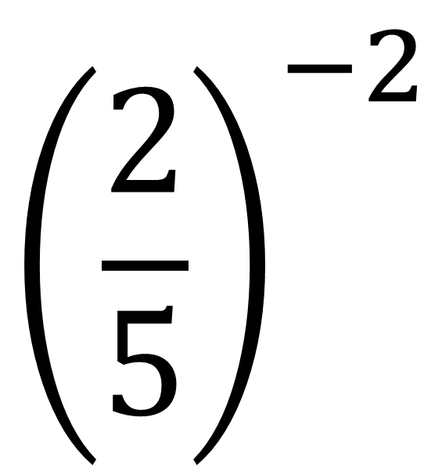
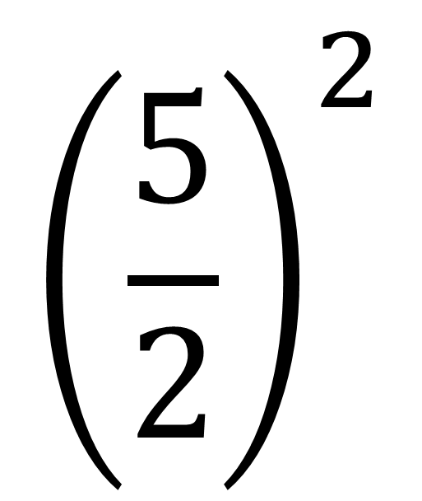
Evaluate
$${\left(\frac{2}{5}\right)}^{−2}$$
$${\left(\frac{5}{2}\right)}^{2}$$
=
=
$$\frac{25}{4}$$

Slide 12

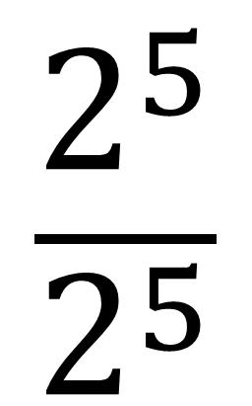

Zero Indices
The answer will always be one.
$$\frac{2^{5}}{2^{5}}$$
=
$$2^{0}$$
=
$$1$$

Slide 13

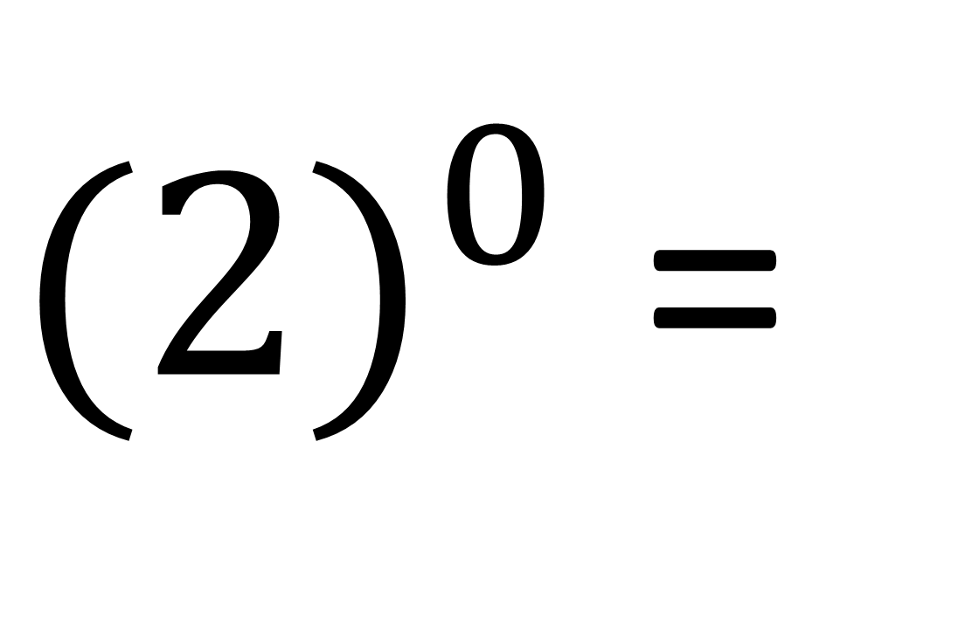
Evaluate
$$1$$
${(2)}^{0}$ =

Slide 14
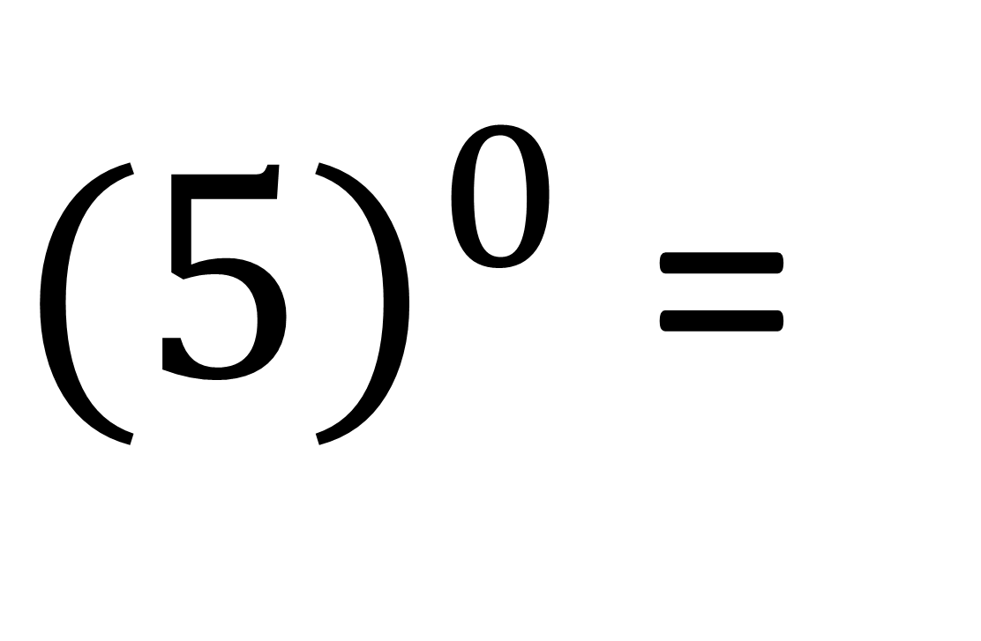
Evaluate
$$1$$
${(5)}^{0}$ =

Slide 15

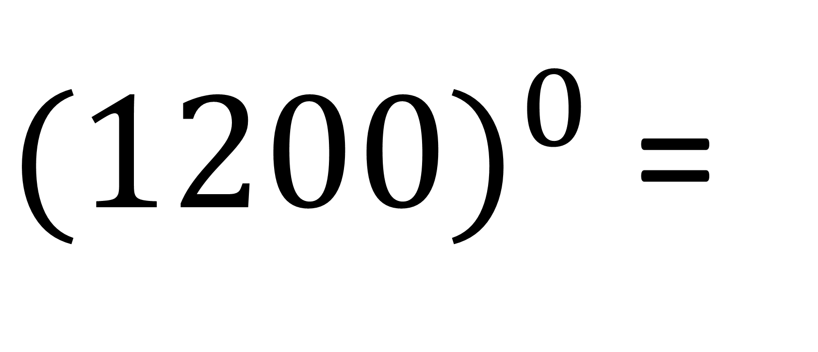
Evaluate
$$1$$
${(1200)}^{0}$ =

Slide 16

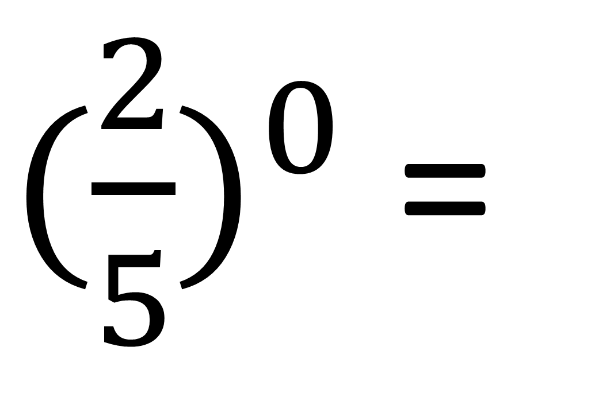
Evaluate
${(\frac{2}{5})}^{0}$ =
$$1$$

Slide 17
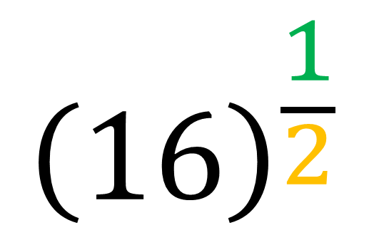
Fractional Indices
Denominator is the root
and
the numerator is the power.
$${\left(16\right)}^{\frac{1}{2}}$$
Power
Root

Slide 18
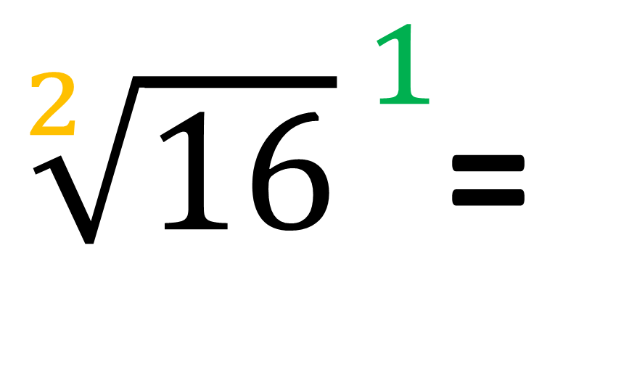
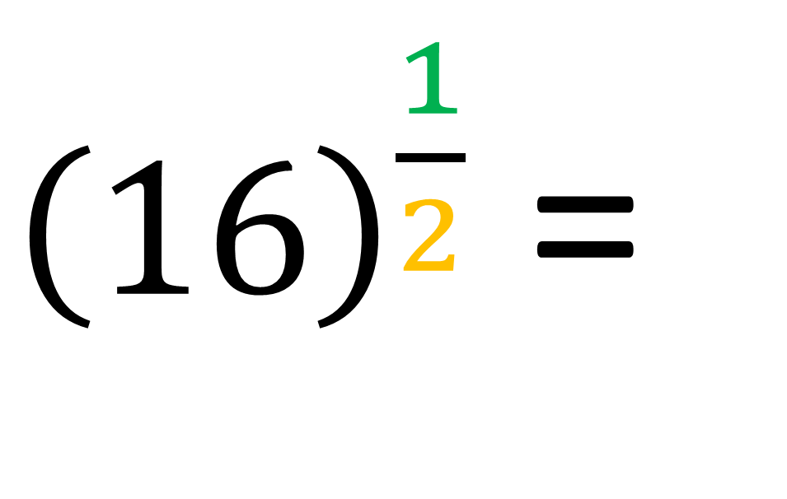
Evaluate
${\left(16\right)}^{\frac{1}{2}}$ =
${\sqrt[2]{16}}^{ 1}$=
4

Slide 19
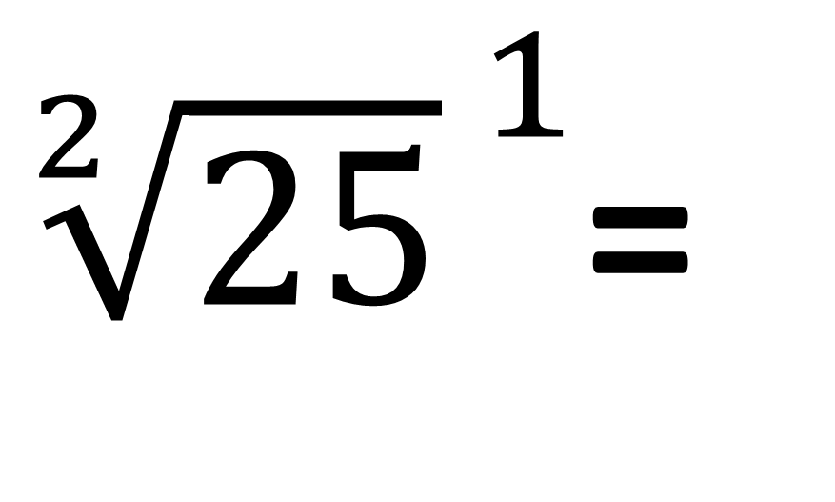
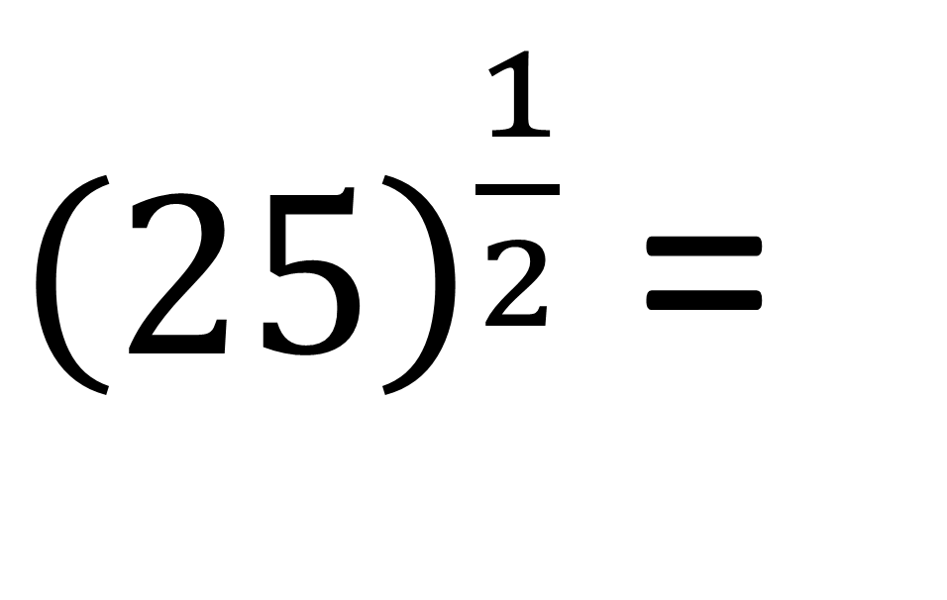
Evaluate
${\left(25\right)}^{\frac{1}{2}}$ =
${\sqrt[2]{25}}^{ 1}$=
5

Slide 20
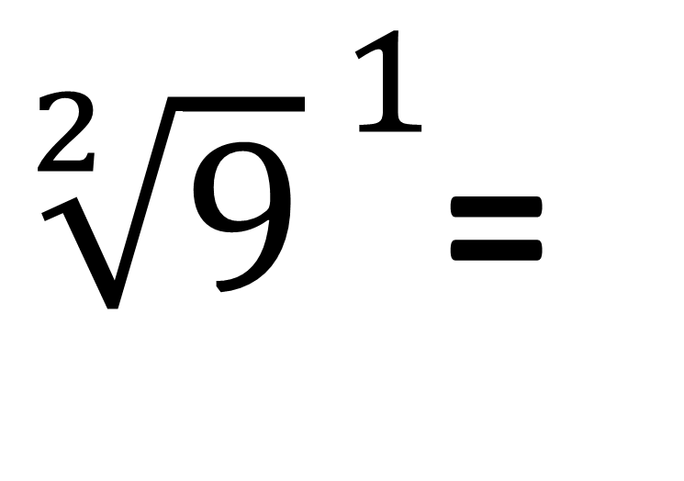
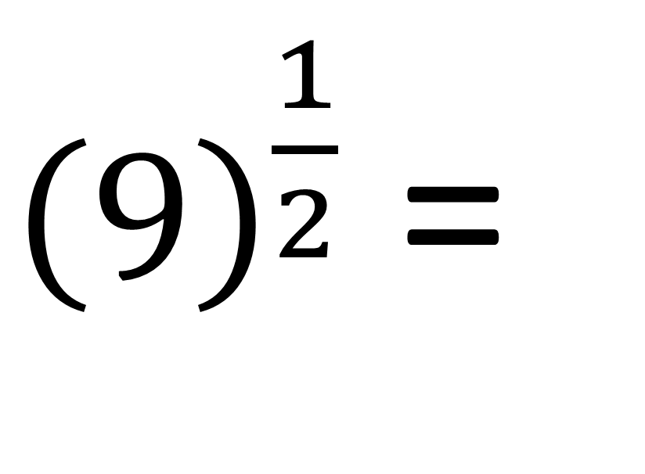
Evaluate
${\left(9\right)}^{\frac{1}{2}}$ =
${\sqrt[2]{9}}^{ 1}$=
3

Slide 21
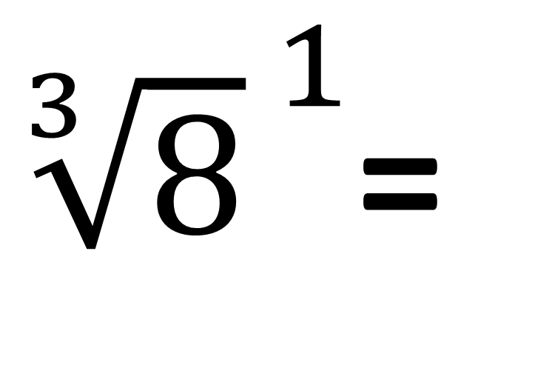
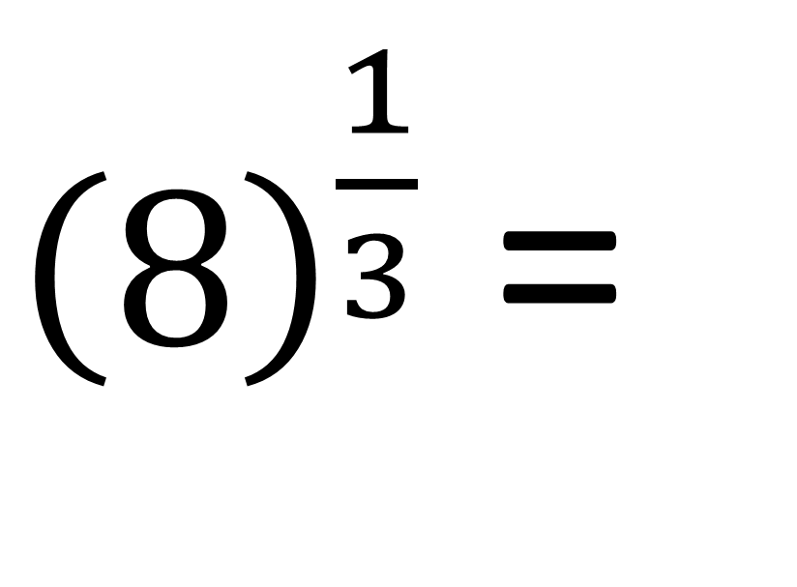
Evaluate
${\left(8\right)}^{\frac{1}{3}}$ =
2
${\sqrt[3]{8}}^{ 1}$=

Slide 22
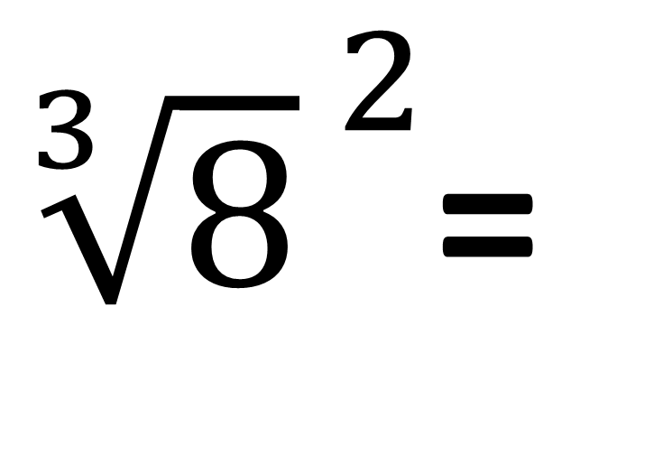
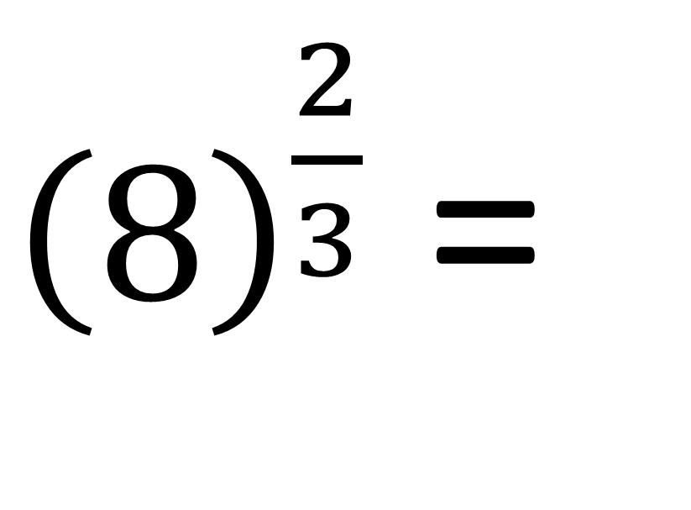
Evaluate
${\left(8\right)}^{\frac{2}{3}}$ =
4
${\sqrt[3]{8}}^{ 2}$=

Slide 23
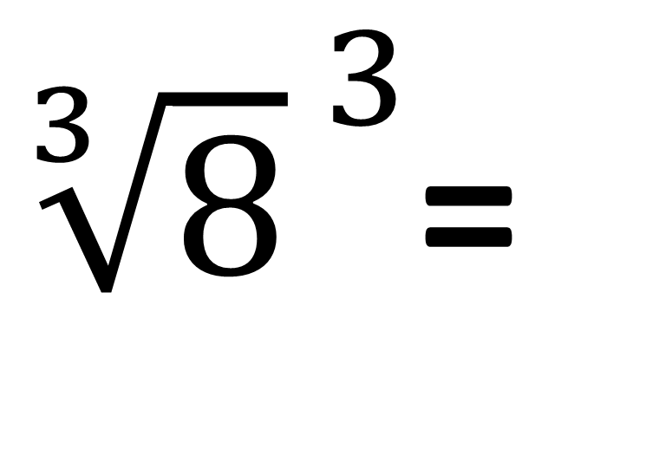
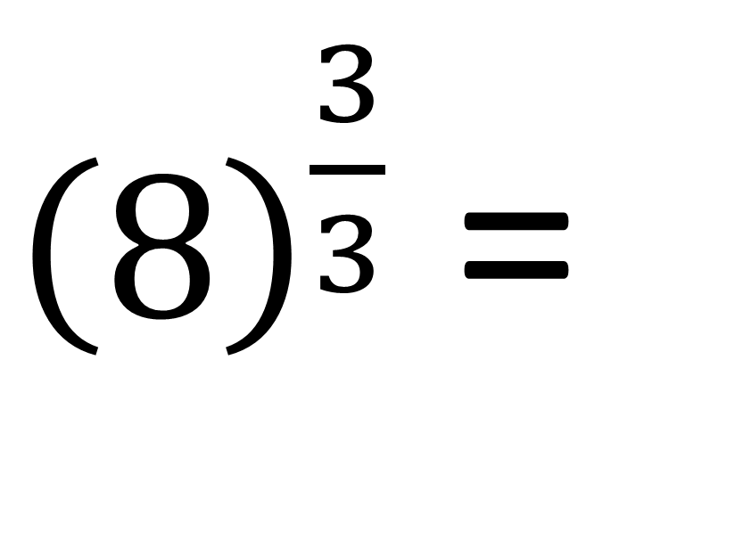
Evaluate
${\left(8\right)}^{\frac{3}{3}}$ =
${\sqrt[3]{8}}^{ 3}$=
8

Slide 24
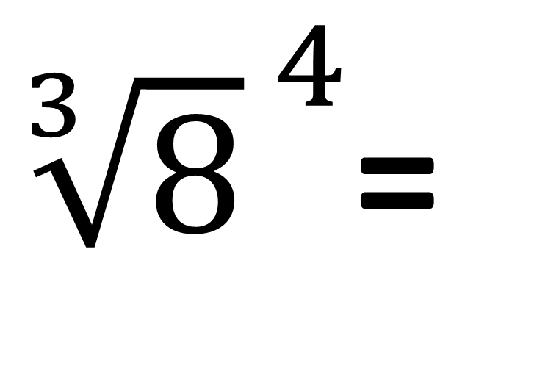
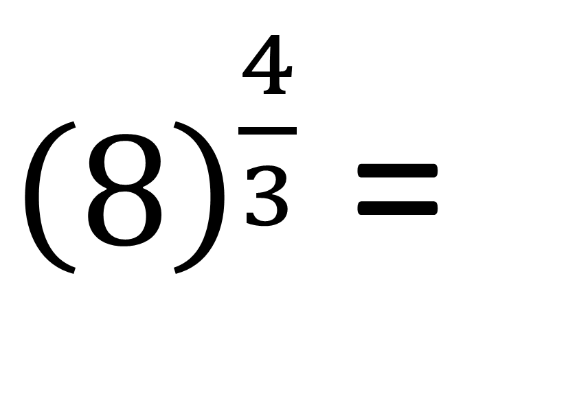
Evaluate
${\left(8\right)}^{\frac{4}{3}}$ =
${\sqrt[3]{8}}^{ 4}$=
16

Slide 25
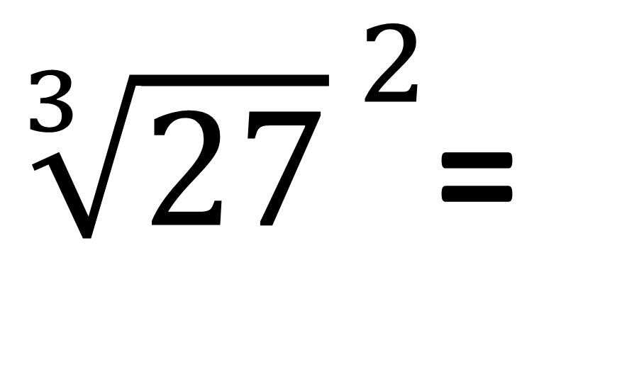
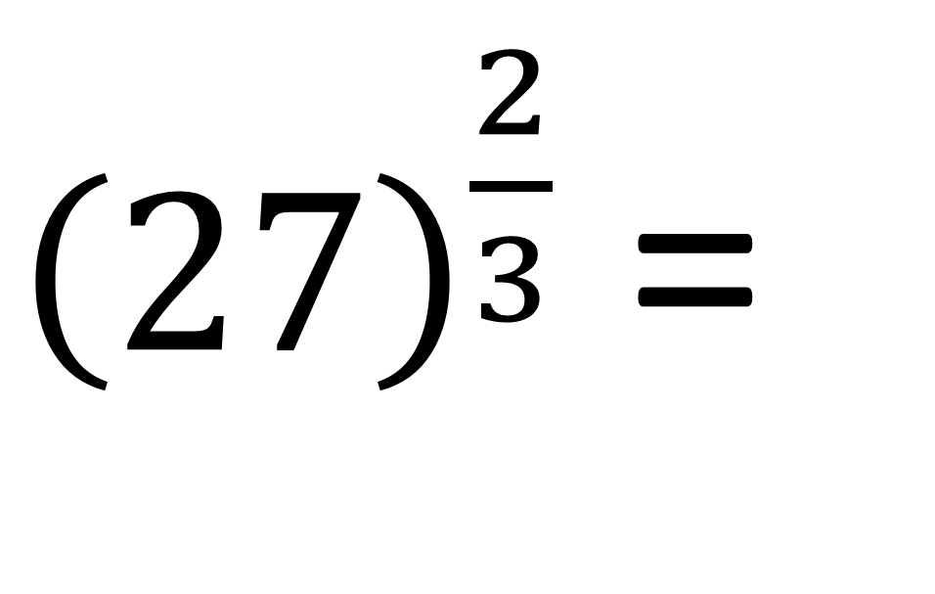
Evaluate
${\left(27\right)}^{\frac{2}{3}}$ =
${\sqrt[3]{27}}^{ 2}$=
9

Slide 26
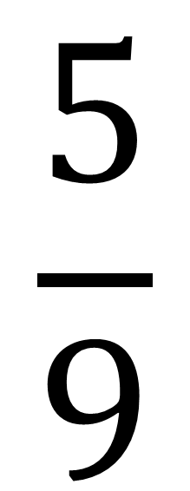
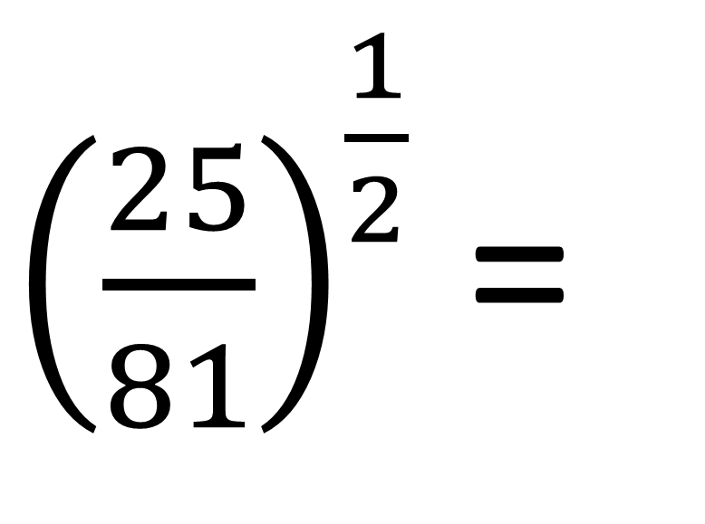
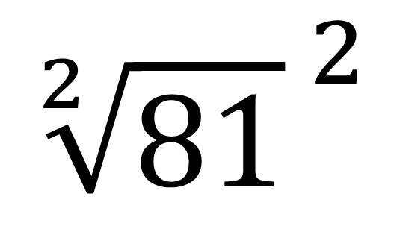
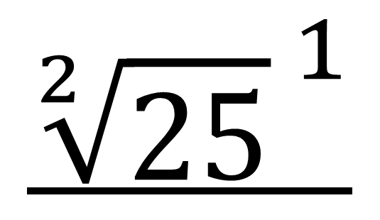
Evaluate
$${\sqrt[2]{25}}^{ 1}$$
$$\frac{5}{9}$$
${\left(\frac{25}{81}\right)}^{\frac{1}{2}}$ =
=
$${\sqrt[2]{81}}^{ 2}$$

Slide 27
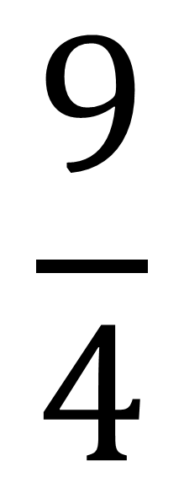
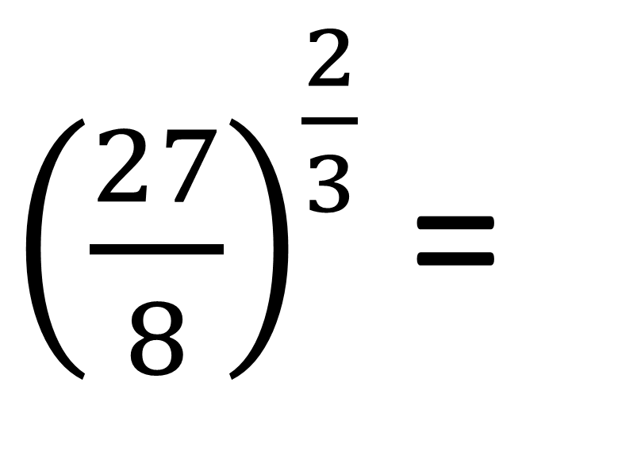
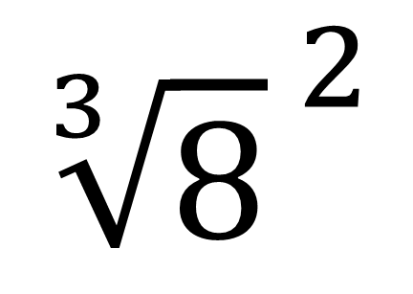
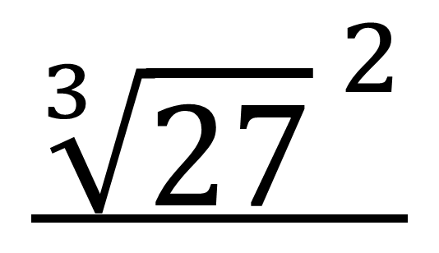
Evaluate
${\left(\frac{27}{8}\right)}^{\frac{2}{3}}$ =
$${\sqrt[3]{27}}^{ 2}$$
$$\frac{9}{4}$$
=
$${\sqrt[3]{8}}^{ 2}$$

Slide 28



Evaluate
${\left(8\right)}^{−\frac{1}{3}}$ =
$$\frac{1}{2}$$
=
$${(\sqrt[3]{8})}^{−1}$$

Slide 29



Evaluate
$$\frac{1}{2}$$
${\left(4\right)}^{−\frac{1}{2}}$ =
=
$${(\sqrt[2]{4})}^{−1}$$

Slide 30



Evaluate
${\left(\frac{25}{81}\right)}^{−\frac{1}{2}}$ =
${\left(\frac{81}{25}\right)}^{\frac{1}{2}}$ =
$$\frac{9}{5}$$

Slide 31



Evaluate
${\left(\frac{125}{1000}\right)}^{−\frac{2}{3}}$ =
${\left(\frac{1000}{125}\right)}^{\frac{2}{3}}$ =
$$\frac{100}{25}$$

