Slide 1
Application of Forces
Dynamics and Friction
Chapter 7
(Part 5 of 6)

Slide 2
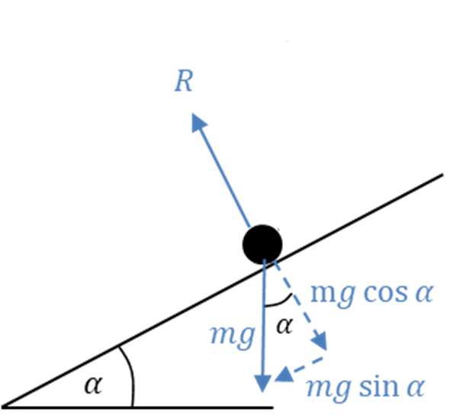
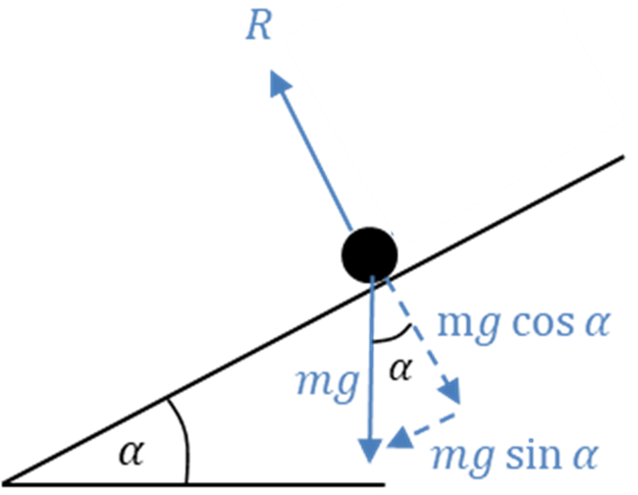
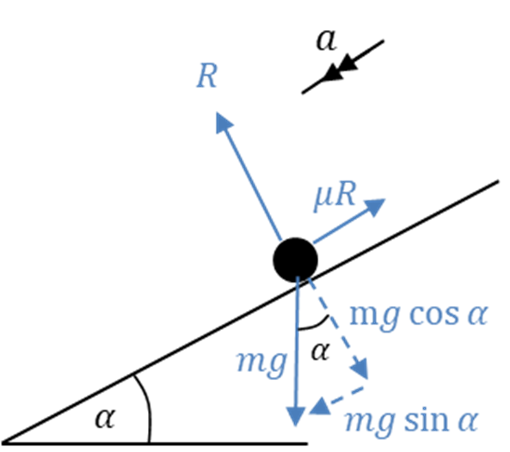


Don’t forget to check direction.
Dynamic
F = ma
Friction
$$Friction=μR$$
Remember, friction always apposes motion.

Slide 3
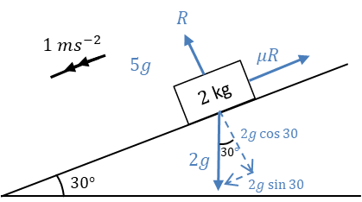

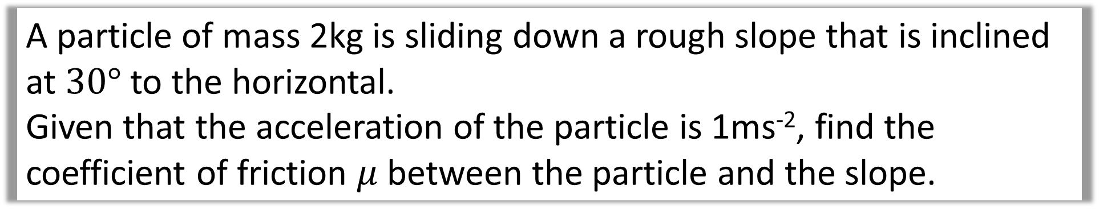


A particle of mass 2kg is sliding down a rough slope that is inclined at $30°$ to the horizontal.
Given that the acceleration of the particle is 1ms⁻², find the coefficient of friction $μ$ between the particle and the slope.
$$R$$
$$Relsove Vertical to the slope$$
$R=2g\cos{30°}$
$$2g\cos{30°}$$

Slide 4

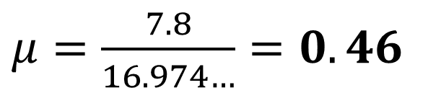




A particle of mass 2kg is sliding down a rough slope that is inclined at $30°$ to the horizontal.
Given that the acceleration of the particle is 1ms⁻², find the coefficient of friction $μ$ between the particle and the slope.
$$Relsove Horizontal to the slope$$
$$μR$$
$$F=ma$$
$$2g\sin{30°}−μR=2a$$
$$g−μ(2g\cos{30°)}=2a$$
$μ=\frac{7.8}{16.974…}=0.46$
$$2g\sin{30}$$

Slide 5
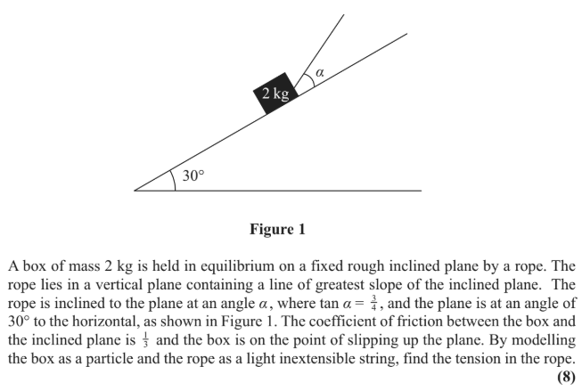

Slide 6
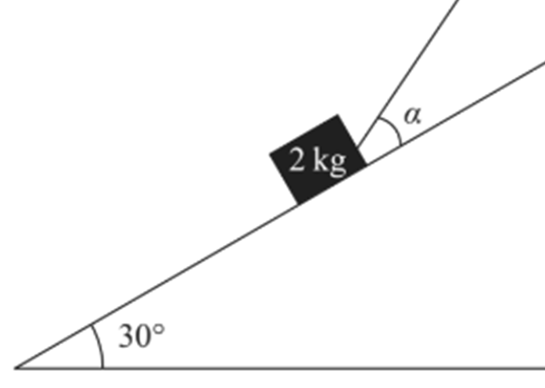
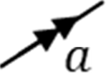
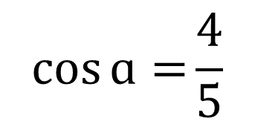
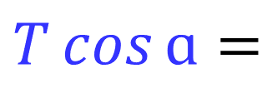
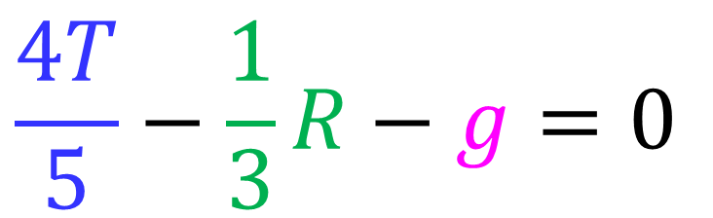
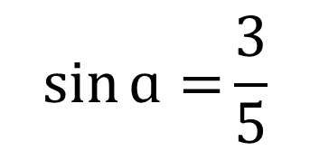

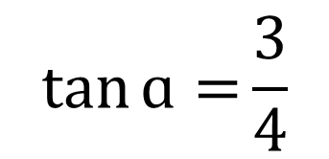


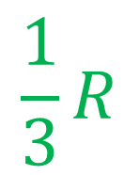
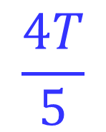
$$\tan{ɑ=}\frac{3}{4}$$
On the point of slipping up the slope
T
$$\frac{4T}{5}$$
$$\sin{ɑ=}\frac{3}{5}$$
$$T\cos{ɑ=}$$
$$\frac{1}{3}R$$
$$=μR$$
$$\cos{ɑ=}\frac{4}{5}$$
$$2gsin 30=$$
$$g$$
$$Relsove Horizontal to the slope$$
$$\frac{4T}{5}−\frac{1}{3}R−g=0$$

Slide 7
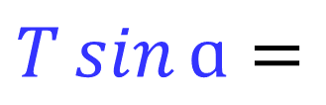
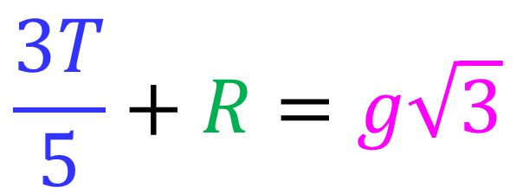

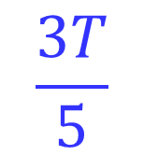


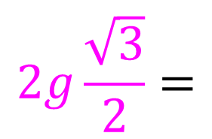
$$\frac{3T}{5}$$
$$\tan{ɑ=}\frac{3}{4}$$
$$T\sin{ɑ=}$$
$$R$$
T
On the point of slipping up the slope
$$\sin{ɑ=}\frac{3}{5}$$
$$2g\frac{\sqrt{3}}{2}=$$
$$2gcos 30=$$
$$g\sqrt{3}$$
$$\cos{ɑ=}\frac{4}{5}$$
$$Relsove Vertical to the slope$$
$$\frac{3T}{5}+R=g\sqrt{3}$$

Slide 8
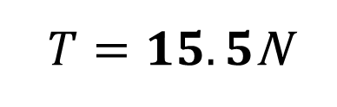
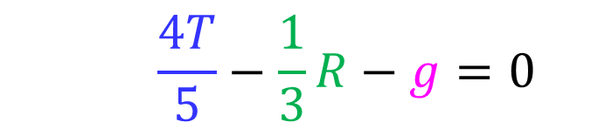


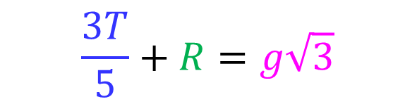
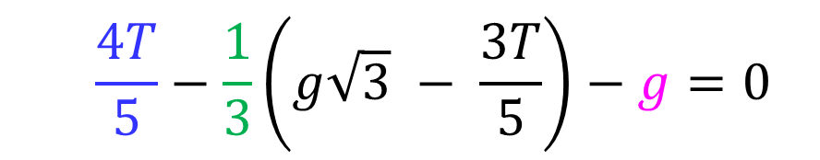
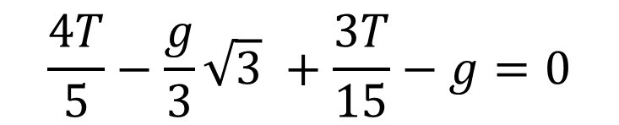
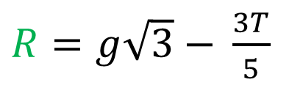

$$Solve Simultaneous$$
$$\frac{3T}{5}+R=g\sqrt{3}$$
$$\frac{4T}{5}−\frac{1}{3}R−g=0$$
$R=g\sqrt{3}$ $− \frac{3T}{5}$
$$\frac{4T}{5}−\frac{1}{3}\left(g\sqrt{3} − \frac{3T}{5}\right)−g=0$$
$$\frac{4T}{5}−\frac{g}{3}\sqrt{3} +\frac{3T}{15}−g=0$$
$$12T−5g\sqrt{3} +3T−15g=0$$
$$15T=5g\sqrt{3} +15g$$
$T=15.5$N

Slide 9
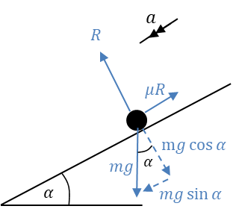
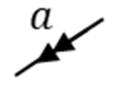
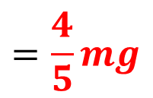
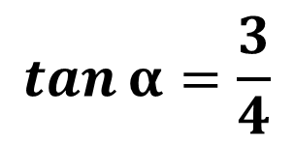
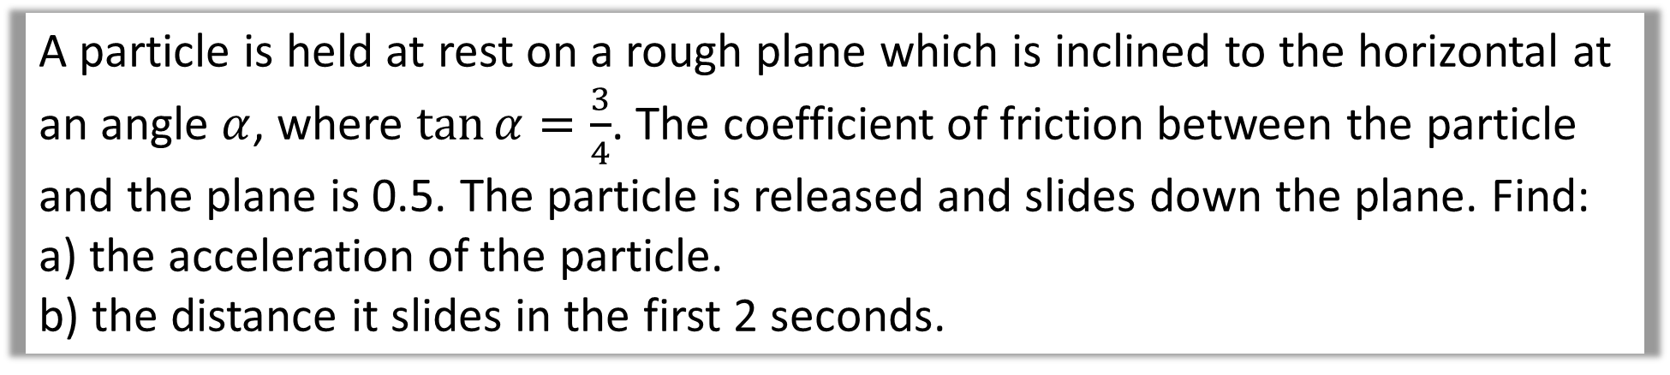
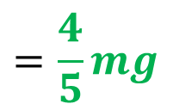
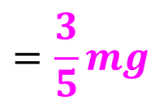
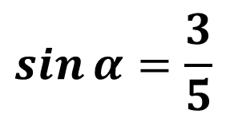
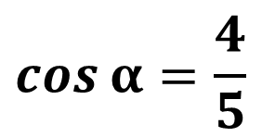
A particle is held at rest on a rough plane which is inclined to the horizontal at an angle $α$, where $\tan{α}=\frac{3}{4}$. The coefficient of friction between the particle and the plane is 0.5. The particle is released and slides down the plane. Find:
a) the acceleration of the particle.
b) the distance it slides in the first 2 seconds.
$$=\frac{4}{5}mg$$
$$\tan{α=\frac{3}{4}}$$
$$\sin{α}=\frac{3}{5}$$
$$=\frac{4}{5}mg$$
$$\cos{α=\frac{4}{5}}$$
$$=\frac{3}{5}mg$$

Slide 10
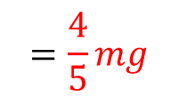

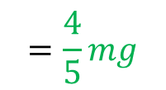
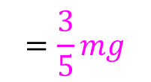
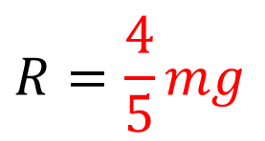
$$=\frac{4}{5}mg$$
a)
$$Relsove Vertical$$
$$R=\frac{4}{5}mg$$
$$=\frac{4}{5}mg$$
$$=\frac{3}{5}mg$$

Slide 11


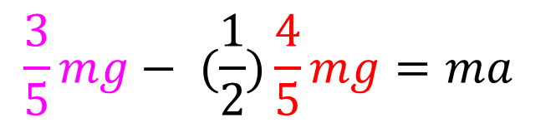
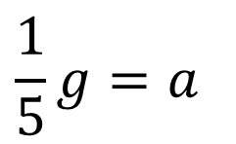

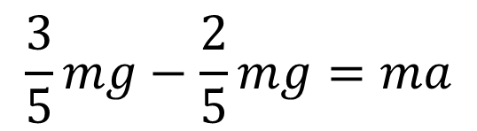
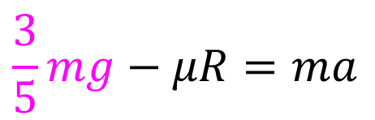

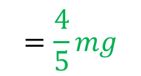

$$=\frac{4}{5}mg$$
a)
$$Relsove Horizontial$$
$$F=ma$$
$$\frac{3}{5}mg−μR=ma$$
$$=\frac{4}{5}mg$$
$$\frac{3}{5}mg− (\frac{1}{2})\frac{4}{5}mg=ma$$
$$=\frac{3}{5}mg$$
$$\frac{3}{5}mg−\frac{2}{5}mg=ma$$
$$\frac{1}{5}g=a$$
$$a=1.96$$

Slide 12
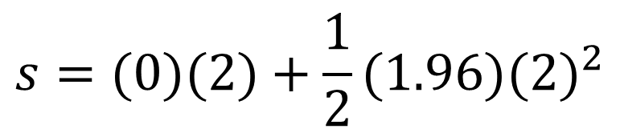

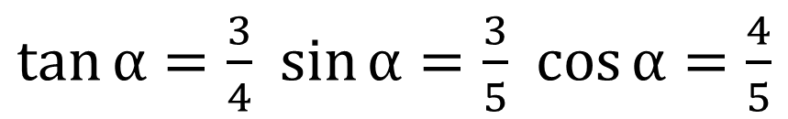

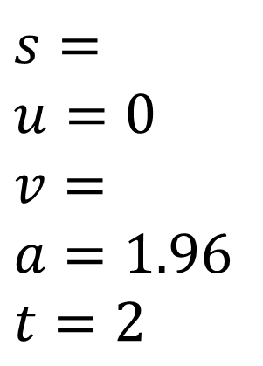
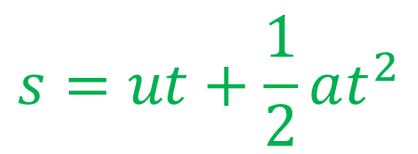
b)
$$suvat$$
$$s=$$
$$u=0$$
$$v=$$
$$a=1.96$$
$$t=2$$
$$s=ut+\frac{1}{2}at^{2}$$
$$s=(0)(2)+\frac{1}{2}(1.96){(2)}^{2}$$
$\tan{α=\frac{3}{4}}$ $\sin{α}=\frac{3}{5}$ $\cos{α=\frac{4}{5}}$
$$s=3.9 (3 sf)$$

Slide 13
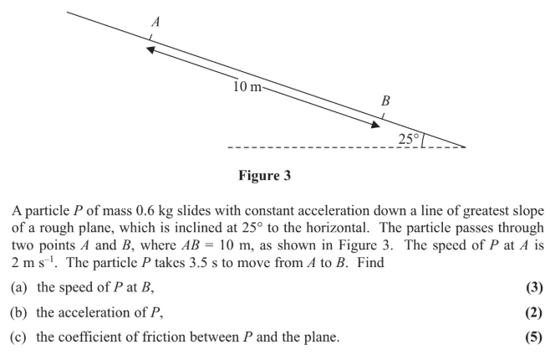

Slide 14
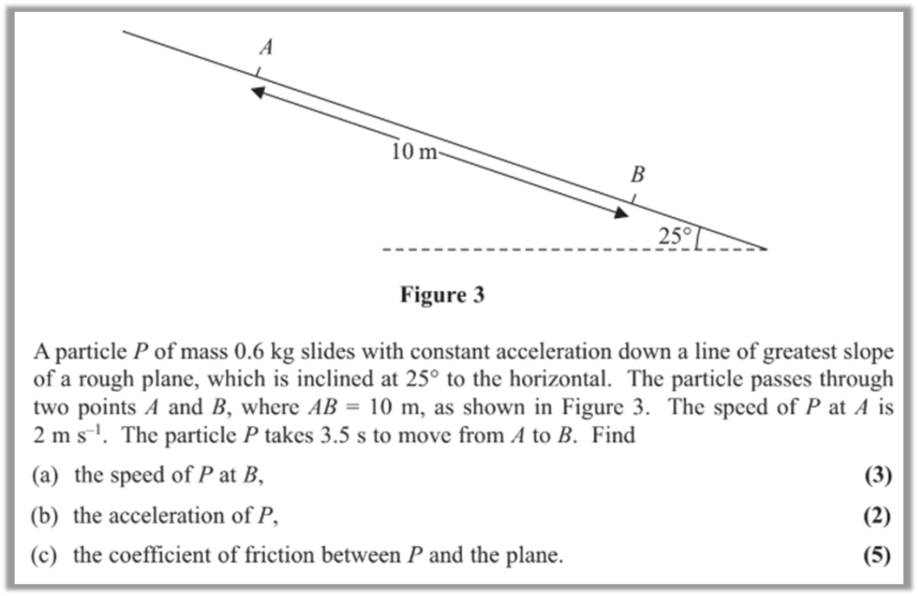





a)
$$suvat$$
$$s=10$$
$$u=2$$
$$v=$$
$$a=$$
$$t=3.5$$
0.6kg
$$s=\frac{u+v}{2}t$$
$$10=\frac{2+v}{2}(3.5)$$
$$v=3. 71(3 sf)$$

Slide 15





b)
$$suvat$$
$$s=$$
$$u=2$$
$$v= \frac{26}{7}$$
$$a=$$
$$t=3.5$$
0.6kg
$$v=u+at$$
$$\frac{26}{7}=2+a(3.5)$$
$$a=0. 490 ms^{−2}(3 sf)$$

Slide 16






c)
$$Resolve Vertical$$
0.6kg
$$R=0.6g\cos{25}$$
$$Resolve Horizontial$$
$$F=ma$$
$$0.6g\sin{25}−μR=0.6a$$
$$0.6g\sin{25}−μ(0.6g\cos{25)}=0.6(0. 490)$$
$$μ=0.411 (3sf)$$

