Slide 1
Further Kinematics
Variable Acceleration Vectors
Chapter 8
(Part 5 of 5)

Slide 2
$$s$$
$$\frac{dv}{dt}$$
$$∫v dt$$
$$v$$
$$\frac{da}{dt}$$
$$∫a dt$$
$$a$$

Slide 3
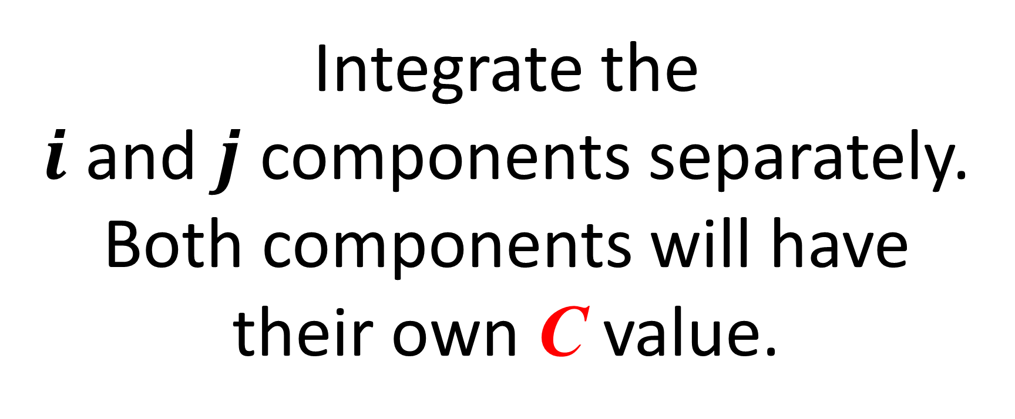
Integrating Vectors
Integrate the
$i$ and $j$ components separately.
Both components will have
their own C value.

Slide 4
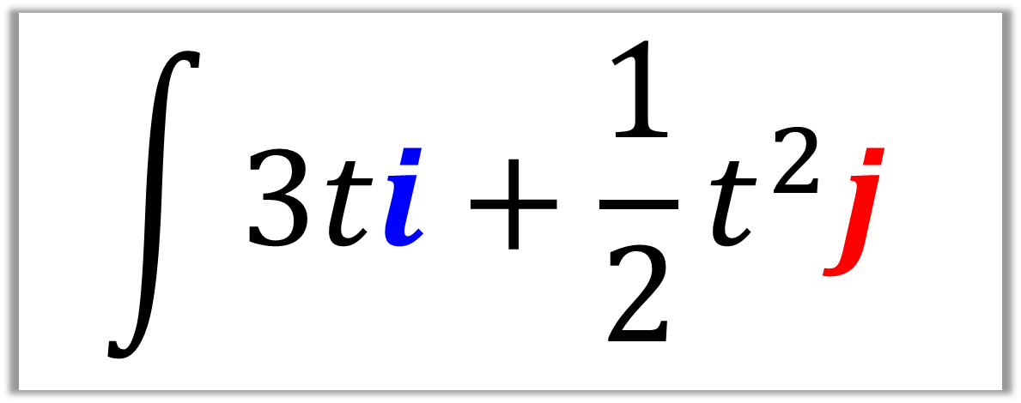
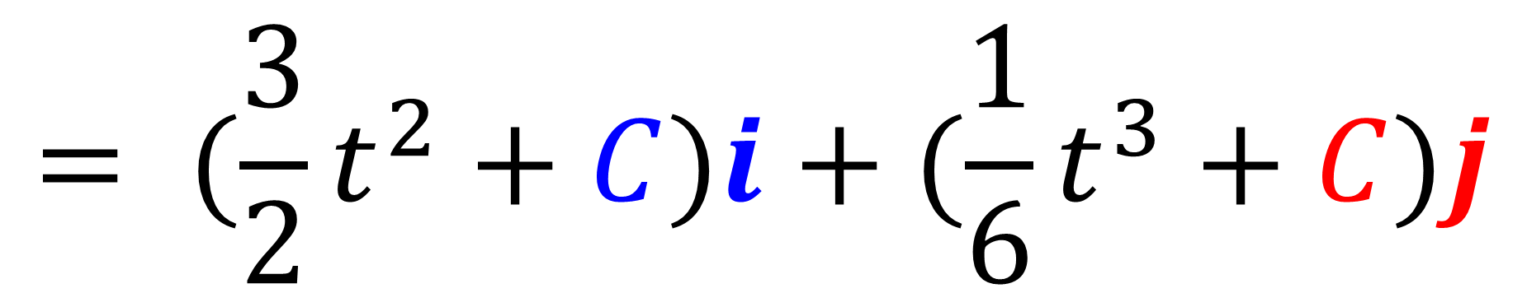
$$\int{3ti+\frac{1}{2}t^{2}j}$$
$$= (\frac{3}{2}t^{2}+C)i+(\frac{1}{6}t^{3}+C)j$$

Slide 5
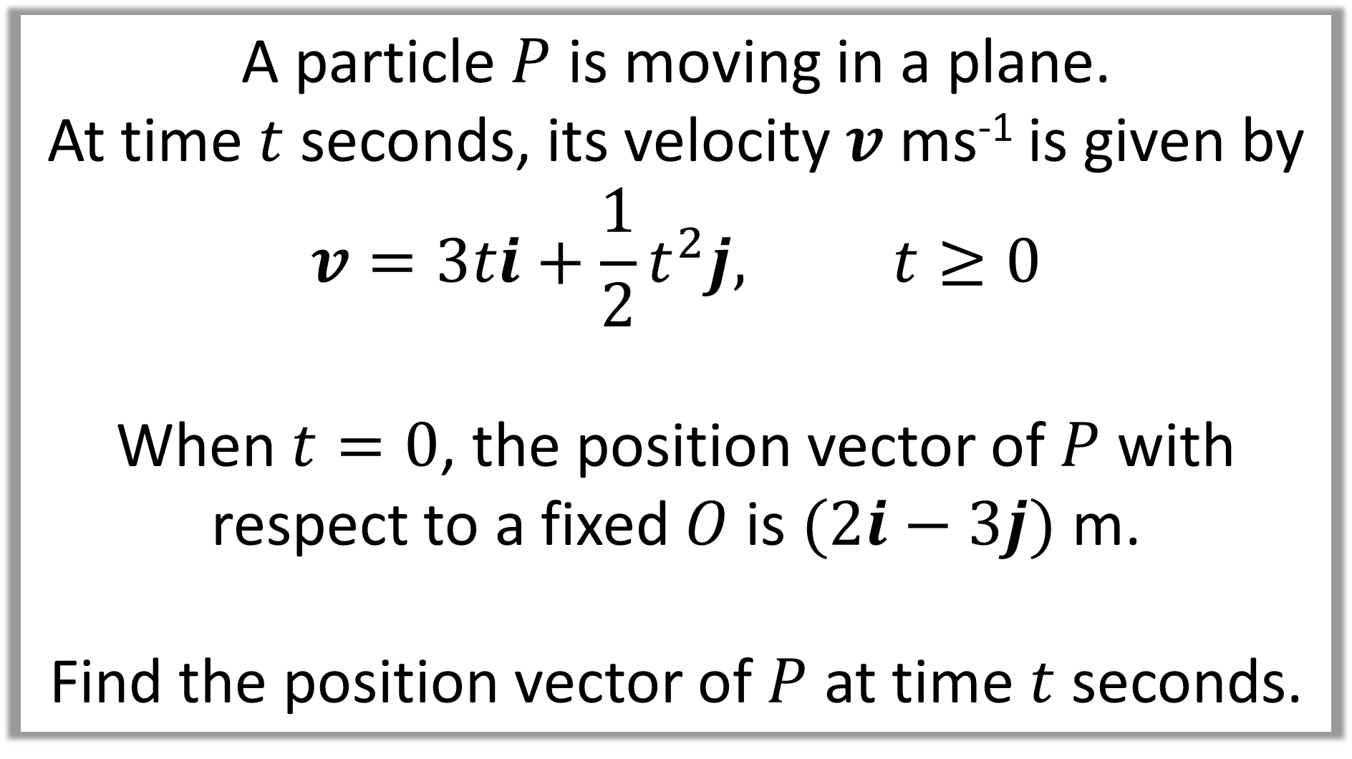
A particle $P$ is moving in a plane.
At time $t$ seconds, its velocity $v$ ms⁻¹ is given by
$$v=3ti+\frac{1}{2}t^{2}j, t≥0$$
When $t=0$, the position vector of $P$ with respect to a fixed $O$ is $(2i−3j)$ m.
Find the position vector of $P$ at time $t$ seconds.

Slide 6
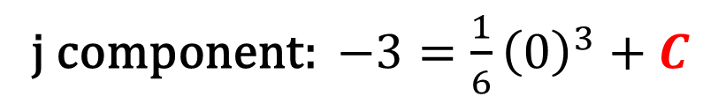
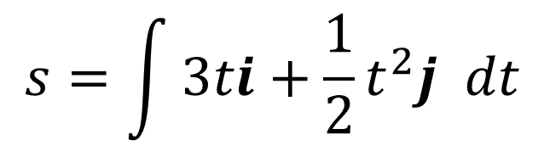
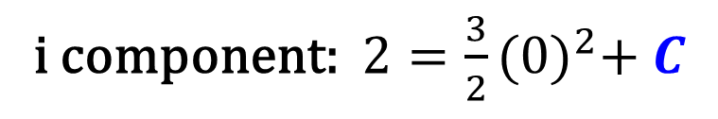
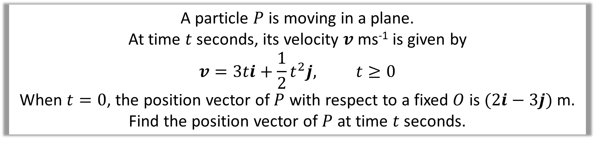
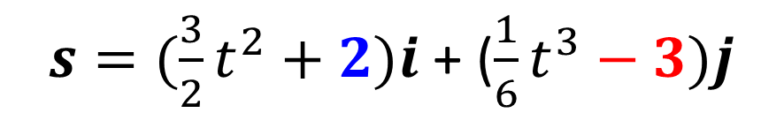
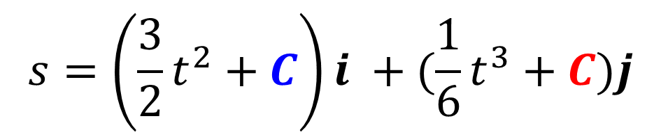
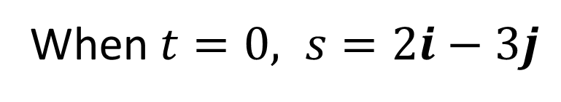
A particle $P$ is moving in a plane.
At time $t$ seconds, its velocity $v$ ms⁻¹ is given by
$$v=3ti+\frac{1}{2}t^{2}j, t≥0$$
When $t=0$, the position vector of $P$ with respect to a fixed $O$ is $(2i−3j)$ m. Find the position vector of $P$ at time $t$ seconds.
When $t=0, s=2i−3j$
$$s=\int{3ti+\frac{1}{2}t^{2}j dt}$$
i component: $2=\frac{3}{2}{(0)}^{2}+ C$
$$s=\left(\frac{3}{2}t^{2}+C\right)i +(\frac{1}{6}t^{3}+C)j$$
j component: $−3=\frac{1}{6}{\left(0\right)}^{3}+C$
$s=(\frac{3}{2}t^{2}+2)i$ + ($\frac{1}{6}t^{3}−3)j$

Slide 7
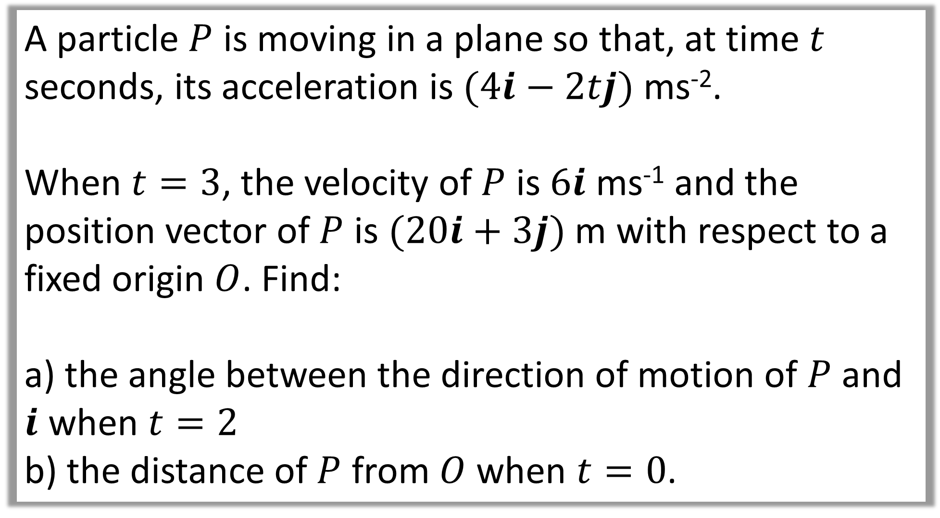
A particle $P$ is moving in a plane so that, at time $t$ seconds, its acceleration is $(4i−2tj)$ ms⁻².
When $t=3$, the velocity of $P$ is $6i$ ms⁻¹ and the position vector of $P$ is $(20i+3j)$ m with respect to a fixed origin $O$. Find:
a) the angle between the direction of motion of $P$ and $i$ when $t=2$
b) the distance of $P$ from $O$ when $t=0$.

Slide 8
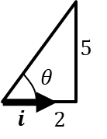

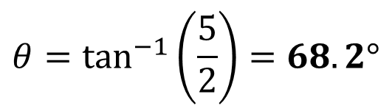
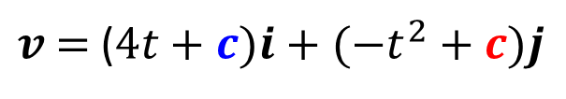
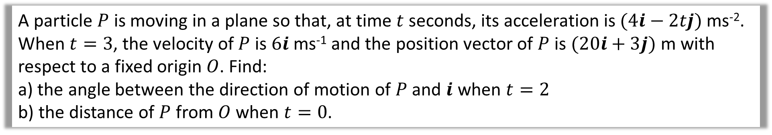
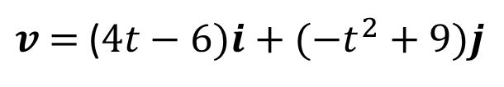


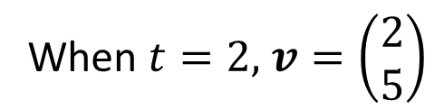
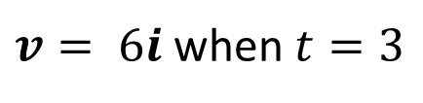
A particle $P$ is moving in a plane so that, at time $t$ seconds, its acceleration is $(4i−2tj)$ ms⁻².
When $t=3$, the velocity of $P$ is $6i$ ms⁻¹ and the position vector of $P$ is $(20i+3j)$ m with respect to a fixed origin $O$. Find:
a) the angle between the direction of motion of $P$ and $i$ when $t=2$
b) the distance of $P$ from $O$ when $t=0$.
a
The direction of motion is the velocity:
When $t=2,$ $v=\left(\begin{matrix}2 \\ 5\end{matrix}\right)$
$$v=∫\left(4i−2tj\right) dt$$
$v$ $=$ ($4t+c)i+(−t^{2}+c)j$
$v= 6i$when $t=3$
i component: $6=4(3)+ C$
j component: $0=−{\left(3\right)}^{2}+C$
$$θ=\tan^{−1}\left(\frac{5}{2}\right)=68.2°$$
$v$ $=$ ($4t−6)i+(−t^{2}+9)j$

Slide 9
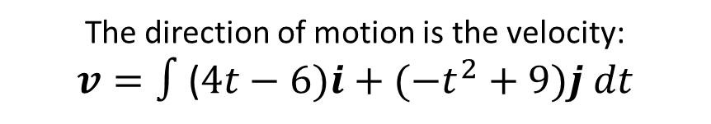


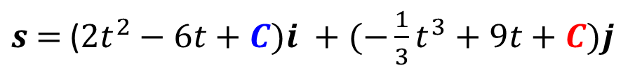
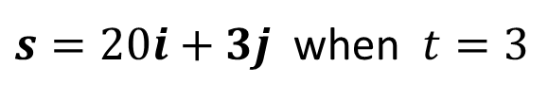
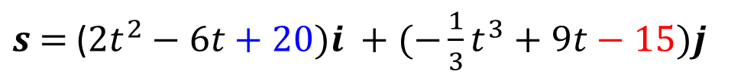
A particle $P$ is moving in a plane so that, at time $t$ seconds, its acceleration is $(4i−2tj)$ ms⁻².
When $t=3$, the velocity of $P$ is $6i$ ms⁻¹ and the position vector of $P$ is $(20i+3j)$ m with respect to a fixed origin $O$. Find:
a) the angle between the direction of motion of $P$ and $i$ when $t=2$
b) the distance of $P$ from $O$ when $t=0$.
b
The direction of motion is the velocity:
$$v=∫\text{(}4t−6)i+(−t^{2}+9)j dt$$
$s$ $=$ ($2t^{2}−6t+C)i +(−\frac{1}{3}t^{3}+9t+C)j$
$s=20i+3j$ when $t=3$
$s$ $=$ ($2t^{2}−6t+20)i +(−\frac{1}{3}t^{3}+9t−15)j$
When $t=0, \text{s}\text{ = }20i−15j$
$$OP=\sqrt{{20}^{2}+{15}^{2}}=25m$$

Slide 10
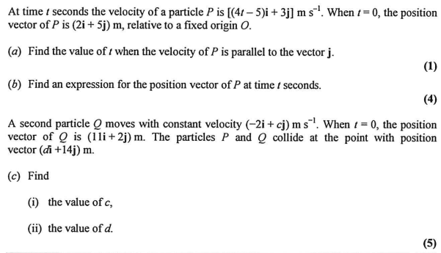

Slide 11
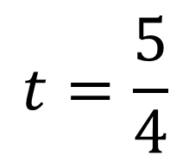
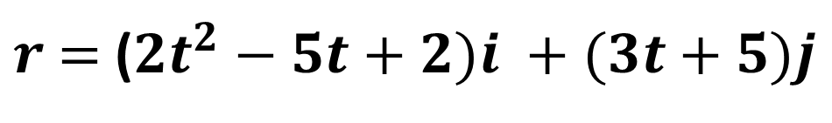
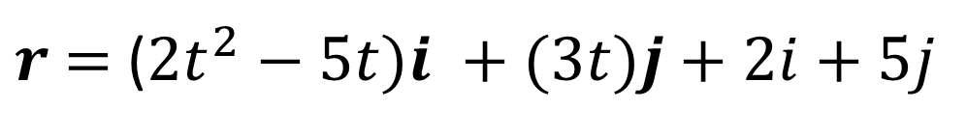

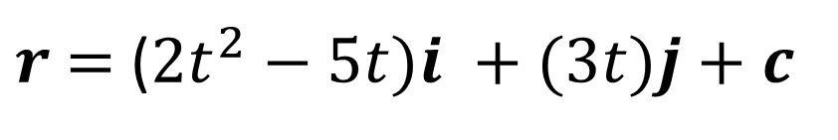
a
$$t=\frac{5}{4}$$
b
$r$ $=$ ($2t^{2}−5t)i +(3t)j+c$
$$when t=0, r=2i+5j$$
$r$ $=$ ($2t^{2}−5t)i +(3t)j+2i+5j$
$r$ $=$ ($2t^{2}−5t+2)i +(3t+5)j$

Slide 12




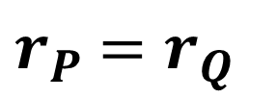

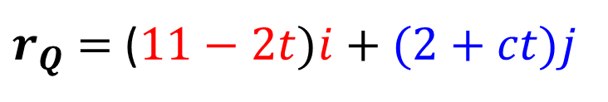


$r_{Q}$ $=$ $11i+2j−2ti+ctj$
$r_{P}$ $=r_{Q}$
c
$$2t^{2}−5t+2=11−2t$$
$r_{Q}$ $=$ ($11−2t)i+(2+ct)j$
$$t=3$$
$r_{P}=$ $(2t^{2}−5t+2)i +(3t+5)j$
$$d= 11−2t$$
$$3t+5=2+ct$$
$$d=5$$
$$c=4$$

